Slide 1

WGU · PROGRAM DEVELOPMENT · SKILLPROOF OVERVIEW
SkillProof
AI Coaching + Extensibility
An introduction and live demo
Brady Redfearn, PhD
Sr. Technology Strategist, Program Development
08 Oct 2026 · v1.2
WGU confidential / proprietary. Internal Program Development review.

Slide 2
Program Experience Strategy
Where Program Development builds what doesn't exist yet.
Futures
Solutions
Research
The long-term horizon for the student experience
Scaling new ideas and technology into reality
Proving it works, and making it better
WGU · PROGRAM DEVELOPMENT · SKILLPROOF OVERVIEW
08 Oct 2026 · v1.2 · 2 / 7

Slide 3


Why SkillProof
An AI-powered coaching platform for WGU students, closing skill gaps before high-stakes assessments.
Adaptive, LLM-driven coaching
Owned in-house, built to scale
Personalized practice with real-time feedback until mastery.
No vendor licensing, no added headcount. ~$150K to build, $50K/yr for 5,000 students.
VS. KYRON The tutoring vendor already in use charges $50K to build 30 experiences and $500K/yr to host 5,000 students, 10x SkillProof's yearly cost.
WGU · PROGRAM DEVELOPMENT · SKILLPROOF OVERVIEW
08 Oct 2026 · v1.2 · 3 / 7

Slide 4







LLM Q&A, feedback every turn
1
DIAGNOSTIC ASSESSMENT
LLM asks a question
Student answers
LLM scores + feedback
Placement on map
↺ repeats each turn, with feedback
2
ADAPTIVE COACHING
LLM sets a task
Student answers
LLM scores + feedback
Verify topic
Mastery
↺ repeats each turn, with feedback
Both phases are LLM-generated Q&A. Real-time feedback and scoring, in the diagnostic and in coaching alike, until the student demonstrates mastery.
WGU · PROGRAM DEVELOPMENT · SKILLPROOF OVERVIEW
08 Oct 2026 · v1.2 · 4 / 7

Slide 5
One engine, any subject
Course teams configure the scope: one topic or a full course.
Time Management
Professionalism
Programming
Your program
Pilot experience
Pilot experience
Pilot experience
Next
WGU · PROGRAM DEVELOPMENT · SKILLPROOF OVERVIEW
08 Oct 2026 · v1.2 · 5 / 7

Slide 6
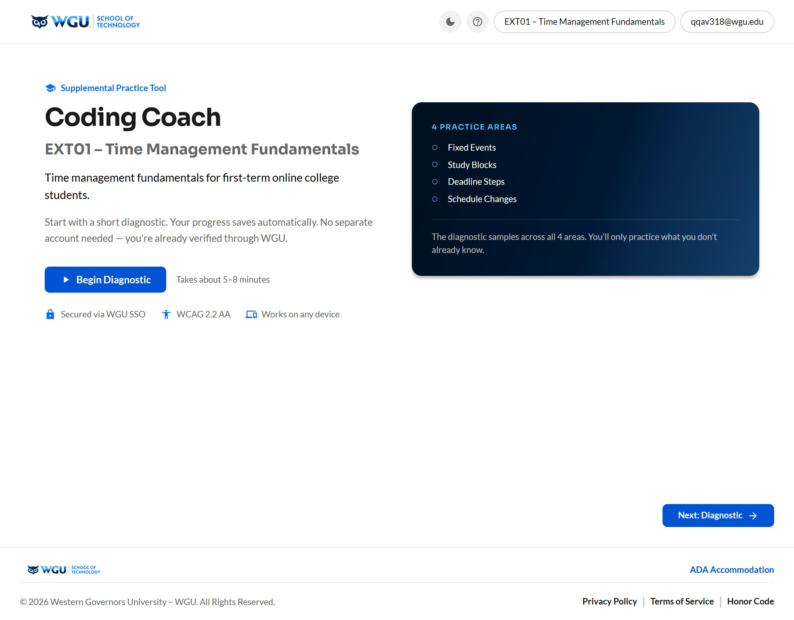

EXT01: Live walkthrough
Launch the live EXT01 coach
WGU · PROGRAM DEVELOPMENT · SKILLPROOF OVERVIEW
08 Oct 2026 · v1.2 · 6 / 7

Slide 7

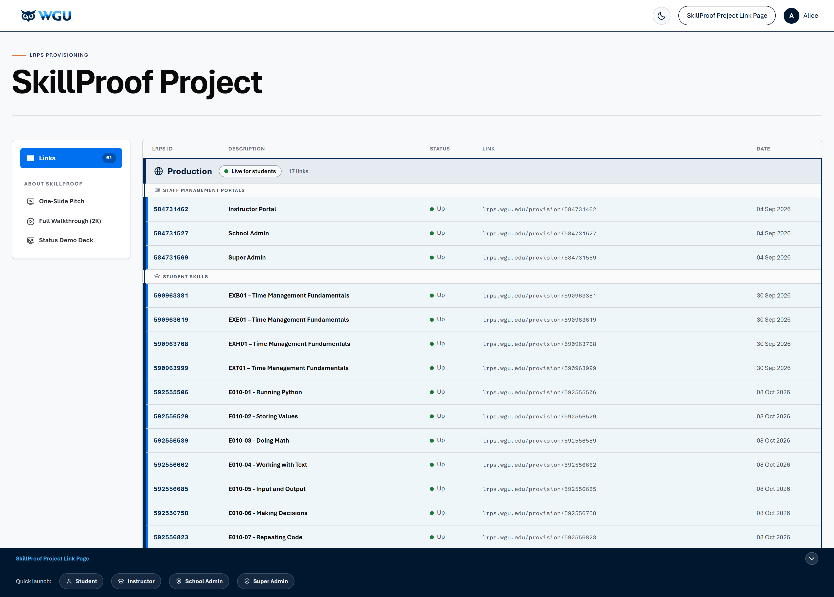
Questions
Let's talk about SkillProof for your program.
Explore on your own
Every persona link and sample skill, all on one page.
Open the SkillProof Project Link Page
brady-wgu.github.io/SkillProof
Brady Redfearn, PhD · Sr. Technology Strategist, Program Development · brady.redfearn@wgu.edu

