Slide 1
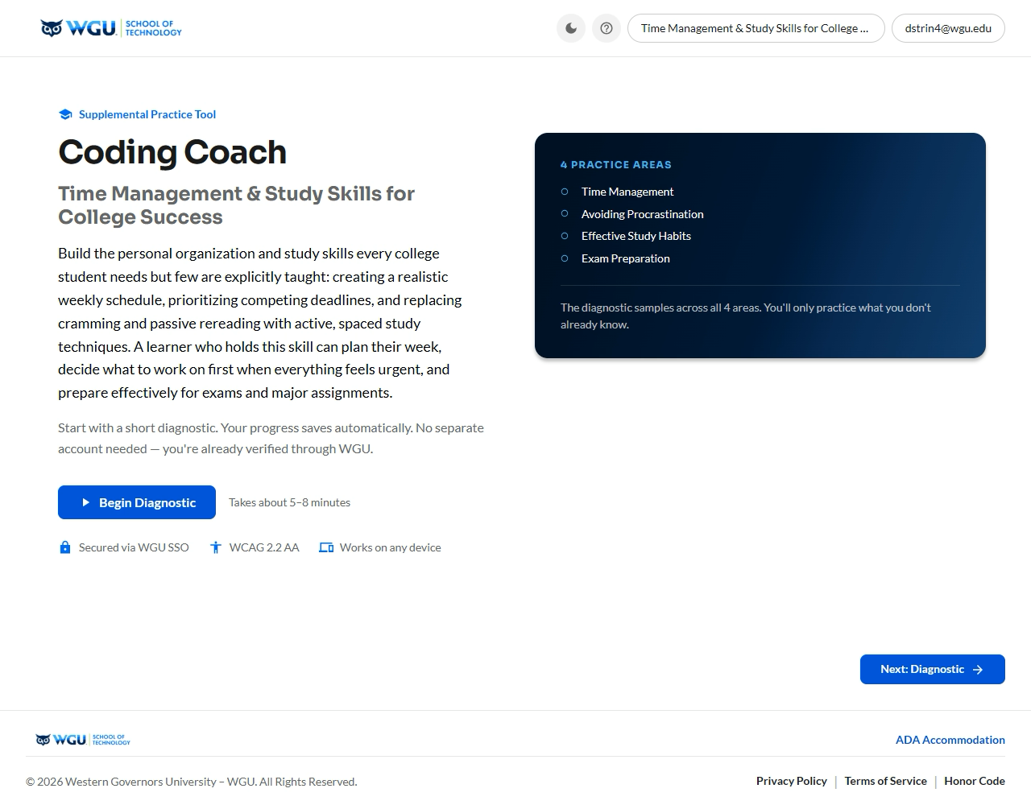
WGU · PROGRAM DEVELOPMENT
Every student deserves their own path to mastery.
SkillProof is WGU's in-house AI coach — adaptive, LLM-driven practice with real-time feedback that closes skill gaps before high-stakes assessments.
$50k $500k
$150K
Live
10x cheaper for hosting 5,000 students than the tutoring vendor already in use
total to build. No vendor licensing, no added headcount.
One engine, running today, ready for every course at WGU.
SkillProof · AI Coaching + Extensibility

