Slide 1
Linear Algebra
HW3 Cosine Transform
謝濬丞 吳宗翰
linear-algebra-lee@googlegroups.com

Slide 2
Outline
What is signal
Fourier Transform
Cosine Transform
HW3
Input&output
Code&util function
Rules

Slide 3
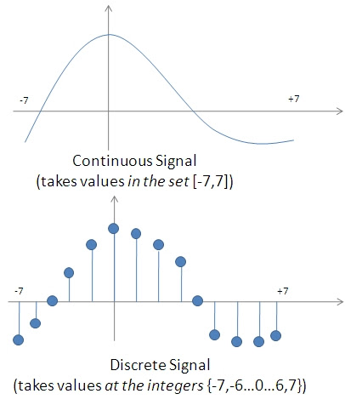
What is signal
傳遞有關一些現象的行為或屬性的資訊的函數
Example
f(t) : 音訊
f(x, y)：圖片
Type
Continuous
Discrete
In this homework, we use
discrete signal

Slide 4

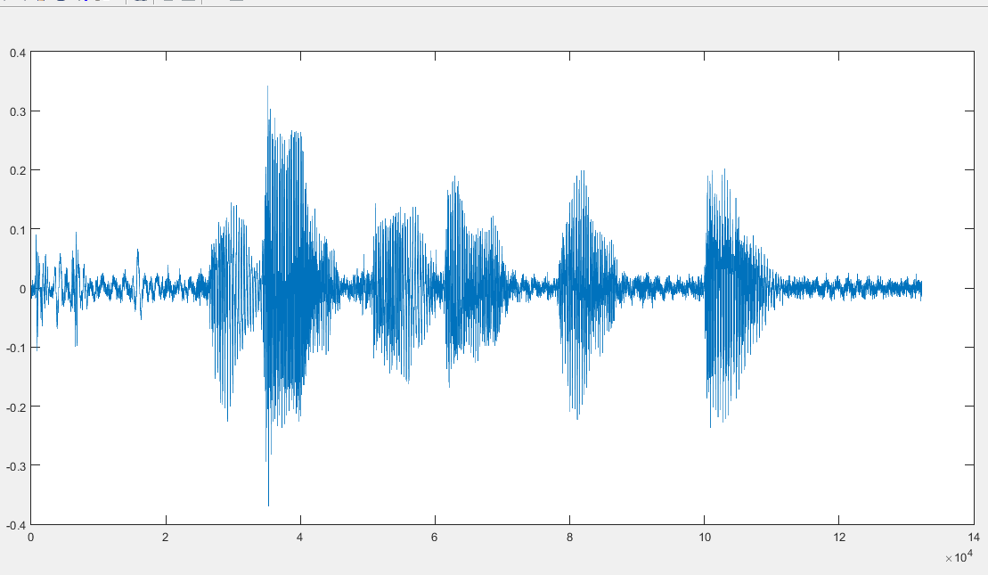
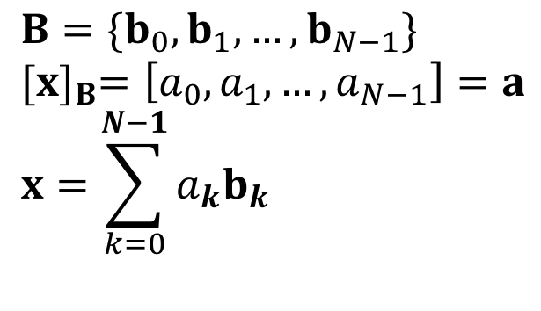
Basis
How to use basis in signal analysis
Given a speech signal
Can we find basis to describe this signal ?
One period T

Slide 5
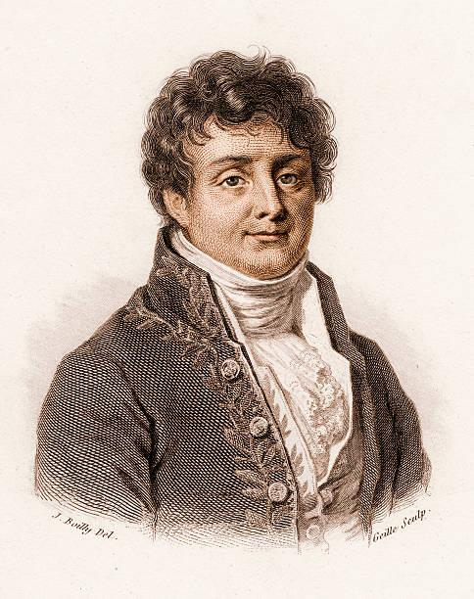
Joseph Fourier
Any periodic signal can be represented as a sum of sinusoids.

Slide 6
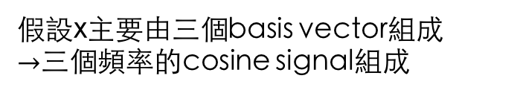
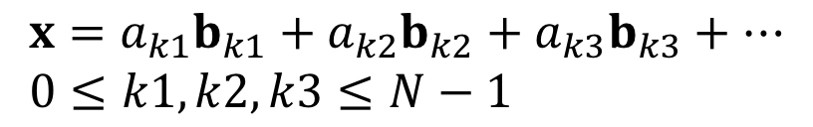

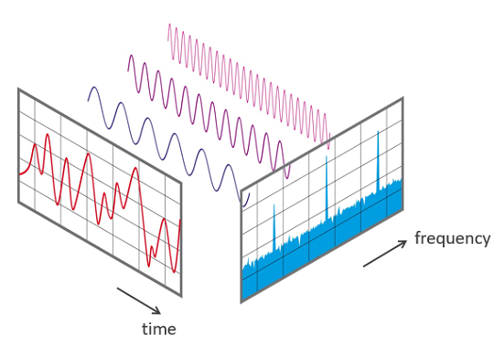



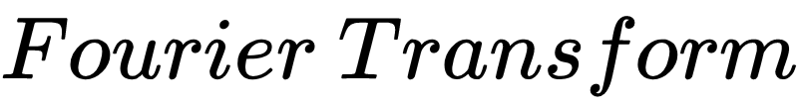



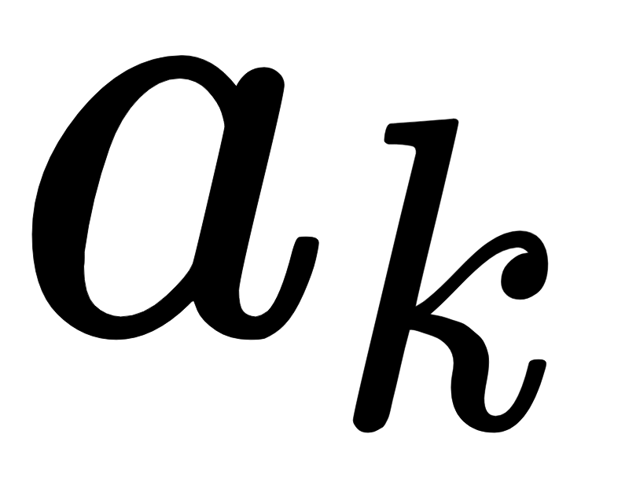


Fourier Transform
時間上的強度
頻率上的強度

Slide 7
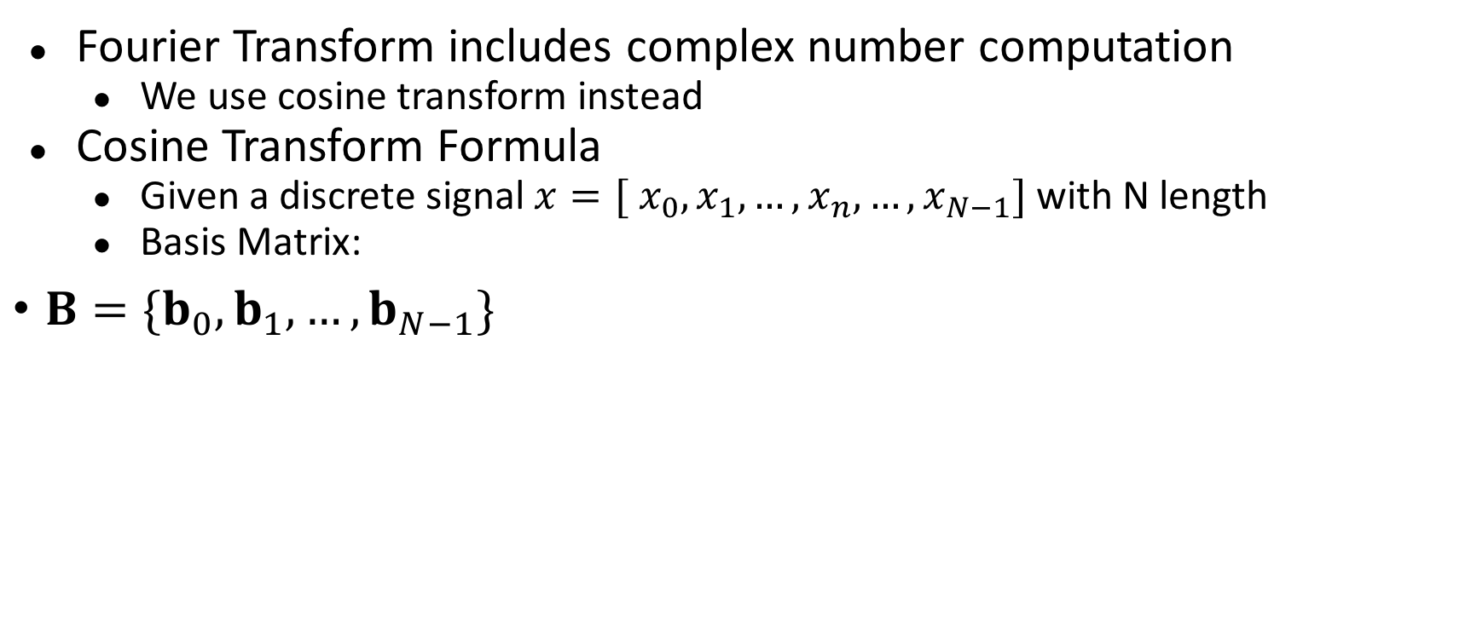
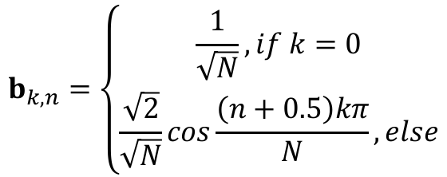
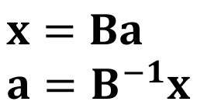
Cosine Transform
How to get a
n: 時間上的index
k: 頻率上的index

Slide 8






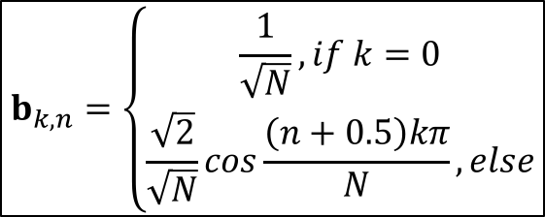






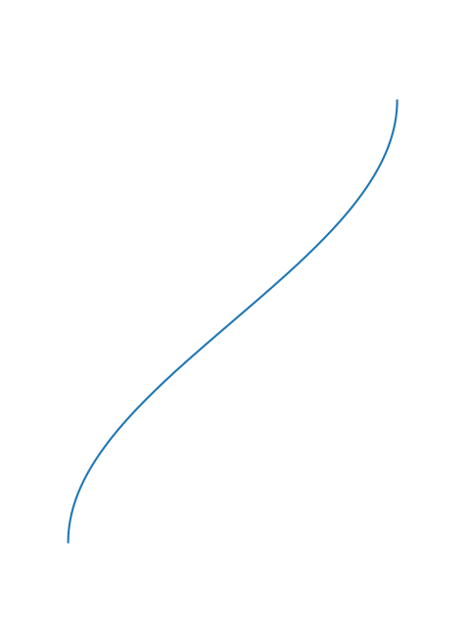
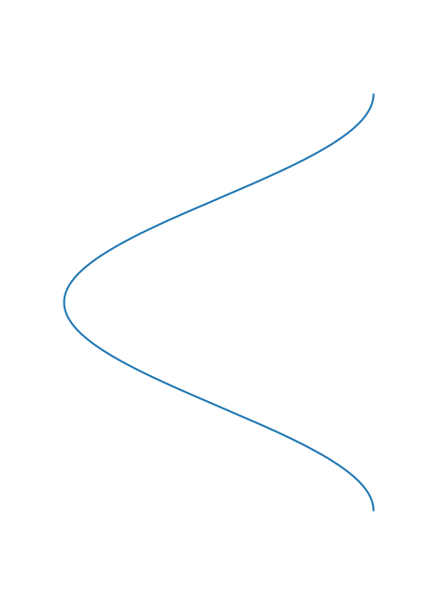
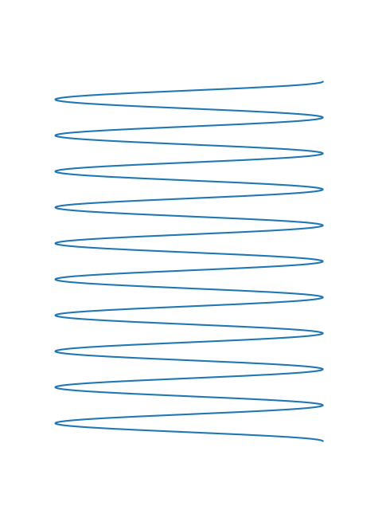
b₀
・・・
・・・
・・・

Slide 9
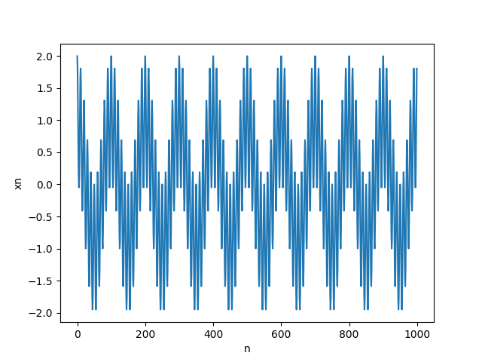
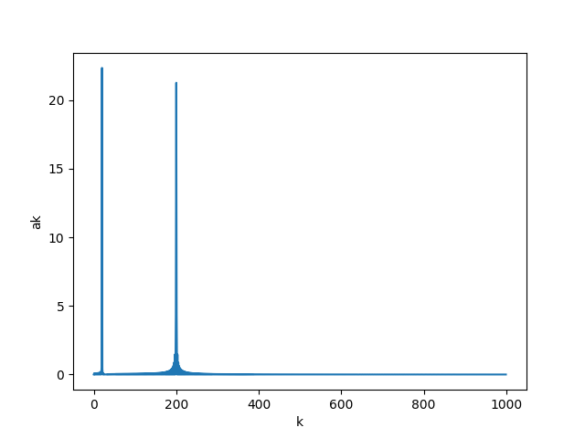

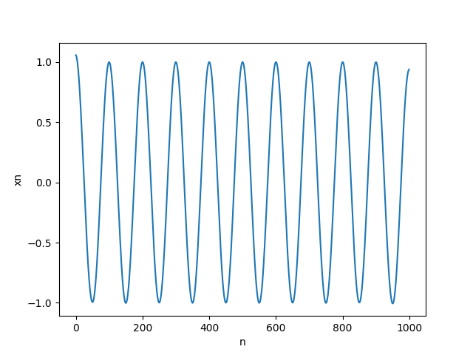
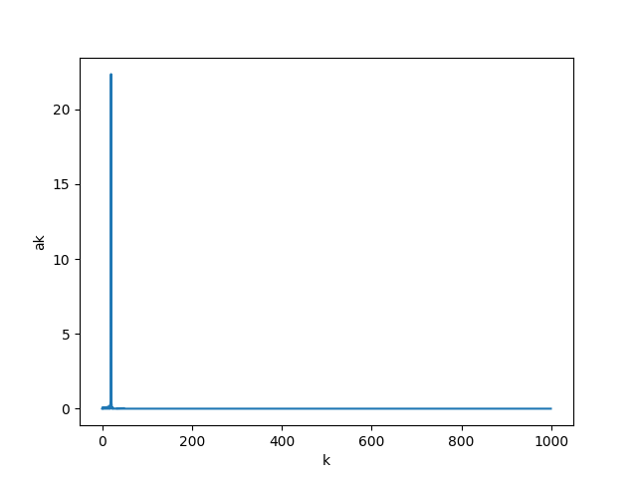
If we want to get the low frequency signal of a mixed signal…
Cosine transform
x
mask
[ 0 0 0 1 0 0 0 0 0 0 0 0 0 0 0 0 0 0 …]
Inverse cosine transform
‘

Slide 10
Application
Filter
Human voice
Man: 85-180Hz
Woman: 165-255Hz
Remove high frequency noise from speech signal

Slide 11
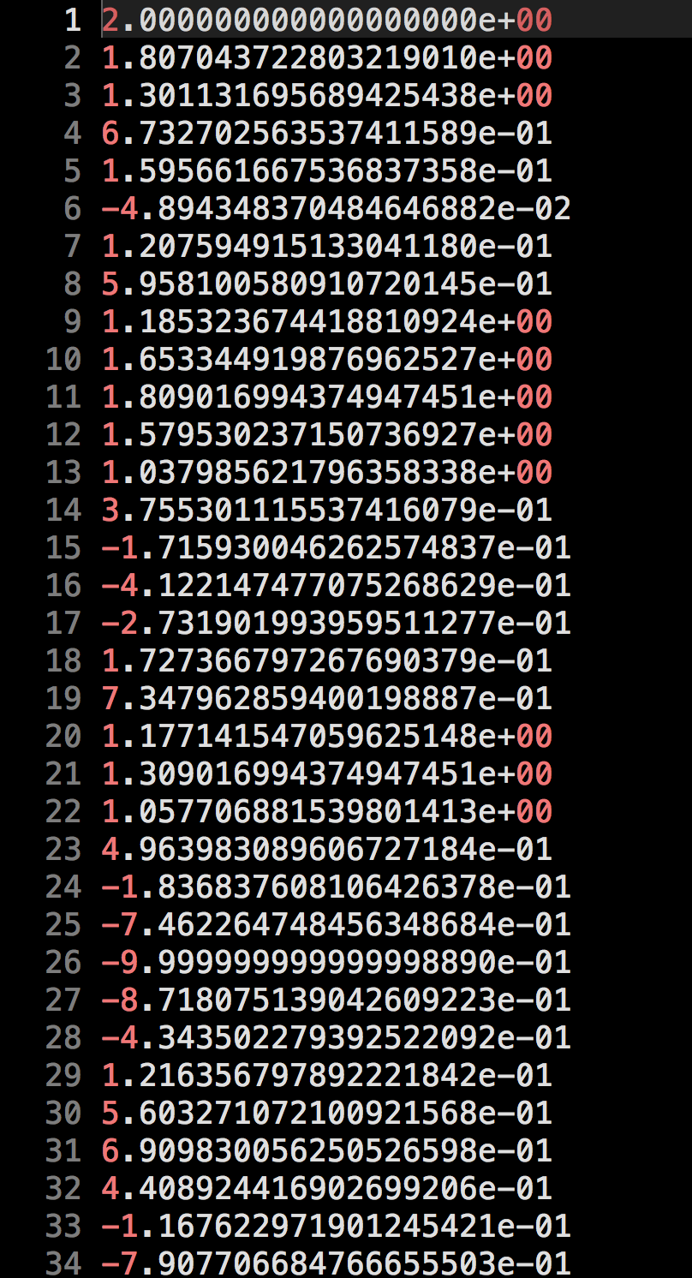
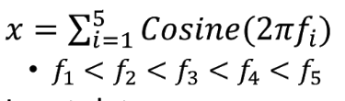
Input
example_data/test.txt
Total 1000 lines, one value per line

Slide 12
Code & Data link
Colab
hw3.py
example_data
test.txt
example_output
freq.png
f1.png
f3.png

Slide 13
Run the code
python hw3.py <input_signal_txt> <output_dir_path>, e.g.
python hw3.py test.txt output/b09901000/
Your code should generate 3 .png files in <output_dir_path> (e.g. output/b09901000).
freq.png
f1.png
f3.png

Slide 14

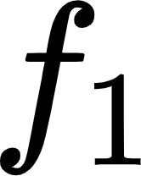
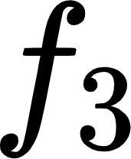
Scoring
(2%) Plot the figure of (freq.png)
(2%) Plot the figure of (f1.png)
(2%) Plot the figure of (f3.png)

Slide 15
Submit
Code you download
|-- hw3.py
Code you submit should be put in a folder and compressed in a zip file
b09901000_hw3.zip
|-- ./b09901000_hw3
|-- hw3.py

Slide 16
Standard Rules
不要抄作業，不要交別人的答案，作弊一律0分計算
上傳 .zip 檔案到 CEIBA
注意繳交的資料夾學號開頭英文用小寫
DEADLINE: 2020/12/02(三) 21:00 (GMT+8:00)
遲交每過一天：分數×0.8 (per day)，超過三天拒收
格式、檔案、各種奇怪的錯誤讓我無法改作業：分數×0.7
上面情況每人有1次修改機會，若不修改一律0分

Slide 17
Code Rules
不可以import額外的library來實作（i.e.上傳的版本中不能import任何其他的library），但若是要檢查自己的code正確與否，是可以使用任何套件的。

Slide 18
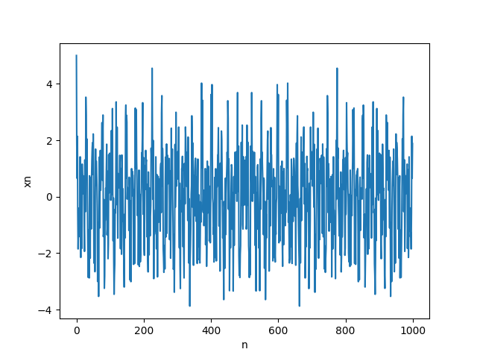
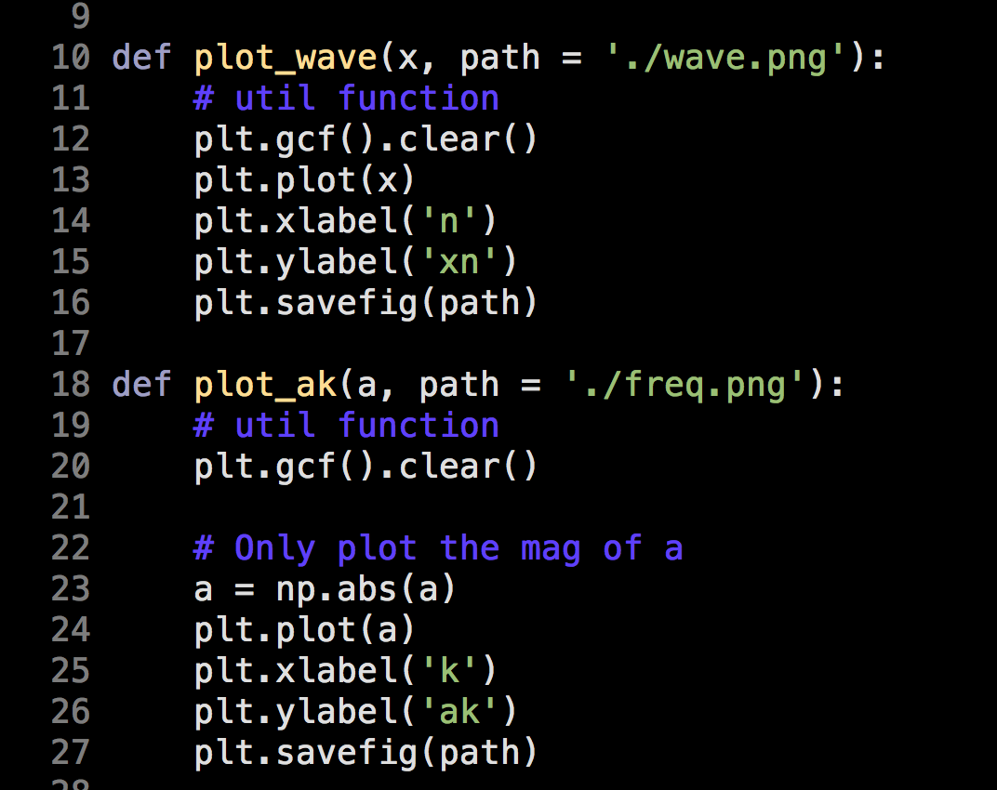
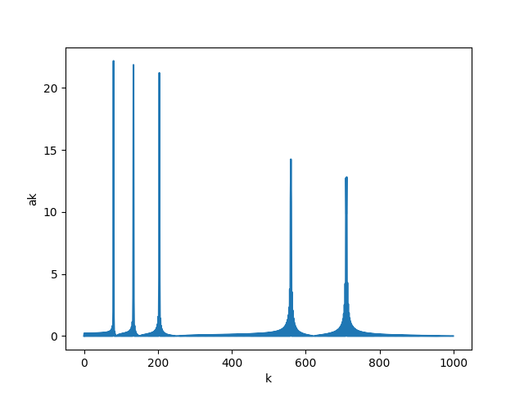
Some util function

Slide 19
test.txt
wave
a_{k}

Slide 20
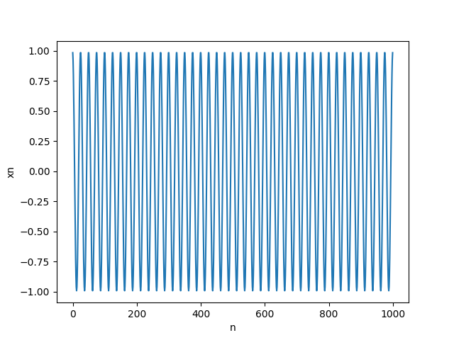
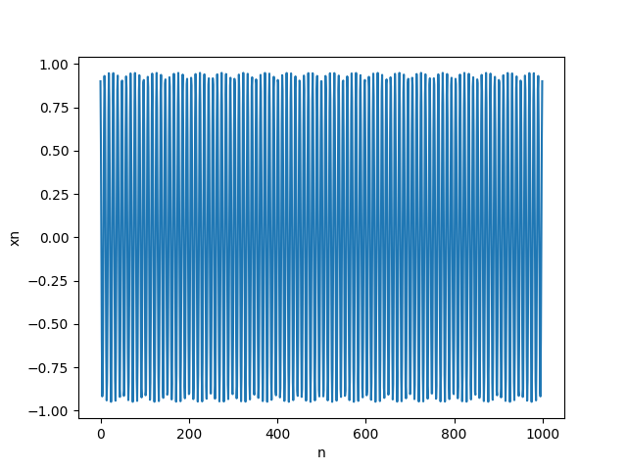
test.txt
f1
f3

