Slide 1
Linear Algebra hw4
PageRank
王子銘

Slide 2
Introduction - PageRank
PageRank is an algorithm to measure the importance of a website.
It was developed by Larry Page and Sergey Brin in 1996.
The more links a website received from other websites, the more important it is.
The algorithm iteratively calculate the importance of a website according to the websites that have links to it and their importance.

Slide 3
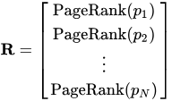
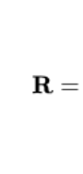

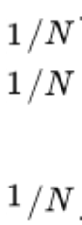
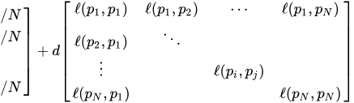
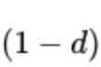


Introduction
1/#ofOutGoingLinksfromPj, if p_{j} has a link to p_{i}
0, else
'
uniform
Original transition matrix

Slide 4

Introduction
Initialize R with
Repeat ‘
'
uniform
Original transition matrix
Until it R converge.

Slide 5
Hw4
Implement the pagerank algorithm and turn a 2-dimensional list into the ordering of web pages.
Download a compressed folder from hw4 on Ceiba.
You will get a 2-dimensional list describing the topology of a network.
E.g. [[0,3],[1,2,3],[2],[0,1]]. The first list [0,3] in this list means the webpage with id 0 has incoming links from 0 and 3. The second list [1,2,3] is the websites webpage 1 has links from, etc.
Our list have a length of 300. Each sublist has at least a number from 0~299.
Submit the file you download from the above link. And another file that contains a list, like [2,0,3,1], which sort the web pages based on pagerank. The web page with a higher probability comes first.

Slide 6
Hw4
2. You will also get a pageRank.py python file that helps you start. Try
$python3 pageRank.py
It will output a answer.json file. Modify the pageRank.py file so that it output the correct ordering.
answer.json contains a list, like [2,0,3,1], which should be the ordering of the web pages based on pagerank. The web page with a higher probability comes first. Float will be acceptable [2.0, 0.0, 3.0,1.0].

Slide 7
Submit format
Submit format should be the following.
A folder with your student id b0XXXXXXX_hw4 that contains three files:
pageRank.py This is your modified pageRank.py file.
summary.json The original summary.json file that comes from Ceiba.
answer.json Your answer on the ordering of the websites.
Compress your folder to b0XXXXXXX_hw4.zip and submit the compressed folder to Ceiba. Make sure your file names match those of above when you submit.

Slide 8
Grading
answer.json (6%)
不要抄作業，不要交別人的答案，作弊一律0分計算
上傳 .zip 檔案到 CEIBA
注意繳交的資料夾學號開頭英文用小寫
DEADLINE: 2020/12/16(三) 21:00 (GMT+8:00)
遲交、改格式、改檔名、改檔案、各種奇怪的錯誤無法改作業：每次分數×0.7，每次修改請完整按照格式繳交。

Slide 9
Hw4 bonus: Page rank competition
Every student will have a web page.
You need to modify your incoming links in order to make your webpage’s probability as close to a number P published by a server every hour as possible (0<=p<1). Your webpages probability will be calculated based on the pagerank algorithm described previously. In this homework we set d=0.85 and always update R 50 times. If there is no link for a website, then d for that website is 0.
The system would choose a winner on every full hour（每個整點） whose best record is closest to P in that hour from 12/5(六)10:00 to 12/11(五)09:00.
Each student can be chosen for only 1 time. But his web page still have influence over the network.

Slide 10
Grading
We calculate your bonus based on when, the full hour, you win. (148 winners out of 300 participants)
If you win before deadline,
your bonus score=1%+3%*( time left to 12/11(五)09:00 / 147hours )
No bonus If you don’t win.
4%
Your bonus score
1%
0%
12/5(六)10:00
The time you win
12/11(五)09:00

Slide 11
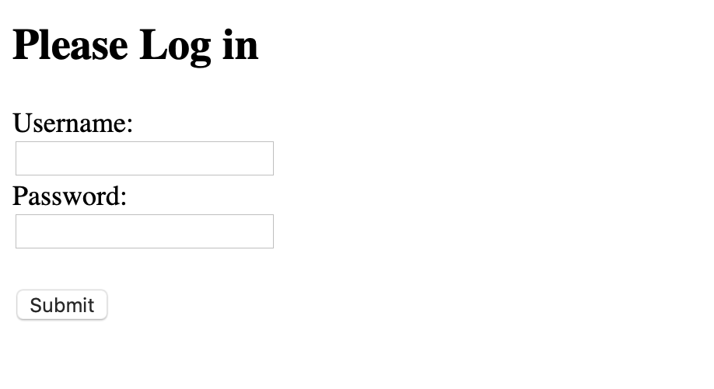
Go to https://140.112.30.34:35000/login , and you will see this page.
Username and password will be sent to you tomorrow.

Slide 12
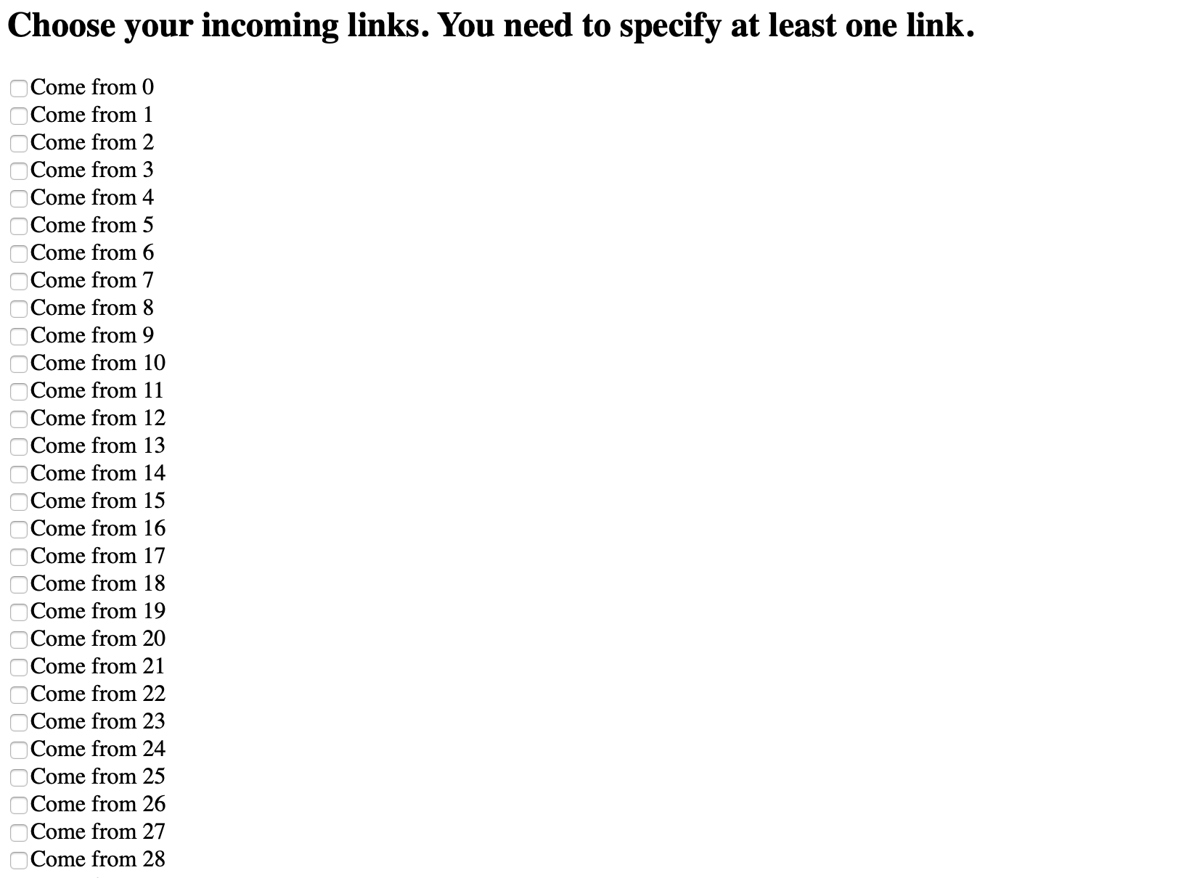
Go to https://140.112.30.34:35000/updateLink , and set your links. Submit button is down below.

Slide 13
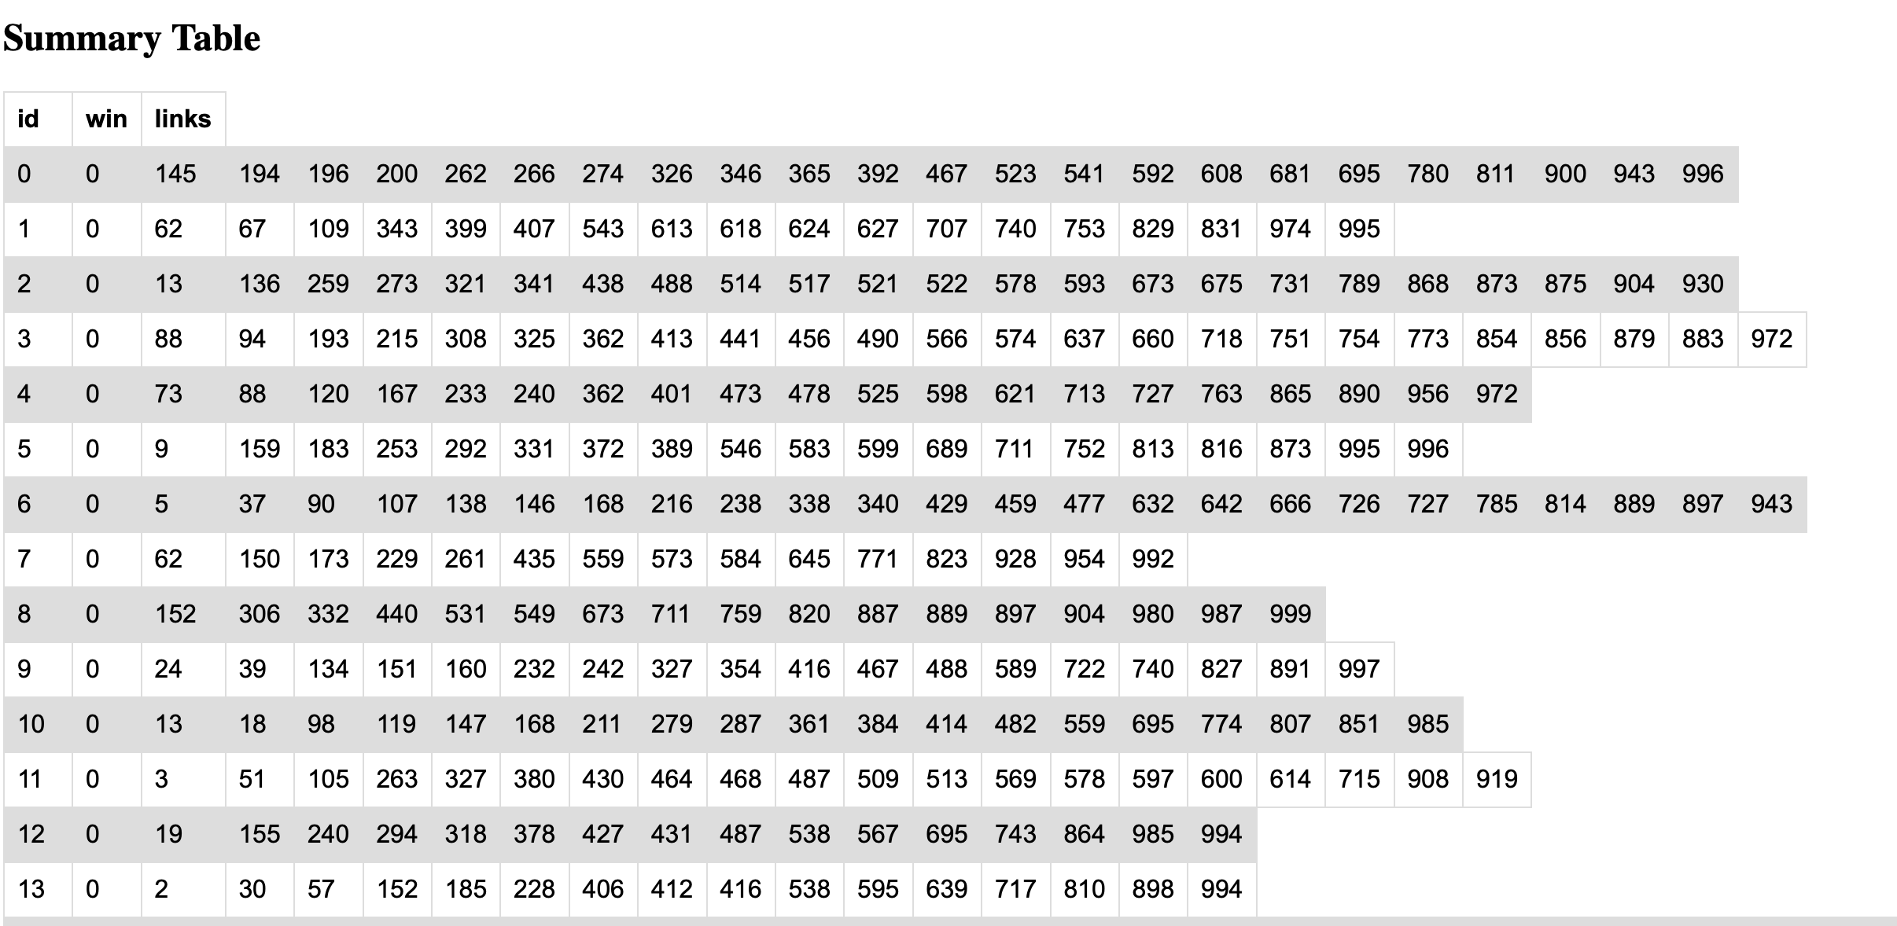
Go to https://140.112.30.34:35000/summary , to see the current summary.

Slide 14
You can modify your page for a maximum of 10 times an hour. The server will store your best score, the one that is closest to P.
Download the summary file, which is in the same format as your summary.json file from Ceiba, at https://140.112.30.34:35000/summary.json to calculate pageRank score before you modify your links.

Slide 15
Total scores
[ (Modified Hw4 score) + (bonus) ] capped by 8%.
Leave a comment on facebook if you have any questions.

