Slide 1
Linear Algebra
HW1
Cycle Detection
謝濬丞

Slide 2
Outline
Task Introduction
Problem 1
Problem 2
Python Tips
Homework Description

Slide 3
Task Introduction

Slide 4
Graph
A graph contains some nodes and edges
The edges can be directed or undirected
This task is given the directed graph, we need to find out whether there is a cycle in the graph
1
6
1
6
4
4
0
2
0
2
5
5
3
7
3
7
Directed Graph
Undirected Graph

Slide 5
Directed Graph
0 → 1
0 → 3
1 → 2
1 → 4
2 → 3
2 → 5
4 → 6
5 → 4
6 → 7
7 → 5
1
6
4
0
2
5
3
7

Slide 6
Cycle
0 → 1
0 → 3
1 → 2
1 → 4
2 → 3
2 → 5
4 → 6
5 → 4
6 → 7
7 → 5
1
6
4
0
2
5
3
7

Slide 7
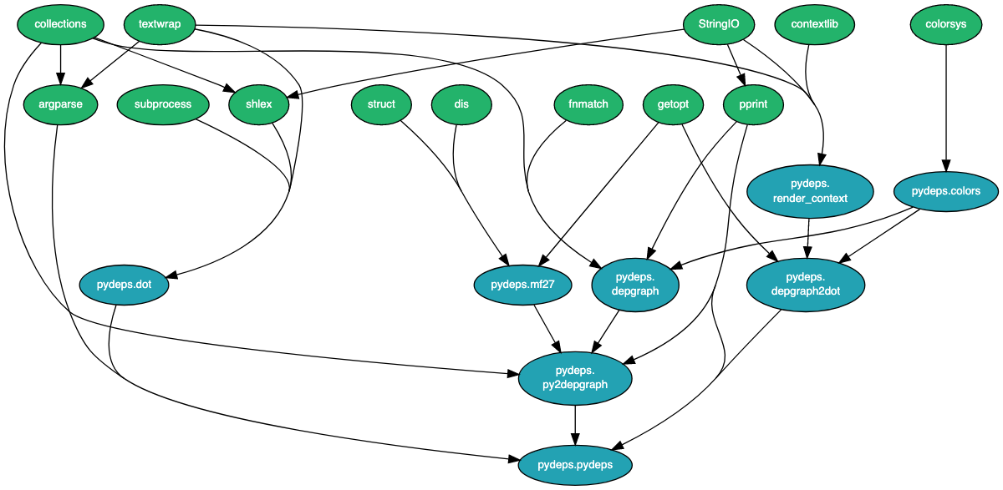
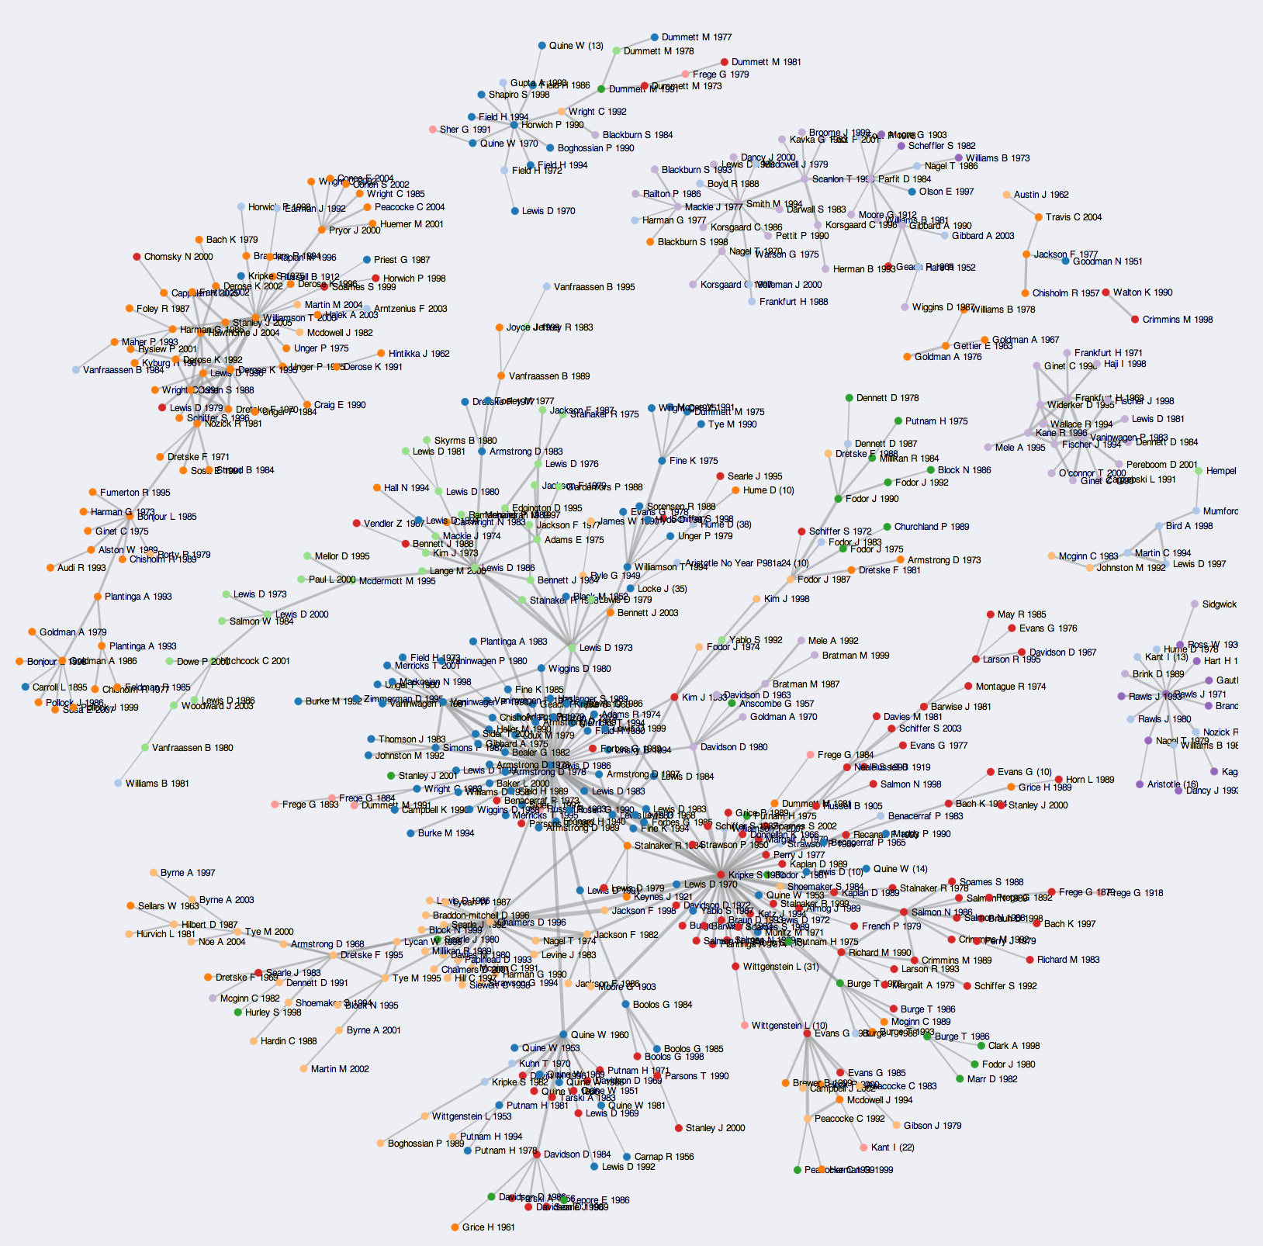
Applications
Python library/module dependency graph
https://github.com/thebjorn/pydeps
Citation network of philosophy papers
https://reurl.cc/v1verN

Slide 8
Problem 1

Slide 9
Graph Representation
 | 0 | 1 | 2 | 3 | 4 | 5 | 6 | 7
0 | -1 | 1
1 | -1 |  |  | 1
2 |  | -1 | 1
3 |  | -1 |  |  | 1
4 |  |  | -1 | 1
5 |  |  | -1 |  |  | 1
6 |  |  |  |  | -1 |  | 1
7 |  |  |  |  | 1 | -1
8 |  |  |  |  |  |  | -1 | 1
9 |  |  |  |  |  | 1 |  | -1
A row is a connection
If a connection is from 0 to 1, the value of column 0 will be -1 and the value of column 1 will be 1
0 otherwise
0 → 1
0 → 3
1 → 2
1 → 4
2 → 3
2 → 5
4 → 6
5 → 4
6 → 7
7 → 5

Slide 10
Linear Dependent to Detect Cycle
2 → 1
1 → 0
0 → 2
1 → 3
0 | 1 | -1 | 0
1 | -1 | 0 | 0
-1 | 0 | 1 | 0
0 | -1 | 0 | 1
1 | -1 | 0 | 0
-1 | 0 | 1 | 0
0 | -1 | 0 | 1
1 | 0 | -1 | 0
0 | 0 | -1 | 1
0 → 2
2 → 0
-1 | 0 | 1 | 0
0 | -1 | 0 | 1
1 | 0 | -1 | 0
0 | 0 | -1 | 1
0 | -1 | 1 | 0
2 → 0
2 → 3
1
1
1
1
0
2
3
0
2
3
0
2
3
0
2
3

Slide 11
Termination
If we get a ALL 0 row after addition, then the graph has a cycle.
If we do addition on all the edges and we don’t get a ALL 0, then the graph does not have a cycle.

Slide 12
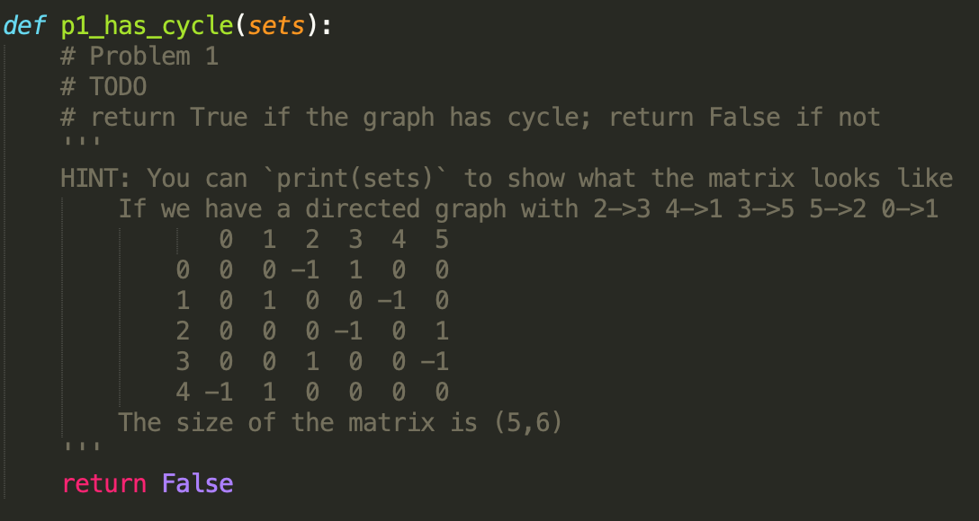
p1.py

Slide 13
Problem 2

Slide 14
Graph Representation
 | 0 | 1 | 2 | 3 | 4 | 5 | 6 | 7
0 |  | 1 |  | 1
1 |  |  | 1 |  | 1
2 |  |  |  | 1 |  | 1
3
4 |  |  |  |  |  |  | 1
5 |  |  |  |  | 1
6 |  |  |  |  |  |  |  | 1
7 |  |  |  |  |  | 1
A cell(x,y) = 1 if there is a connection from x to y
0 otherwise
0 → 1
0 → 3
1 → 2
1 → 4
2 → 3
2 → 5
4 → 6
5 → 4
6 → 7
7 → 5

Slide 15
Matrix Multiplication
0 | 0 | 1 | 0
1 | 0 | 0 | 0
0 | 1 | 0 | 0
0 | 1 | 0 | 0
0 | 0 | 1 | 0
1 | 0 | 0 | 0
0 | 1 | 0 | 0
0 | 1 | 0 | 0
0 | 1 | 0 | 0
0 | 0 | 1 | 0
1 | 0 | 0 | 0
1 | 0 | 0 | 0
1 → 0
×
=
2 → 0
2 → 1
Do multiplication at most N times. (N: # of nodes)

Slide 16
Matrix Multiplication
0 → 2
1 → 0
2 → 1
3 → 1
0 | 0 | 1 | 0
1 | 0 | 0 | 0
0 | 1 | 0 | 0
0 | 1 | 0 | 0
0 → 1
1 → 2
2 → 0
3 → 0
0 | 1 | 0 | 0
0 | 0 | 1 | 0
1 | 0 | 0 | 0
1 | 0 | 0 | 0
0 → 0
1 → 1
2 → 2
3 → 2
1 | 0 | 0 | 0
0 | 1 | 0 | 0
0 | 0 | 1 | 0
0 | 0 | 1 | 0
1
1
1
0
2
3
0
2
3
0
2
3

Slide 17
Termination
If we find a value greater or equal to 1 in the diagonal of matrix, then the graph has a cycle.
If we do N times of multiplication and all value in the diagonal are 0, then the graph does not have a cycle.

Slide 18
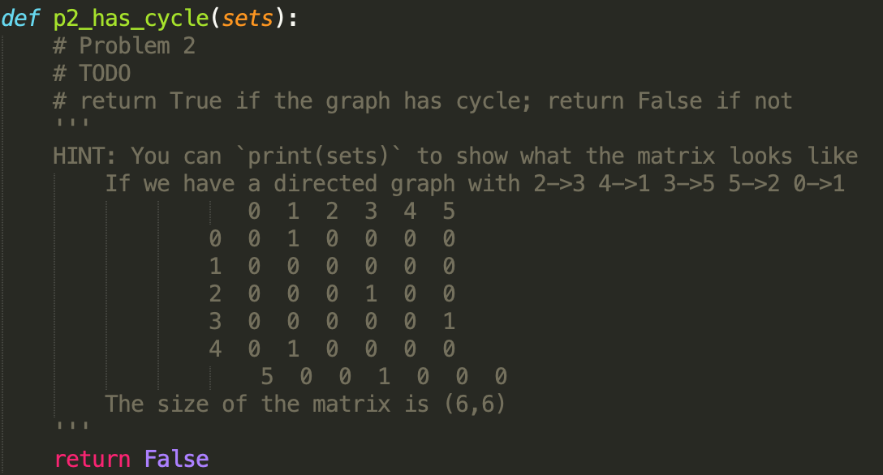
p2.py

Slide 19
Code Implementation
You should only complete the function `has_graph(sets)` in p1.py and p2.py. DO NOT modify the other parts of code
This function will return True or False
If the graph(sets) has cycles, this function should return True
Otherwise, return False

Slide 20
Python Tips

Slide 21
List
Generate an empty list
L = list() or L = []
Get a sublist of a list L
From A to B: L[A:B]
From begin to B: L[:B]
From A to end: L[A:]
Push an object in list
L.append(object)
L = [ 2, 4, [1, 2], [3, 6] ]
object = 8
L.append(object)
>>> L = [ 2, 4, [1, 2], [3, 6], 8 ]
Extend a list L2 and push it in list L
L.extend(L2)
L2 = [ 4, [2, 3] ]
L.append(L2)
>>> L = [ 2, 4, [1, 2], [3, 6], 8, 4, [2, 3] ]
0 | 1 | 2 | 3 | 4 | 5 | 6 | 7 | 8 | 9
0 | 1 | 2 | 3 | 4 | 5 | 6 | 7 | 8 | 9 | 10

Slide 22
NumPy&SciPy
numpy
L = numpy.array( [ 3, 2, 5, 1 ] )
Two numpy matrix A, B multiplication
numpy.matmul(A, B)
A = [ [1, 2], [3, 4] ]
B = [ [2, 3], [4, 5] ]
numpy.matmul(A, B)
>>> [ [10, 13], [22, 29] ]
scipy will be similar

Slide 23
Homework Description

Slide 24
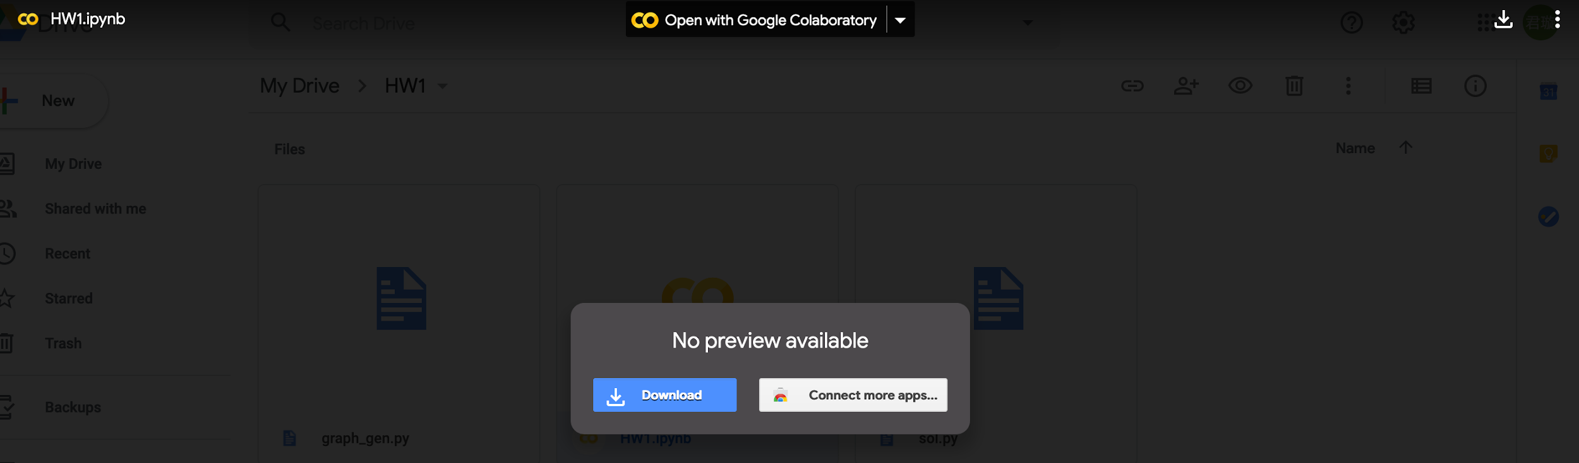
What you should do
打開 (Colab連結) , 右鍵make a copy複製一份至自己的google帳戶下
整份資料只允許更動p1.py和p2.py檔，將2題的function都完成之後，評分也只會依據p1.py和p2.py！！
將HW1.ipynb用colab打開
按這個

Slide 25
Run Code
到HW1.ipynb
除了學號之外，不需要改HW1.ipynb的command，但是如果你想要debug可以增加一些自己所需的指令，最後不需要繳交這個檔案，所以你可以照自己需求使用
可將HW1.ipynb載到自己的電腦執行，如果有較大的記憶體則可以測試自己的code是否能運行在較大的graph上
持續按執行的按鈕到最後，如果code的正確性有誤的話，會如： Bug in the 5th graph. P1.

Slide 26
Run Code
如果跳出error，可能是你在p1.py或p2.py的地方寫錯了，請再回去p1.py或p2.py重新寫過之後，再來執行
因為照ipython的邏輯，已經import過的東西就不會再import一次，所以你要跑的時候記得要重新開一個colab喔！這樣才會跑到你改過的code，否則被跑的code是你原本的code。

Slide 27
Grading
助教會把同學的code跑在8個隨機生成的graph上，graph的vertex數以及edges數的量級爲數千左右。每一種做法在每一個graph上的正確性（以networkx衡量）佔5%，總計80%。而每個同學的graph將以各自學號經某種hashing而成的數字作爲random seed
另外還會將code跑在真實世界的案例上，在這份作業中用的是citation network，vertex數以及edges數的量級爲1～2萬左右（2個graph，分別佔10%）。
注意單個演算法在10個graph上運行的時間請勿超過5分鐘，總計起來請勿超過10分鐘。若超過時間只會對已有結果的graph進行評分

Slide 28
Notices
p1.py以及p2.py中不可import額外的library
爲加速運算且減少計算量，p1和p2的矩陣以sparse的形式儲存以及運算
需注意助教測試code用的都是用量級較大的graph，用sparse矩陣來進行矩陣加發或乘法會減少計算量，不然可能難以運行。同學可以先用numpy熟悉操作，再換成用scipy的稀疏矩陣來implement
切記p1的row之間addition這一步請勿使用for loop，請用矩陣加法

Slide 29
Code Structure
Code you download from github |—p1.py
|—p1_main.py
|—p2.py
|—p2_main.py
|—graph_gen.py
同學只須繳交p1.py&p2.py
b09901xxx_hw1.zip
b09901xxx_hw1
|—p1.py
|—p2.py
HW1.ipynb可以用來debug

Slide 30
Rules
不要抄作業，不要交別人的答案，作弊一律0分計算
上傳 .zip 檔案到 CEIBA
注意繳交的資料夾學號開頭英文用小寫
Deadline: 2020/10/21(三) 21:00 (GMT+8:00)
遲交每過一天：分數×0.8 (per day) 超過三天拒收
格式、檔案、各種奇怪的錯誤讓助教無法改作業：分數×0.7
上面情況每人有1次修改機會，若不修改一律0分

Slide 31
Q & A
若有作業相關問題請到FB社團發問
你的問題很可能也是其他同學的問題：）
FB私訊助教或寄信一律不予理會...

