Slide 1
extending visual studio code
brady gaster | senior program manager | docs.microsoft.com

Slide 2
agenda
prerequisites
scaffolding extension projects
snippets
commands
user experience
editor interaction
publishing
design considerations

Slide 3
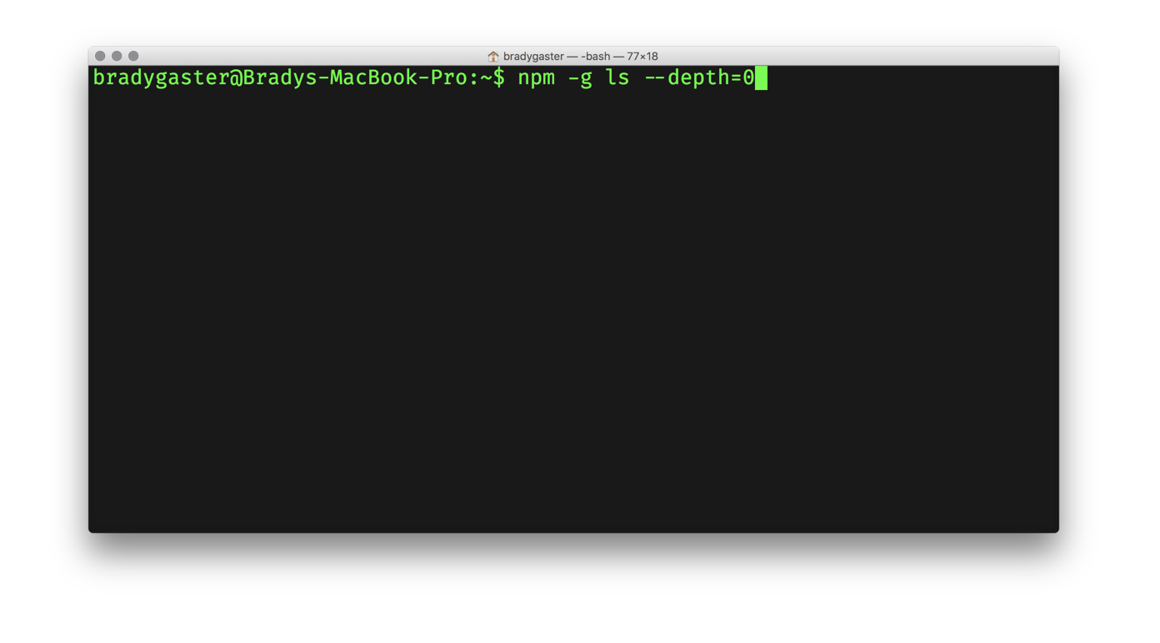
prerequisites

Slide 4
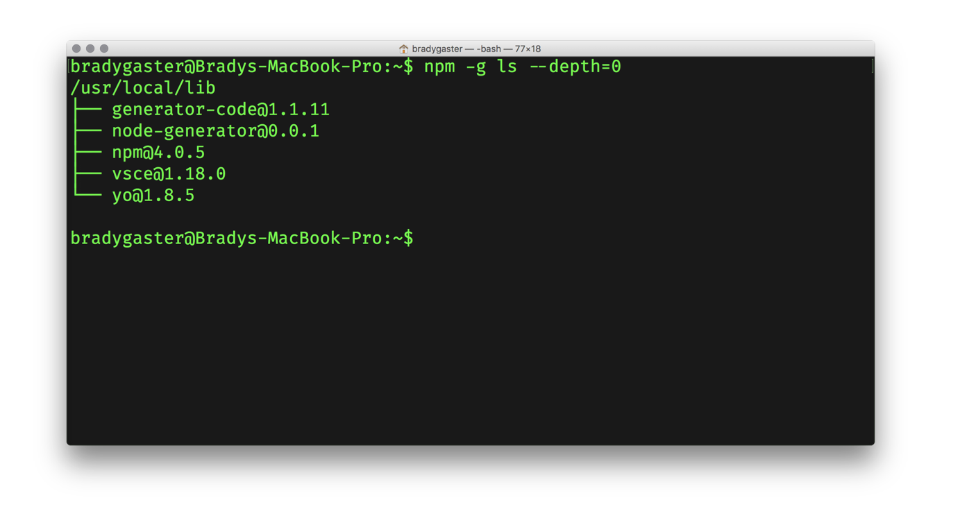
prerequisites

Slide 5
prerequisites
1
Yeoman
Project scaffolding tool with a rich open-source library of templates useful for developers
2
3
VS Code Scaffold A Yeoman template containing boilerplate code to get you started with a new extension
2
1
3
VSCE Used to package up VS Code extensions for publication in the marketplace

Slide 6
yo code
Using the yeoman vs code extension generator

Slide 7
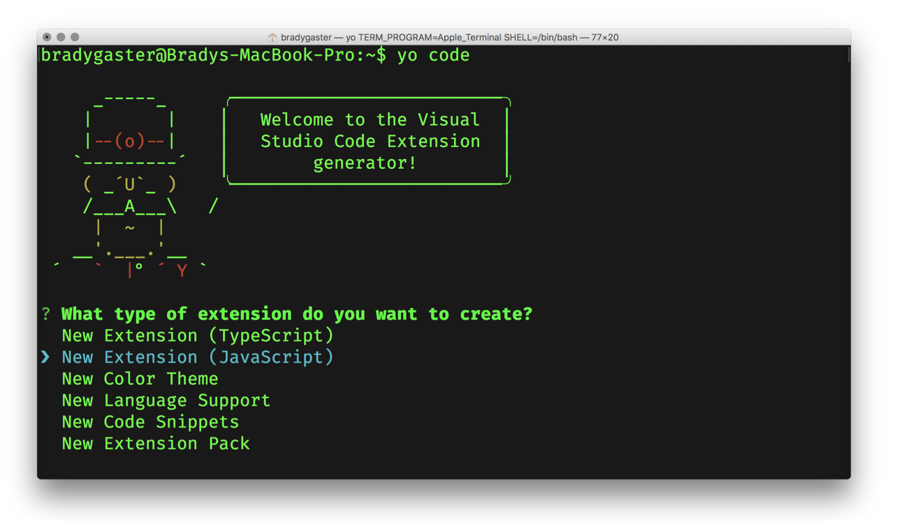

yo code the extension’s skeleton

Slide 8
yo code the extension’s skeleton

Slide 9
demo - snippets
authoring custom snippets that are distributed with your extension
Notes:
Demo 1

Slide 10
demo - contributions
my extension contributes a new snippet to the product
Notes:
Demo 2

Slide 11
commands
how vs code extensions know when and how to respond

Slide 12
demo – creating commands
create a custom command that responds to being triggered
Notes:
Demo 3

Slide 13
demo – contributing commands
contributing commands to the running instance of visual studio code
Notes:
Demo 4

Slide 14
demo – registering commands
wiring custom commands up to the custom extension’s context
Notes:
Demo 5

Slide 15
user experience

Slide 16
user experience in vs code
purpose
api
progress updates
toolbar buttons
select lists or combo boxes
collecting input
tell the customer something happened
tell the customer something broke
window.createOutputChannel
window.createStatusBarItem
window.showQuickPick
window.showInputBox
window.showInformationMessage
window.showErrorMessage

Slide 17
demo – outputting messages
don’t forget to keep the user informed on progress and activity
Notes:
Demo 6

Slide 18
demo – toolbars & buttons
add a button to the toolbar to make it easy for users to discover commands
Notes:
Demos 7-9

Slide 19
demo – input, inform, error
confirm when things complete, report when things break, and collect input
Notes:
Demo 10

Slide 20
editor interaction

Slide 21
some editor interaction apis
purpose
api
create a new text editor decoration
get a reference to the active editor
activate a text decoration
handle when the text of the document changes
handle when the active document changes
window.createTextEditorDecorationType
window.activeTextEditor
window.activeTextEditor.setDecorations
window.onDidChangeActiveTextEditor
workspace.onDidChangeTextDocument

Slide 22
demo – decorate important text
highlight relevant text segments using decorations
Notes:
Demo 10

Slide 23
publishing

Slide 24
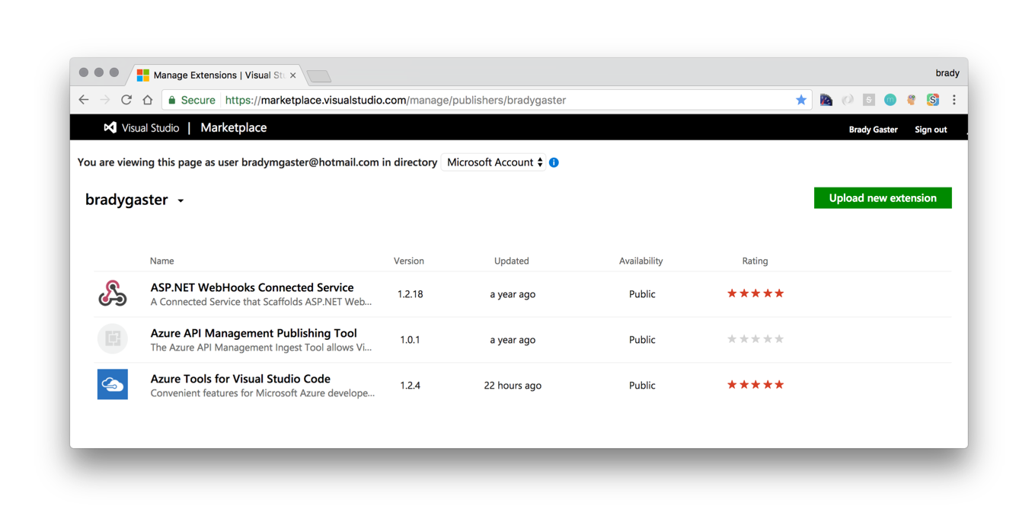
uploading new marketplace entries
https://marketplace.visualstudio.com/manage/publishers/{publisher}

Slide 25
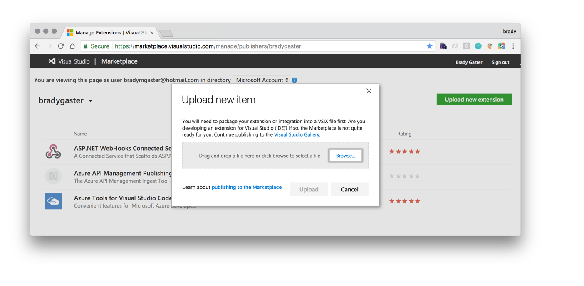
managing your marketplace entries
https://marketplace.visualstudio.com/manage/publishers/{publisher}

Slide 26
managing your marketplace entries
https://marketplace.visualstudio.com/manage/publishers/{publisher}

Slide 27
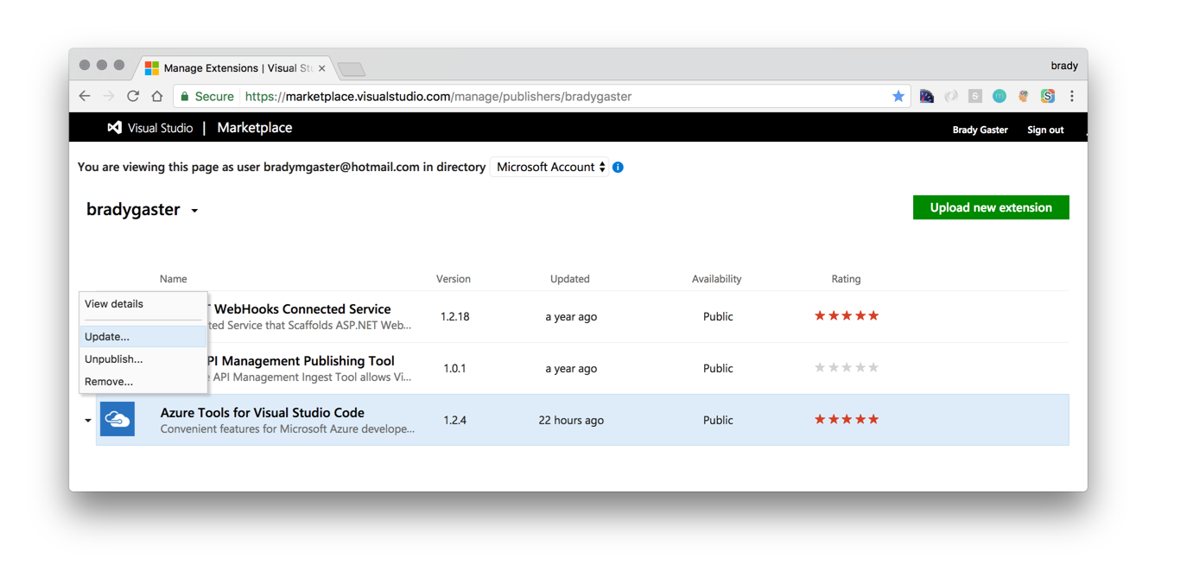
managing your marketplace entries
https://marketplace.visualstudio.com/manage/publishers/{publisher}

Slide 28
command-line focused
design considerations
embrace extension
most vs code users demonstrate comfort at the command line, so try not to make the user need to use the mouse
if you realize a component of your extension could be used by another extension, break your extension up and take an extension dependency on the componentized part
open-source at heart
data-drive feature decisions
whenever possible try to publicize your extension’s code in a public Git repository and include the repository’s URL in your package.json file
use telemetry wisely to understand how customers are using your feature and frequently review that telemetry to understand where problem areas exist

Slide 29
thanks
I hope you enjoyed this journey on extending vs code together!

Slide 30
add value
if you need the feature, someone else does too!

Slide 31
go build it

