Slide 1
Extending Visual Studio Code
Brady Gaster
Senior Program Manager
docs.microsoft.com

Slide 2
Agenda
Prerequisites
Scaffolding extension projects
Snippets
Commands
User Experience
Editor Interaction
Publishing

Slide 3
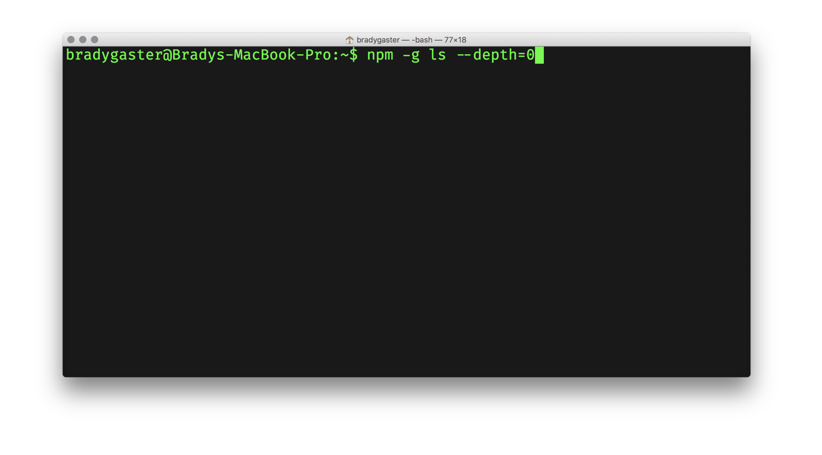
Prerequisites

Slide 4
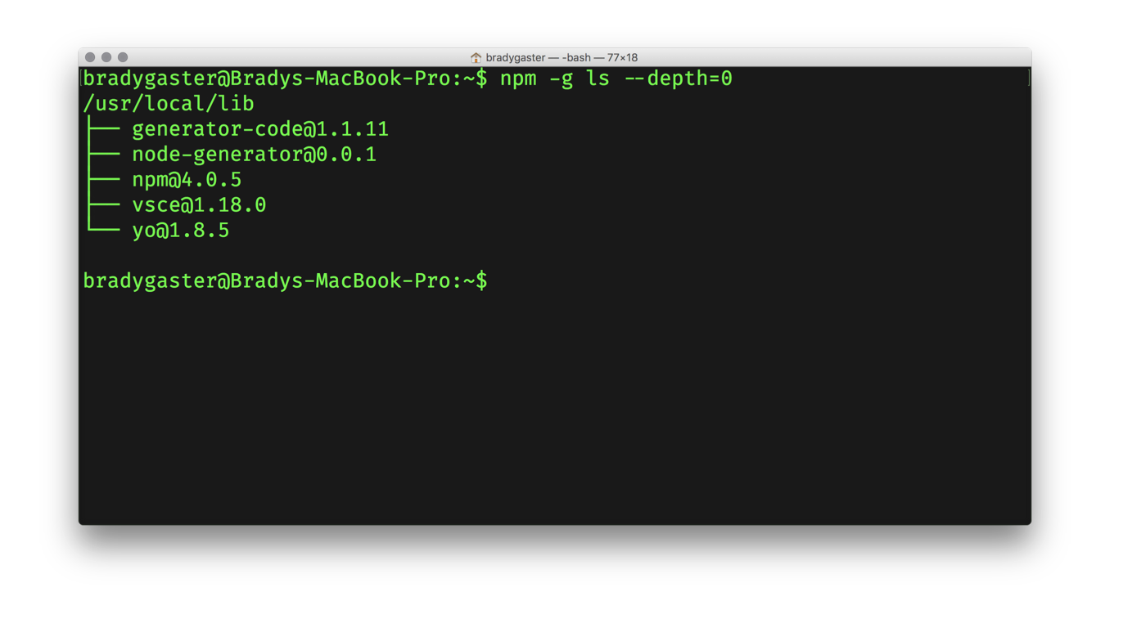
Prerequisites

Slide 5
Prerequisites
1
Yeoman
Project scaffolding tool with a rich open-source library of templates useful for developers
2
3
VS Code Scaffold A Yeoman template containing boilerplate code to get you started with a new extension
2
1
3
VSCE Used to package up VS Code extensions for publication in the marketplace

Slide 6
yo code
Using the yeoman vs code extension generator

Slide 7
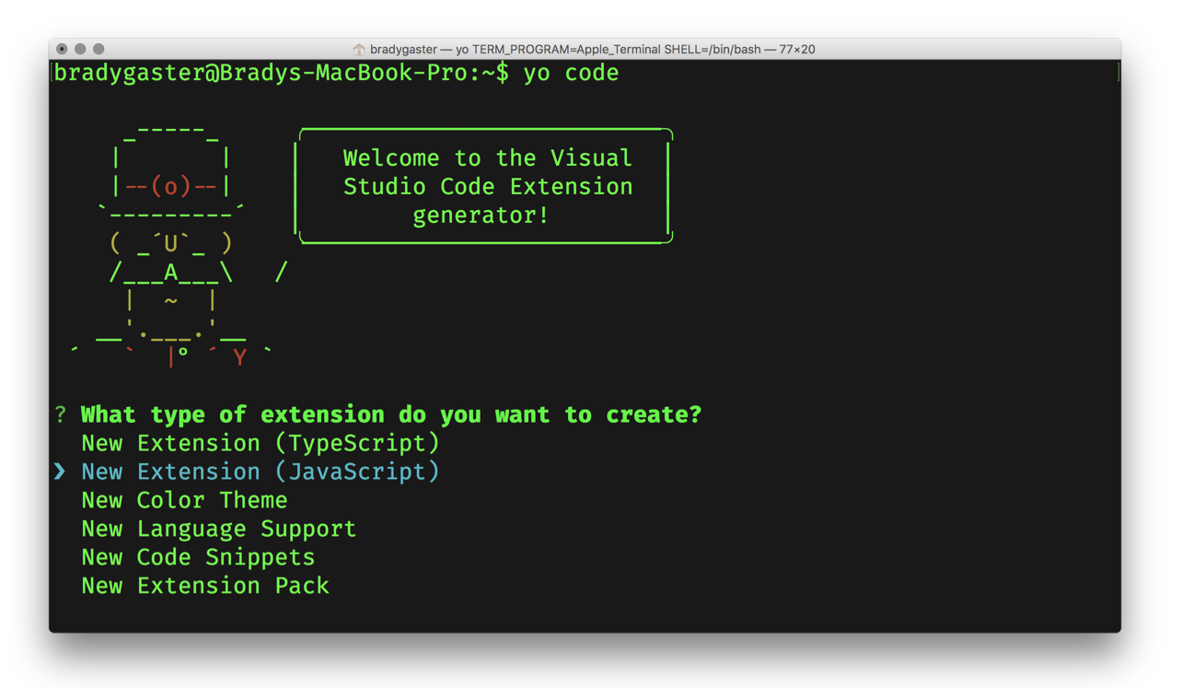

yo code the extension’s skeleton

Slide 8
yo code the extension’s skeleton

Slide 9
snippets

Slide 10
commands

Slide 11
user experience

Slide 12
editor interaction

Slide 13
publishing

