Slide 1
extending visual studio code
brady gaster | senior program manager | docs.microsoft.com

Slide 2
agenda
prerequisites
scaffolding extension projects
snippets
commands
user experience
editor interaction
publishing
design considerations

Slide 3
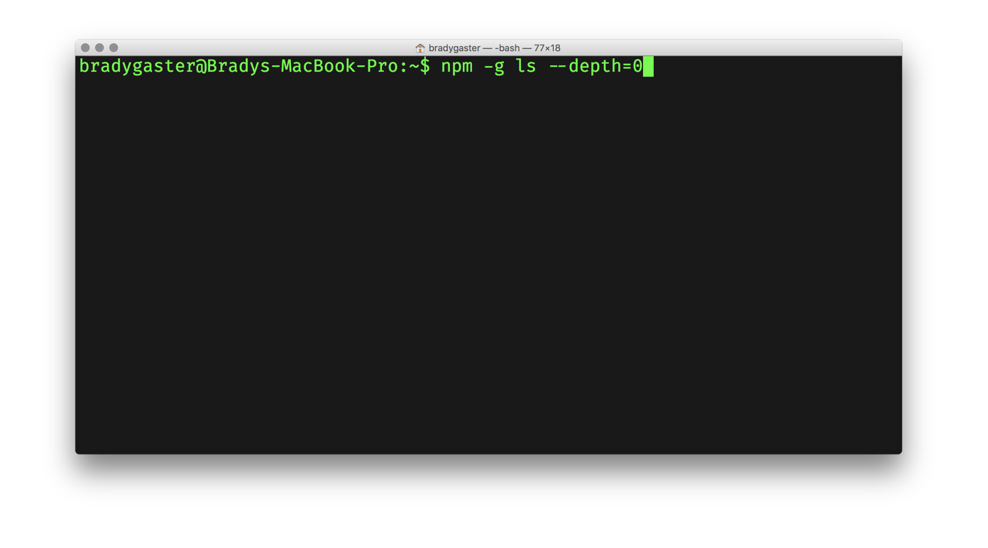
prerequisites

Slide 4
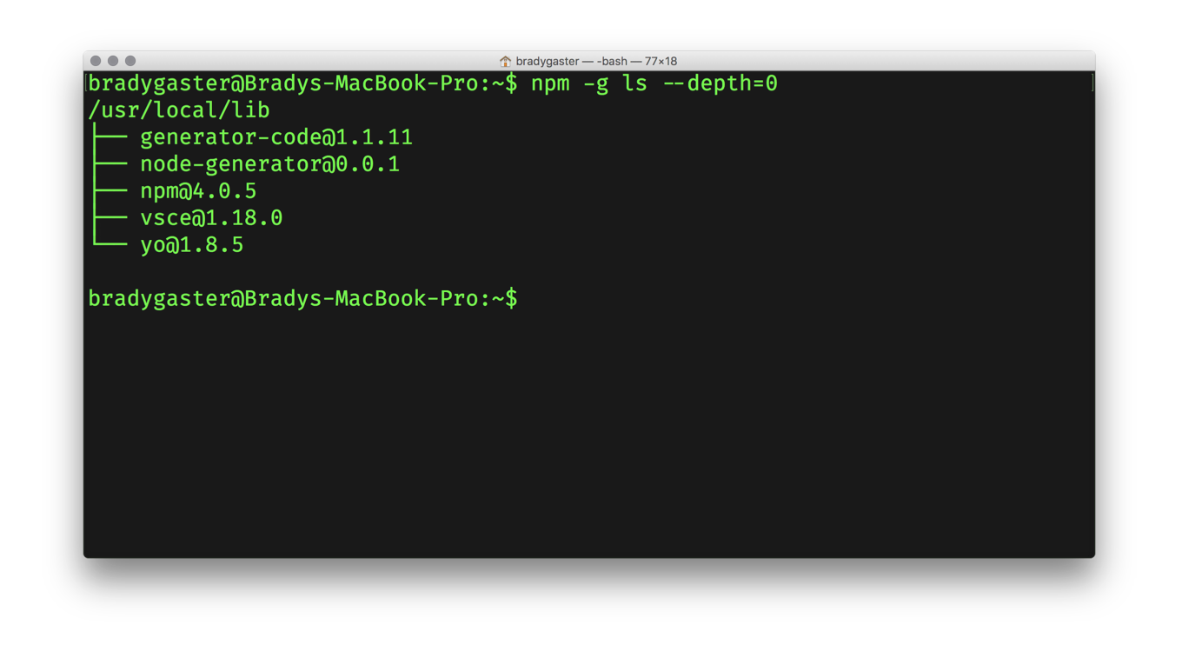
prerequisites

Slide 5
prerequisites
1
Yeoman
Project scaffolding tool with a rich open-source library of templates useful for developers
2
3
VS Code Scaffold A Yeoman template containing boilerplate code to get you started with a new extension
2
1
3
VSCE Used to package up VS Code extensions for publication in the marketplace

Slide 6
yo code
Using the yeoman vs code extension generator

Slide 7
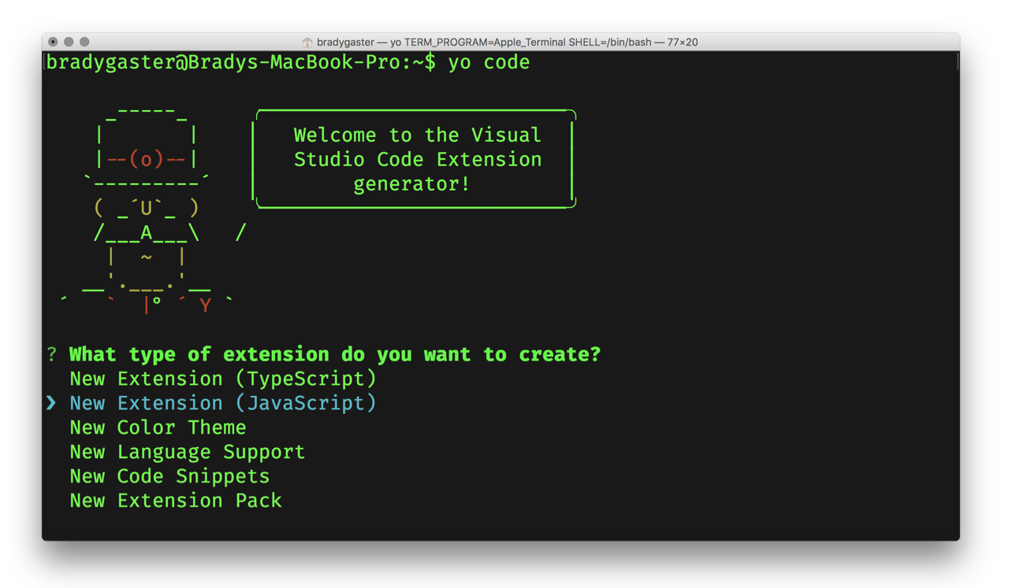

yo code the extension’s skeleton

Slide 8
yo code the extension’s skeleton

Slide 9
snippets

Slide 10
commands

Slide 11
user experience

Slide 12
editor interaction

Slide 13
publishing

Slide 14
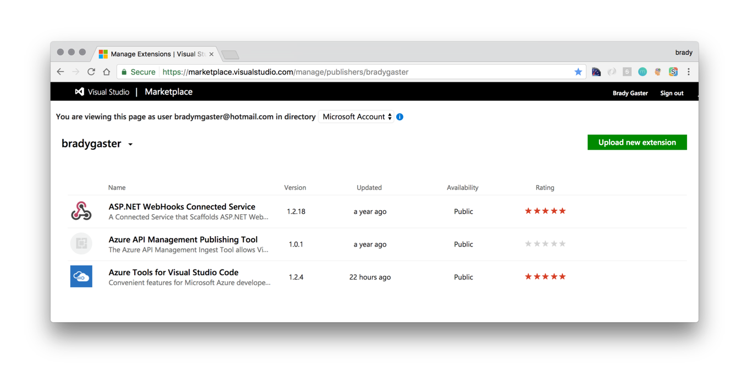
uploading new marketplace entries
https://marketplace.visualstudio.com/manage/publishers/{publisher}

Slide 15
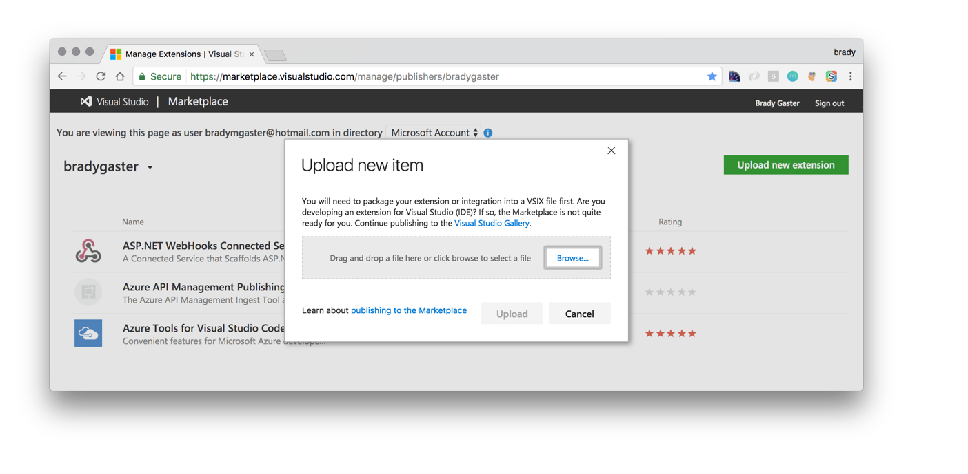
managing your marketplace entries
https://marketplace.visualstudio.com/manage/publishers/{publisher}

Slide 16
managing your marketplace entries
https://marketplace.visualstudio.com/manage/publishers/{publisher}

Slide 17
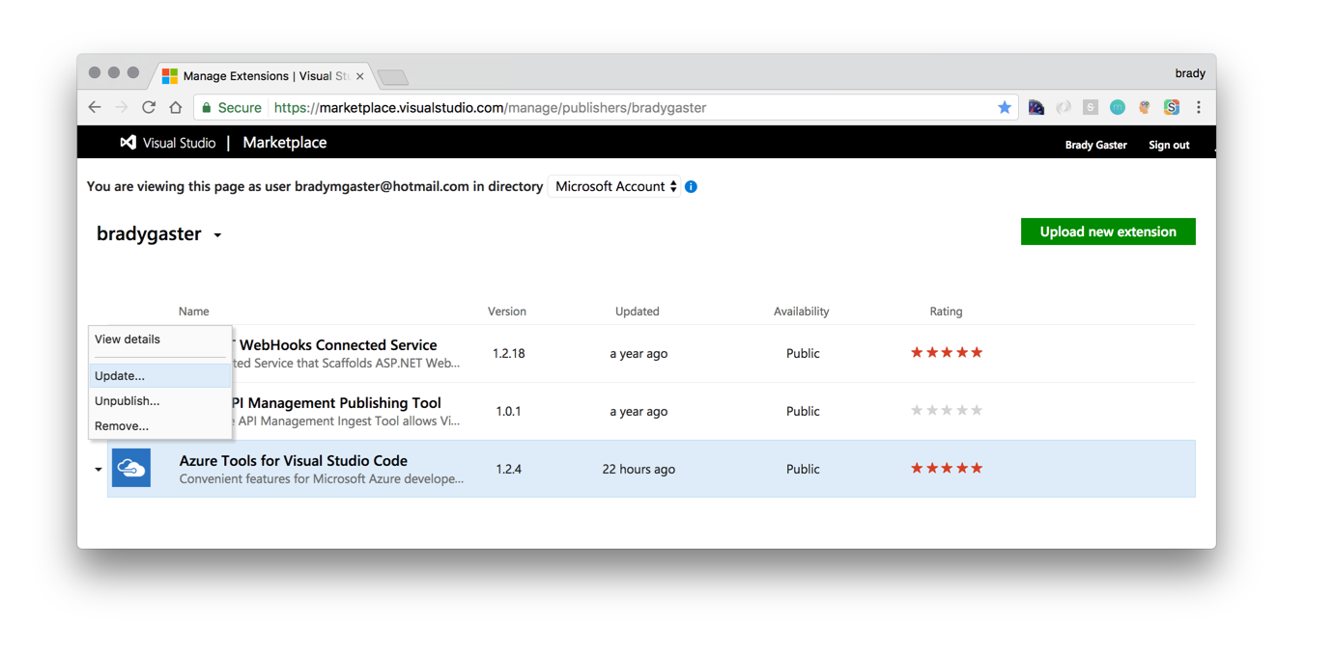
managing your marketplace entries
https://marketplace.visualstudio.com/manage/publishers/{publisher}

Slide 18
design considerations

Slide 19
understand the vs code audience
command-line saavy
embrace extension
most vs code users demonstrate comfort at the command line, so try not to make the user need to use the mouse
if you realize a component of your extension could be used by another extension, break your extension up and take an extension dependency on the componentized part
open-source at heart
data-drive feature decisions
whenever possible try to publicize your extension’s code in a public Git repository and include the repository’s URL in your package.json file
use telemetry wisely to understand how customers are using your feature and frequently review that telemetry to understand where problem areas exist

Slide 20
thanks for attending
If you have a need for an extension, someone else probably needs it too, so go build your idea and add value!
Contact me online
email: bradyg@microsoft.com
twitter: @bradygaster

