Slide 1
Extending Visual Studio Code
Brady Gaster
Senior Program Manager
docs.microsoft.com

Slide 2
Agenda
Prerequisites
Scaffolding extension projects
Snippets
Decorations
Buttons and toolbars
Commands
Publishing
Considerations

Slide 3
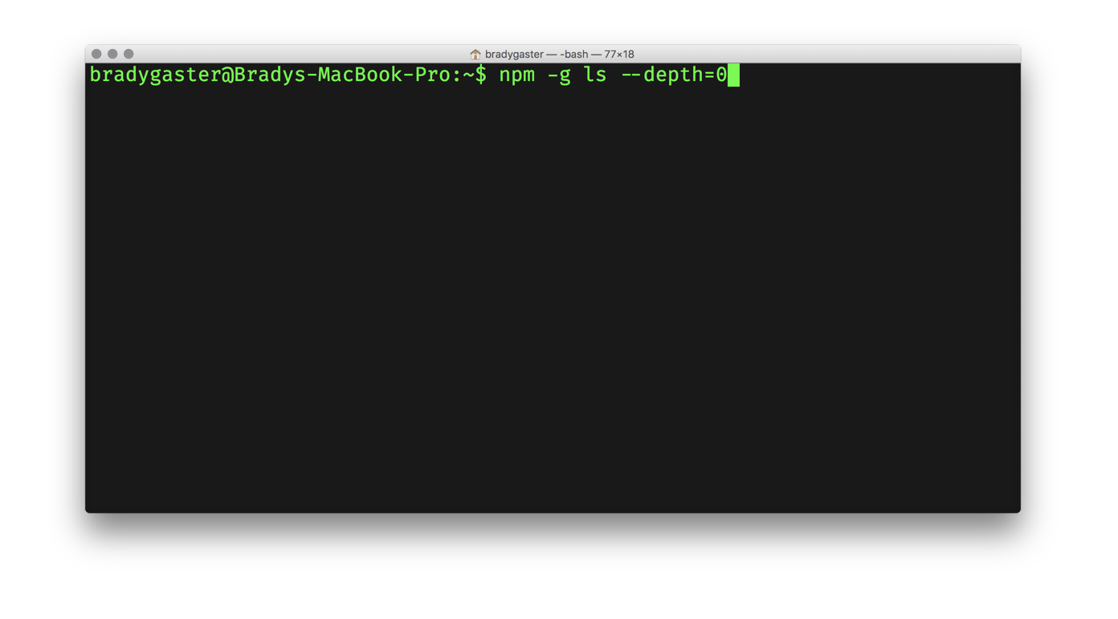
Prerequisites

Slide 4
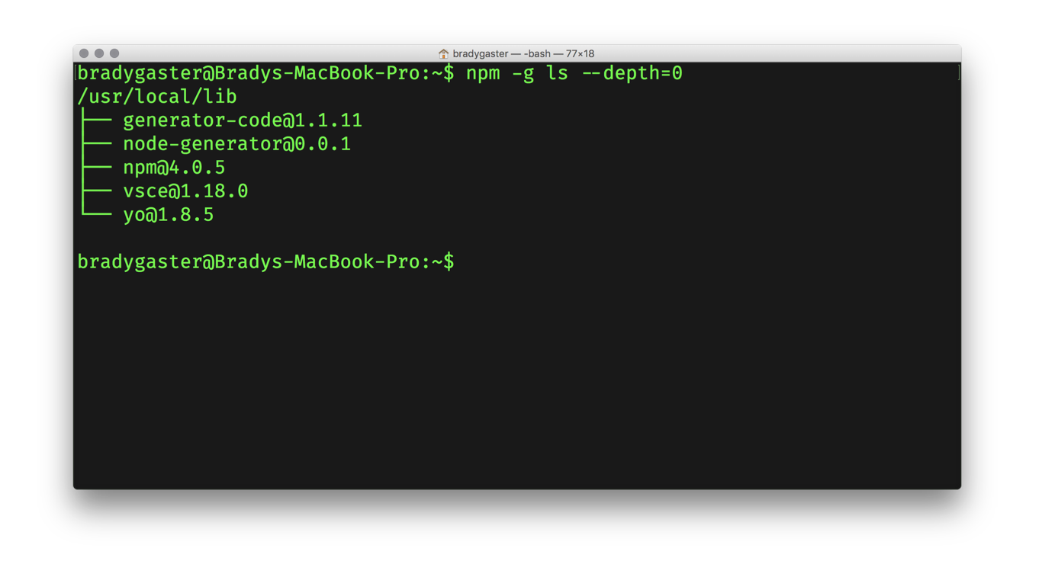
Prerequisites

Slide 5
Prerequisites
1
Yeoman
Project scaffolding tool with a rich open-source library of templates useful for developers
2
3
VS Code Scaffold A Yeoman template containing boilerplate code to get you started with a new extension
2
1
3
VSCE Used to package up VS Code extensions for publication in the marketplace

Slide 6
yo code
Using the yeoman vs code extension generator

Slide 7
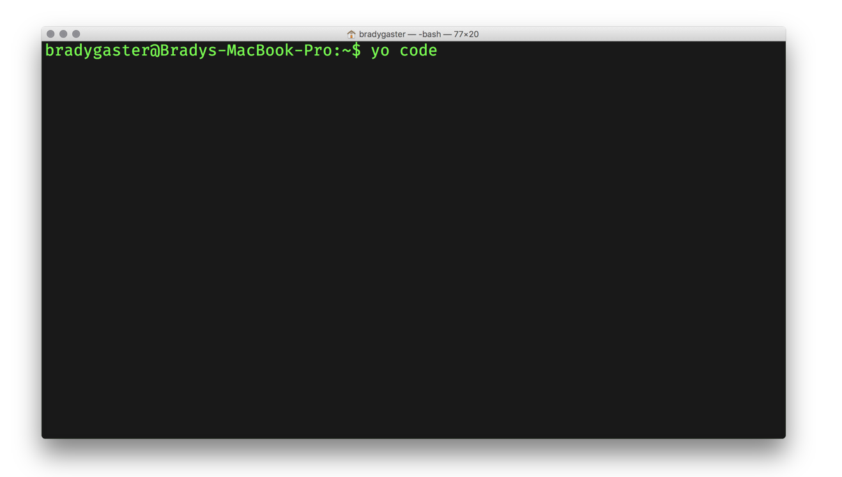

yo code the extension’s skeleton

Slide 8
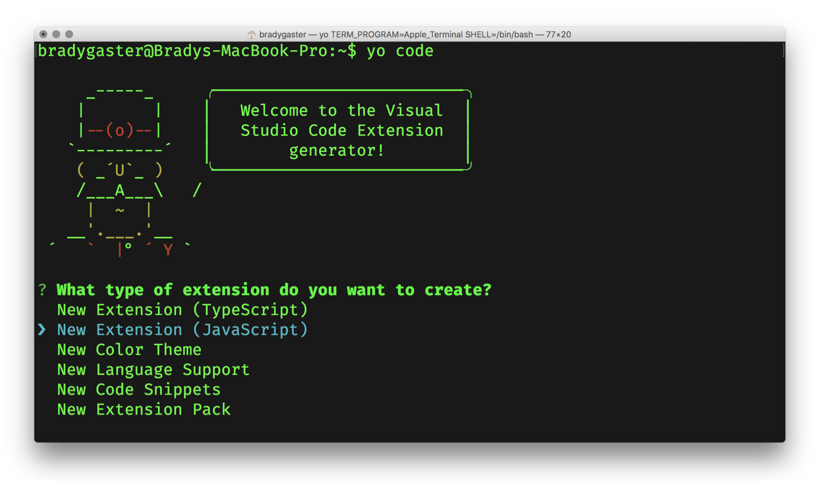
yo code the extension’s skeleton

Slide 9
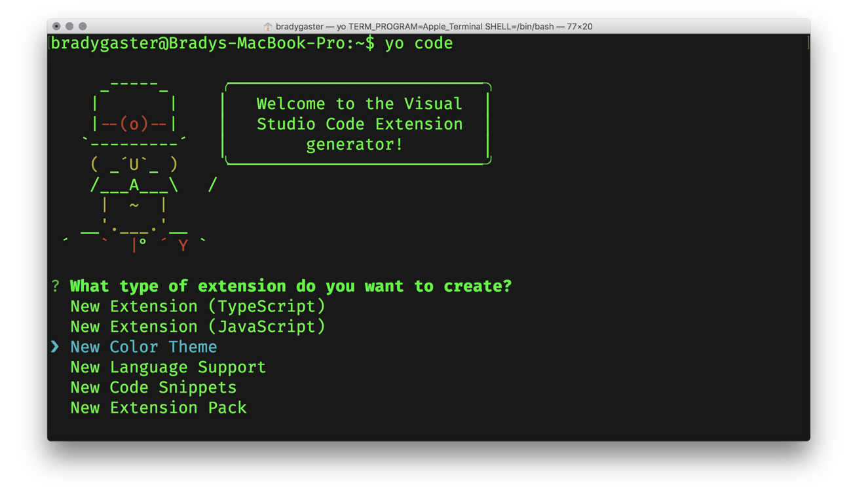
yo code the extension’s skeleton

Slide 10
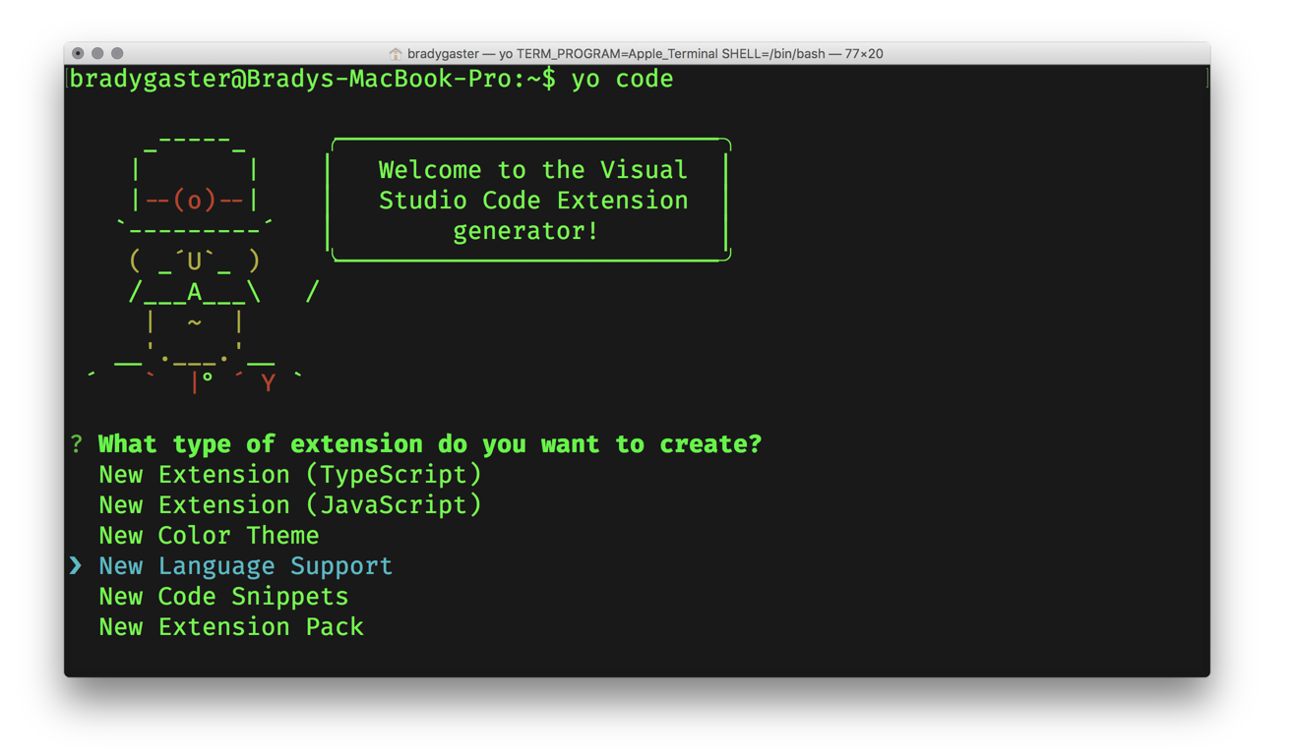
yo code the extension’s skeleton

Slide 11
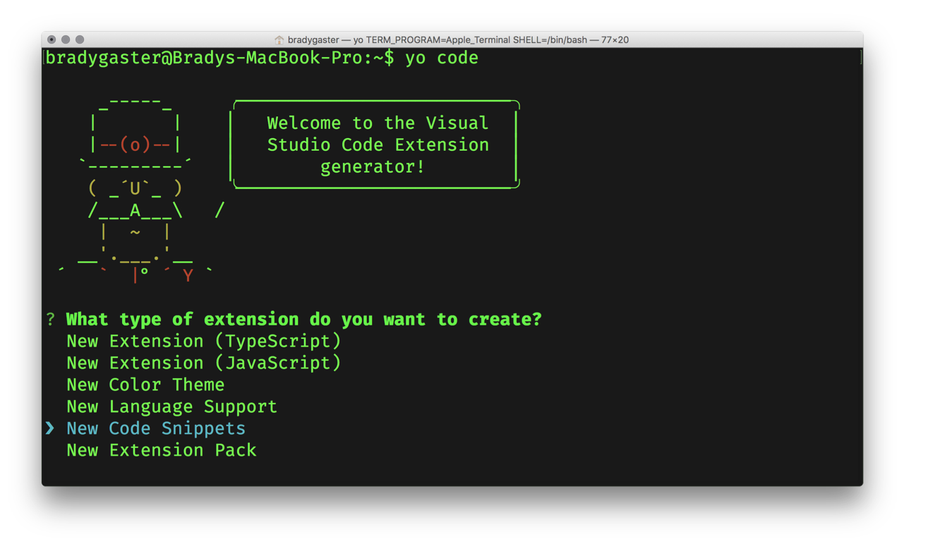
yo code the extension’s skeleton

Slide 12
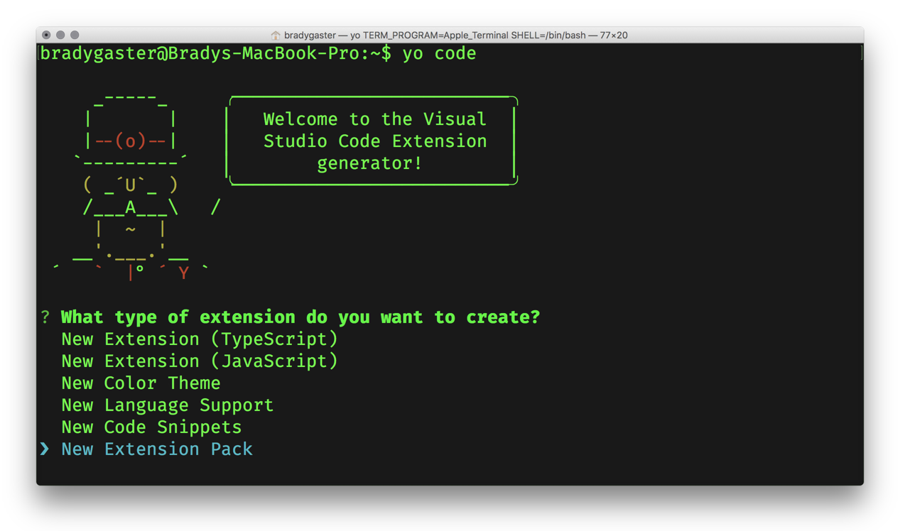
yo code the extension’s skeleton

Slide 13
snippets

Slide 15
decorations

Slide 16
buttons and toolbars

Slide 17
commands

Slide 18
publishing

Slide 19
considerations

