Slide 1
ASP.NET Core RESTful Web APIs with Swagger, Angular2 and Azure App Service
Brady Gaster
Cloud & Enterprise Content Team

Slide 2
Brady Gaster
Works at Microsoft making content and tools that make it easier for developers to party in the cloud
azure evangelist
azure sdk pm
azure app service visual studio tools pm
cloud & enterprise content

Slide 3
Disclaimer
Your time is valuable and your speaker appreciates that you chose to spend it in this session, which will go broad on a few topics rather than go deep on any specific topic

Slide 4
Agenda
Build an RESTful service that’s consumed by an HTML front-end using Angular2 hosted in Azure App Service
technologies
asp.net core
swagger
swashbuckle
angular 2
app service
tools
visual studio 2015
visual studio code
git

Slide 5
more tools and frameworks
“if you give them too many options they’ll screw it up.” – David Fowler

Slide 6
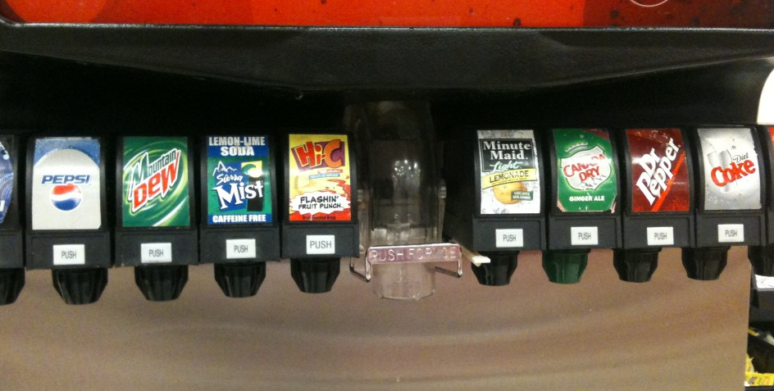
classic soda machine

Slide 7
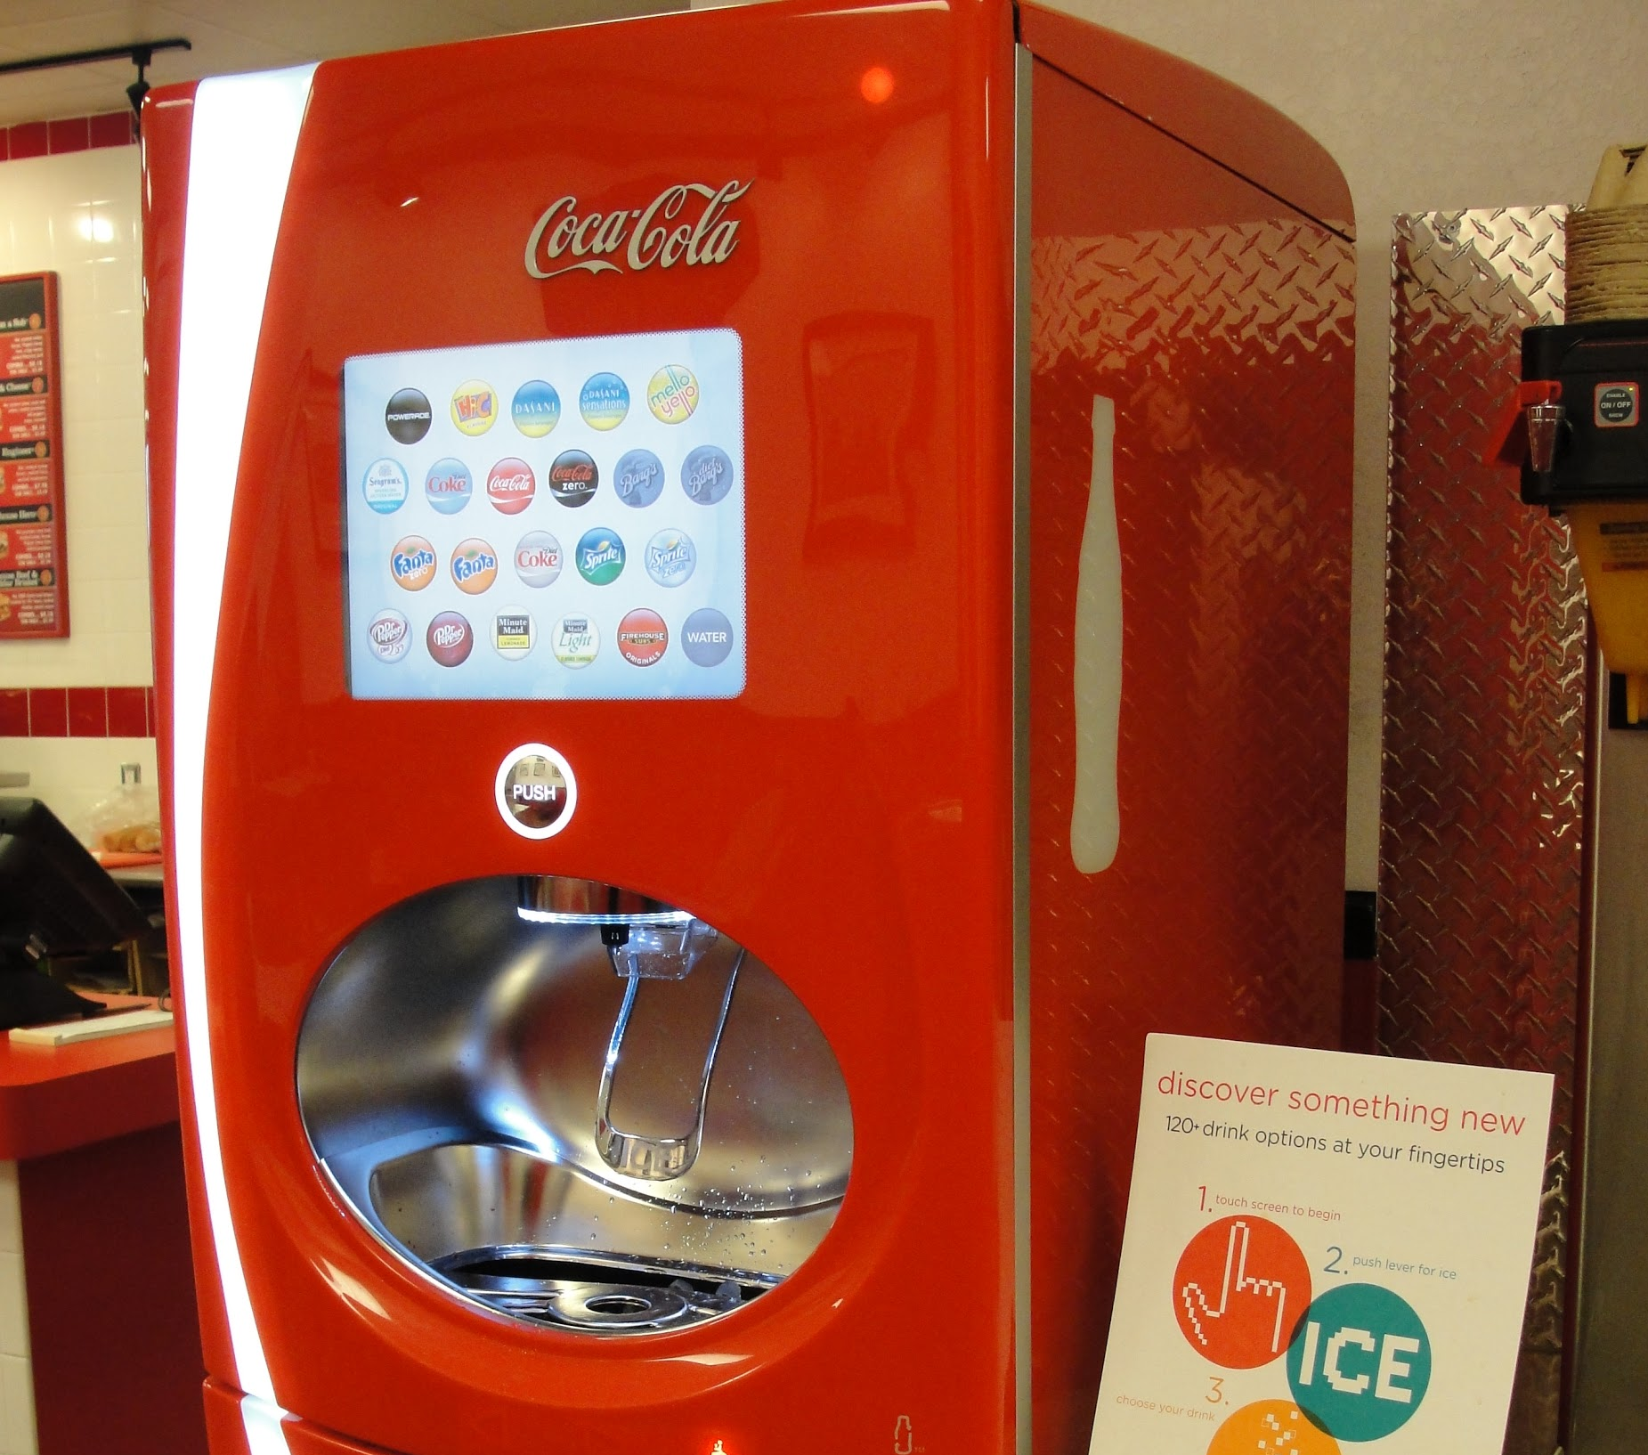
shiny new machine

Slide 8
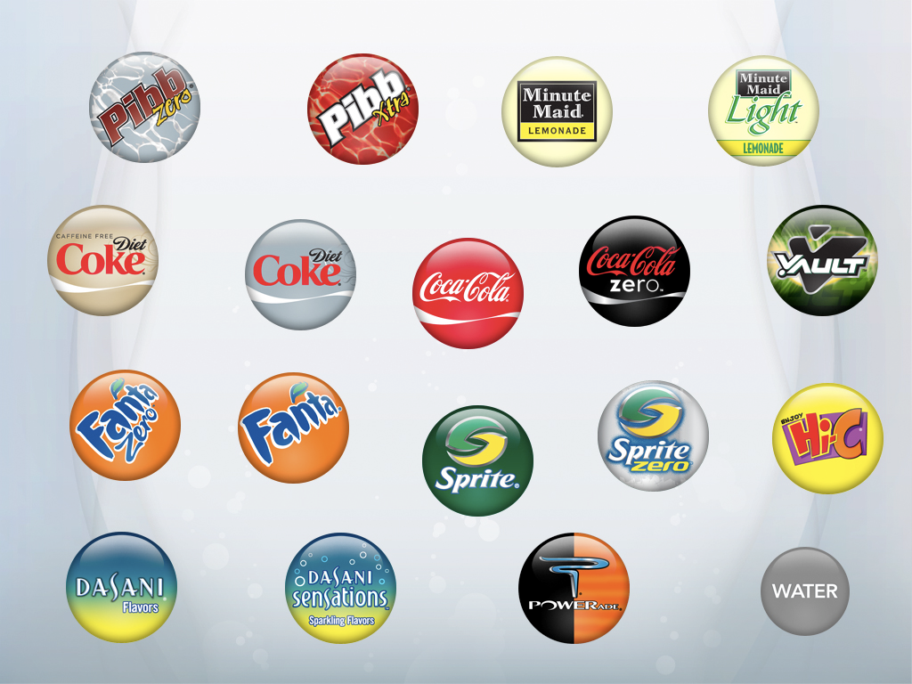
behind every option

Slide 9

is more options

Slide 10


















options
mix them until it tastes right

Slide 11
demo
build a RESTful service using asp.net core web api

Slide 12
What is Swagger?
SOAP
REST
WSDL
Swagger

Slide 13
Swashbuckle
NuGet package that reflects over Web API action methods and emits Swagger dynamically
Web API
Models
Swashbuckle
Annotations
Configuration
Controllers
Swagger
Description
Documentation
Install-Package Swashbuckle -Pre
curl http://localhost:42004/swagger/ui

Slide 14
demo
adding swagger to the api by adding swashbuckle to the project

Slide 15
demo
using swagger annotations for operation id customization

Slide 16
IOC in ASP.NET Core
Service Lifetimes
Transient Each call to the service results in a new instance
Scoped New service instance created once per HTTP request
Singleton The service lives for the lifetime of the application
The IOC layer is built right into ASP.NET core, so you can use what’s provided or you can bootstrap your favorite IOC (Unity, Ninject, etc.)

Slide 17
demo
wiring up the data service for the api

Slide 18
App Service
Publishing One-click publishing within Visual Studio
Git Integration Not using VS? You can publish using Git
Metadata Support Swagger support is first-class
Azure App Service provides a hosting mechanism for Web, Mobile, and API apps that supports a multitude of development frameworks

Slide 19
demo
publishing the api to azure

Slide 20
demo
generating client using visual studio and autorest

Slide 21
demo
setting the api definition using the azure portal

Slide 22
Angular2
Getting Started
Data-binding
Calling the HTTP API
Building an HTML client using the latest JavaScript framework

Slide 23
Getting Started
File | Purpose
package.json | NPM packages used by the app, and scripts frequently executed during development
tsconfig.json | TypeScript compiler configuration
typings.json | Identifies the TypeScript definition files
systemjs.config.js | Configures the SystemJS runtime

Slide 24
demo
scaffolding a new Angular 2 app

Slide 25
Components
ASP.NET MVC
Controllers
Angular2
Components

Slide 26
Components & Views
Angular2 Component
Injecting into an HTML View
import { Component } from '@angular/core';
@Component({
selector: 'my-app',
template: '<h1>Hello World!</h1>'
})
export class AppComponent { }
<body>
<my-app>Loading...</my-app>
</body>

Slide 27
Components & Views
Angular2 Component
Injecting into an HTML View
import { Component } from '@angular/core';
@Component({
selector: 'my-app',
template: '<h1>Hello World!</h1>'
})
export class AppComponent { }
<body>
<my-app>Loading...</my-app>
</body>

Slide 28
Components & Views
Angular2 Component
Injecting into an HTML View
import { Component } from '@angular/core';
@Component({
selector: 'my-app',
template: '<h1>Hello World!</h1>'
})
export class AppComponent { }
<body>
<my-app>
<h1>Hello World!</h1>
</my-app>
</body>

Slide 29
demo
creating our first component

Slide 30
TypeScript Models
Instrument
Song
export class Instrument {
name: string;
device: string;
preset: string;
}
import { Instrument } from './instrument';
export class Song {
name: string;
bpm: number;
instruments: Instrument[]
}

Slide 31
demo
adding models to represent the app’s ontology

Slide 32
Services
import { Injectable } from '@angular/core';
import { Http } from '@angular/http';
import 'rxjs/add/operator/map';
@Injectable()
export class SongListService {
constructor(private http: Http){
}
}

Slide 33
Services
import { Injectable } from '@angular/core';
import { Http } from '@angular/http';
import 'rxjs/add/operator/map';
@Injectable()
export class SongListService {
constructor(private http: Http){
}
}

Slide 34
demo
adding a service to retrieve the data from the api

Slide 35
demo
setting the appropriate CORS settings for your api using the azure portal

