Slide 1


Slide 2
WHAT IS SP90X?

Slide 3


Not an exercise program
Not affiliated with Beachbody’s products
Power 90
A 90 day exercise and diet program that includes cardio and weight training
P90X (Power 90 Extreme)
An intense 90 day exercise and diet program
“Muscle confusion”

Slide 4

Muscle Confusion
Most of the success of P90X comes from the concept of muscle confusion
Variety of exercises and scheduling of exercises
Routines work different muscle groups than the ones before
Never plateau

Slide 5
Intense Spiritual Training
SP90X = Scripture Power 90 Extreme
Intense 90 day program of gospel study and application
Diet = Intense daily scripture study
Exercise = Daily and monthly actions to apply what you are learning

Slide 6
Spiritual Muscle Confusion?
We need to read the scriptures every day
We should also be studying:
The words of living prophets
Topical study / Preach My Gospel
Scripture mastery
Duty to God / Personal Progress
Etc.
This programs schedules doing different study activities each day so that you can do it all, but not get burned out on any single activity

Slide 7
SUCCEEDING IN THE PROGRAM

Slide 8
Do Your Best
The program that is outlined in the following slides is an intense one.
The study portion of the program should take approximately one hour each day.
Those who keep up with the schedule will be blessed for their efforts and dedication.
However, you can always modify

Slide 9
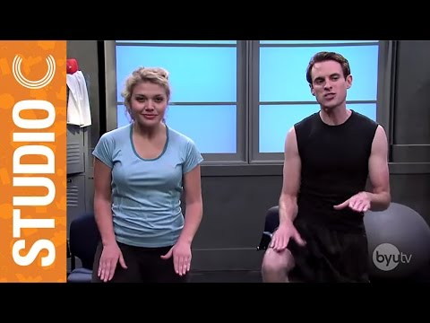
Modify, Modify, Modify

Slide 10
Consistency is key
Consistency is the most important part of following any long term program
Do the best that you can and keep moving forward
If you miss some study, you can either start where you left off, just keep following the schedule for the day, or make it up later

Slide 11
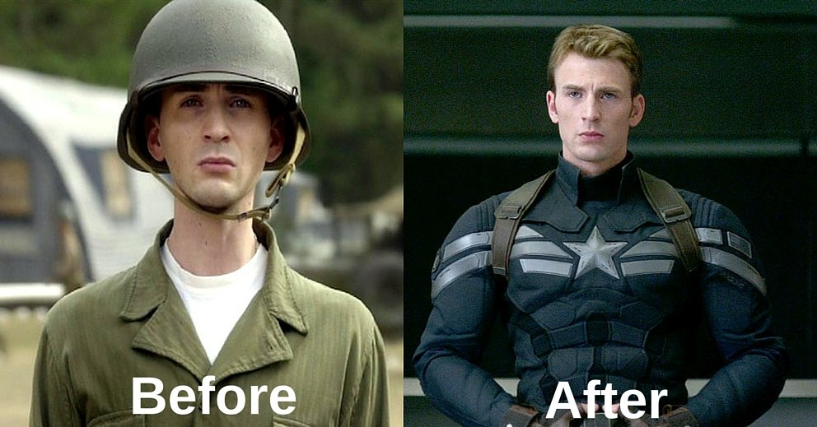
Consistency Yields Results
Consistent exercise can change you like this:
Imagine what consistent study and action do to your spirit

Slide 12
The Program
Where the rubber meets the road!

Slide 13
STUDY

Slide 14
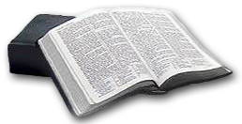
Study
Daily scripture study is an essential part of spirituality
Studying the word of God keeps our minds pointed towards Him and gives us perspective throughout our day
For those of us preparing to go on missions or doing any other type of teaching, study is also a prerequisite

Slide 15
Study
“Seek not to declare my word, but first seek to obtain my word, and then shall your tongue be loosed; then, if you desire, you shall have my Spirit and my word, yea, the power of God unto the convincing of men.” (D&C 11:21)

Slide 16

Book of Mormon
“My beloved brothers and sisters, the Book of Mormon is the keystone of our religion—the keystone of our testimony, the keystone of our doctrine, and the keystone in the witness of our Lord and Savior.”
“The second great reason why we must make the Book of Mormon a center focus of study is that it was written for our day.”
Ezra Taft Benson – October 1986

Slide 17
Book of Mormon
We’ve been encouraged by many of the prophets to read the Book of Mormon daily
In this 90 day program, you will read the entire Book of Mormon if you follow the schedule
Most days have an assignment of 2-3 chapters

Slide 18
Topical Study
Studying a gospel principle by topic gives us a deeper understanding of doctrine
Helps us to become better teachers and missionaries

Slide 19
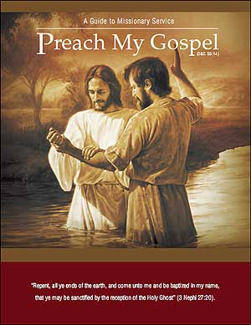
Topical Study
Preach My Gospel is a wonderful resource for topical study of the gospel and to prepare to become a missionary
Study a chapter in Preach My Gospel each week. Study enough each day so you will finish the chapter by the end of the week.
Alternatives include Gospel Principles (one chapter a week)

Slide 20
General Conference
Doctrine of conference
General Conference is scripture and counsel for our day
We should study and understand the words of our modern day prophets
Study one conference talk each assigned day (twice a week)

Slide 21

Church Magazines
Church magazines also contain the words of modern prophets
They also contain church news and other inspiring stories
Read one article in a recent issue of your age-appropriate magazine each day assigned (twice a week)

Slide 22
Scripture Mastery
Memorizing scriptures helps us to better understand the doctrine they teach
Required for seminary
Useful in missionary work and other teaching
Memorize the specified Book of Mormon scripture mastery scripture each day assigned (two a week)
If you need more than one day to memorize the scripture, spend a little bit of time on it each day and extra time on the scheduled day.
At least memorize the reference and key concept
Alternatively, use the scripture mastery sets from other books of scripture

Slide 23

Duty to God Personal Progress
Duty to God and Personal Progress are the Church’s programs to help us apply the gospel to our lives
Spend at least 30 minutes each Sunday working on these programs
Online tracking
dutytogod.lds.org
personalprogress.lds.org

Slide 24
ACTION

Slide 25
Action
The Gospel of Jesus Christ is not just studying; it’s a program of action
“Therefore whosoever heareth these sayings of mine, and doeth them, I will liken him unto a wise man, which built his house upon a rock” (Matthew 7:24)
We need to put into action what we learn with regular daily and monthly activities to apply what we learn and become who Heavenly Father wants us to become

Slide 26
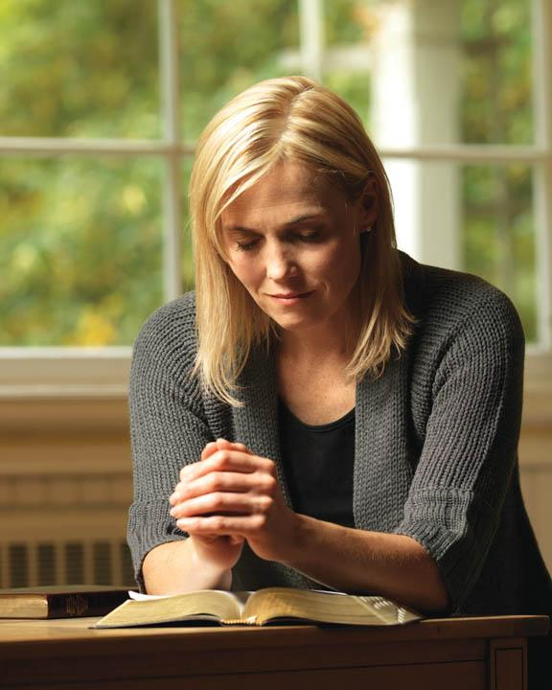
Daily Prayer
Have a meaningful conversation with your Heavenly Father at least morning and night.
Counsel with the Lord in all thy doings, and he will direct thee for good; yea, when thou liest down at night lie down unto the Lord, that he may watch over you in your sleep; and when thou risest in the morning let thy heart be full of thanks unto God; and if ye do these things, ye shall be lifted up at the last day. (Alma 37:37)

Slide 27

Pondering
Find some time each day to quietly ponder the gospel and your life
“Behold, I would exhort you that when ye shall read these things, if it be wisdom in God that ye should read them, that ye would remember how merciful the Lord hath been unto the children of men, from the creation of Adam even down until the time that ye shall receive these things, and ponder it in your hearts.” (Moroni 10:3, emphasis added)

Slide 28
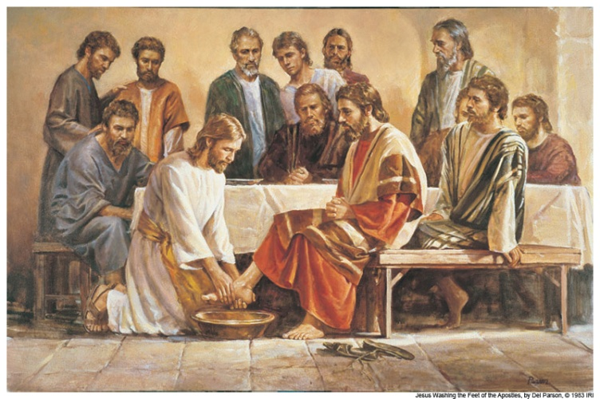
Service
Search for ways to serve those around you and perform at least one act of service a day
It doesn't have to be a big thing, just service
Don't forget your family members, as well.
“And behold, I tell you these things that ye may learn wisdom; that ye may learn that when ye are in the service of your fellow beings ye are only in the service of your God.” (Mosiah 2:17)

Slide 29

Journal Writing
Record your progress and how the Lord has blessed your life each day
Elder Eyring in his October 2007 General Conference address shared some of the blessings he received from journal writing

Slide 30
Journal Writing
“I wrote down a few lines every day for years. I never missed a day no matter how tired I was or how early I would have to start the next day. Before I would write, I would ponder this question: “Have I seen the hand of God reaching out to touch us or our children or our family today?” As I kept at it, something began to happen. As I would cast my mind over the day, I would see evidence of what God had done for one of us that I had not recognized in the busy moments of the day. As that happened, and it happened often, I realized that trying to remember had allowed God to show me what He had done.” (Henry B. Eyring, October 2007)

Slide 31

Monthly Actions
Fasting
Fast for two meals at least each month on Fast Sunday with a purpose.
Temple Attendance
If you hold a temple recommend, attend the temple at least once a month.
Home/Visiting Teaching
If you are a home or visiting teacher, have at least one meaningful visit each month with each of your assigned families or sisters.

Slide 32

Fit Test
The first step to improving performance is measuring performance (Six Sigma)
Take the "Christlike Attributes" questionnaire found in Preach My Gospel on page 126 on days 1, 30, 60 and 90 to track your spiritual progress.
Extremely important part of the program

Slide 33
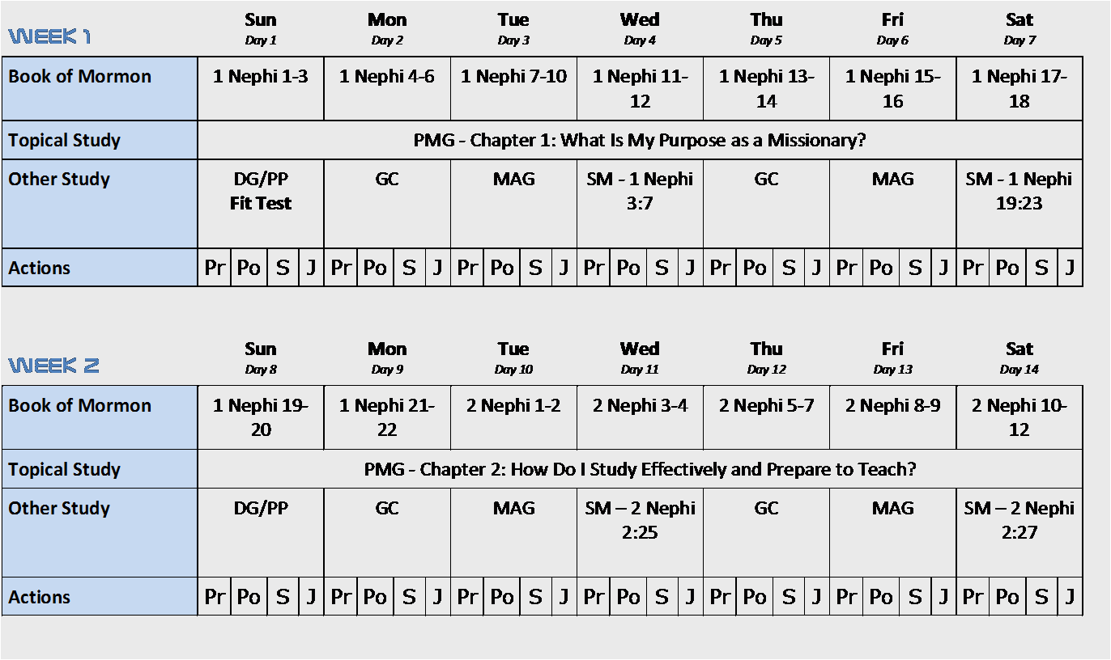
Example Schedule

Slide 34
TRACKING WEBSITE

Slide 35
Tracking Website
You can always use paper or your own tracking mechanism to keep track of your progress through the program
However, there is also an online tracking system to help you at SP90X.net
Create an account and start tracking
If you’re doing the program with a group, make sure you attach your program to your group

Slide 36
Tracking Website
All information is confidential
Links to online church resources
Scriptures
Preach My Gospel
Duty to God / Personal Progress
General Conference
Church Magazines
Online fit test
Statistics and reports to show progress

Slide 37
IN CONCLUSION

Slide 38
Motivation
Bring It!
Keep Pushing Play!
Do Your Best and Forget the Rest!

