Slide 1
The Influence of Human Factors on the Spread of COVID-19
NASA Space Apps COVID-19 Challenge:
Human Factors
May 30^{th–}31st, 2020
By: Carolyn Guse and Brady Lange
GitHub Repository: https://github.com/bradylange/covid-19-human-factors/tree/feature-analysis/brady-lange

Slide 2
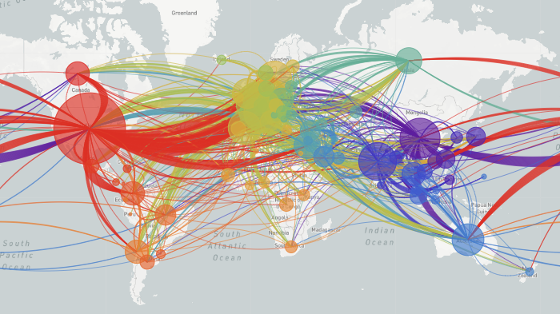
The Challenge
With the emergence and spread of an infectious disease like COVID-19, can a pattern between factors such as population density and movement predict hotspot of disease spread?
Figure 1: https://nextstrain.org/ncov/global

Slide 3
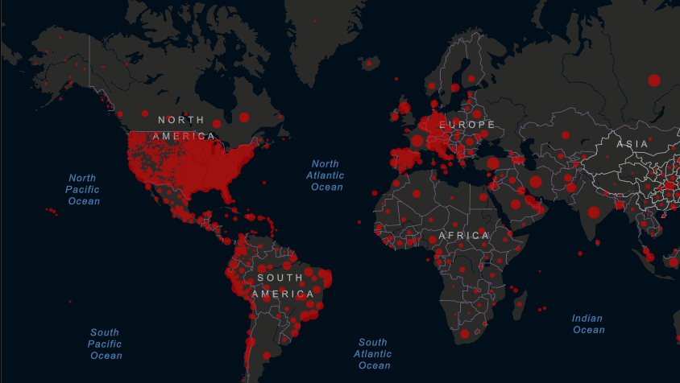
Goal
Our goal is to find how human movement affects the number of cases on a global scale.
Figure 2: https://coronavirus.jhu.edu/map.html

Slide 4
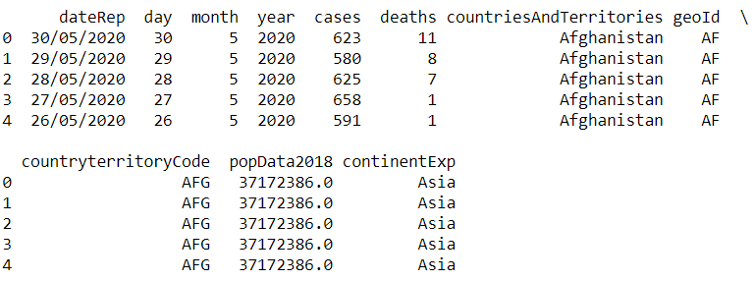
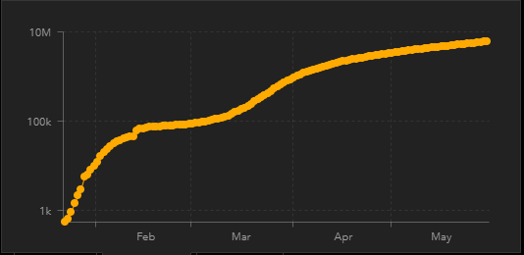
Data
 | country_region_code | country_region | sub_region_1 | sub_region_2 | date | retail_and_recreation_percent_change_from_baseline | grocery_and_pharmacy_percent_change_from_baseline | parks_percent_change_from_baseline | transit_stations_percent_change_from_baseline | workplaces_percent_change_from_baseline | residential_percent_change_from_baseline
0 | AE | United Arab Emirates | NaN | NaN | 2020-02-15 | 0.0 | 4.0 | 5.0 | 0.0 | 2.0 | 1.0
1 | AE | United Arab Emirates | NaN | NaN | 2020-02-16 | 1.0 | 4.0 | 4.0 | 1.0 | 2.0 | 1.0
2 | AE | United Arab Emirates | NaN | NaN | 2020-02-17 | -1.0 | 1.0 | 5.0 | 1.0 | 2.0 | 1.0
3 | AE | United Arab Emirates | NaN | NaN | 2020-02-18 | -2.0 | 1.0 | 5.0 | 0.0 | 2.0 | 1.0
4 | AE | United Arab Emirates | NaN | NaN | 2020-02-19 | -2.0 | 0.0 | 4.0 | -1.0 | 2.0 | 1.0
COVID-19 Community Mobility Report-Google
https://www.google.com/covid19/mobility/
COVID-19 Confirmed Cases Time Series-Europa
https://data.europa.eu/euodp/en/data/dataset/covid-19-coronavirus-data/resource/260bbbde-2316-40eb-aec3-7cd7bfc2f590#
Figure 3: COVID-19 mobility from Google.
https://coronavirus.jhu.edu/map.html
Total Cases
Figure 4: COVID-19 confirmed cases from Europa.
Date
Figure 5: COVID-19 global cases by date.

Slide 5
Preprocessing
Global mobility and COVID-19 cases datasets were inner joined by ID and date
A preprocessing pipeline was created to efficiently and consistently clean new data that has been added
Numeric data pipeline:
Select numeric features from data frame
Impute missing numeric values with the features average value
Standard scale the numeric values
Categoric data pipeline:
Select categorical features from the data frame
Target data pipeline:
Select target feature from the data frame
Averaged the mobility features, COVID-19 cases, and COVID-19 deaths for each unique date
Countries feature dropped

Slide 6
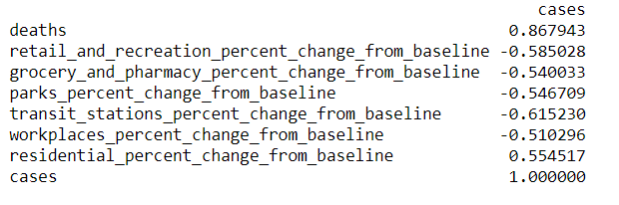
Data Analysis
Target variable:
COVID-19 cases
Feature variables:
COVID-19 deaths
Average retail and recreation percent change from baseline
Average grocery and pharmacy percent change from baseline
Average parks percent change from baseline
Average transit stations percent change from baseline
Average workplaces percent change from baseline
Average residential percent change from baseline
Correlation matrix showed good correlation with cases target and deaths feature, but poor correlation with mobility features
Heteroskedasticity between mobility features (highly correlated)
Models will be unreliable and could be why they’re not very correlated with the cases target
Need more human factor data features (which has proven to be difficult to find given the recent dates we have)
Linear transformations on cases target and mobility features improved correlation (using logarithm and square root)
Received good loss of around 10% with Gradient Boosting Regression (not reliable with the heteroskedasticity)
Figure 6: Correlation matrix.

Slide 7
Conclusion
The human factor mobility alone isn’t extremely significant to COVID-19 cases
Need more varying human factors features to eliminate heteroskedasticity
Potential future modeling (with more human factors features):
Time series analysis
Machine Learning algorithms to predict COVID-19 cases based upon human factors features

