Slide 1

Team : U-11
Luke Schiefelbein
Brady Lange
Branon Page
Carolyn Guse
Eric Byerly

Slide 2
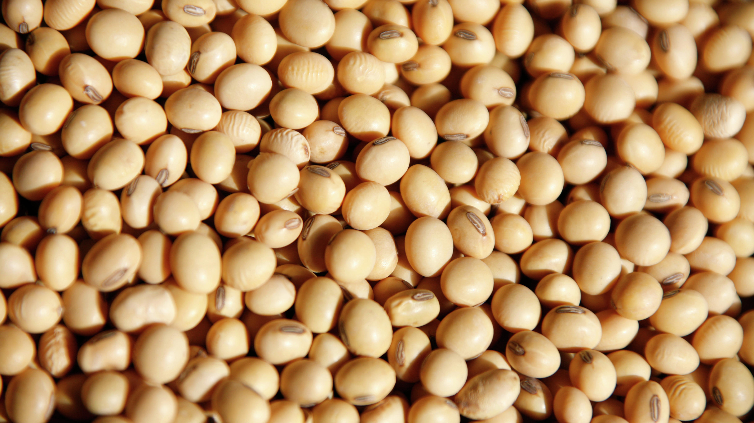
What is a bushel?

Slide 3
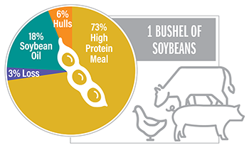

Slide 4
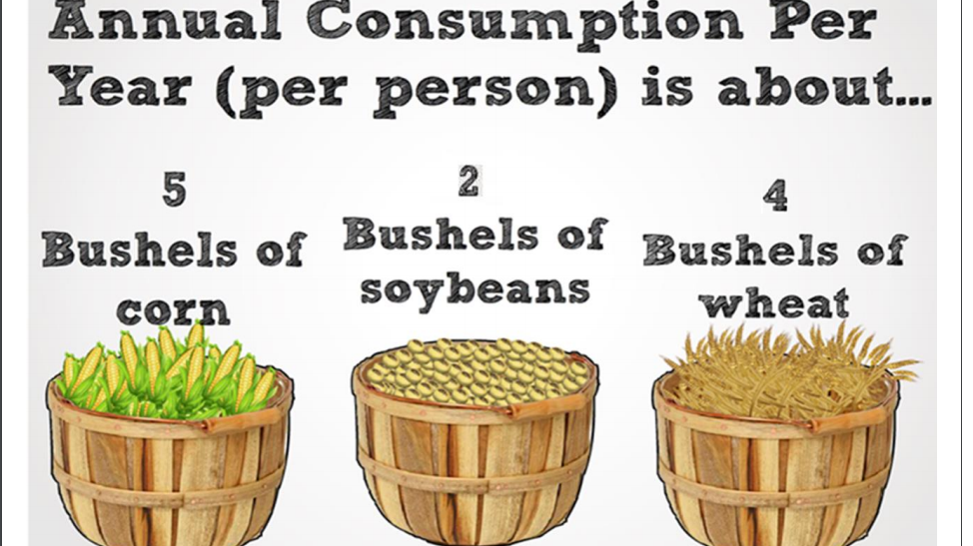

Slide 5

Terminology:
ZS= Soybean (raw)
ZL= Soybean Oil
(processed)
ZM= Soybean Meal (processed)

Slide 6

Purpose?

Slide 7
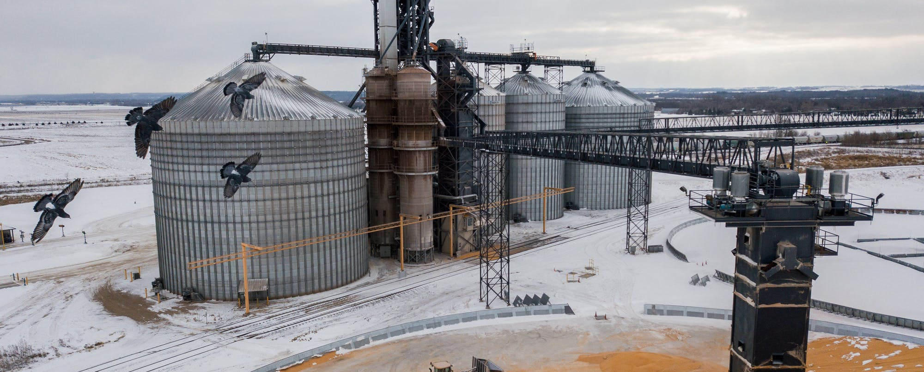
Methodology

Slide 8
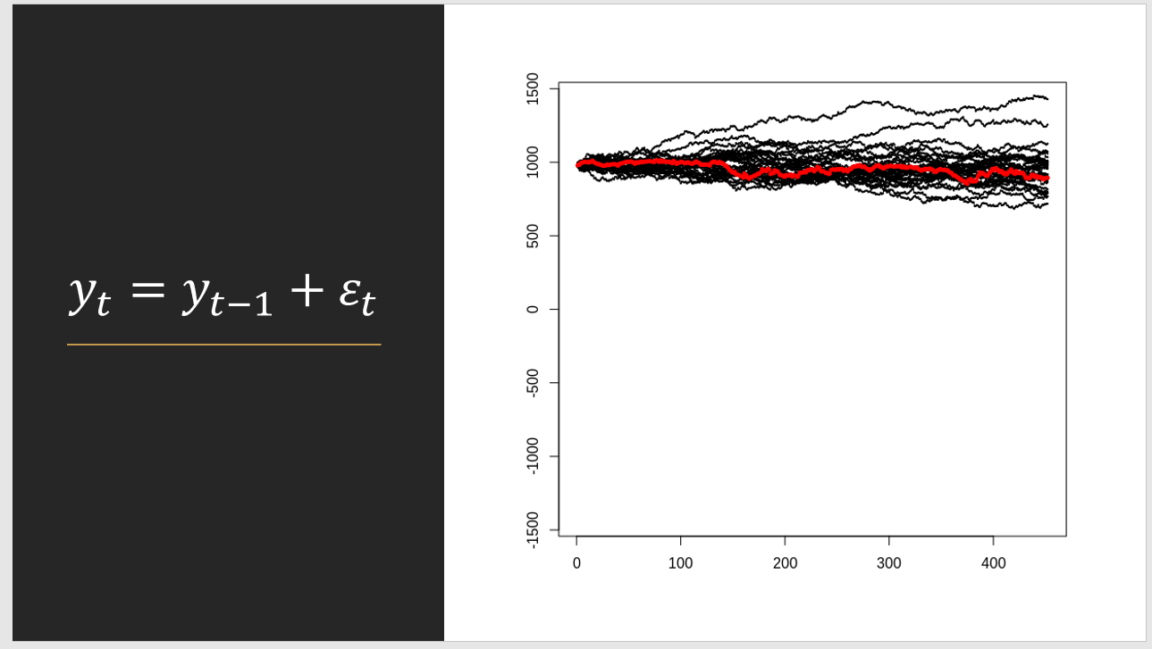
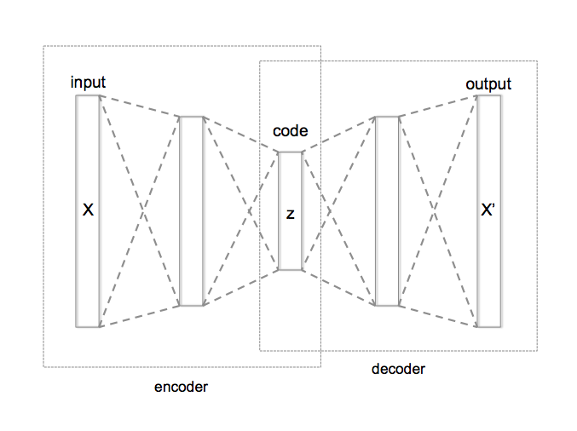
Autoencoder: Dimensionality Reduction

Slide 9
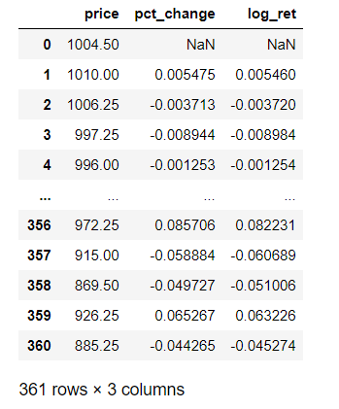
Autoencoder Preprocessing

Slide 10
Autoencoder Models
Simple Autoencoder
Deep Autoencoder
1D Convolutional Autoencoder
LSTM Autoencoder
*Synthetic Data & Simple Autoencoder
**Synthetic Data & Deep Autoencoder

Slide 11
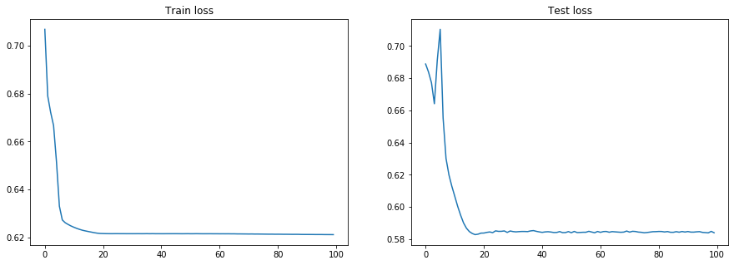
Synthetic Data & Deep Autoencoder

Slide 12

Key tests used
Augmented Dickey-Fuller Tests
Shapiro-Wilk Tests for Data Normality
Studentized Breusch-Pagan Tests for constant variance
Variance Inflation Factors

Slide 13
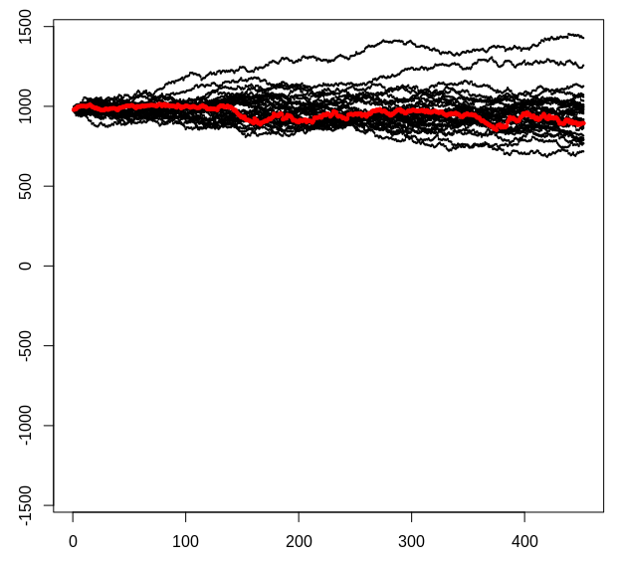


$$y_{t}=y_{t−1}+ε_{t}$$
$$Random Walk$$

Slide 14
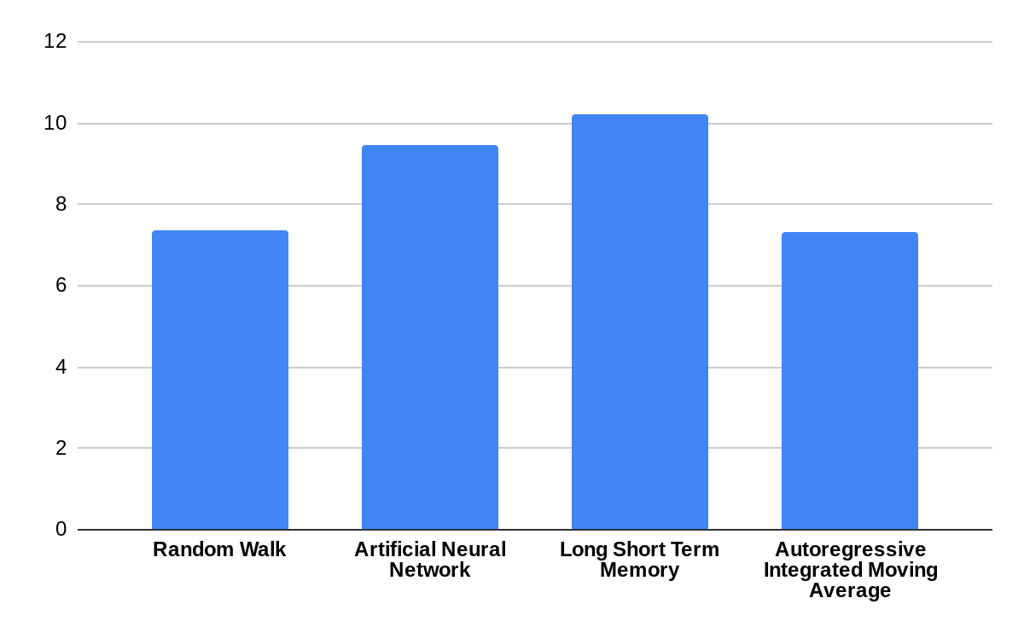
Comparison of Models
Root Mean Squared Error

Slide 15
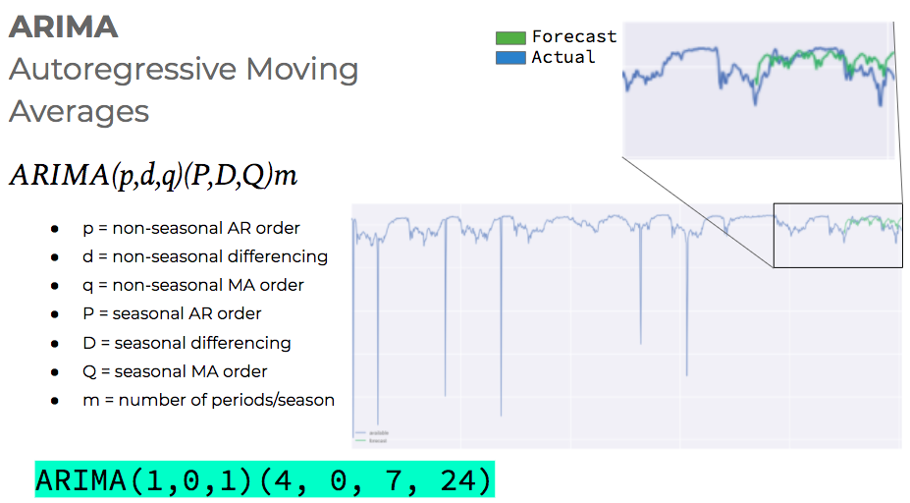

Slide 16
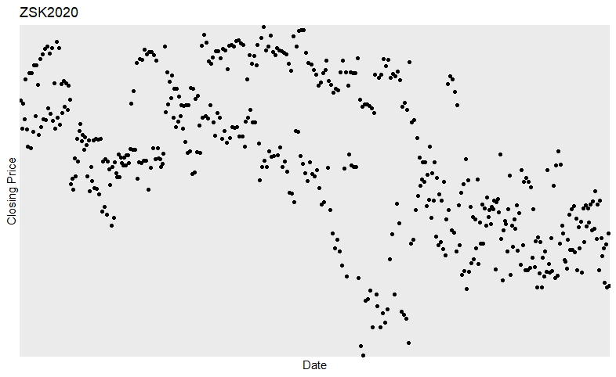
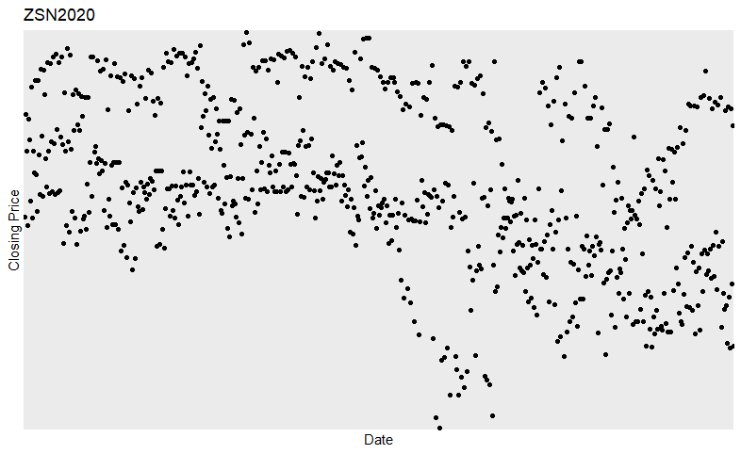
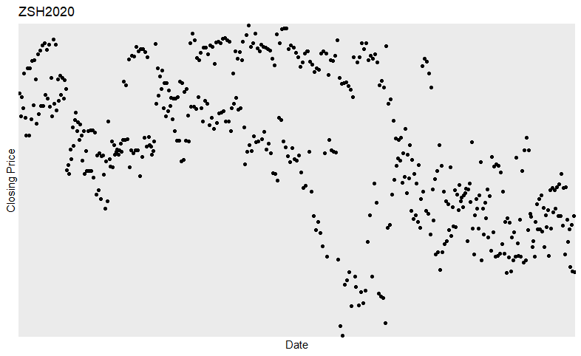

Slide 17
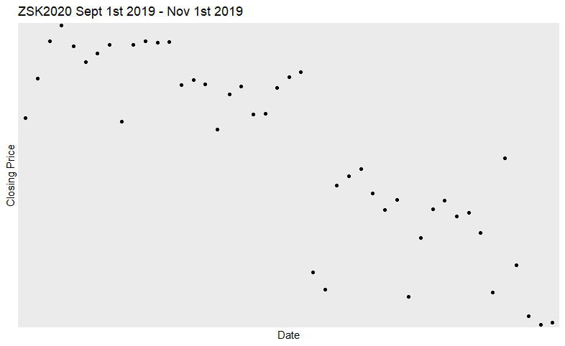

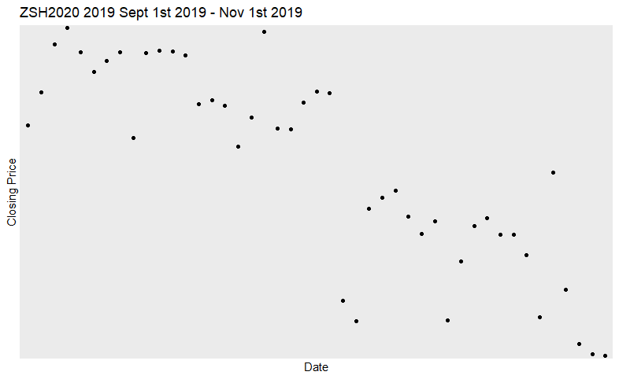
Data source:
https://www.barchart.com/futures/quotes/ZS*0/futures-prices

Slide 18
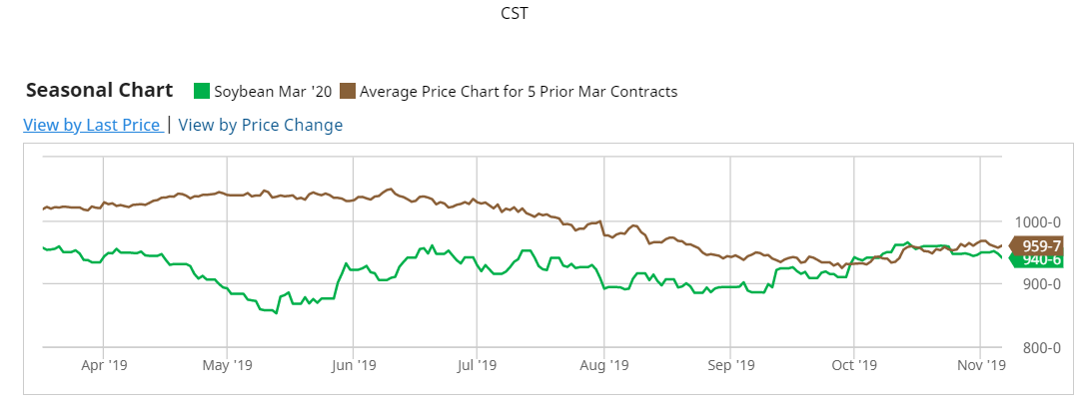
https://www.barchart.com/futures/quotes/ZSH20/overview

Slide 19
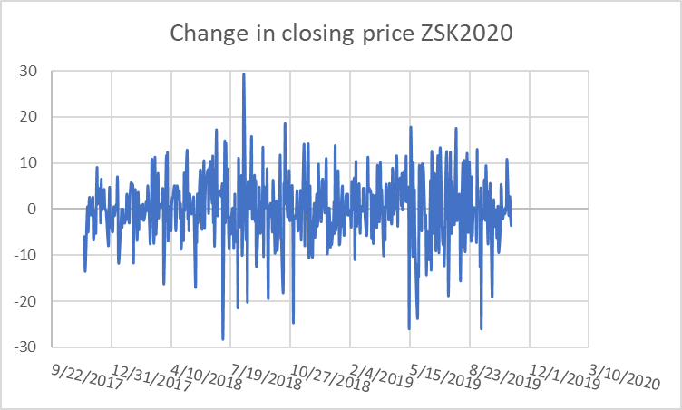
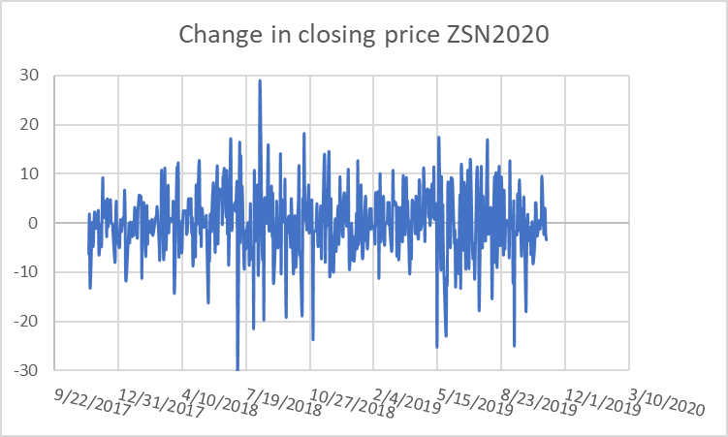
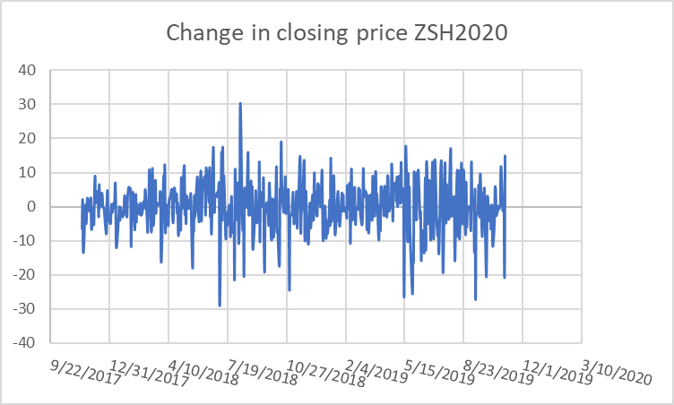
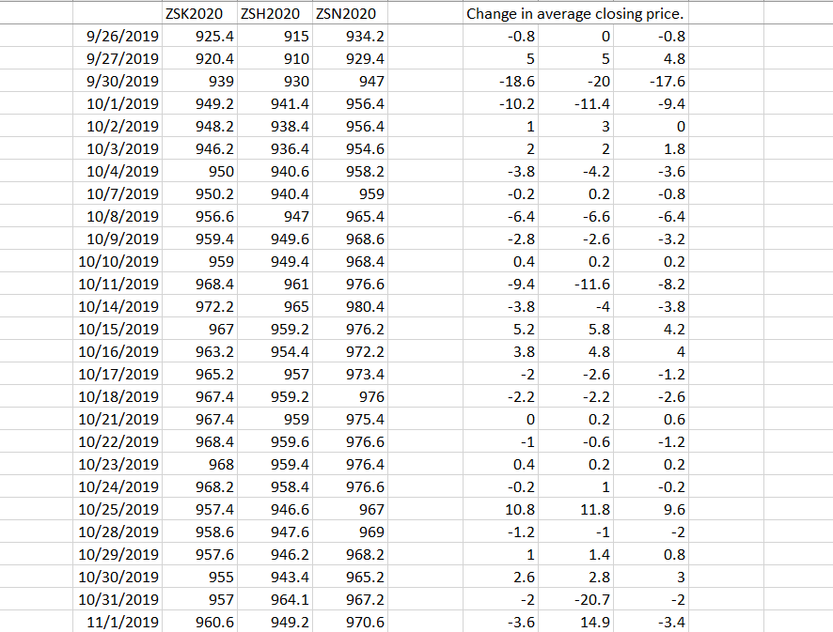

Slide 20
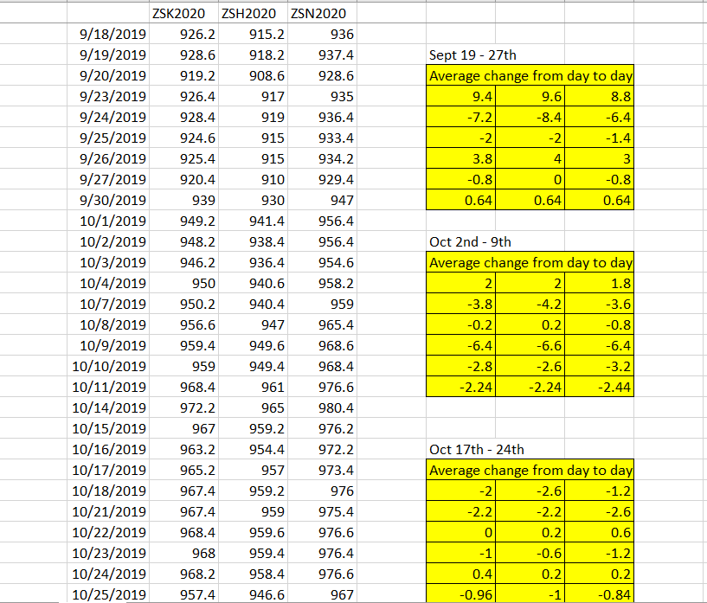

Slide 21
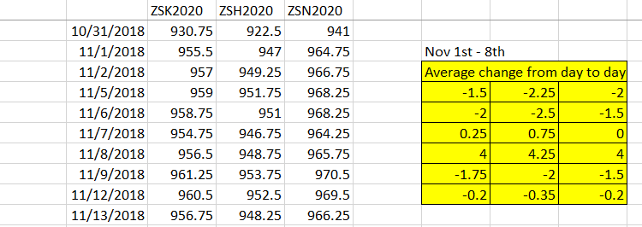

Slide 22
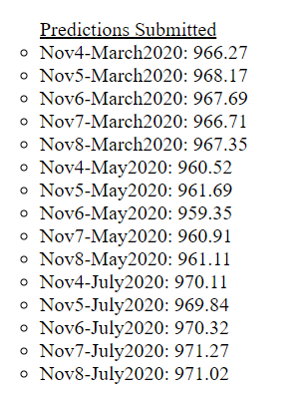


Slide 23
Questions?
Luke Schiefelbein
Brady Lange
Branon Page
Carolyn Guse
Eric Byerly

Slide 24
Appendix

Slide 25
Test for Stationarity on the March Closing Prices
(It fails and is non-stationary)
Augmented Dickey-Fuller Test
alternative: stationary
Type 1: no drift no trend
lag ADF p.value
[1,] 0 -0.610 0.461
[2,] 1 -0.689 0.432
[3,] 2 -0.649 0.447
[4,] 3 -0.754 0.409
[5,] 4 -0.779 0.400
[6,] 5 -0.794 0.395
Type 2: with drift no trend
lag ADF p.value
[1,] 0 -1.85 0.388
[2,] 1 -1.71 0.443
[3,] 2 -1.85 0.387
[4,] 3 -1.85 0.386
[5,] 4 -1.87 0.380
[6,] 5 -1.77 0.419
Type 3: with drift and trend
lag ADF p.value
[1,] 0 -2.91 0.194
[2,] 1 -2.68 0.289
[3,] 2 -2.87 0.208
[4,] 3 -2.76 0.256
[5,] 4 -2.75 0.259
[6,] 5 -2.65 0.302
----
Note: in fact, p.value = 0.01 means p.value <= 0.01

Slide 26
Call:
lm(formula = close ~ close_lag + close_prev_year + year + month +
day)
Residuals:
Min 1Q Median 3Q Max
-19.6717 -5.5500 0.5108 5.0508 22.0855
Coefficients: (1 not defined because of singularities)
Estimate Std. Error t value Pr(>|t|)
(Intercept) 126.97861 60.65280 2.094 0.0383 *
close_lag 0.92684 0.03499 26.490 <2e-16 ***
close_prev_year -0.05260 0.03409 -1.543 0.1253
year NA NA NA NA
month -1.43695 0.73303 -1.960 0.0521 .
day -0.08752 0.07754 -1.129 0.2611
---
Signif. codes: 0 ‘***’ 0.001 ‘**’ 0.01 ‘*’ 0.05 ‘.’ 0.1 ‘ ’ 1
Residual standard error: 7.813 on 129 degrees of freedom
Multiple R-squared: 0.9427, Adjusted R-squared: 0.941
F-statistic: 531 on 4 and 129 DF, p-value: < 2.2e-16
The Tests done on a Linear Regression on the March Closing Prices
> shapiro.test(e) # Passes
Shapiro-Wilk normality test
data: e
W = 0.99172, p-value = 0.6187
> bptest(reg_march) # Fails
studentized Breusch-Pagan test
data: reg_march
BP = 12.856, df = 4, p-value = 0.012
> VIF(reg_march) # Fails
[1] 17.46377
> summary(reg_march) # Passes

Slide 27
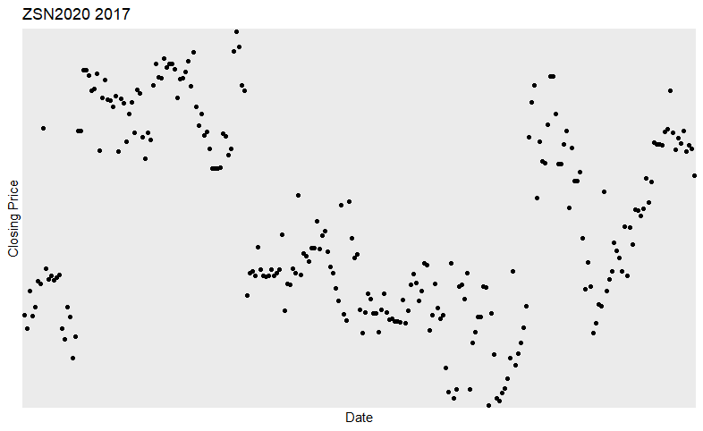
geom_path: Each group consists of only one observation.

Slide 28
