Slide 1
Gain measurement
PMT 1
V965
NEW FIT ALGORITHM
CONSTRAINED FITS

Slide 2
Outline
Vocabulary ( 3 minutes )
Electronics ( 10 minutes )
Exp. setup ( 8 minutes )
Taking data ( 5 minutes )
Data analysis ( 10 minutes )
Results ( 5 minutes )
Error ( 5 minutes )
Summary ( 4 mintues )

Slide 3
Vocab
Photon – A photon is a particle of light; it is the smallest piece of a color of light that you can get at once.
PE (Photoelectron) – A photoelectron is an electron that was ejected from a piece of metal by an incoming photon.
Photoelectric effect – The photoelectric effect is what we call it when an electron gets knocked loose by a photon. Albert Einstein got the Nobel Prize for a paper describing this phenomenon mathematically.
PMT (Photomultiplier tube) – A photomultiplier tube is an electronic detector that sends a pulse of electricity out every time a photon strikes the photocathode.
  Photocathode – a piece of metal designed to be hit with light in order to eject PE's.
Gain – Gain is a measurement of amplification. If a PMT had gain = 1, then for each PE that came off the photocathode, we would get a pulse of one single electron (we can't measure this). Our PMT's have gain ~ 1 million. In other words, for each PE that comes off the photocathode, we get a pulse out of size 1 million electrons (we CAN measure this).

Slide 4
More Vocab
HV (high voltage) – We have to power our PMT with a high voltage ( ~1000V ) to get the amplification; the gain of the PMT will go up and down with the HV.
Quantum efficiency – Not every photon that strikes the photocathode ejects a PE. The probability of a given photon ejecting a PE from the cathode is known as the quantum efficiency (for our PMT's, this is around 25%)
Pedestal – This is usually a gaussian bump on a histogram that represents our “zero” level measurement.
Daq (Data acquisition system) – The daq is what we call our system of computers that take in the signals from our detectors and store the information in digital data files for later analysis.
ADC (analog-to-digital converter) – We use ADC's in the lab to convert continuous analog electronic signals into a discrete, digital signal. In other words, we take in some electrical signal and say how big it is by picking a number between 0 and 4095; 0 is a very small signal, 4095 is a very big signal.

Slide 5
PMT (Photomultiplier tube)
A PMT consists of 3 parts
  The photocathode is a piece of metal that the light hits. Light comes through the windows and hits the photocathode; this causes PE's to come off this metal.
  The series of dynode stages are used to cause a shower or avalanche process of electrons by accelerating electrons (with high voltage) and smashing them into metal plates causing multiple electrons to be stripped off the metal dynode. This process is repeated in series around 10 times turning 1 PE into 10⁶ PE's. The large signal is then sent to a computer for processing.
  The third component of a PMT is the base. The base houses a system of resistors which distributes the HV appropriately to the different dynode stages. We must have a potential difference from each stage to the next in order to accelerate the electrons on the way to the next stage.

Slide 6
Experimental Setup
To gather data that will allow us to measure the gain of a PMT, we will need to shine the smallest amounts of light possible at our PMT. The reason for this will become more apparent when we look at the data, but the idea is that if we can see the signal from 1-PE, then we should be able to look at a signal from N-PE's and see that it is N times as big as the 1-PE signal.
We have built a dark box which we can use to filter all outside light to create a pitch black interior. Inside the box, we have our PMT as well as a shutter, diffuser, and filter apparatus for controlling our light beam.

Slide 7
Experimental Setup
We send light into the box from our light source via a fiber optic cable. The light leaves the fiber, travels through the diffuser which will make the light more regular (reduce systematic error). The light leaves the diffuser and travels through the shutter (if it is open), then it travels through a filter (to attenuate the light). Finally, after passing through the filter, if there are any photons left, they will travel through the PMT window and strike the photocathode.
We can turn the light level up or down as we please to take high or low light level data.
Another detail of the setup is that we sometimes pass the PMT signal through another electronic amplifier in an attempt to “zoom in” and distinguish different bumps in the data. This gives us another perspective from which we can look at our data.

Slide 8
Parameters
We have control over some parameters, such as:
  Daq – We have 3 different data acquisition systems and can use any of them.
  Light level – We can produce a lot of light in each pulse, or just a little bit.
  Filter – We have 7 different filter strengths as well as the absence of a filter to choose from.
  Amplification – We can choose to take the signal as it is or give it extra amplification.
  Pedestal injection – We can inject as many pedestal events to our data as we want.
Here are some of the parameters we need to measure:
  Pedestal mean – This is decided by the noise floor; more noise means a higher mean.
  1-PE mean – The size of the signal we see from 1-PE is what we need to calculate gain.
  Mean PE – The average number of PE's per event during a given data run. This is determined by the light level and filter setting.
  Lambda – Parameter talking about the relative heights of our data peaks. (statistics)
  W – This is a “weight” or probability of a discrete background event occuring.
  Alpha – This is a parameter that tells us about the exponential background contribution

Slide 9
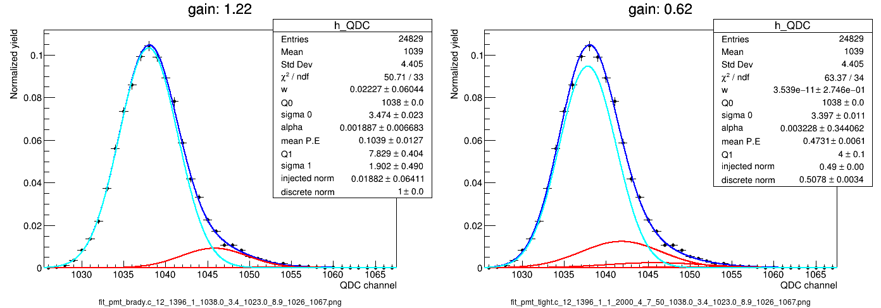
LOW LIGHT LEVEL DATA
Run 1396 shows very low light level measurement
Big bump is called the pedestal. This is a ZERO light measurement.
The small bump to the right is a 1-PE measurement
Since this is a histogram, the height of the bump tells us about how often we see this type of measurement. We almost always see a 0-PE event.
How far to the right the bump is tells you how many photons we observed. The pedestal will be the leftmost peak.

Slide 10
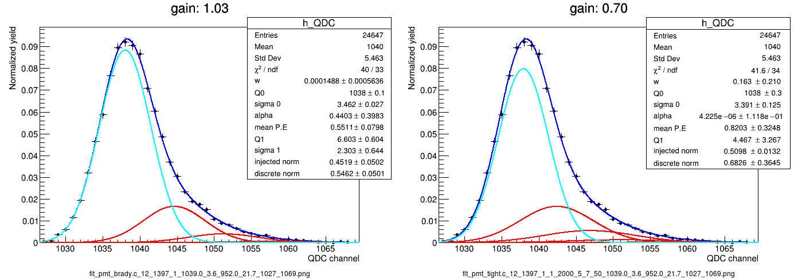
LOW LIGHT LEVEL DATA
Run 1397 has a slightly higher light level
Here, we can see the 2-PE bump showing up to the right of the 1-PE bump.
Most events here are still pedestal. In fact, for every real event we gather, we actually inject an extra pedestal (or zero light) event to make sure that the pedestal is present. We say that we have a pedestal injection of 50%.

Slide 11
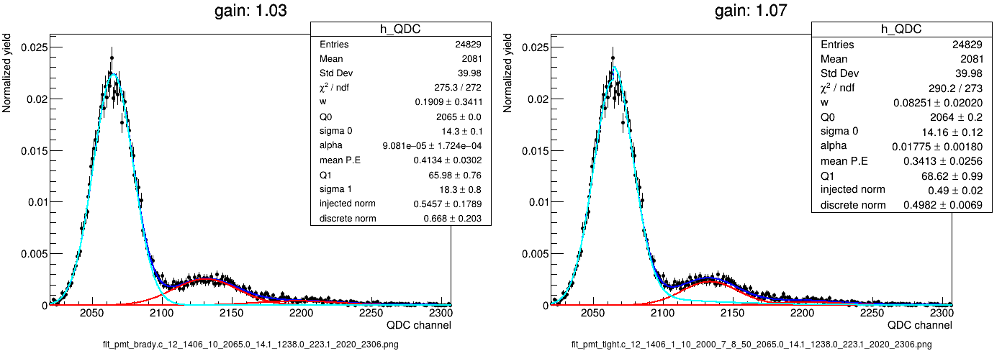
LOW LIGHT LEVEL AMPLIFIED DATA
Run 1406 shows very low light level measurement like run 1396, but this run is amplified 10x.
The small bump to the right is the 1-PE measurement
The smaller bump farther to the right is the 2-PE bump (we couldn't really see this in 1396)
You can see how much easier it is now to distinguish between the pedestal, 1-PE, and 2-PE bumps. Extra amplification allows us to differentiate by eye between these events.
Without amplification, we fully rely on the fitting algorithm to disentangle the lump.

Slide 12
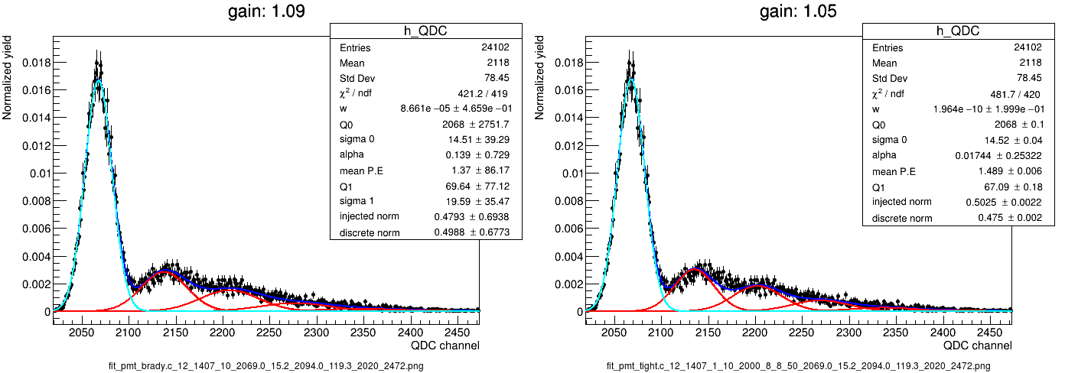
LOW LIGHT LEVEL AMPLIFIED DATA
Run 1407 has a slightly higher light level, like run 1397
Here, we can see 1-PE, 2-PE, 3-PE, and 4-PE events
Run 1397 is displayed again at the bottom for comparison

Slide 13
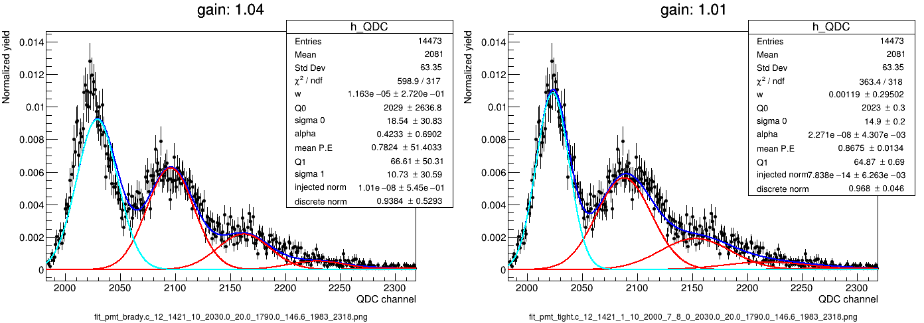
LOW LIGHT LEVEL AMPLIFIED DATA
Run 1421 is similar data to what we have seen, but this has 0% pedestal injection
We see that the height of the pedestal is much closer to that of the 1-PE peak now. The 0-PE peak should scale with the rest of the peaks as a Poisson distribution.
Run 1407 is shown on bottom to compare. Run 1407 has pedestal injection of 50%.

Slide 14
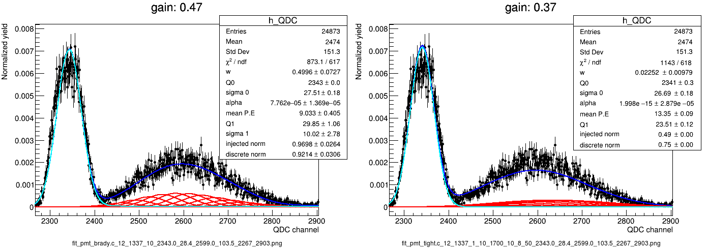
MEDIUM TO HIGH LIGHT LEVEL DATA
Run 1337 shows a medium light level. We are still pretty close to the pedestal here.
We can see that the 1-PE, 2-PE, 3-PE, …, ~15-PE peaks are scaling relatively as a Poisson distribution (we have clearly injected pedestal events), and as the average # of PE's goes up, the signal turns into a large gaussian of its own. We cannot reliably extract the gain information from this data unless we have an absolute calibration of our light level (which is very hard to get).
By calibrating our light level, we can use high light level data to measure gain at lower voltages.

Slide 15
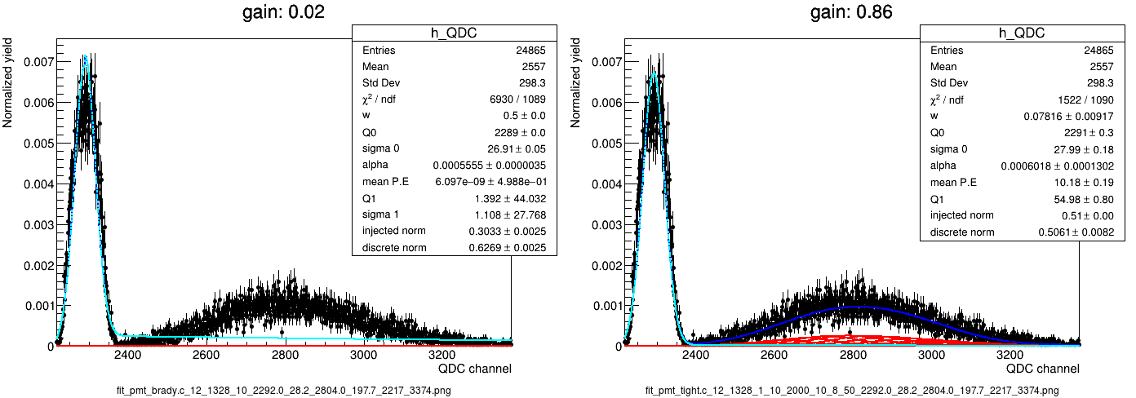
LOW, MEDIUM, AND HIGH LIGHT LEVEL
Run 1421 at the top shows a low light level with no pedestal injection.
Run 1337 in the middle shows a medium light level.
Run 1328 on the bottom shows the highest light level.
The high voltage for the top and bottom are 2000V (expect gain ~10⁶)
The high voltage for the middle is 1700V (expect gain < 10⁶)

Slide 16
Results

Slide 17
Error

Slide 18
Summary

