Slide 1
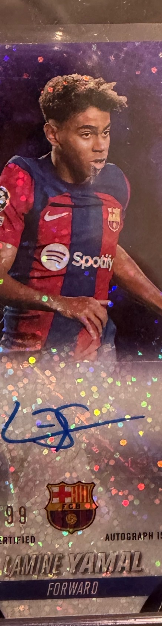

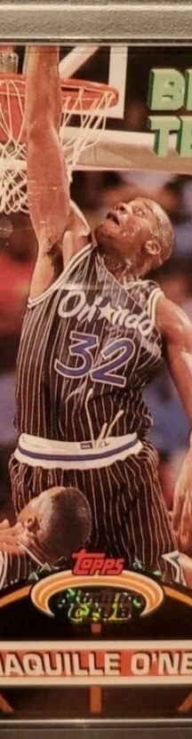
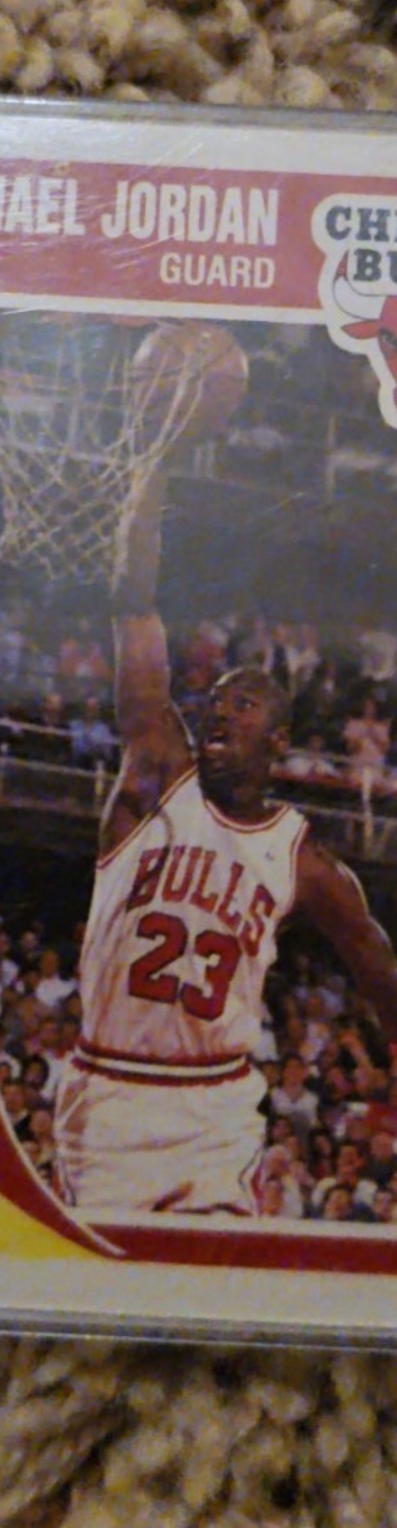

THE HOBBY, REBUILT.
A collector-first operating system for discovery, valuation, collection intelligence and commerce.
PITCH DECK DESIGN SYSTEM
FIND YOURS.
Confidential · 2026
01

Slide 2
THE THESIS
eBay digitized the classified ad. The Grail digitizes the collection.
Every card becomes a living position: owned, valued, watched, compared, traded and understood.
01
02
03
04
05
SCAN
VALUE
COLLECT
CONNECT
TRADE
Physical card → digital asset
Real sales → market signal
Portfolio → intelligence
Want graph → opportunity
Collection → marketplace
YOUR COLLECTION BECOMES YOUR MARKETPLACE.
02

Slide 3
THE PROBLEM
A massive market still runs on screenshots, stickers and search tabs.
Collectors are making financial decisions with fragmented data, inconsistent pricing and limited transparency.
01
PRICE DISCOVERY
02
COLLECTION VALUE
Recent sales are scattered across marketplaces and auction houses.
Most collectors cannot see their portfolio value or exposure in one place.
03
TRADING
04
TRUST
Card-show trading is high-friction and matching wants to inventory is manual.
Condition, comps, provenance and counterparties are difficult to assess quickly.
03

Slide 4
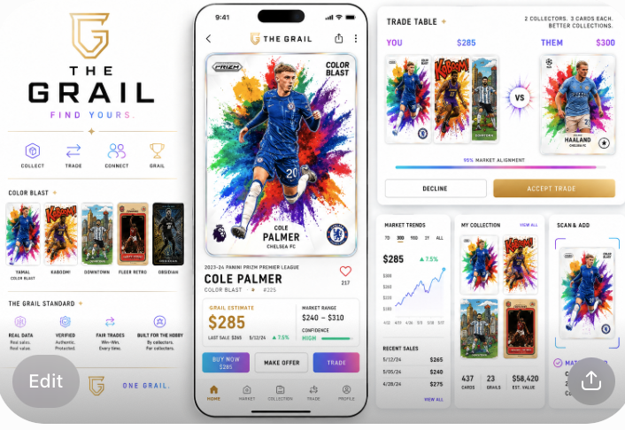
THE PRODUCT
One home for the Hobby.
The front end should feel like a premium card product. The data layer should feel like a market terminal.
COLLECTION-FIRST
The portfolio is the home screen.
CARD-CENTRIC
Every card has a persistent market identity.
DATA WITH CONTEXT
Range, trend, liquidity and confidence — not a fake precise price.
COMMERCE LATER
Buy, offer and trade layer onto the collection graph.
04

Slide 5
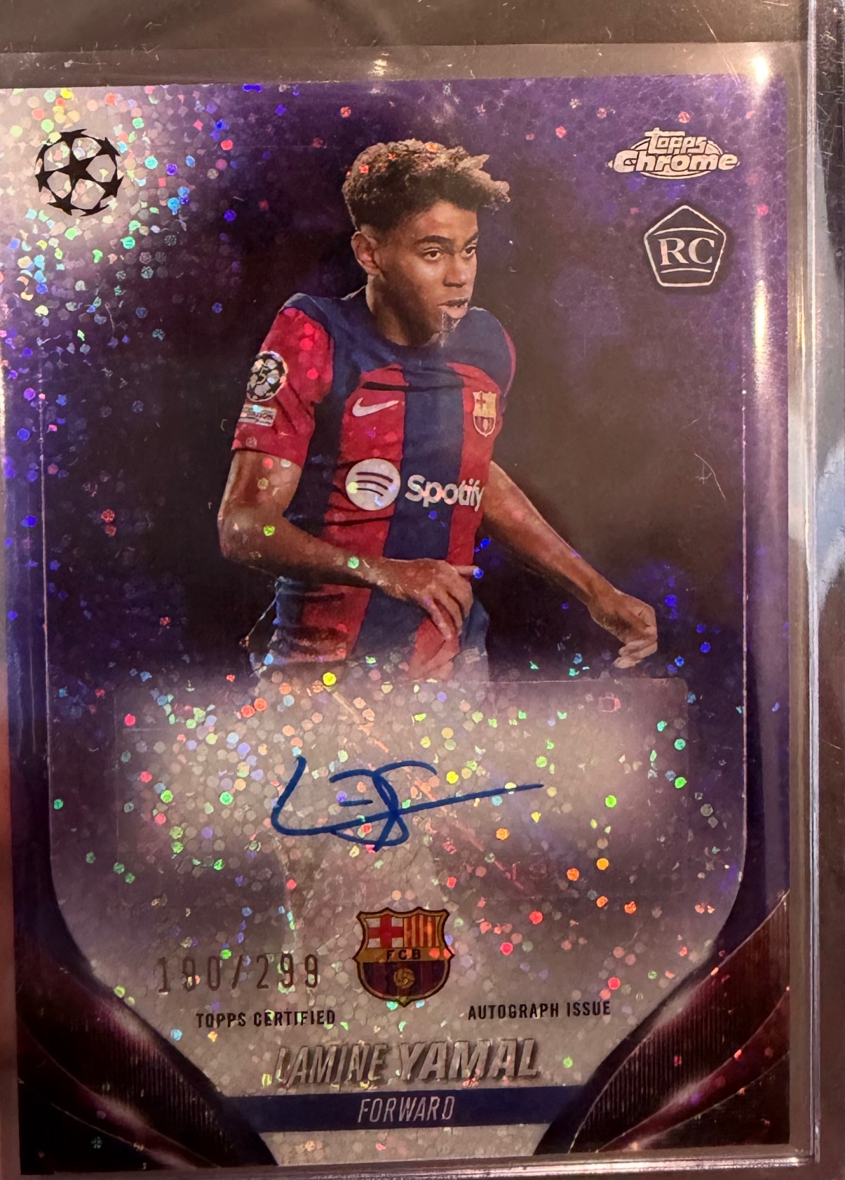
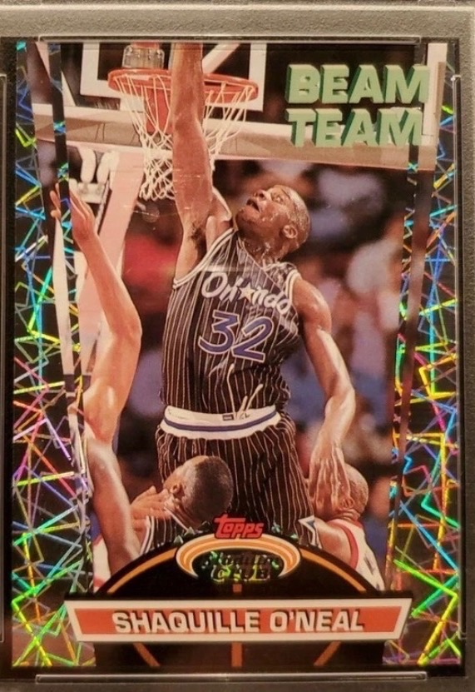
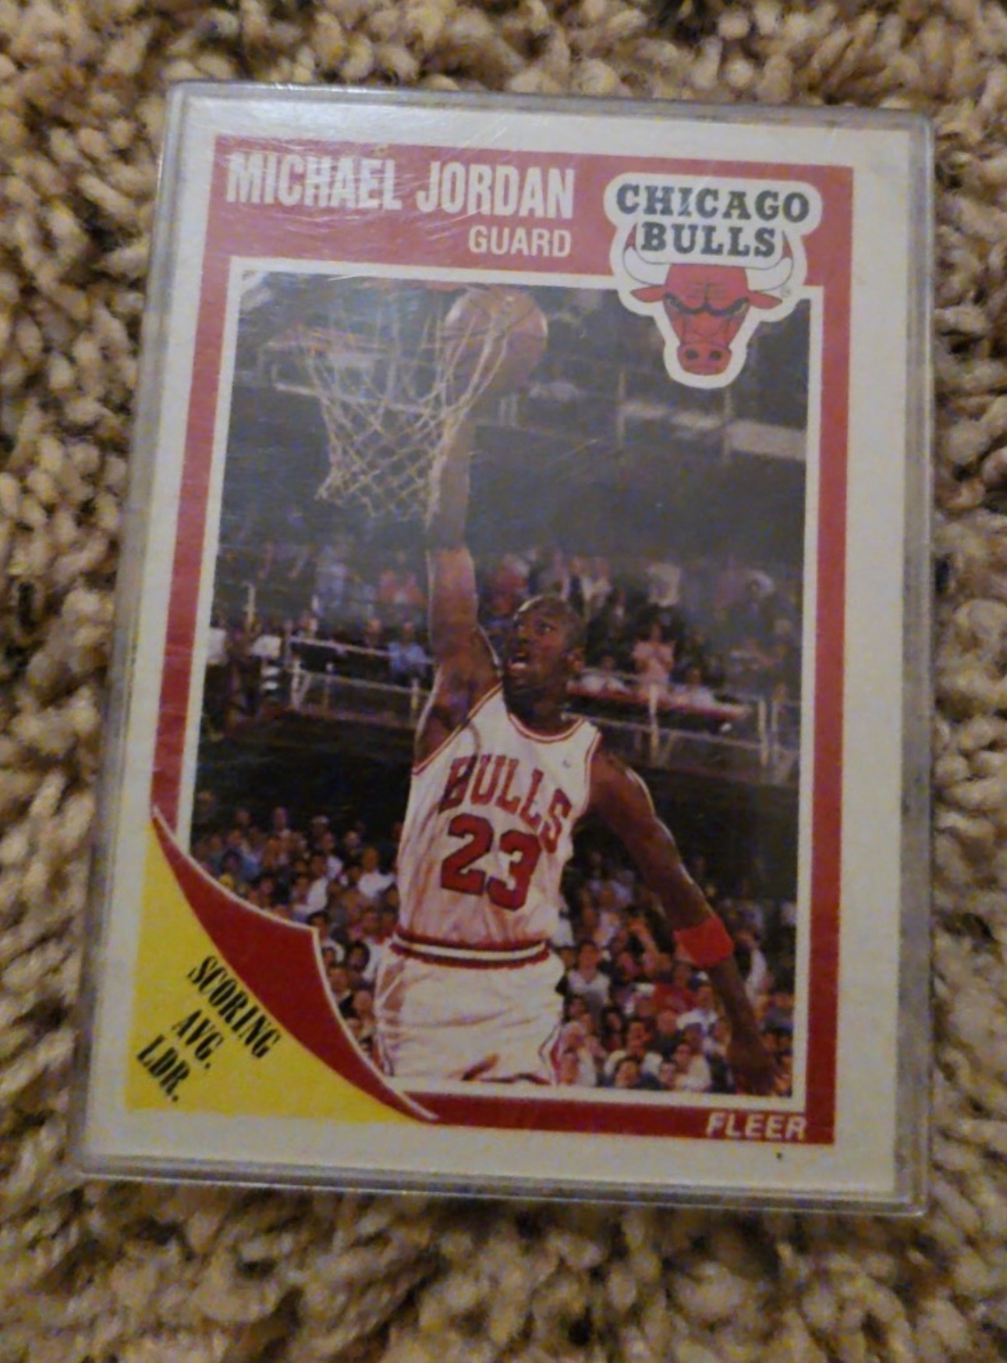
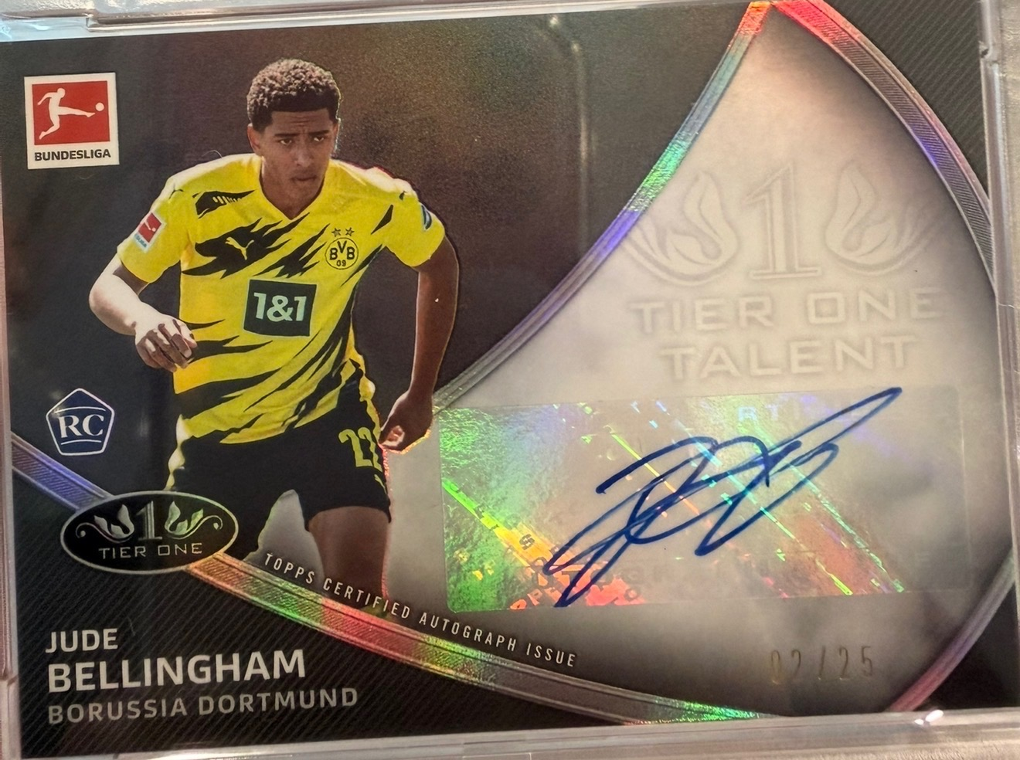
MY COLLECTION
A sports-card portfolio, not a spreadsheet.
Each card is a position. Multiples behave like multiple shares. The portfolio can be viewed by player, sport, era, set, grade or Grail status.
427
28
$62,450
+5.4%
COLLECTION VALUE
CARDS
GRAILS
EST. VALUE
30D CHANGE
$62,450
▲ $3,210 · 5.4%
05

Slide 6
MARKET INTELLIGENCE
Every card gets a ticker.
Completed transactions create the time series. Grail adds liquidity, volatility, confidence, grade spreads and a plain-English market read.
MICHAEL JORDAN · 1993-94 ULTRA SCORING KINGS #5
PSA 8
$6,250
▲ 58.2% · 3M
$5,883
47
$6,899
$3,950
HIGH
AVG SALE
SALES
HIGH
LOW
LIQUIDITY
06

Slide 7
THE GRAIL RATING
Not every Grail is expensive.
The G identifies cards that matter — through value, scarcity, velocity, cultural importance or iconic status within an era/set.
VALUE
>$1K or exceptional value tier
G
DEMAND
High transaction velocity / wants
SCARCITY
Print run, population, availability
97
SIGNIFICANCE
Iconic card, player, set or era
ICONIC
MOMENTUM
Market acceleration with confirmation
07

Slide 8
DESIGNED FOR THE WHOLE HOBBY
One ecosystem. Very different collectors.
The interface adapts to sophistication without splitting the market into separate products.
THE GRAIL HUNTER
Authentication · provenance · liquidity · discreet trading
THE BUILDER
Portfolio · comps · wants · trade matching · set completion
High-value collector
Active collector
THE BREAKOUT
Instant identification · valuation · grade economics · sell/trade
THE NEXT GEN
Favorite players · simple collecting goals · parent-controlled account
Pack/box hitter
Kids + families
08

Slide 9
THE DATA MOAT
The collection graph compounds.
The more cards users scan, own, want and transact, the better The Grail becomes at pricing, matching and discovery.
OWN GRAPH
WANT GRAPH
VALUE GRAPH
TRADE GRAPH
TRUST GRAPH
What exists in collections
What collectors are chasing
What cards actually transact for
What combinations clear
Who and what can be trusted
SCAN → COLLECTION → MARKET DATA → WANT LIST → MATCH → TRANSACTION → BETTER DATA
Each completed loop increases utility and lowers friction for the next collector.
09

Slide 10
BUSINESS MODEL ARCHITECTURE
Free to enter. Paid for intelligence and execution.
A blended model aligns revenue with both power users and marketplace activity.
FREE
GRAIL+
GRAIL PRO
Collection · scan · basic comps
Advanced comps · alerts · Trade Finder · portfolio analytics
Dealer tools · bulk workflows · exports/API · storefront
~5% transaction fee
~$9.99/mo · lower fee
~$24.99/mo · lowest fee
ADDITIONAL REVENUE LAYERS
Trade protection · Authentication · Shipping · Grading referrals · Vault/storage · Data/API
10

Slide 11
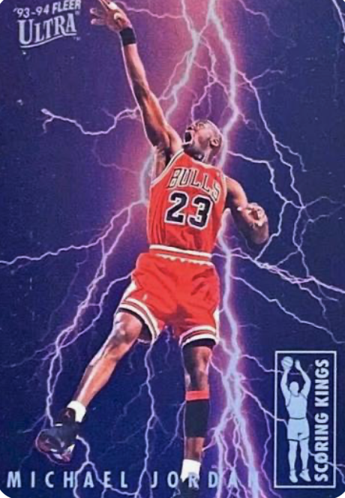
THE WEDGE
Start where passion and liquidity overlap.
Modern soccer + 1990s basketball create a strong initial community with both emerging stars and enduring icons.
MODERN SOCCER
90s BASKETBALL
GLOBAL · YOUNGER · FAST-GROWING
ICONIC · LIQUID · NOSTALGIA-DRIVEN
11

Slide 12
THE VISION
The Hobby lives here.
A central hub where collectors know what they own, understand what it is worth, discover what matters next — and eventually transact with confidence.
LOVE THE HOBBY.
Know what you own. Find what you love. Trade what you don’t. Build your collection.
FIND YOURS.
12

