Slide 1
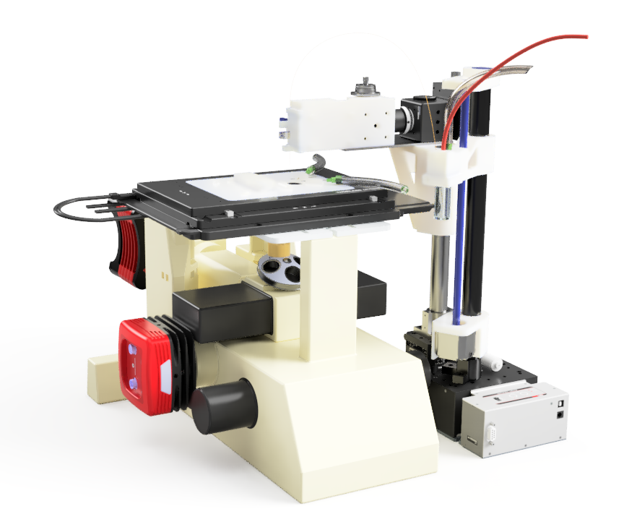
Instrument Overview
CE Detection Assembly
Hardware setup can be divided into a few key assemblies:
Microscope Assembly
CE Detection Assembly
CE Outlet Assembly
CE Outlet Assembly
Microscope Assembly

Slide 2
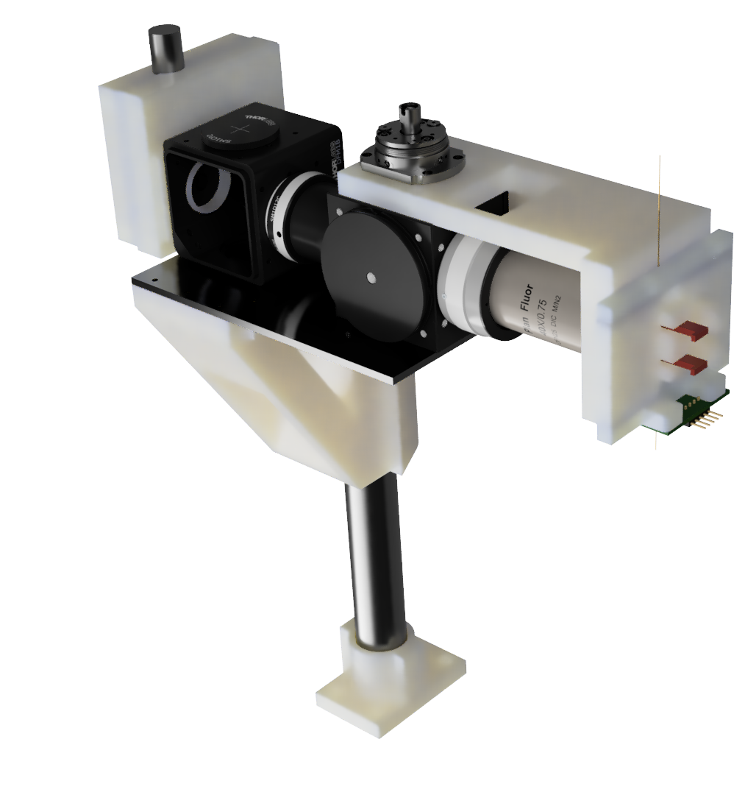
CE Detection Assembly Custom Parts
SiPM Mount
Capillary Arm
Capillary Alignment Assembly
Custom Material List
Object | Material | Fabrication
SiPM Mount | PLA/PETG | 3D Print
Capillary Arm | PLA/PETG | 3D Print
Cantilever Support | Aluminum | Mill
Optical Mount | PLA/PETG | 3D Print
Smooth Post Mount | PLA/PETG | 3D Print
Capillary Alignment Assembly | PLA/PETG | 3D Print
RGB-PCB | FR4 | EDA/PCB Fab.
Cantilever Support
Optical Mount
RGB-PCB
Smooth Post Mount

Slide 3
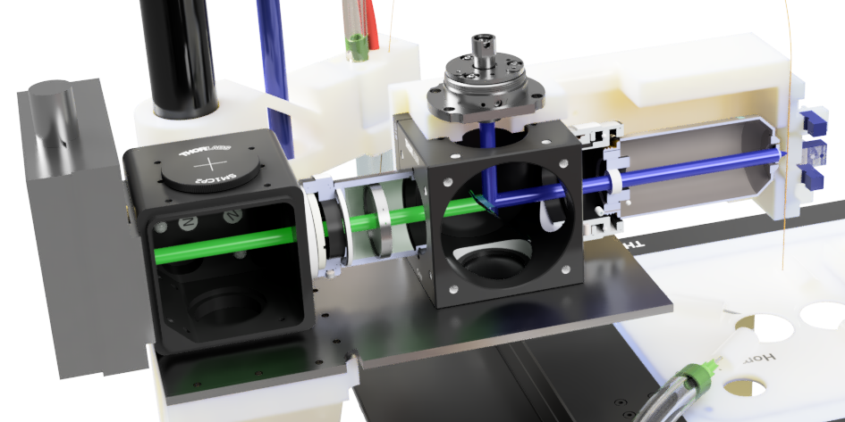
CE Detection Assembly Purchased Components
 | Component | Company | Part number | Notes
A | 40X Objective 0.75 NA | Nikon
B | 4-Way Mounting Cage | Thorlabs | C4W
C | Cage Dichoic Filter Mount | Thorlabs | FFM1
D | Rotatable Cover Plate | Thorlabs | B3C
E | Blank Cover Plate | Thorlabs | B1C
F | 10 mm Lens Tube | Thorlabs | SM1L10
G | External SM1 threads to internal M25x0.75 Thread (objective) | Thorlabs | SM1A12
H | External C-mount to SM1 thread | Thorlabs | SM1A39 | *PMT
I | Calibrated Iris Diaphragm | Thorlabs | SM1D12C
J | SM1 Threaded Manual Shutter | Thorlabs | SM1SH1 | *PMT
K | End Cap with SM1 Threads | Thorlabs | SM1CP2
L | Non Roating adjustable SM1 Lens Tube | Thorlabs | SM1ZM
M | Dichroic (488 nm) | Chroma | ZT488rdc-UF2 (IN036384) | 25.5 x 36 x 2mm
N | Bandpass Filter (525 +/- 25 nm) | Chroma | ET525/50m (IN005750) | 25 mm dia mounted
O | Notch Filter (488 nm) | Chroma | ZET488NF | 25 mm dia mounted
Q | Fiber Receptacle Collimators | OZ Optics | HPUCO
P | gasket tape | McMaster-Carr | 95705K133 | *PMT .02" thick
R | Optical post | Generic |  | 25 mm Diameter
Q
F
A
G
I
N
O
C
B
Q
Detector
Capillary
M
A
I
N
O
* Items needed for Hammatsu PMT detector. Can be ignored when using SiPM

Slide 4
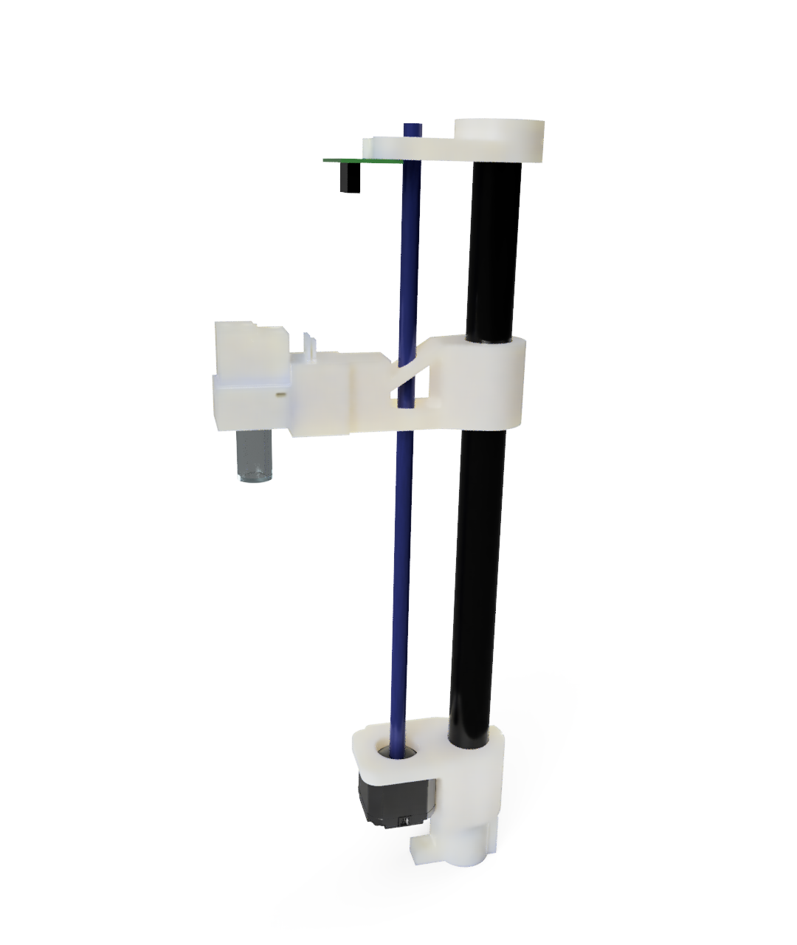
CE Outlet Assembly Custom Parts
Lead Screw Smooth Bracket
Limit Switch
Object | Material | Fabrication
Outlet Vial Arm | PLA/PETG | 3D Print
Outlet Vial Clamp | PLA/PETG | 3D Print
Lead Screw Smooth Bracket | PLA/PETG | 3D Print
Motor Smooth Bracket | PLA/PETG | 3D Print
Optical Post Bracket | PLA/PETG | 3D Print
Limit Switch | Breadboard | Snips/Scissors
Outlet Vial Clamp
Outlet Vial Arm
Motor Smooth Bracket
Optical Post Bracket

Slide 5
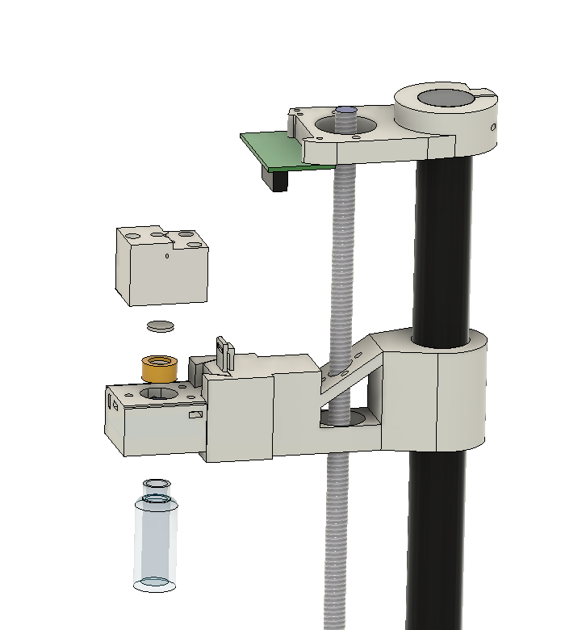
CE Outlet Assembly Purchased Components
Breadboard
Limit Switch
Object | P/N | Supplier | Notes
2.54 mm Pitch Connectors | HDB-635 | Hilitchi, Amazon | Any standard crimped 2.54 mm connectors
Limit Switch | DBWDKG-FT01 | MUZHI, Amazon | Any standard SPDT Switch
Lead Screw w/ Motor and nut | RDX3D060 | Redrex, Amazon | Any leadscrew + motor combo*
Vial, Cap, and Septum | 27340 | MilliporeSigma | Can be swapped with other 4 mL open top screw cap vials with PTFE/Silicon septum.
M3 Nylon Screw | 92492A721 | McMasterCarr | 16 mm L
M3 Screws + Hex Nuts | M3-0420F-SS305 | Iexcell, Amazon | Generic assortment of lengths
Arduino Uno |  | Arduino
PowerSTEP01 | X-NUCLEO-IHM03A1 | Mouser
12 V Power Supply |  | SmoTecQ, Amazon | The driver can power 12-48V so choose a power supply suitable for your motor.
Setpum
Vial cap
Vial
LeadScrew
Exploded view of the outlet assembly.
* 8 mm lead on the lead screw and 1.8° step for the motor will not require adjusting the OutletControl.ino code.

Slide 6
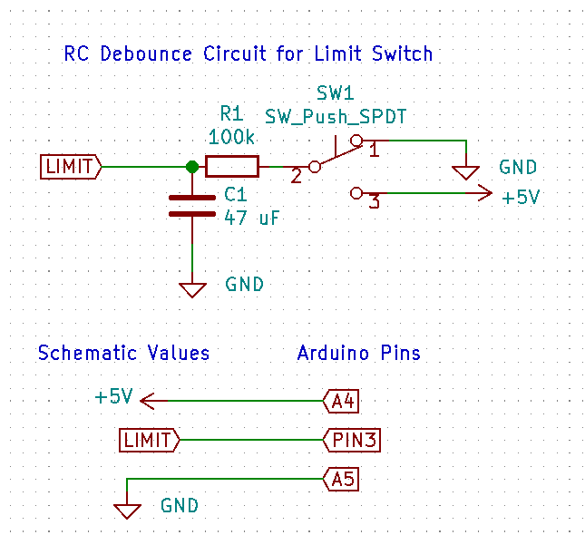
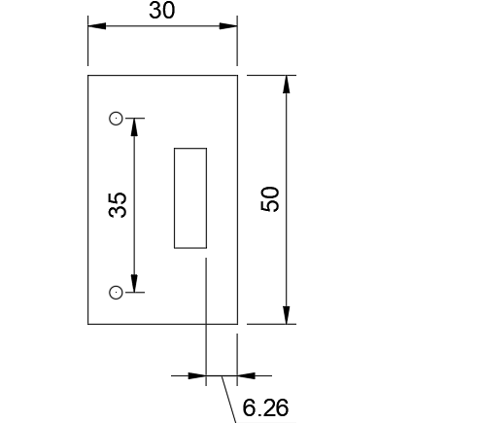
Limit Switch for Outlet
Simple through hole bread board can be used.
Most generic single pull double throw (SPDT) limit switches will work.
Breadboard can be cut with box cutters or snips. To rough dimensions specified.
Breadboard will need to have two holes drilled for 3M mounting spaced 35 mm apart, 3.1mm diameter.
Wiring diagram for Limit Switch
Breadboard dimensions in mm

Slide 7
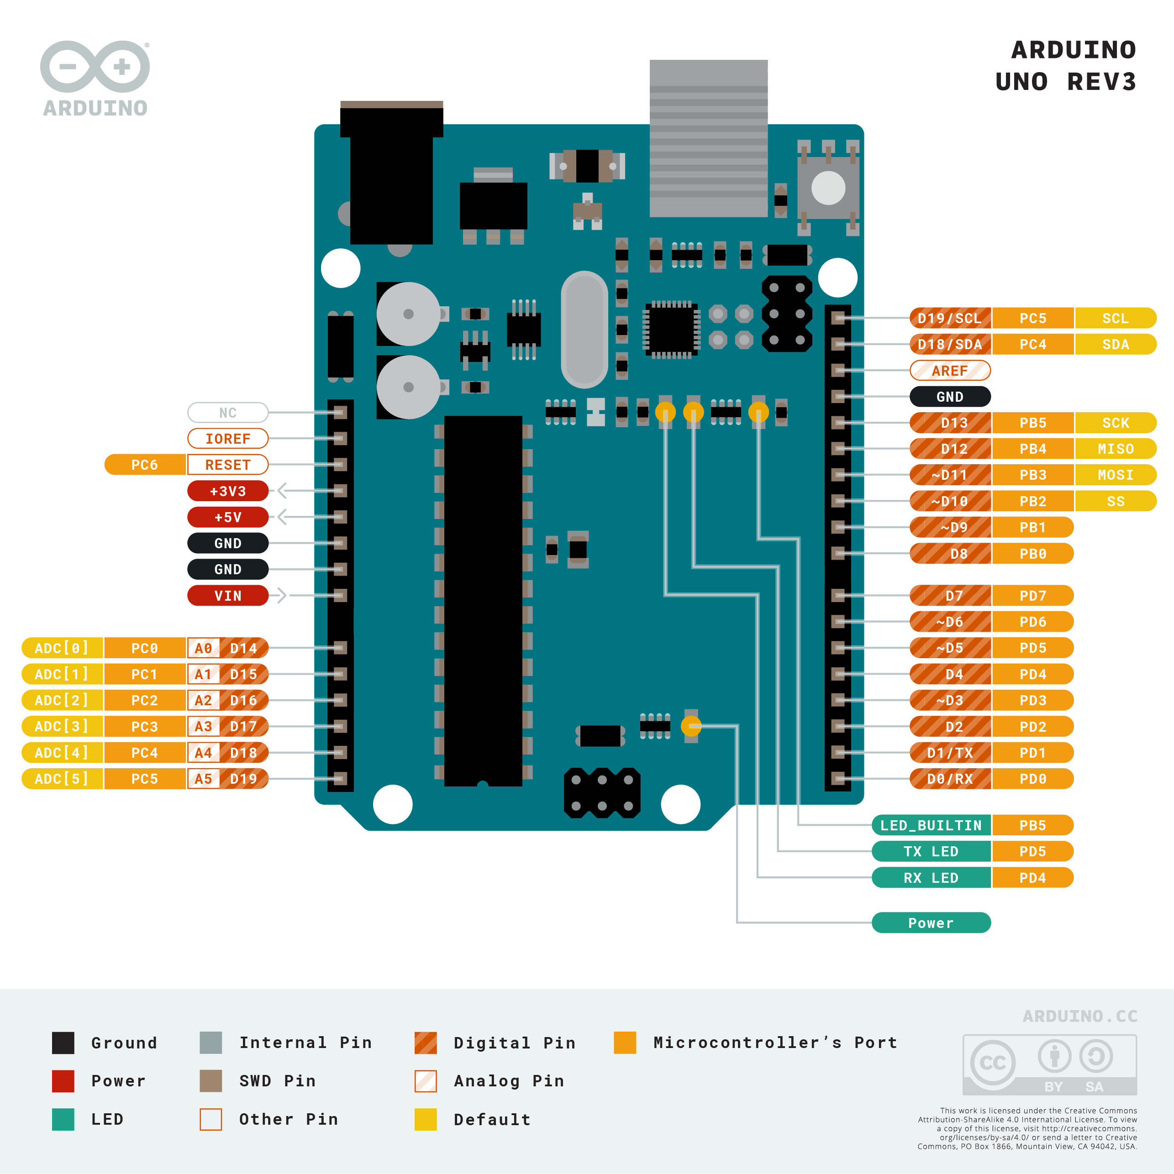
Outlet Arduino Pin Assignments
Place the X-Nucleo ontop of the Arduino Uno.
Pin spacing is the same for Nucleo and Arduino Uno.
3 Wires are reserved for the limit switch (A4, A5, D3).
3 Wires are reserved for the inlet RGB LED (A1, A2, A3)
3 Wires are reserved for the Solenoid (D4, D6, & D7)
Wire the stepper motor to the Nucleo output screw terminals (A+/A-, B+/B-).
Each coil of the stepper motor is indicated by A or B. Identify which leads correspond to the same coil using an Ohm meter.
Connect the 12 V power supply to the Nucleo power screw terminals (Labeled GND and +V).
Solenoid
RGB LED
SOLENOID
LIMIT
LIMIT
https://store.arduino.cc/usa/arduino-uno-rev3

