Slide 1
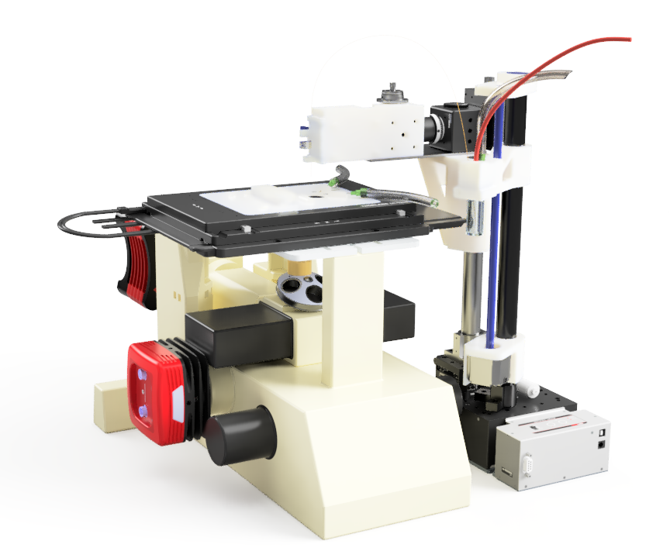
Instrument Overview
CE Detection Assembly
Hardware setup can be divided into a few key assemblies:
Microscope Assembly
CE Detection Assembly
CE Outlet Assembly
CE Outlet Assembly
Microscope Assembly

Slide 2
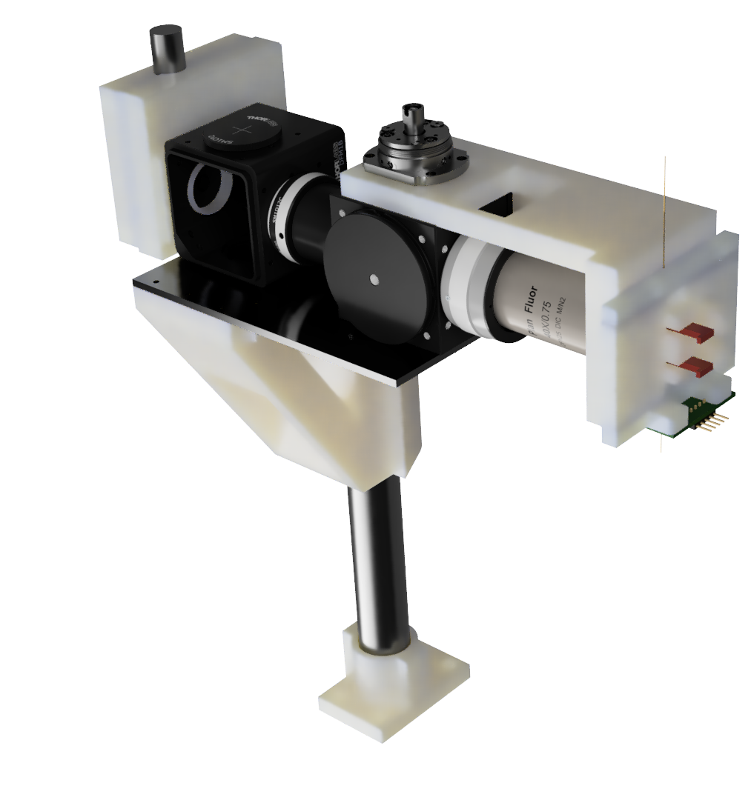
CE Detection Assembly Custom Parts
SiPM Mount
Capillary Arm
Capillary Alignment Assembly
Custom Material List
Object | Material | Fabrication
SiPM Mount | PLA/PETG | 3D Print
Capillary Arm | PLA/PETG | 3D Print
Cantilever Support | Aluminum | Mill
Optical Mount | PLA/PETG | 3D Print
Smooth Post Mount | PLA/PETG | 3D Print
Capillary Alignment Assembly | PLA/PETG | 3D Print
RGB-PCB | FR4 | EDA/PCB Fab.
Cantilever Support
Optical Mount
RGB-PCB
Smooth Post Mount

Slide 3
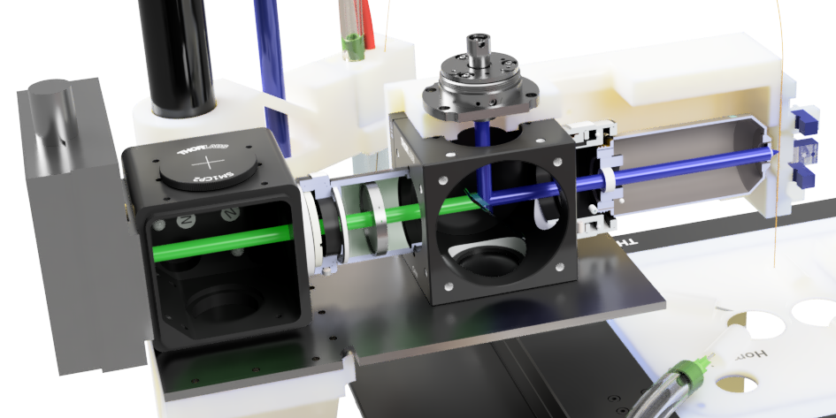
CE Detection Assembly Purchased Components
 | Component | Company | Part number | Notes
A | 40X Objective 0.75 NA | Nikon
B | 4-Way Mounting Cage | Thorlabs | C4W
C | Cage Dichoic Filter Mount | Thorlabs | FFM1
D | Rotatable Cover Plate | Thorlabs | B3C
E | Blank Cover Plate | Thorlabs | B1C
F | 10 mm Lens Tube | Thorlabs | SM1L10
G | External SM1 threads to internal M25x0.75 Thread (objective) | Thorlabs | SM1A12
H | External C-mount to SM1 thread | Thorlabs | SM1A39 | *PMT
I | Calibrated Iris Diaphragm | Thorlabs | SM1D12C
J | SM1 Threaded Manual Shutter | Thorlabs | SM1SH1 | *PMT
K | End Cap with SM1 Threads | Thorlabs | SM1CP2
L | Non Roating adjustable SM1 Lens Tube | Thorlabs | SM1ZM
M | Dichroic (488 nm) | Chroma | ZT488rdc-UF2 (IN036384) | 25.5 x 36 x 2mm
N | Bandpass Filter (525 +/- 25 nm) | Chroma | ET525/50m (IN005750) | 25 mm dia mounted
O | Notch Filter (488 nm) | Chroma | ZET488NF | 25 mm dia mounted
Q | Fiber Receptacle Collimators | OZ Optics | HPUCO
P | gasket tape | McMaster-Carr | 95705K133 | *PMT .02" thick
R | Optical post | Generic |  | 25 mm Diameter
Q
F
A
G
I
N
O
C
B
Q
Detector
Capillary
M
A
I
N
O
* Items needed for Hammatsu PMT detector. Can be ignored when using SiPM

