Slide 2
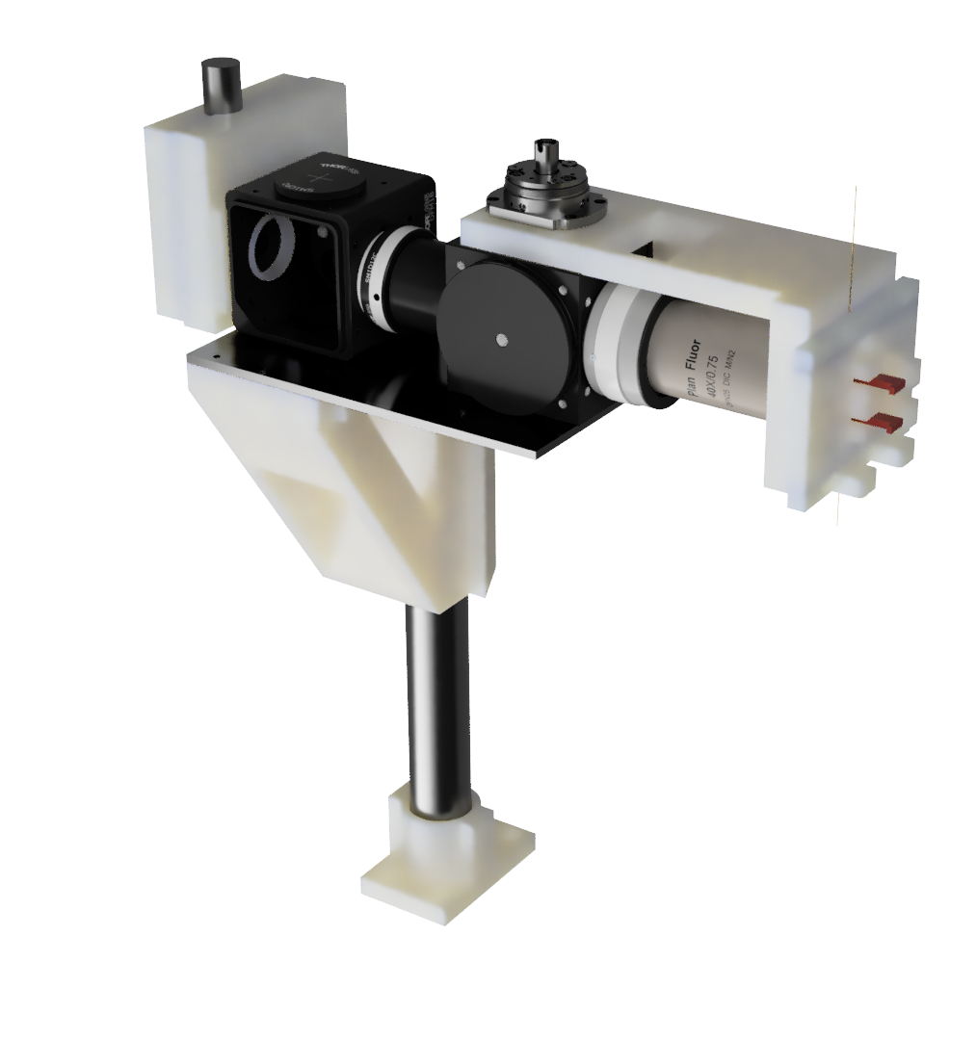
Optical Assembly
SiPM Mount
Capillary Arm
Custom Material List
Object | Material | Fabrication
SiPM Mount | PLA/PETG | 3D Print
Capillary Arm | PLA/PETG | 3D Print
Cantilever Support | Aluminum | Mill
Optical Mount | PLA/PETG | 3D Print
Smooth Post Mount | PLA/PETG | 3D Print
Capillary Alignment Assembly | PLA/PETG | 3D Print
Cantilever Support
Capillary Alignment Assembly
Optical Mount
Smooth Post Mount

