Slide 1
Building a
Web Component Library
Burton Smith
@stuffbreaker
burton@breakstuff.io
Please check Discord for instructions

Slide 2


Slide 3

arewebcomponentsathingyet.com

Slide 4



A.
B.
C.

Slide 5
Web Components
“Web Components is a suite of different technologies allowing you to create reusable custom elements — with their functionality encapsulated away from the rest of your code — and utilize them in your web apps.” - MDN

Slide 6
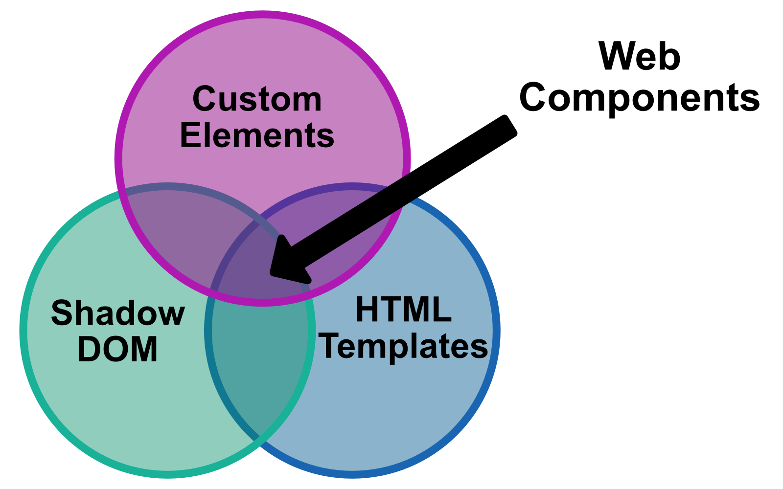

Slide 7
Custom Elements
“The ability to create custom elements that encapsulate your functionality on an HTML page, rather than having to make do with a long, nested batch of elements that together provide a custom page feature.” - MDN

Slide 8
Shadow DOM
“The Shadow DOM API is a key part of this, providing a way to attach a hidden separated DOM to an element.”
“[This provides the ability] to keep the markup structure, style, and behavior hidden and separate from other code on the page so that different parts do not clash, and the code can be kept nice and clean.” - MDN

Slide 9
HTML Templates
“The <template> HTML element is a mechanism for holding HTML that is not to be rendered immediately when a page is loaded but may be instantiated subsequently during runtime using JavaScript.” - MDN

Slide 10
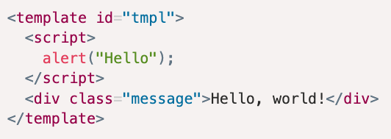
HTML Templates

Slide 11










Custom Element Integration

Slide 12
Web Components Are Everywhere!!!

Slide 13
Why not web components?
SSR 🫤
SEO 🙂
Requires JavaScript 🫤
Browser Spec Adoption 🫤
Forms 🙂
Legacy Browsers 🙂
Learning Curve 🫤
Component Registries 🫤

Slide 14
What we will cover
Composing Web Components
Passing Data to Web Components
Getting Data Out of Components
Styling Web Components
Making Web Components Styleable
Integrations

Slide 15
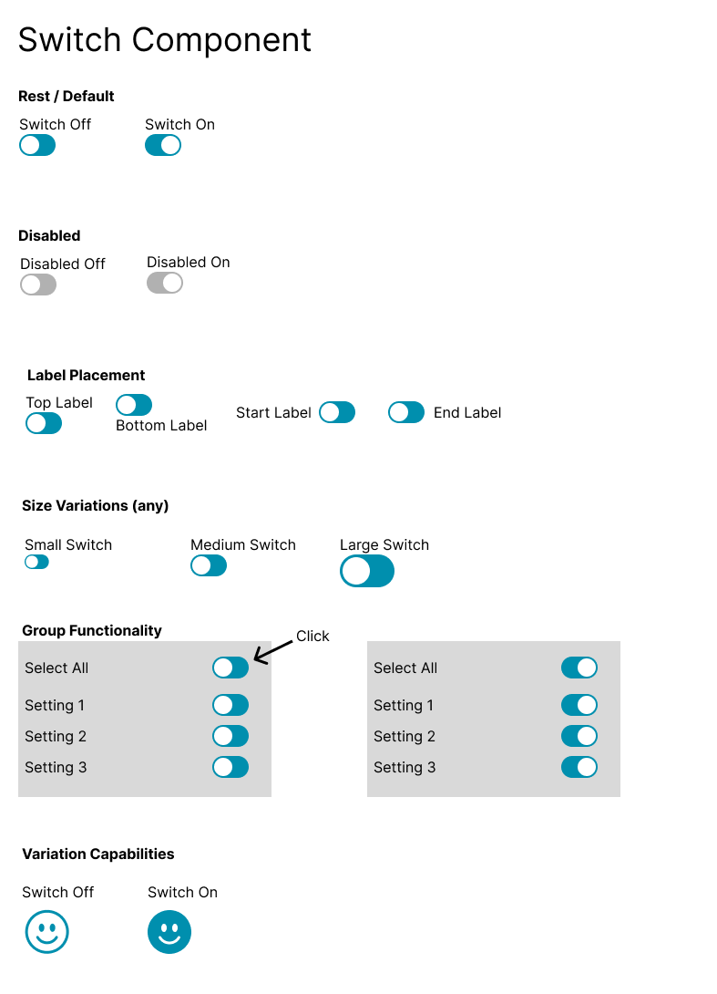

Slide 16

webcomponents.dev

Slide 17
Custom Element Integration

Slide 18

custom-elements-everywhere.com

Slide 19
THANK YOU
Burton Smith
@stuffbreaker
burton@breakstuff.io

