Slide 1


The Long Lost Art of Refactoring
Jimmy Bogard
@jbogard
github.com/jbogard
jimmybogard.com

Slide 2
What is Domain-Driven Design?
Notes:
An architectural design strategy in which we selectively distill, organize, and abstract the body of knowledge from the users to the software

Slide 3
What is a domain model?
Notes:
From PoEAA: An object model of the domain that incorporates both behavior and data.
Key – data AND behavior
Beyond nouns and verbs

Slide 4
But my code, it sucks!

Slide 5
Red
Green
Refactor

Slide 6
¯\_(ツ)_/¯
¯\_(ツ)_/¯
Refactor

Slide 7
Shoulders of Giants

Slide 8


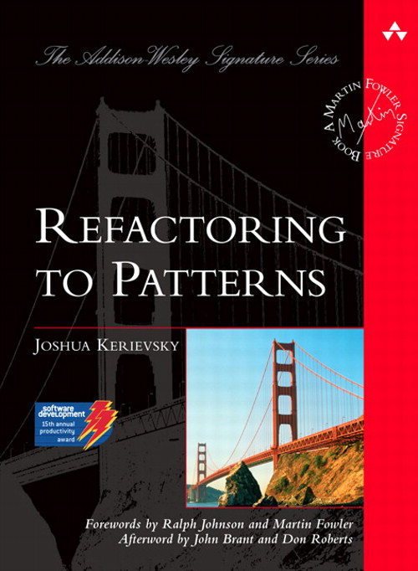

Slide 9
Current State

Slide 10
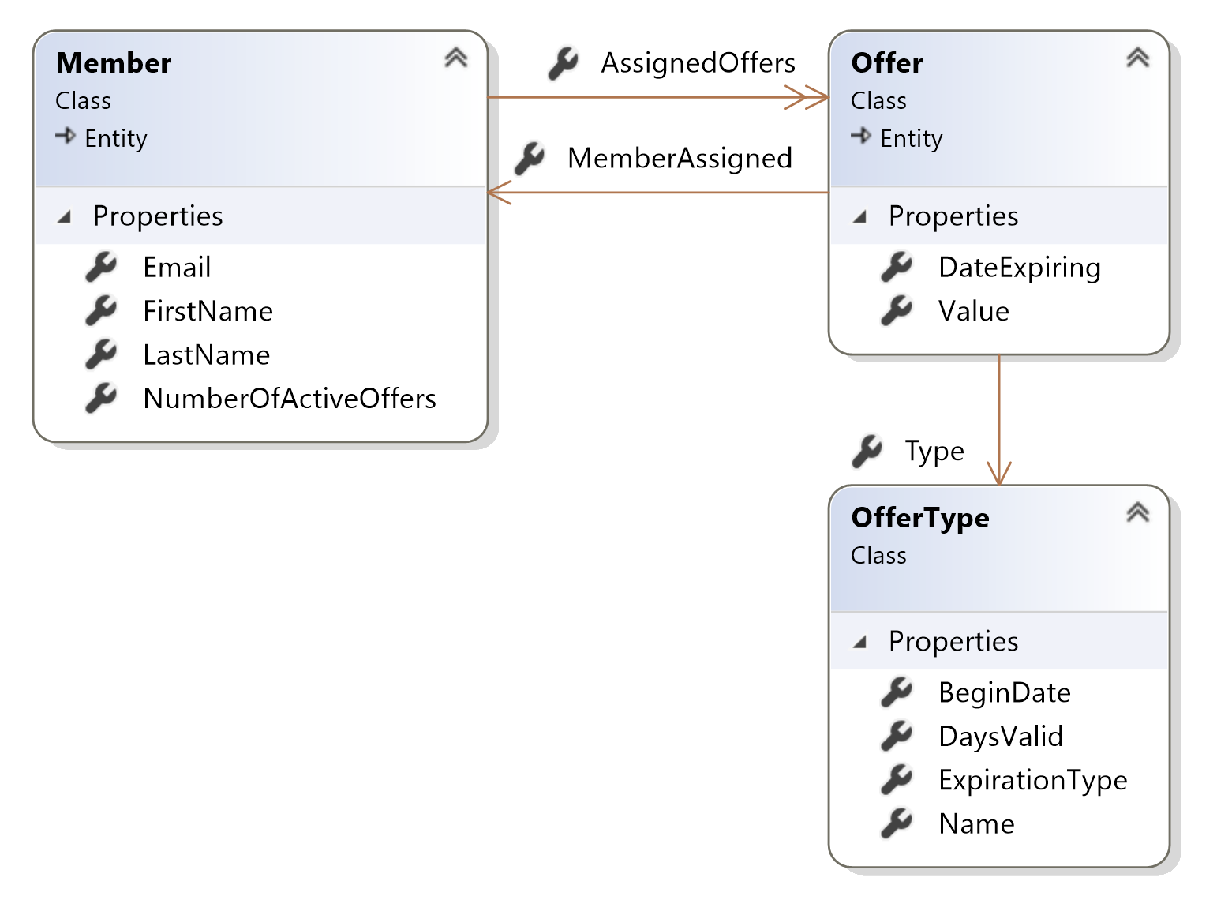

Slide 11
Where’s the behavior?

Slide 12
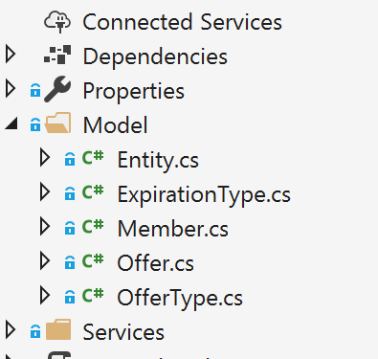

Slide 13
The Long Lost Art of Refactoring
Jimmy Bogard
@jbogard
github.com/jbogard
jimmybogard.com
github.com/jbogard/presentations

Slide 14

The Long Lost Art of Refactoring
DDD with Vertical Slice Architecture Training
July 17-18th in Rotterdam
20% discount code Techorama20

Slide 15
Domain-Driven Refactoring
Jimmy Bogard
@jbogard
github.com/jbogard
jimmybogard.com
github.com/jbogard/presentations

