Slide 1
Simulation First Results
Braedyn Au
June 9, 2020

Slide 2
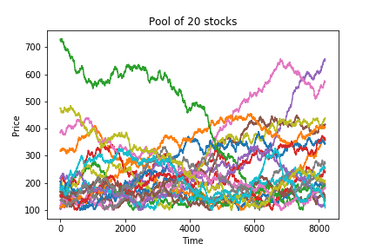
Stocks
20 stocks simulated with fBM
https://www.mathworks.com/matlabcentral/fileexchange/38935-fractional-brownian-motion-generator
The algorithm I have starts at 0 and moves up and down which can create negative numbers.
I shifted each stock price up by the minimum price and then added a flat 100 for each stock—how to improve?
The algorithm can only generate powers of 2 number of datapoints, so to match the 7200 minutes if a 5 day trading week, I generate 2¹³ = 8192 points and set point 992 as time 0 for the simulation. The 900 points before this time are used to find an optimal sharpe ratio for the initial portfolio allocation spread.
Sharpe ratios at future time steps are then calculated based on the 900 points before that time, similar to a simple moving average.

Slide 3
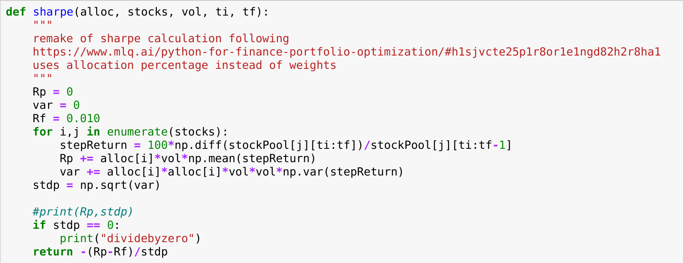
Sharpe Ratio
I find the percentage change between each time step to find the expected return percentage and standard devation of the returns.
Return negative value for minimization via sequanetial least squareds quadratic programming (SLSQP)
I’ve seen some calculations use log returns instead of arithmetic, and also normalizing to an annual sharpe ratio. Are these applicable here?

Slide 4
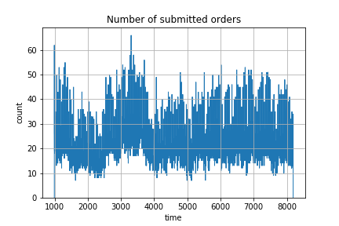
With overlap
5 portfolios with a uniform random number of stocks between 8-12, chosen from a uniformly distributed pool of 20 stocks, and uniform random volume chosen from 10³, 10⁴, 10⁵, 10⁶ dollars.
Sharpe ratio optimization done through portfolio percentage volume allocation—when the change in a stock’s percentage allocation corresponds to at least one whole stock at the price at that given time, an order for that stock is sent through.
The portfolio’s allocation spread is updated to the optimal point at the end of each step.
Working on function to generate portfolios at specific overlap levels and with non uniform distributions.

Slide 5
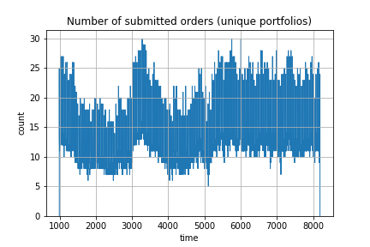
Without overlap
5 portfolios each with 4 unique stocks and each with a volume of 10⁶ dollars .
Same dynamics as before.
In terms of number of stocks and volume, how best to compare to portfolios with overlap?
How to threshold?

Slide 6
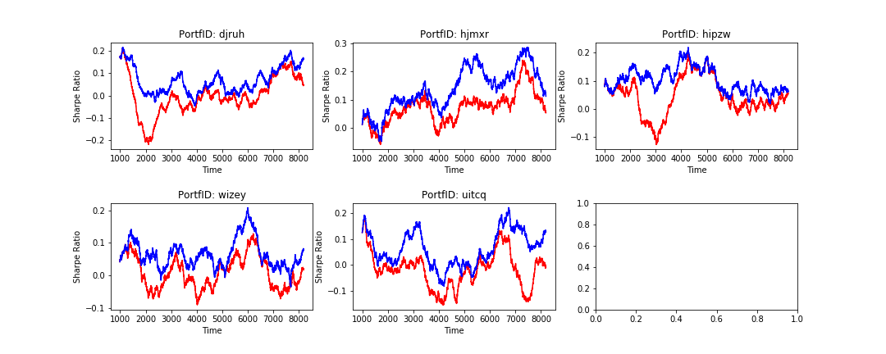
Sharpe comparison
Compared Sharpe ratio’s of the 5 non-overlapping portfolios when follwing a dynamic portfolio spread (blue) vs a static portfolio spread (red).

Slide 7
Artificial Broker
I also wrote a broker which would collect orders from traders and match buyers and sellers following a first in first out algorithm.
Would result in a final list containing every transaction with time of sale, buyer ID, seller ID, stock, volume, and a unique transaction ID.
Was originally planning on optimzing portfolios by their weights on each stock, not the portfolio percentage allocation. In the dynamics, when the order is generated, stocks with a sell order immediately have their weights changed, but stocks with a buy order don’t have their weights changed until the transaction is complete. The trouble was finding a limit on the weights when optimizing since I did not code an ‘available cash’ variable.
Realized this wasn’t applicable for non-overlapping stocks, but could be interesting later on.

