Slide 1
July 17 Update
Braedyn

Slide 2
Updates
Added portfolio cash and value attributes
Price Change
Variance vs weight plots
Cosine similarity heatmaps
Distinguishing Cascades

Slide 3
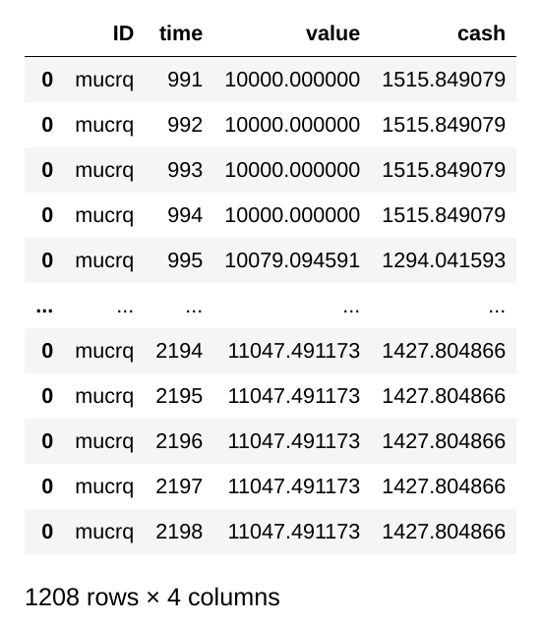
Cash and Value
Cash and value added to fix bug with stock weight calculation
Cash included in sharpe ratio calculation with the risk free interest rate

Slide 4
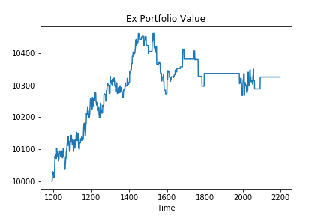
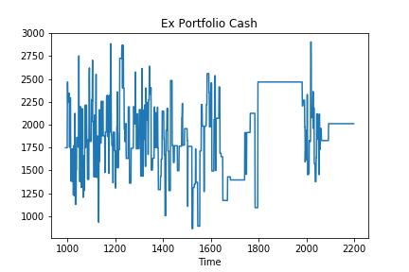
Cash and Value

Slide 5
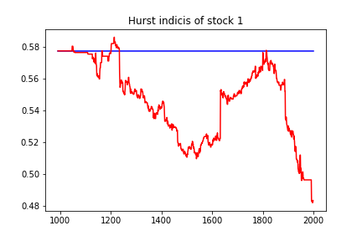
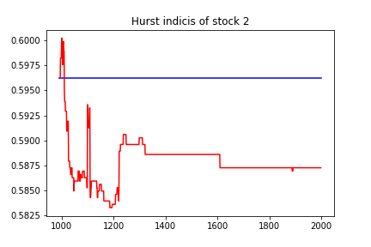
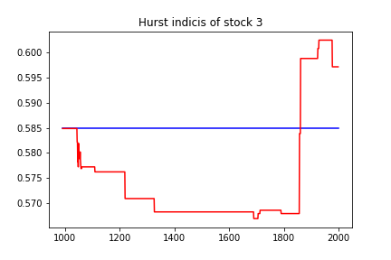
Price Change
Chooses a random number within
Ex. 2 stocks sold => Hurst Parameter changes by a random number
between [-0.002,0.002]

Slide 6
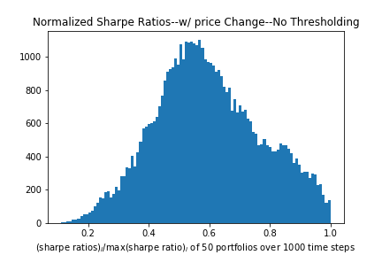
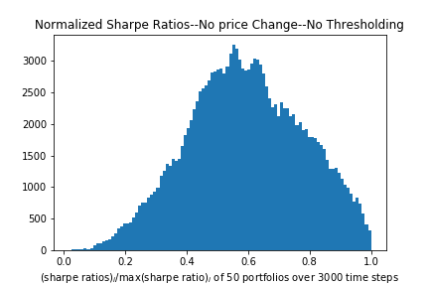
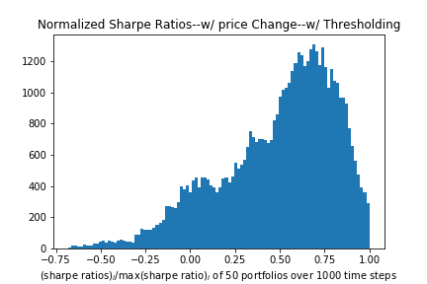
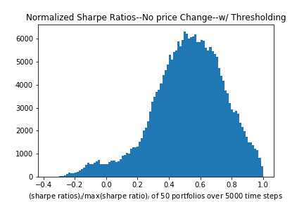
Sharpe Ratios (Change vs No Change)

Slide 7
Weight vs Variance

Slide 8
Weight vs Variance

Slide 9
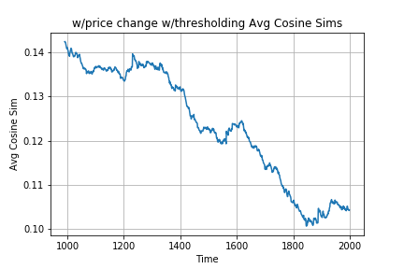
Cosine Similarity
Average cosine similarity fluctuates
Haven’t ran full 5 day period yet
w/ price change w/ threshold

Slide 10
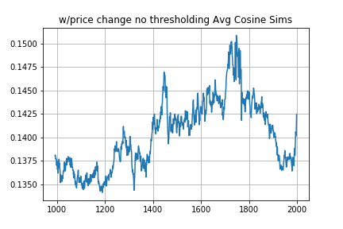
*Different initial simulation than before
w/ price change No threshold

Slide 11
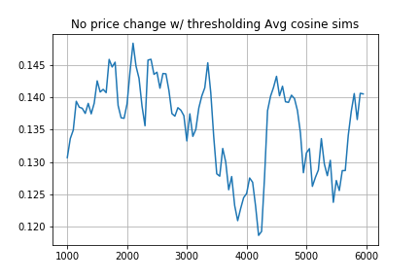

Slide 12
Rebalance Cascades
Cascades of individual stock trades compiled together
Cascades of traders making any change to their portfolio

Slide 13
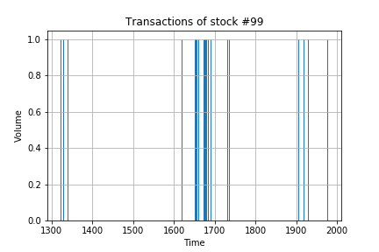
Individual Stock Cascades
For each stock, find temporally seperated cascades of activity
Compile all the cascades of each stock for a total Cascades list
Volume of stock not accounted for

Slide 14
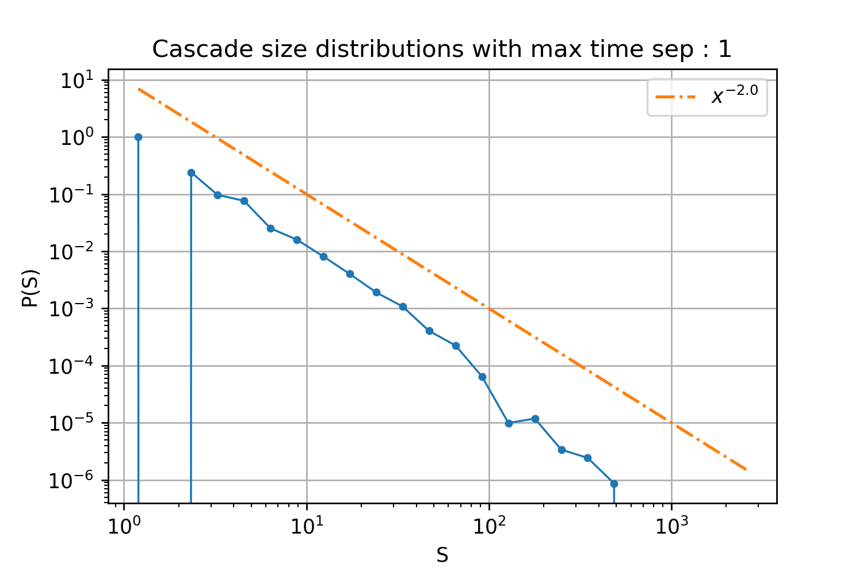
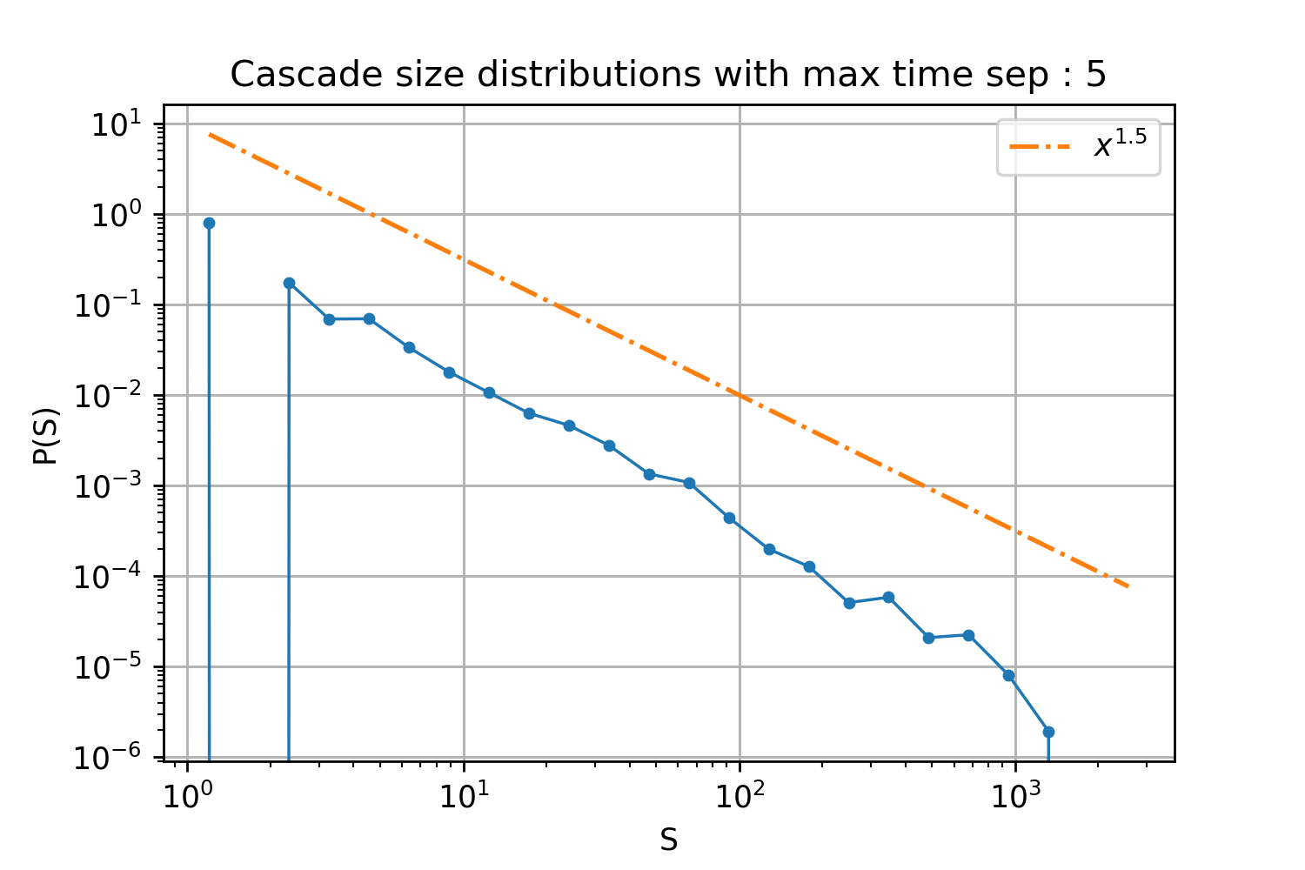
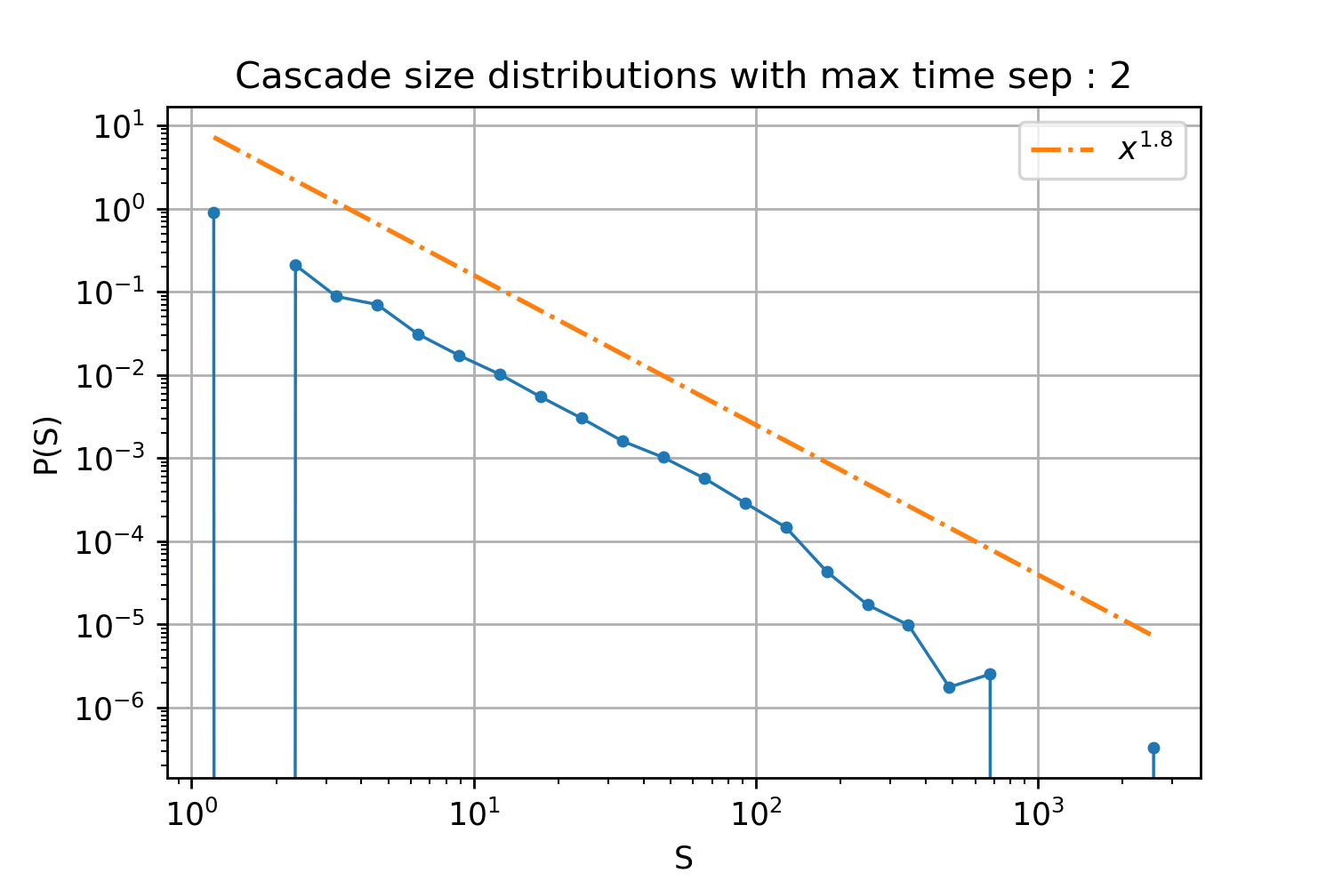
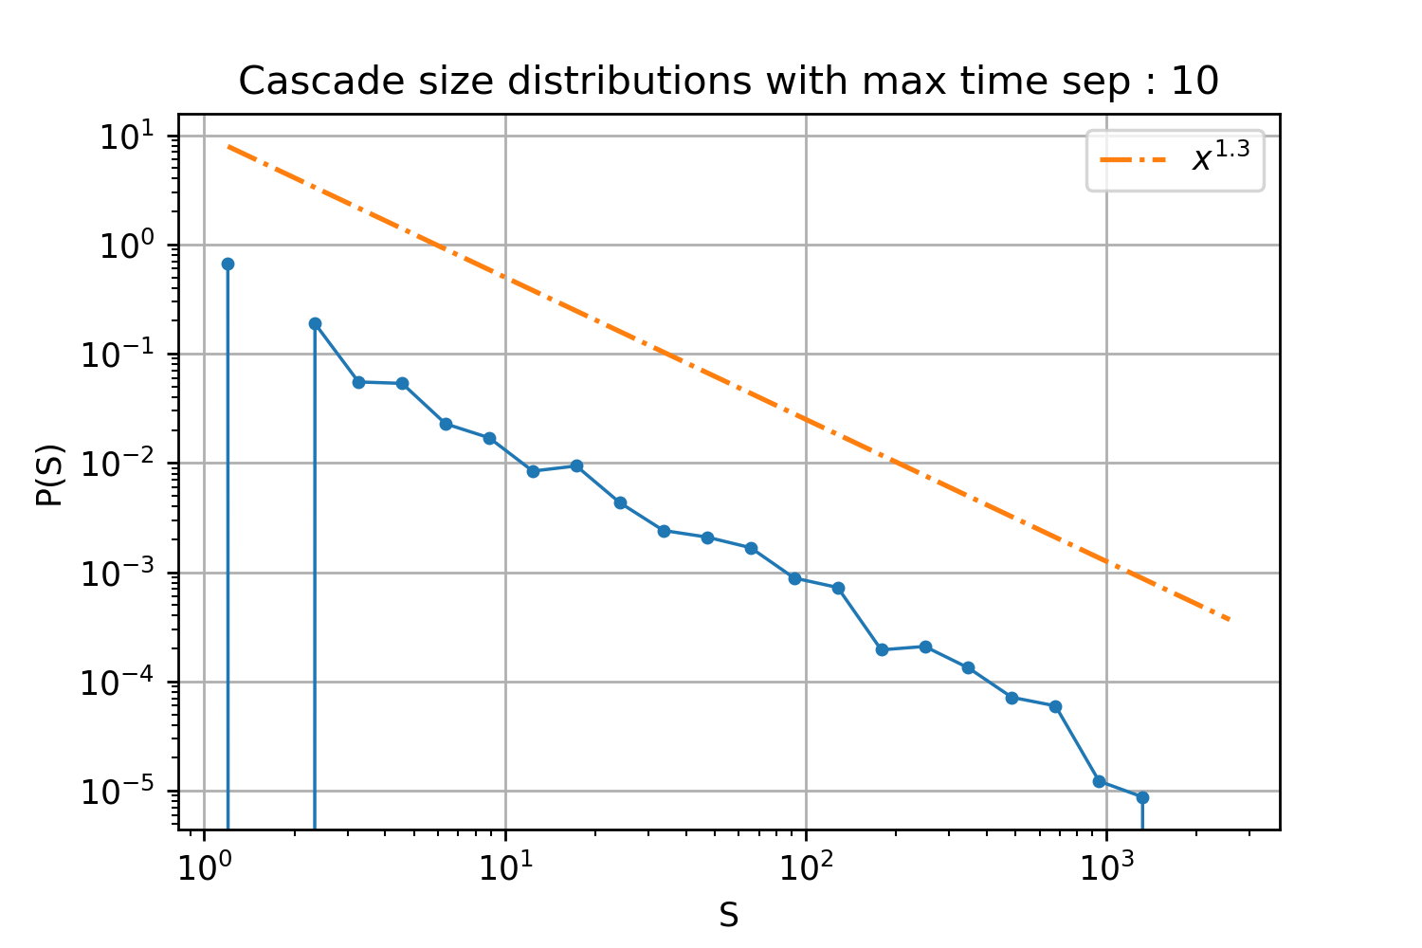

Slide 15
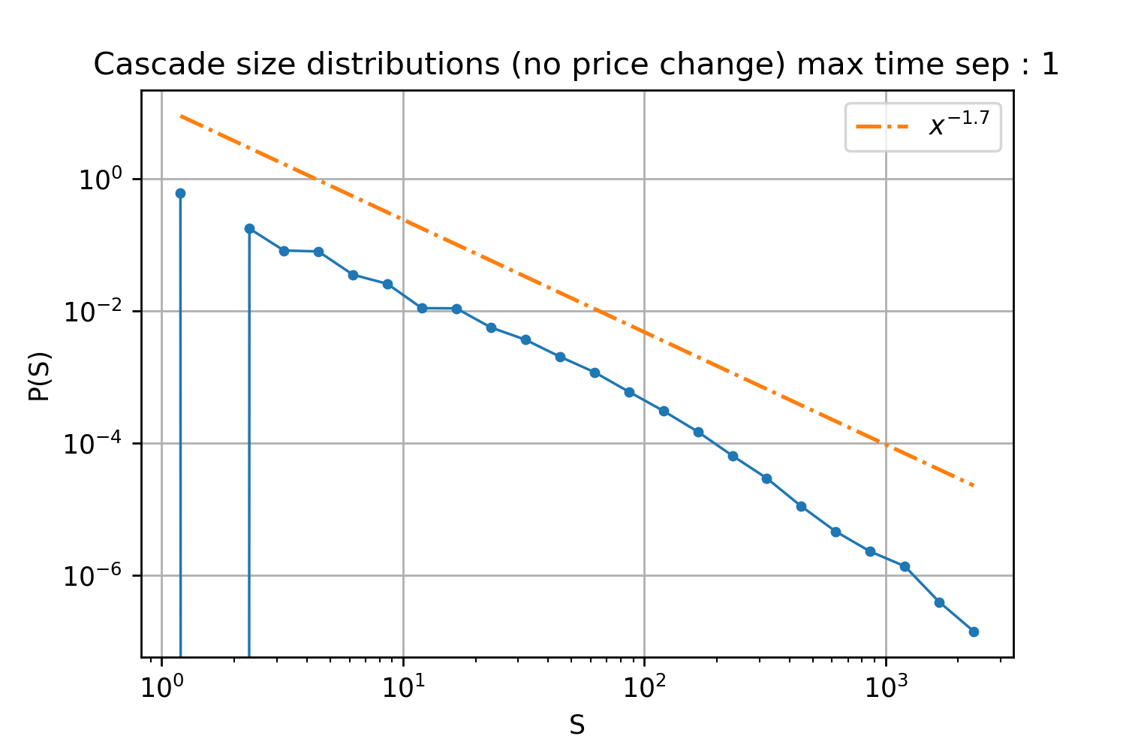
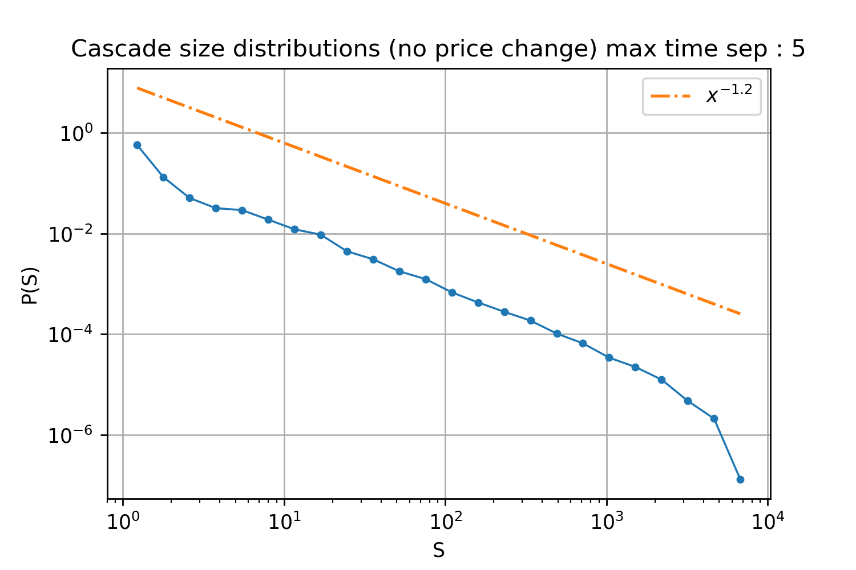
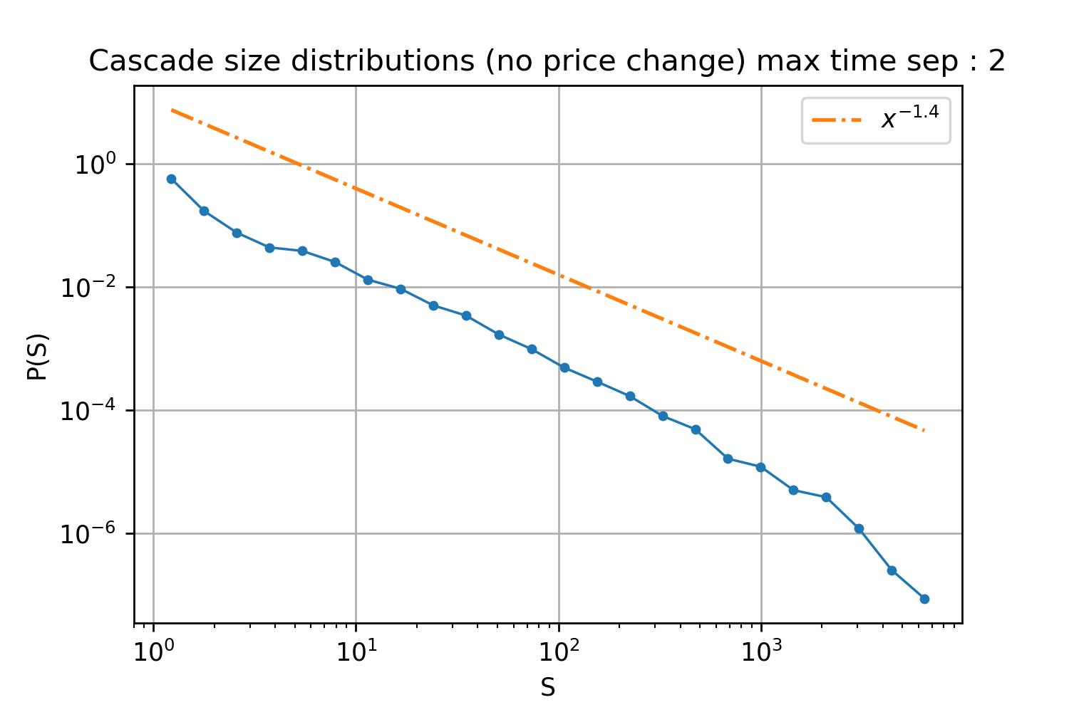
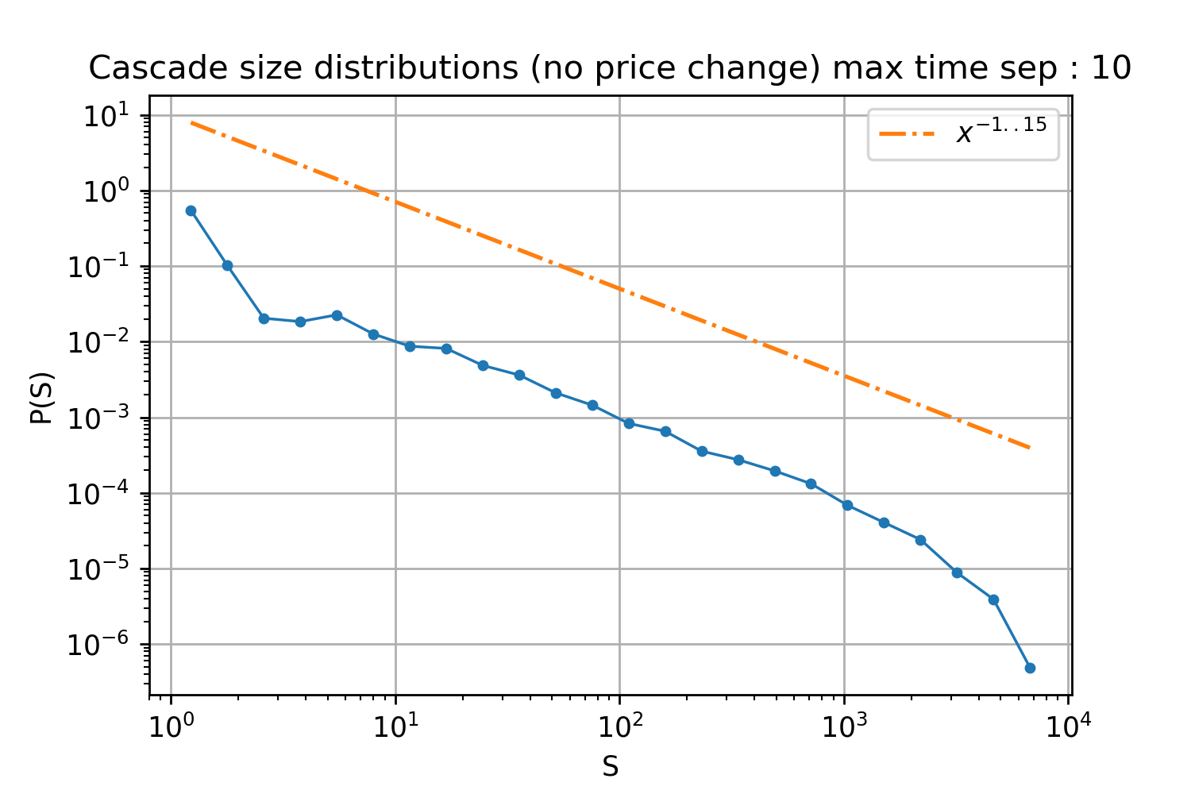

Slide 16
Portfolio Rebalance Cascades
Similar to stock cascades, but looking at number of portfolios rebalanced as a binary event
Seperate cascades by a minimum number of portfolios rebalanced

Slide 17
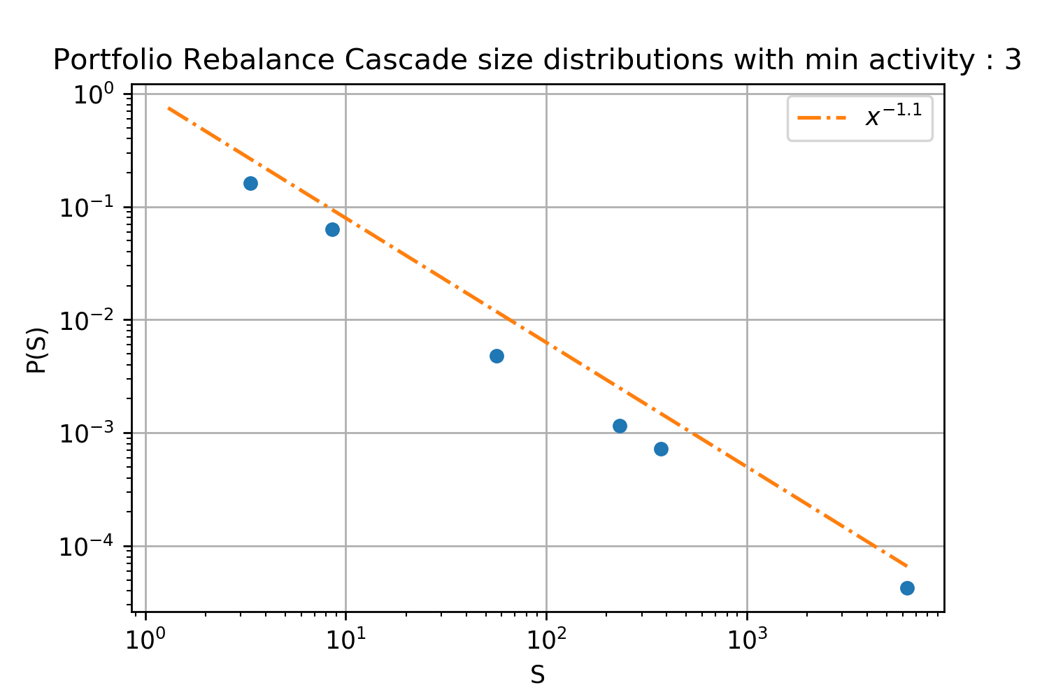
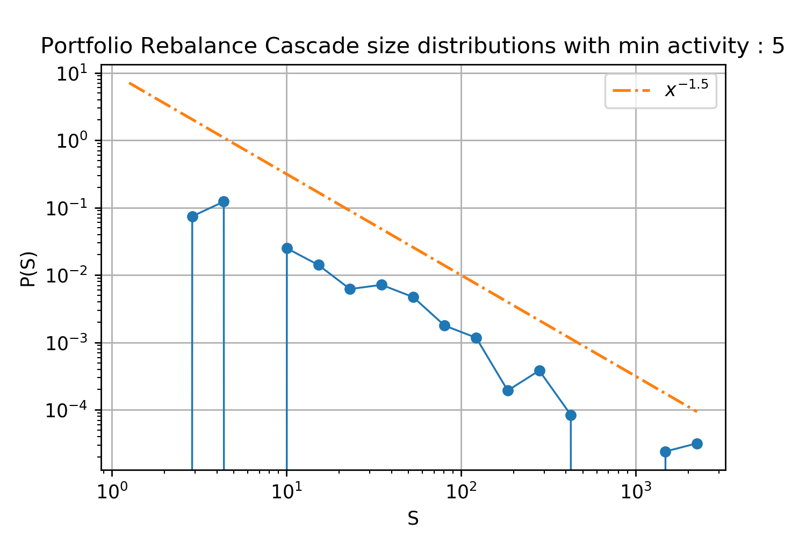
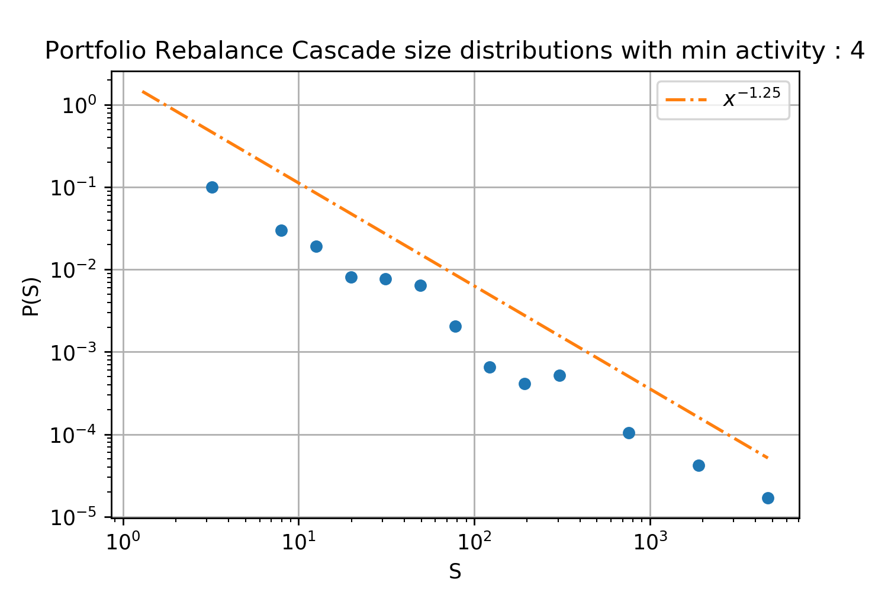
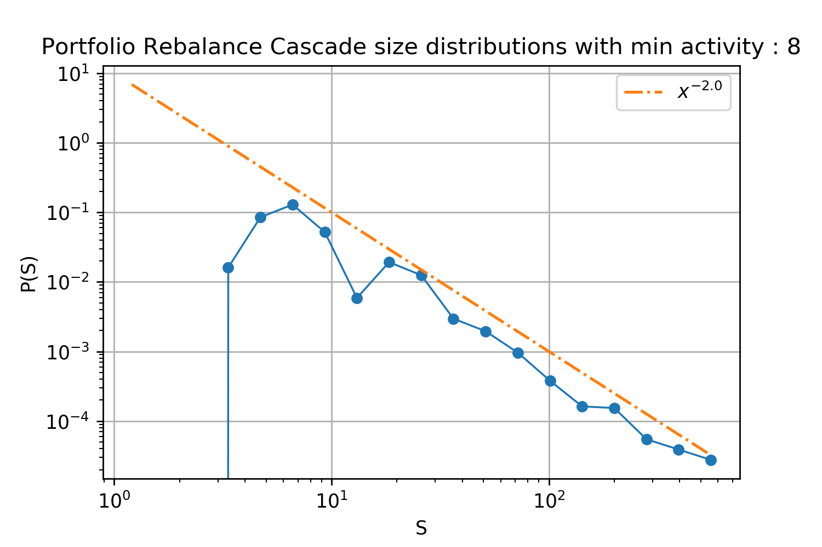

Slide 18
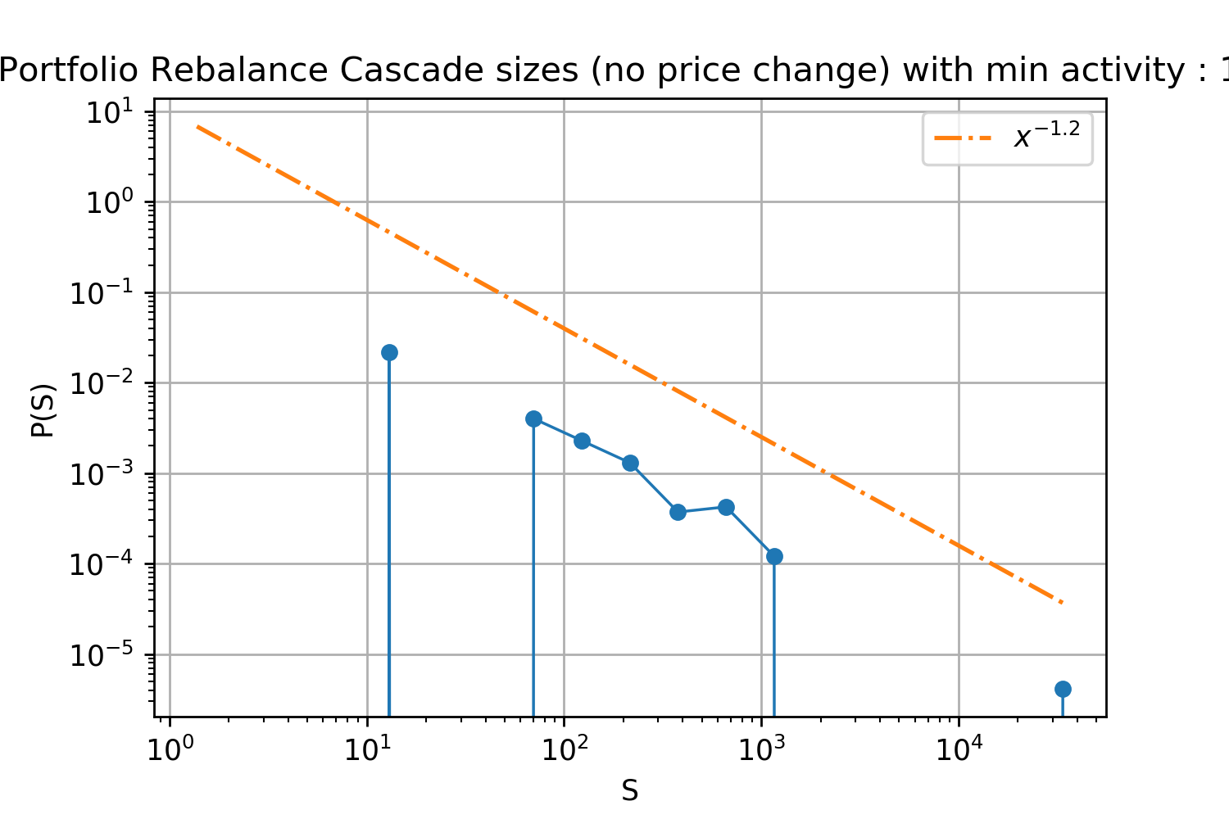
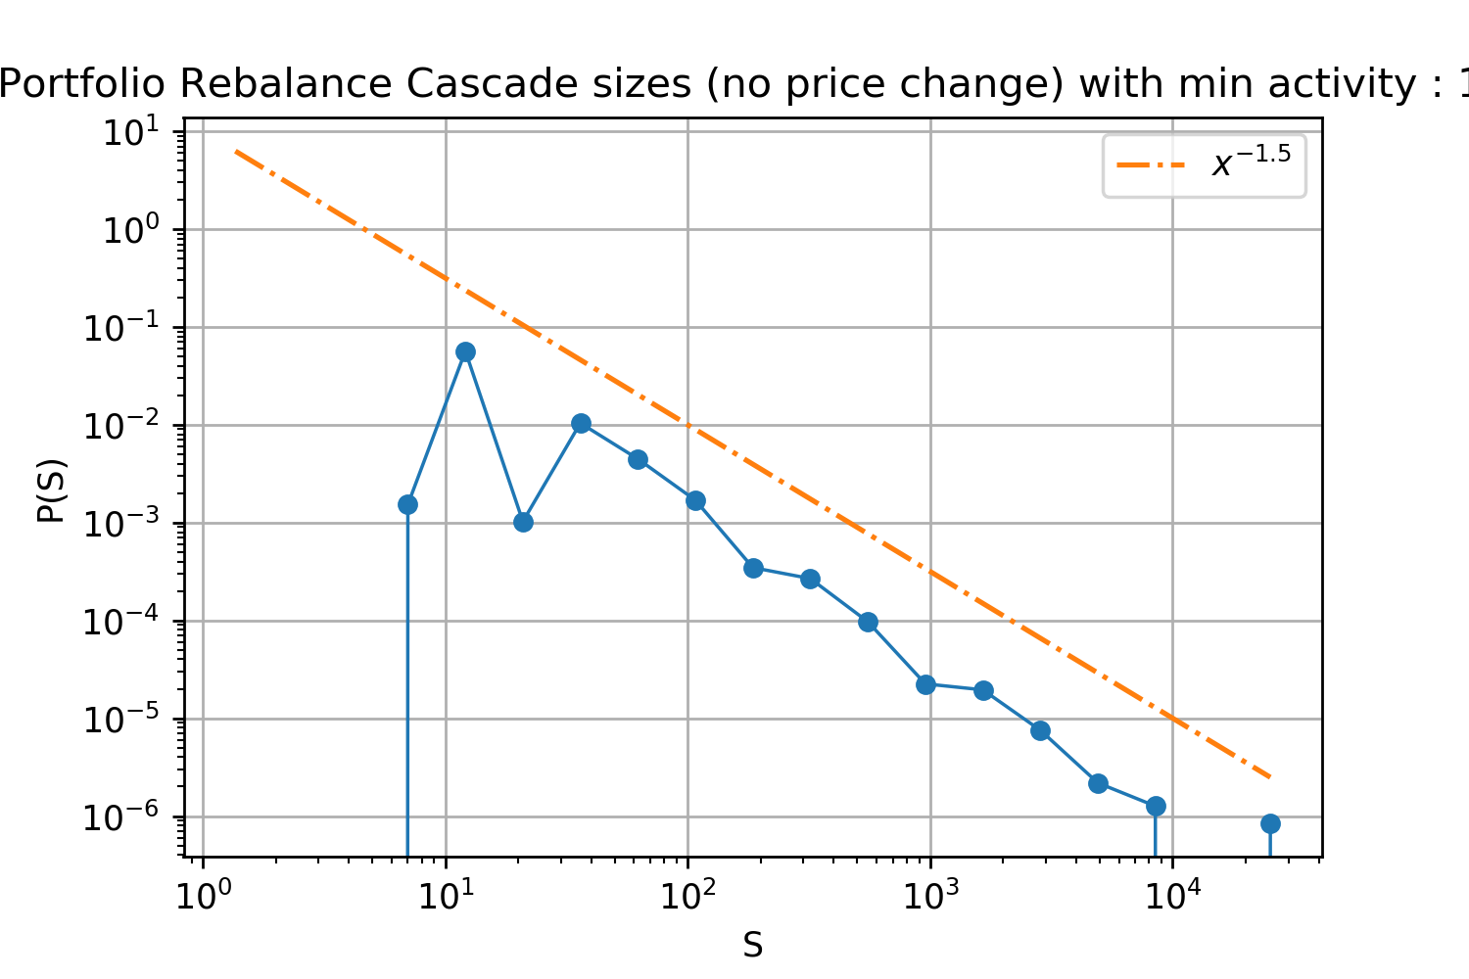
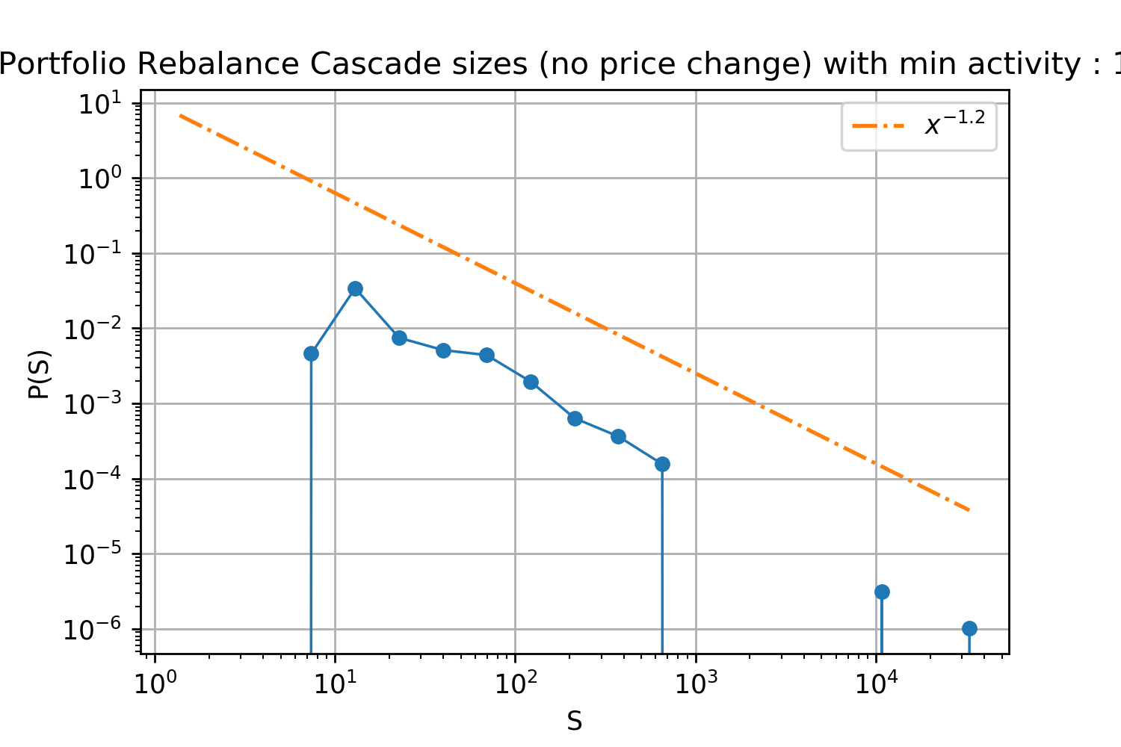
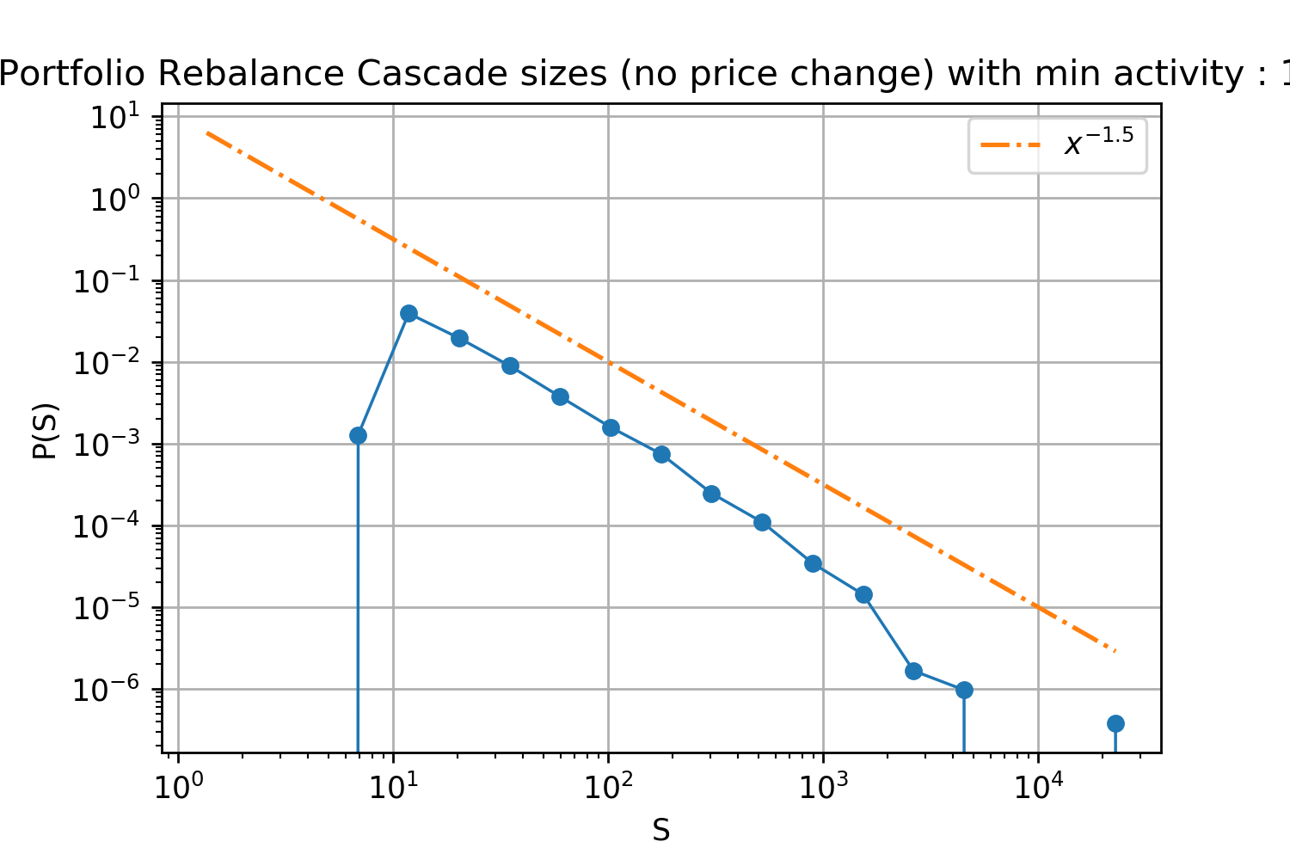
10
14
12
16

