Slide 1
June 28 Update
Portfolio Network Generation—3 different methods
Price Update with Hurst Index
Thresholding with Sigmoid Function
Data format and analysis
Braedyn Au

Slide 2
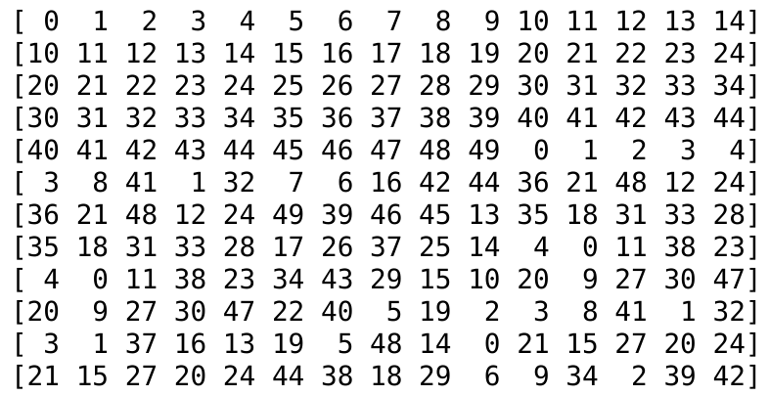
Rolling method
5 overlap in size 15 portfolios
shuffle
shuffle

Slide 3
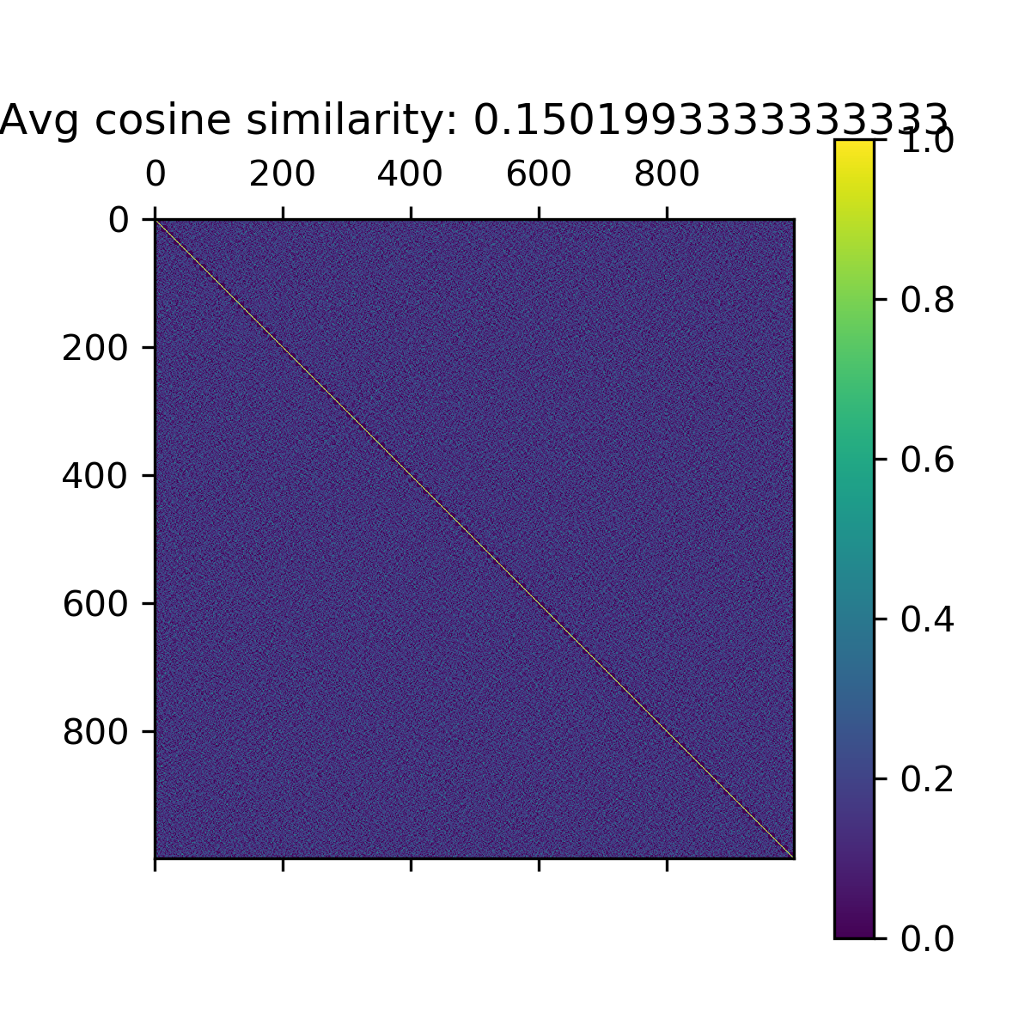

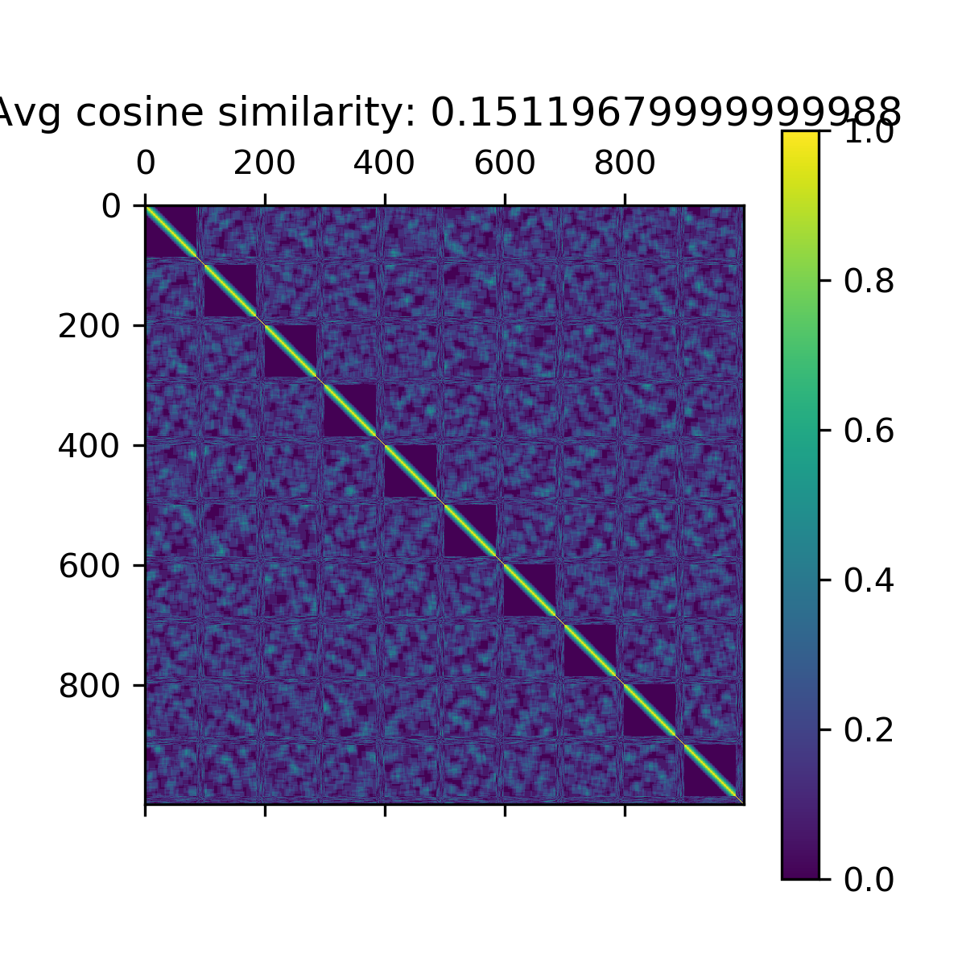
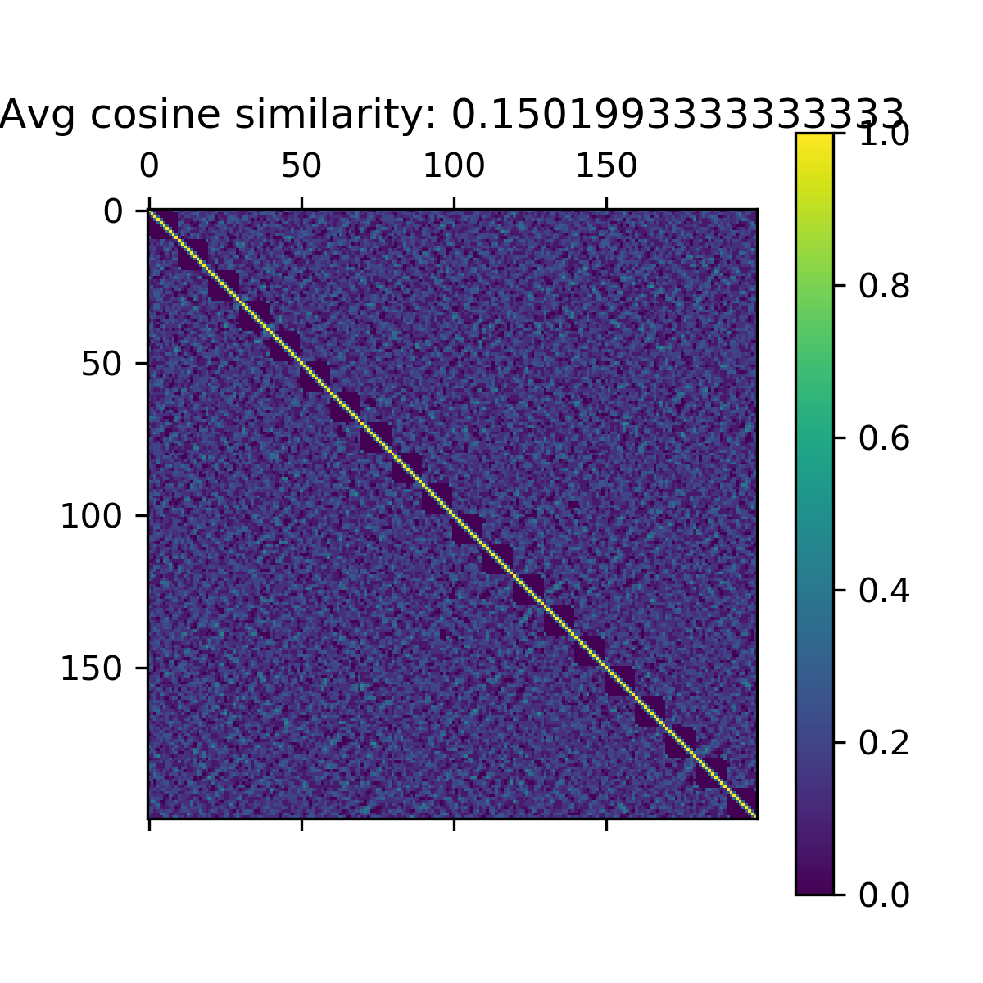

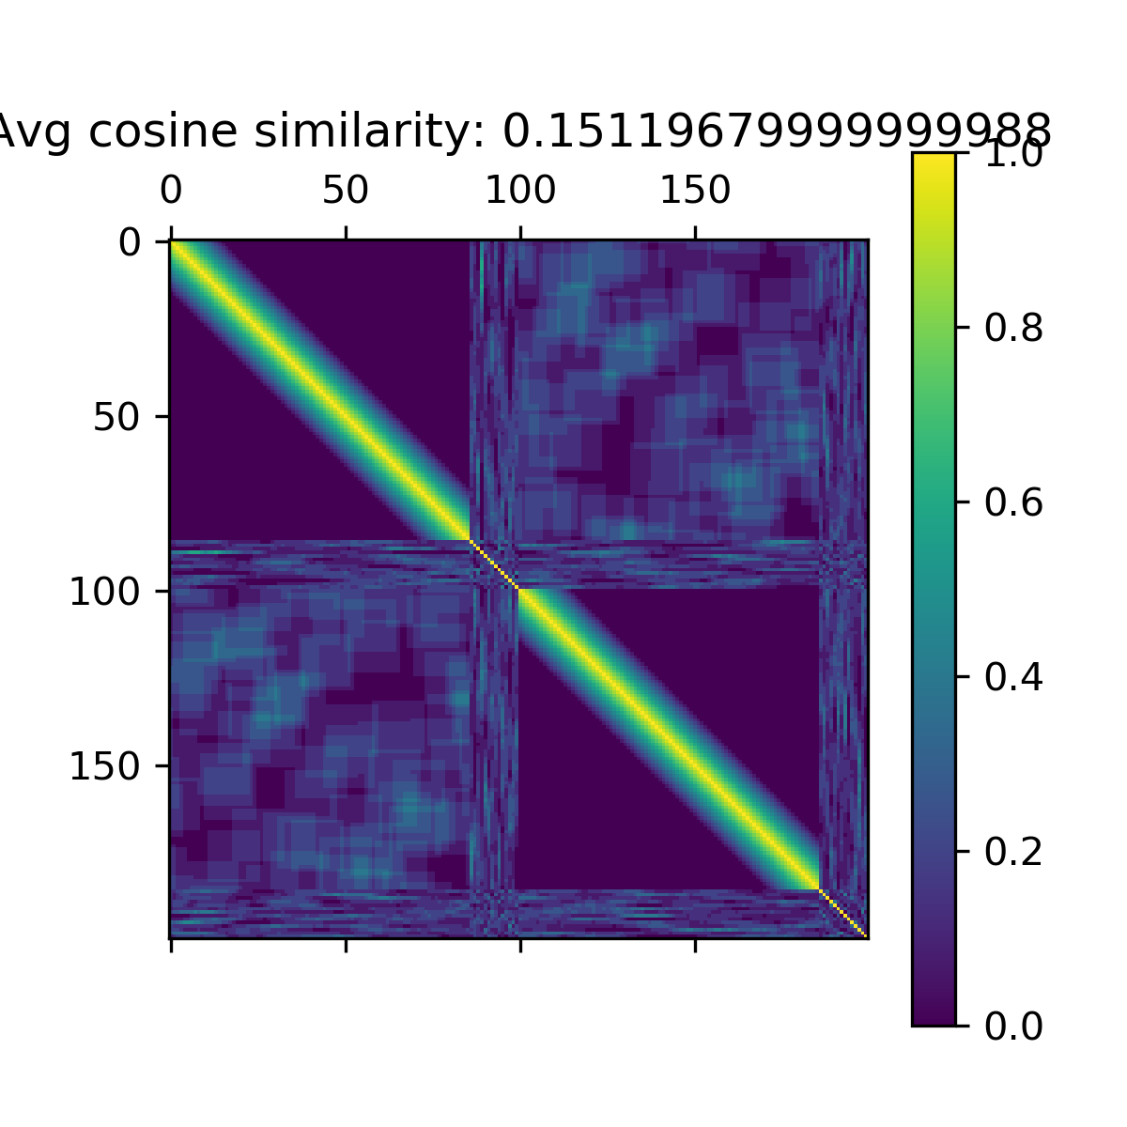
Rolling Method cosine similarities
1000 portfolios of size 15
Overlap window size: 5
Overlap window size: 10
Overlap window size: 14

Slide 4
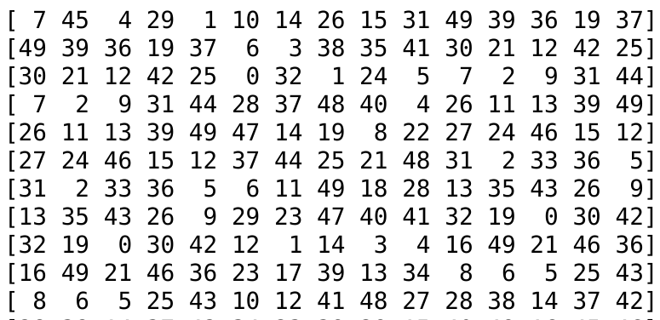
Rolling with random choice
5 overlap in size 15 portfolios
First 5 overlap last 5 of previous portfolio
Last 10 chosen randomly from remaining stocks

Slide 5
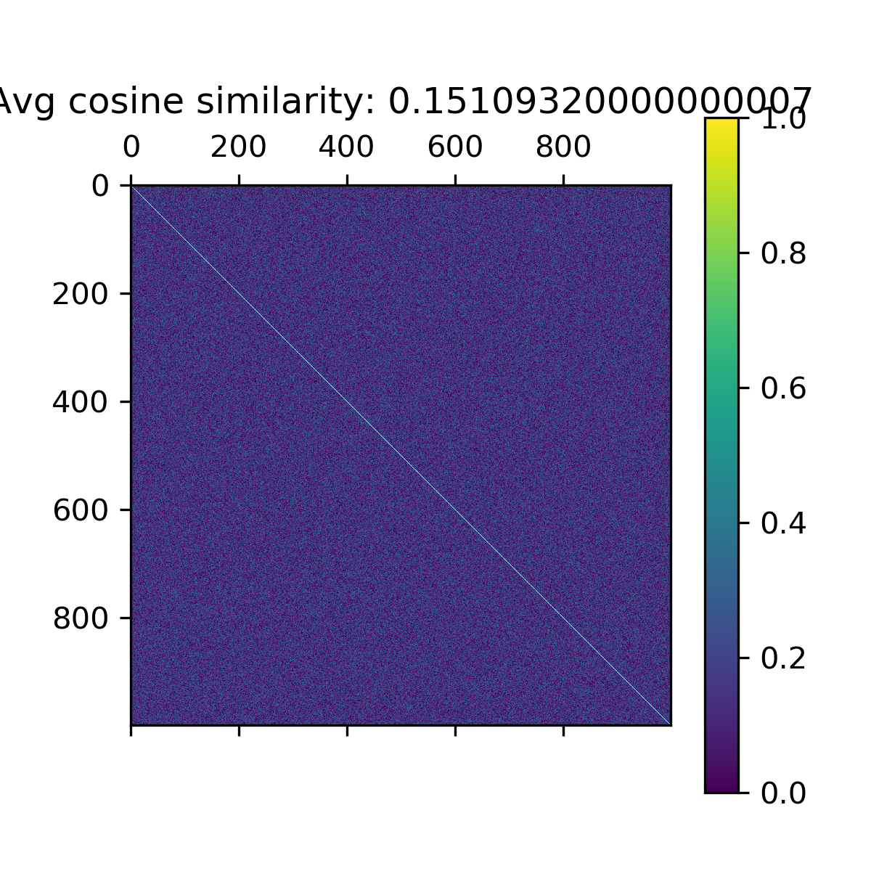
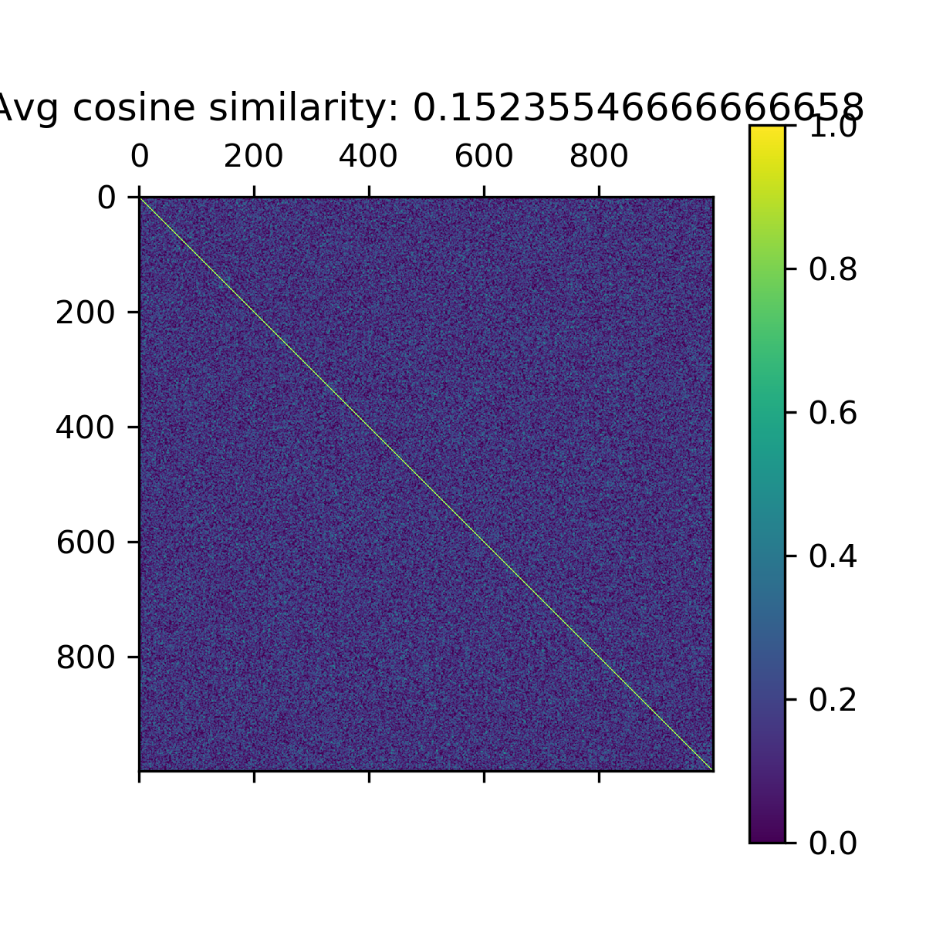
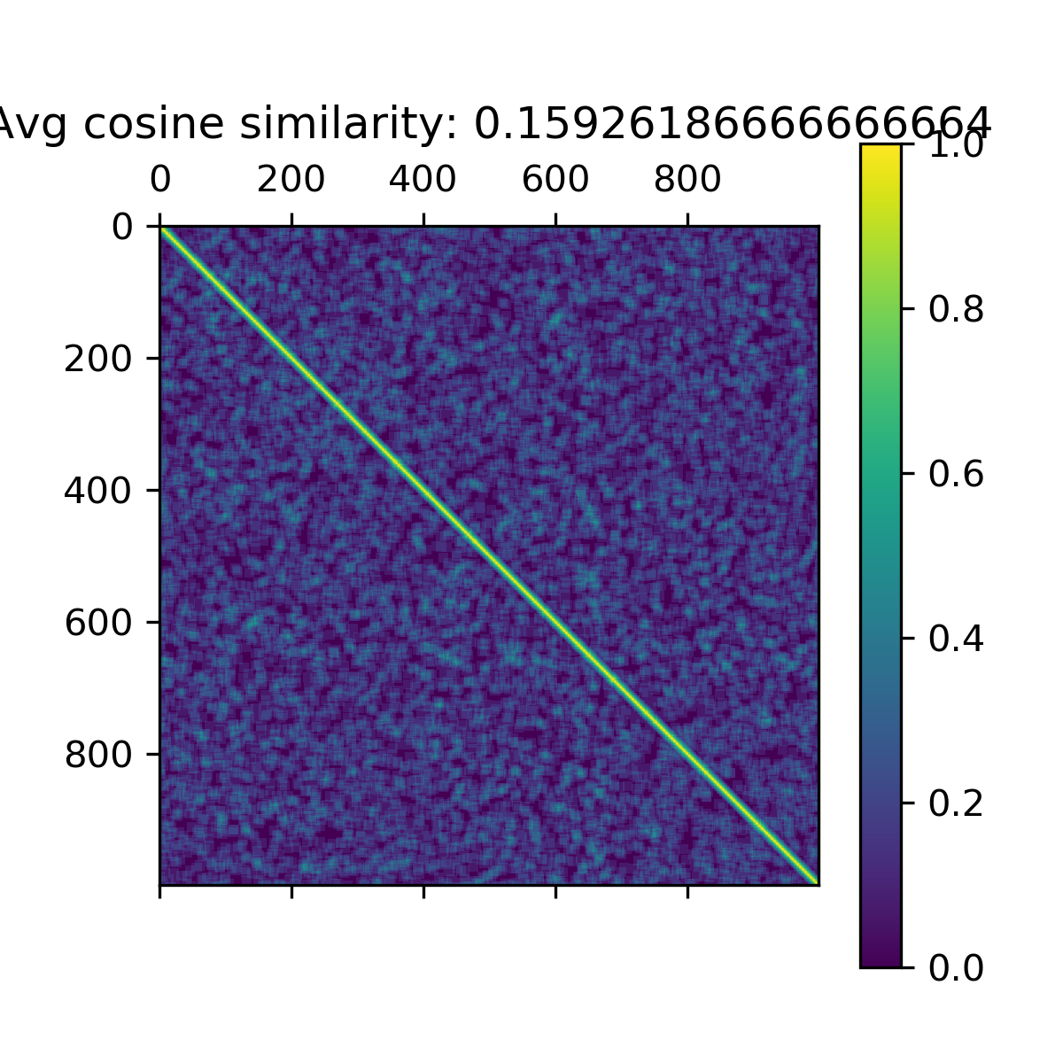
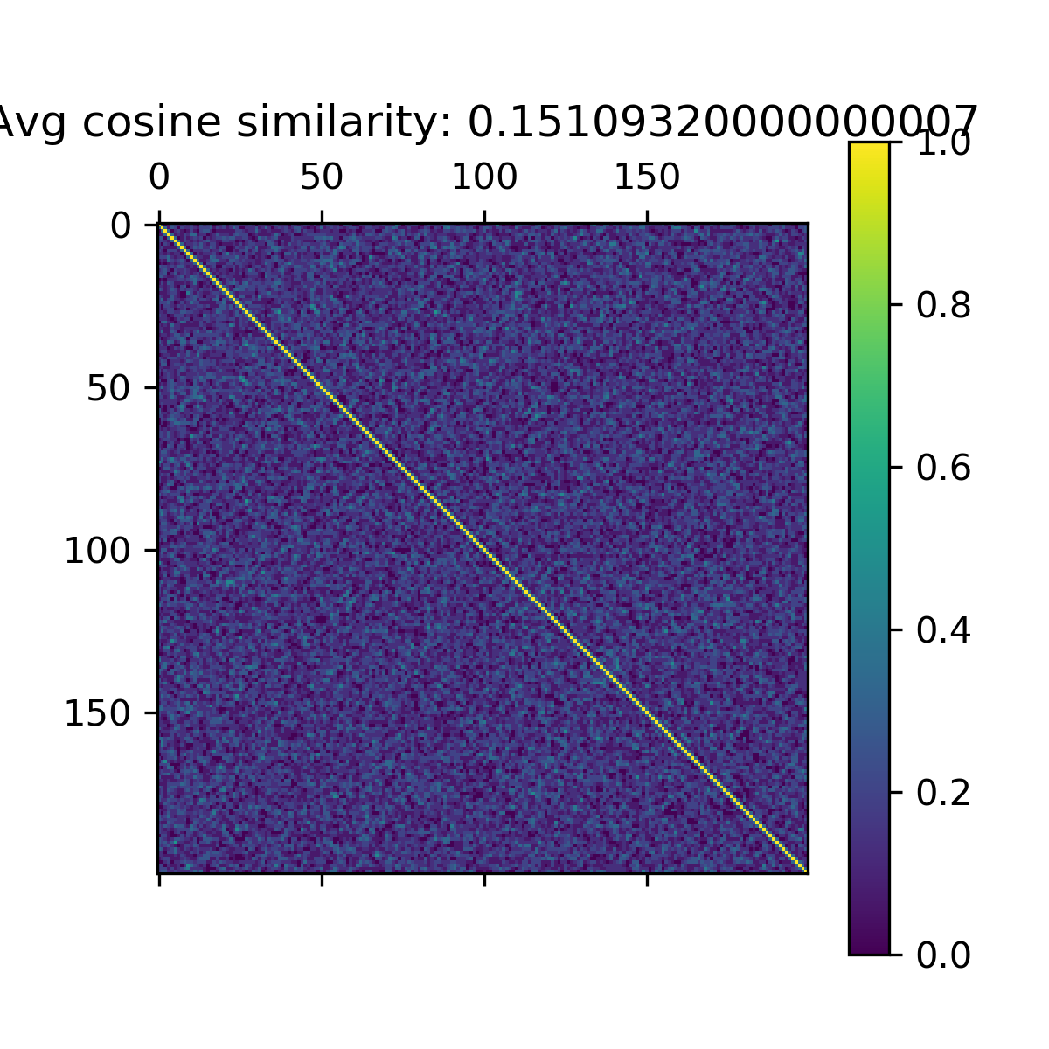
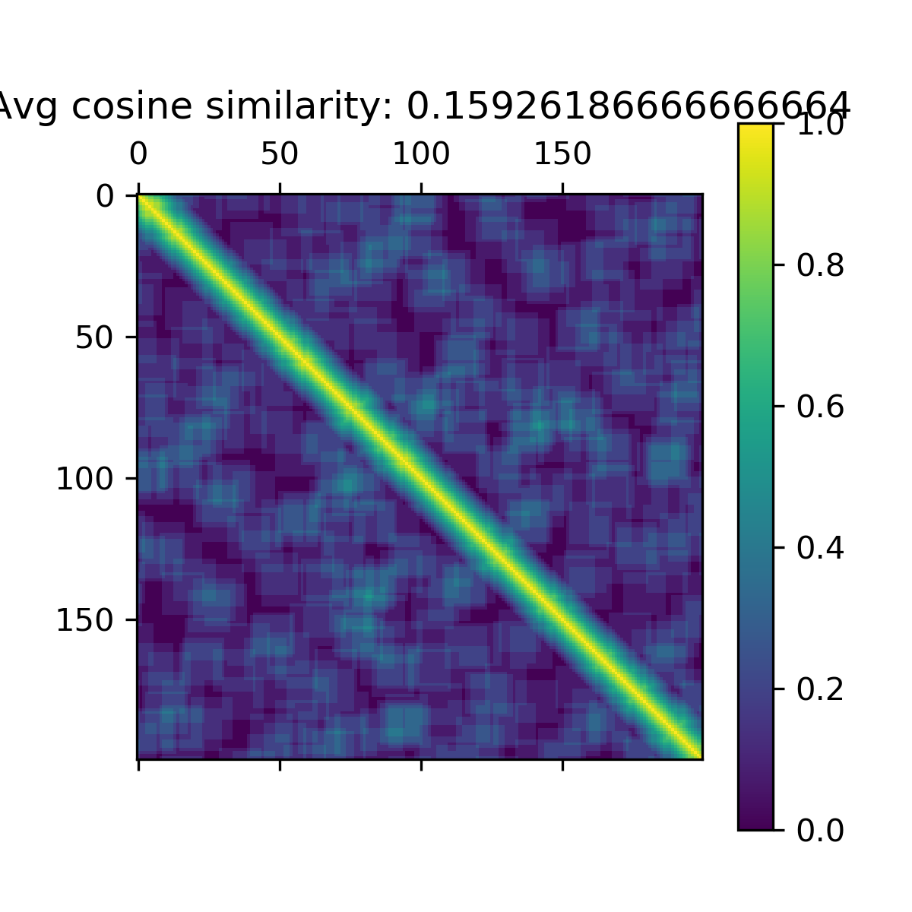
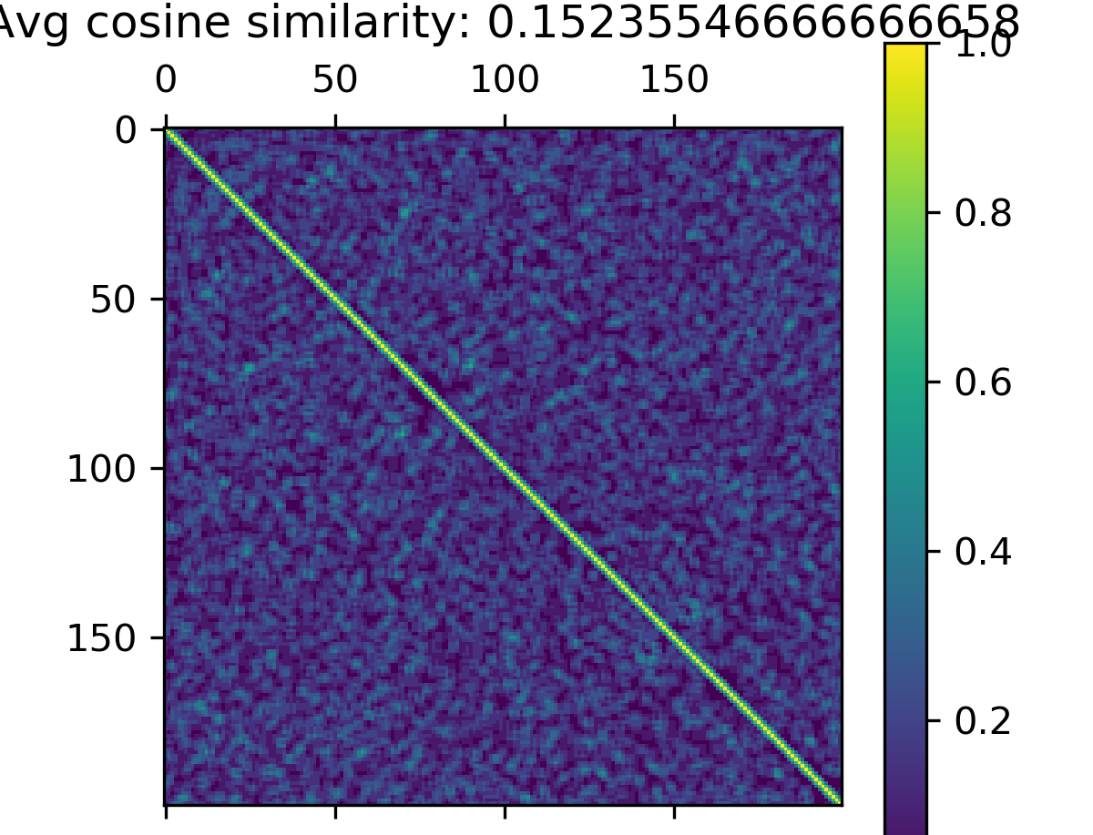
Rolling w/ Random cosine similarities
1000 portfolios of size 15
Overlap window size: 5
Overlap window size: 10
Overlap window size: 14

Slide 6
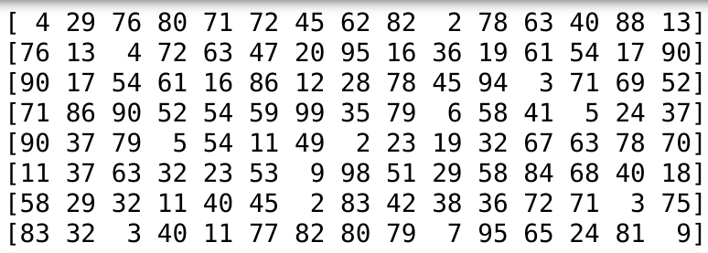
Random method
5 overlap in size 15 portfolios
First 5 overlap chose randomly from previous portfolio
Last 10 chosen randomly from remaining stocks

Slide 7

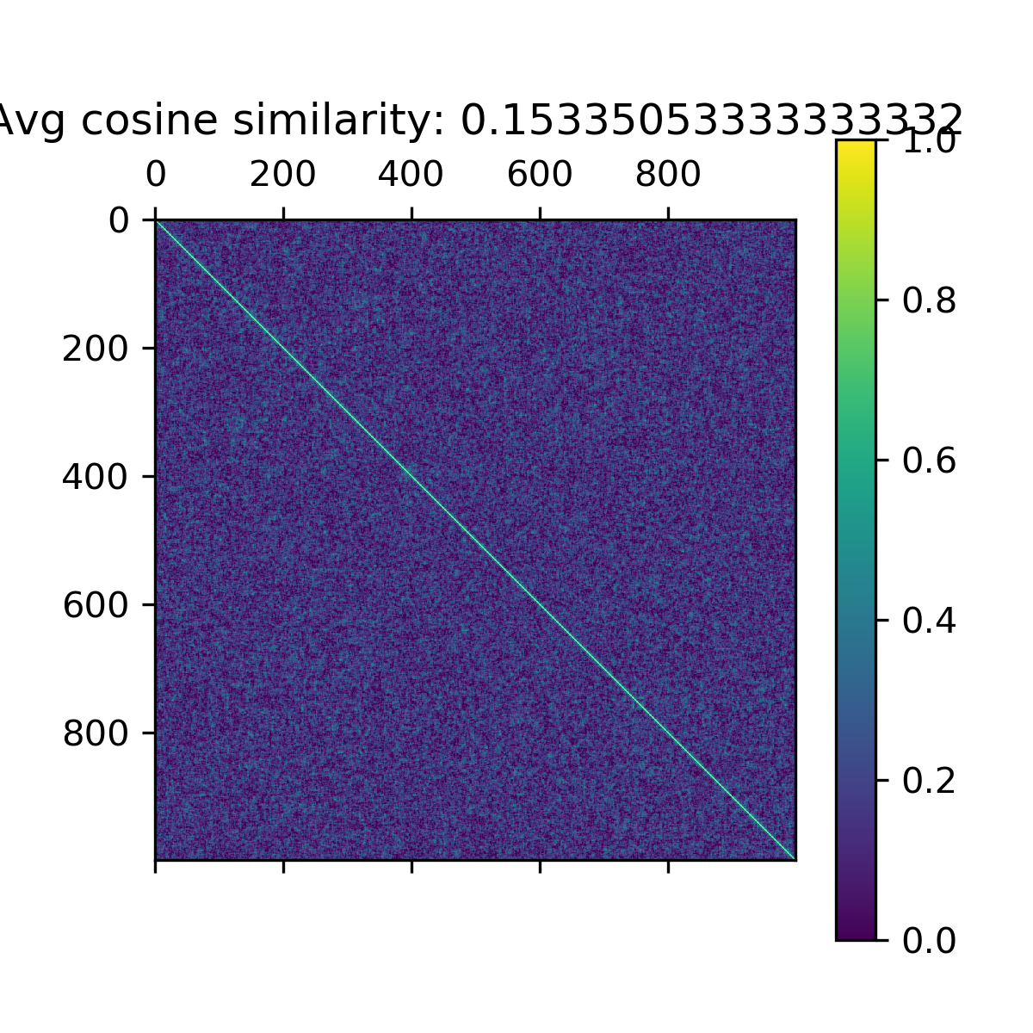

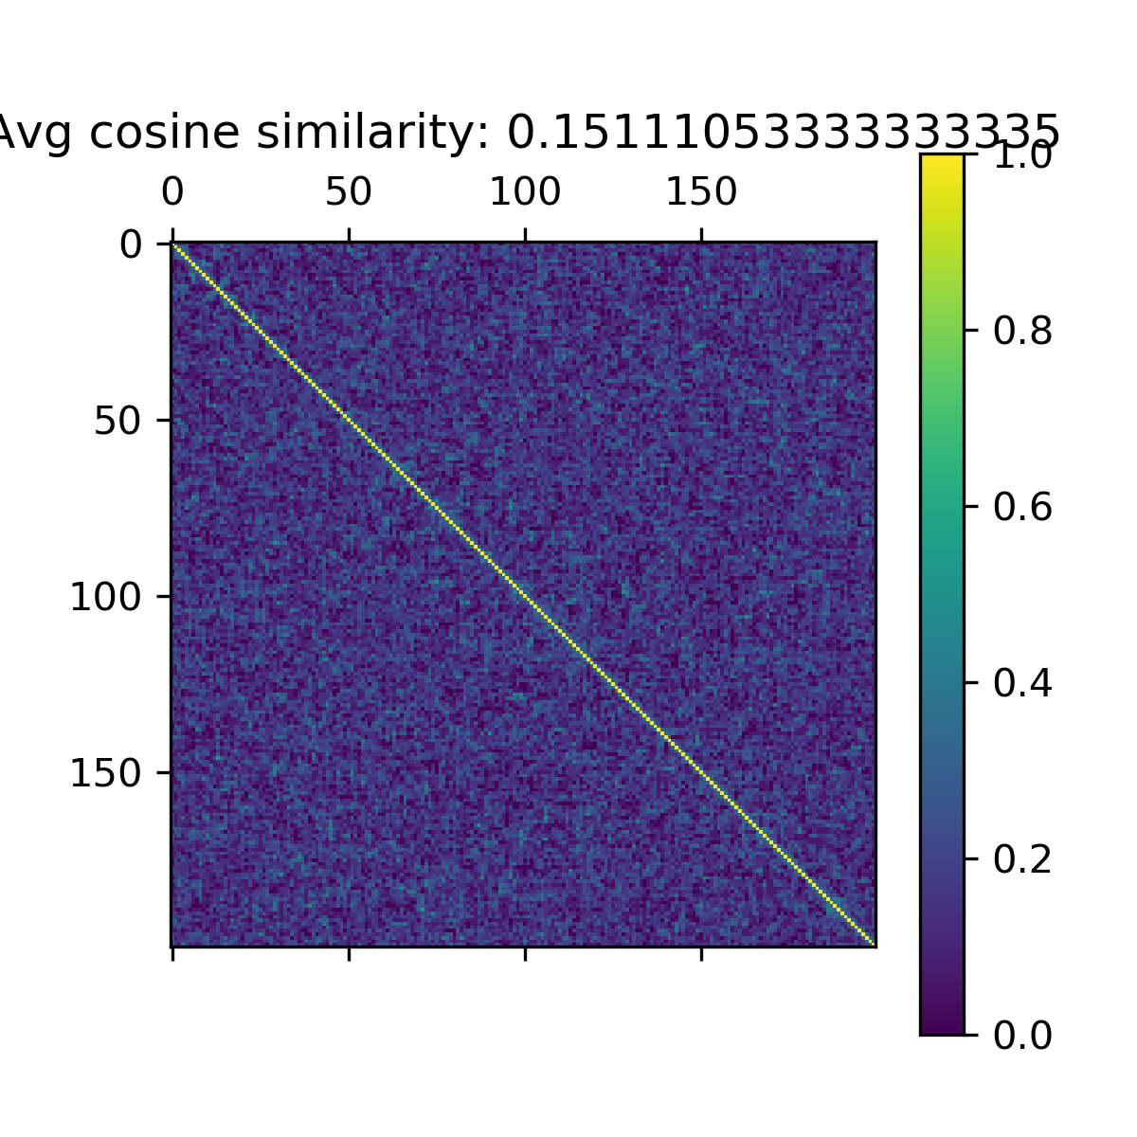
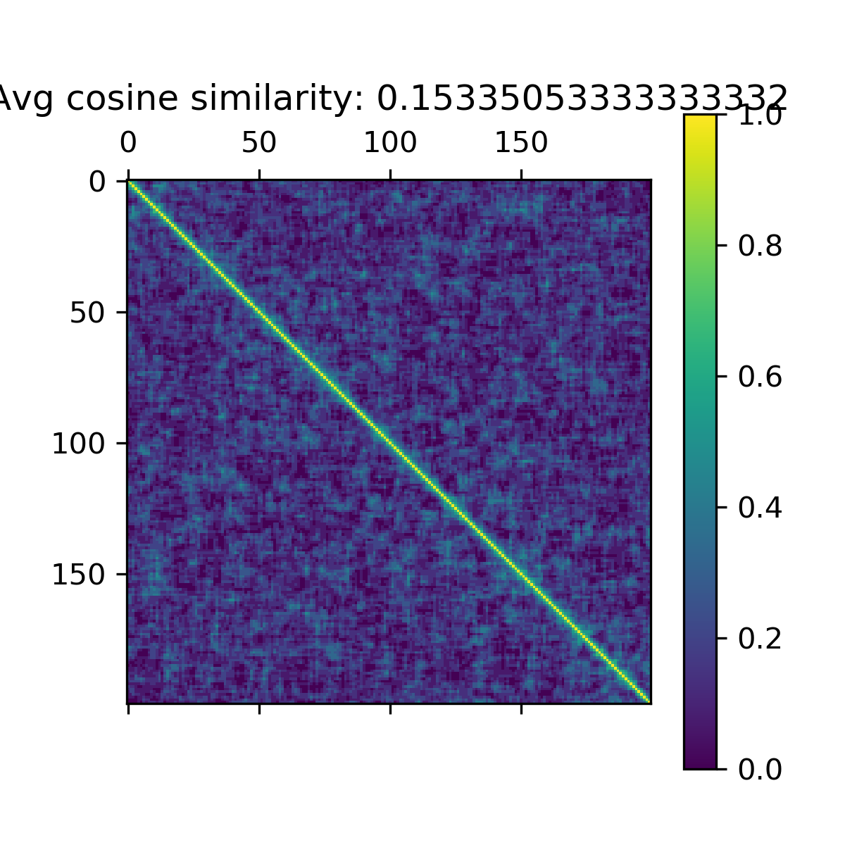
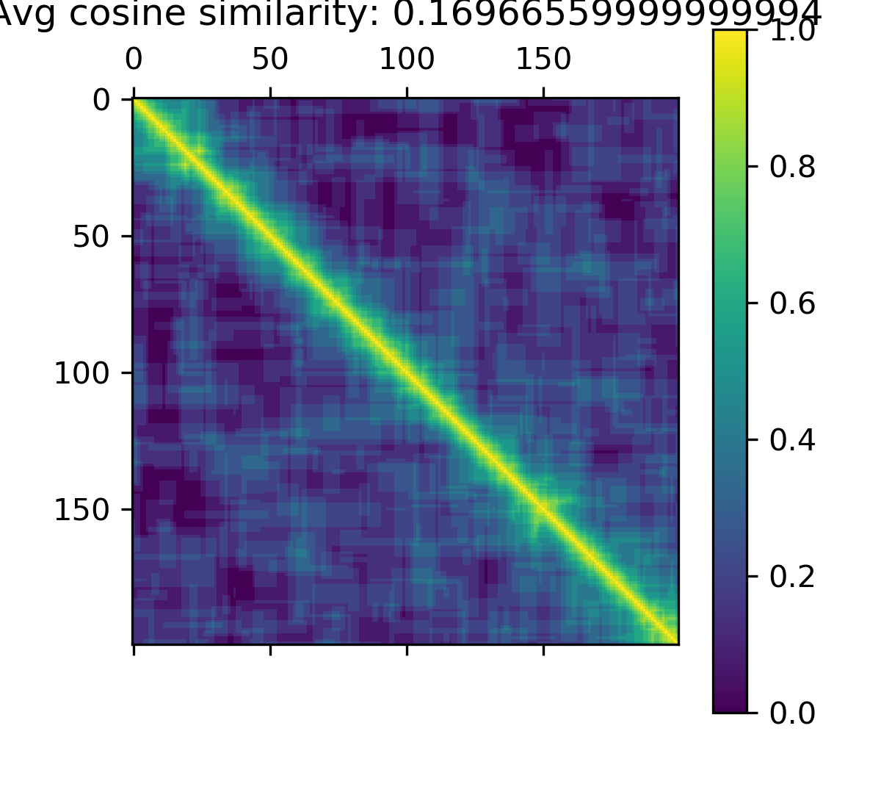
Rolling w/ Random cosine similarities
1000 portfolios of size 15
Overlap window size: 5
Overlap window size: 10
Overlap window size: 14

Slide 8
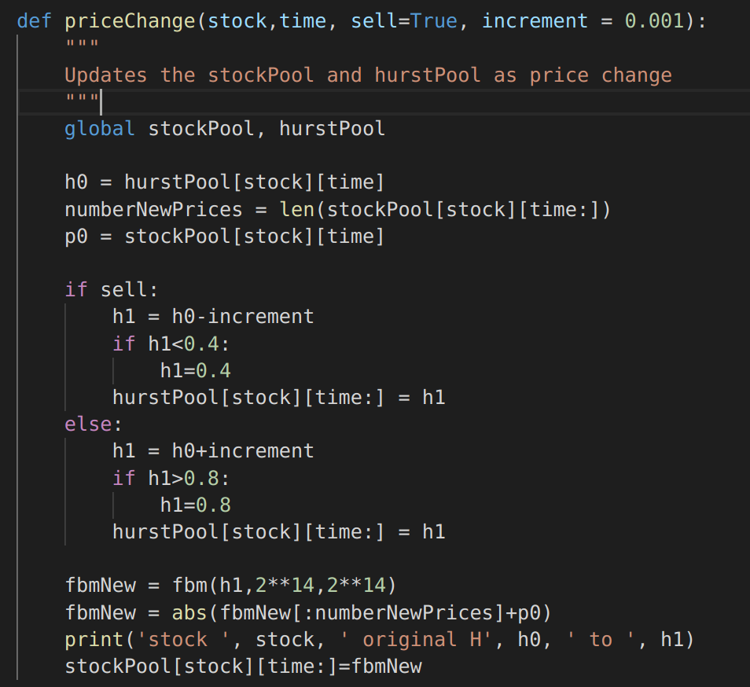
Price Update
If selling a stock, decrease H index
If buying, increase H index
Generates new fBM path and replaces the remaining stock prices from that point forward
Absolute value of the new stock prices

Slide 9
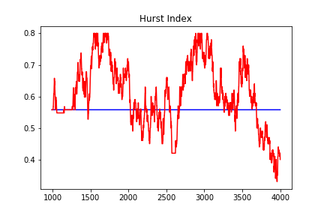
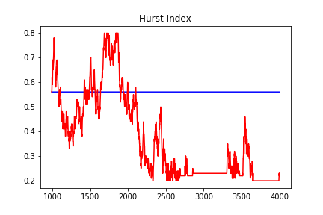
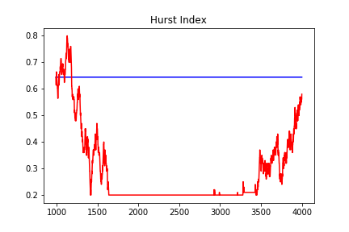
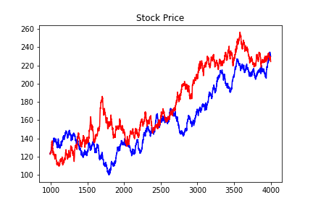
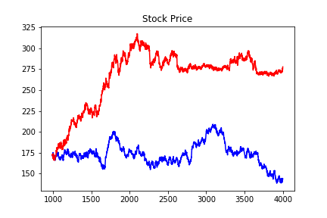
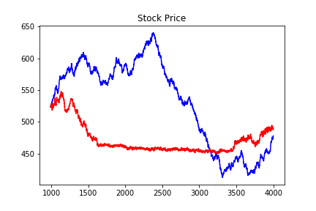
Increment of 0.01
Stock 4
Stock 5
Stock 2
Changing Index Original Index
Hurst indices (top) and corresponding stock price (bottom)

Slide 10
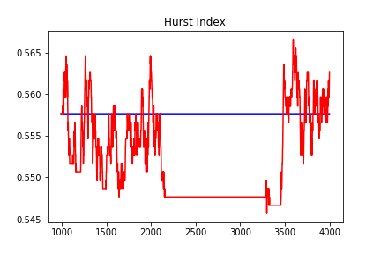
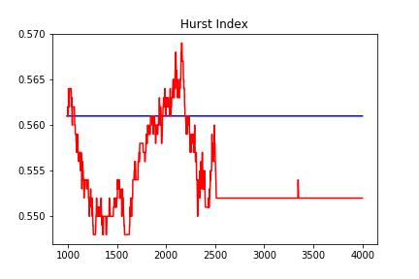
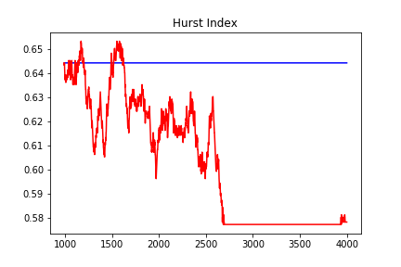
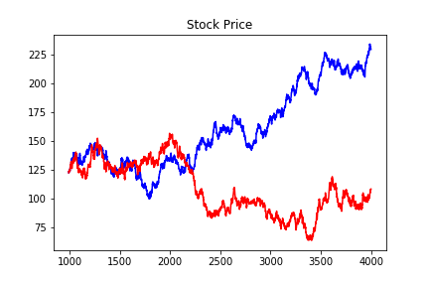
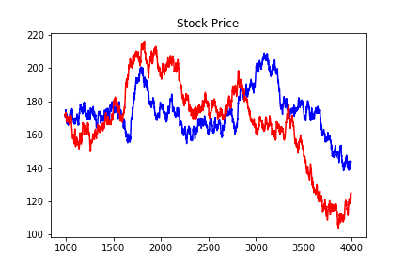
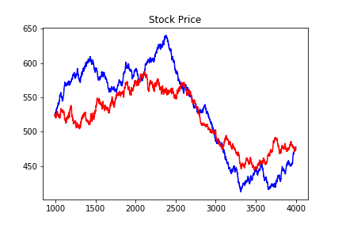
Increment of 0.001
Stock 4
Stock 5
Stock 2
Changing Index Original Index
Hurst indices (top) and corresponding stock price (bottom)

Slide 11
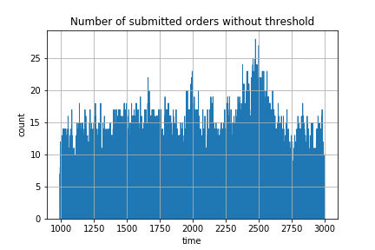
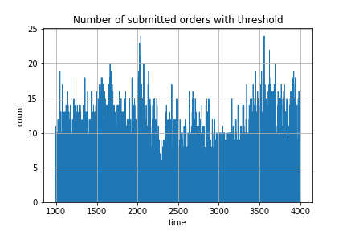
Thresholding with Sigmoid Function
1st run: 100% rebalance probability each turn
  compile all the Sharpe ratios at each point in time of each portfolio
  Take a top percentile of these ratios for sigmoid function
2nd run: varying probability based on sigmoid function

Slide 12
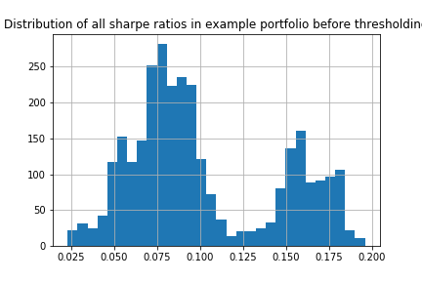
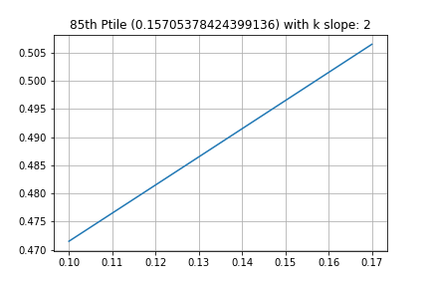
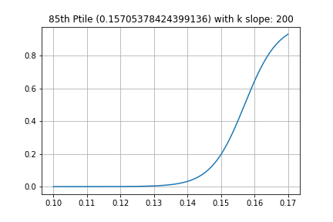
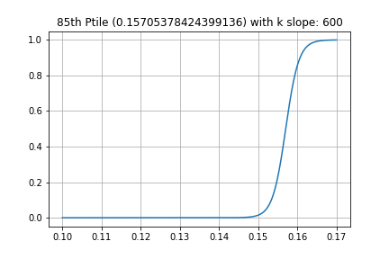
Sigmoid functions
Small slopes hover around 50% at all ratios

Slide 13
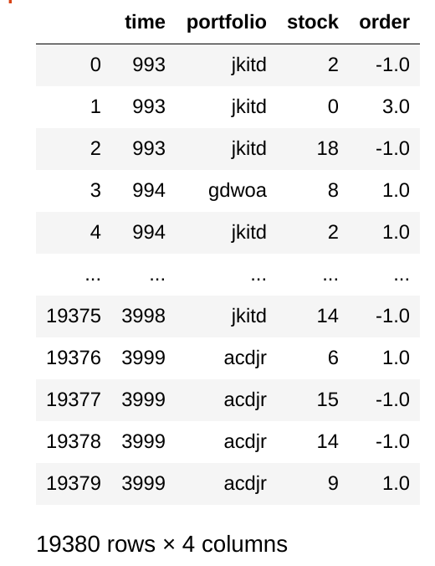
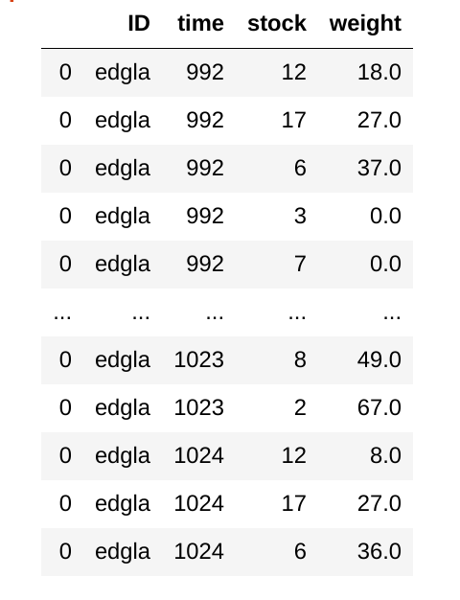
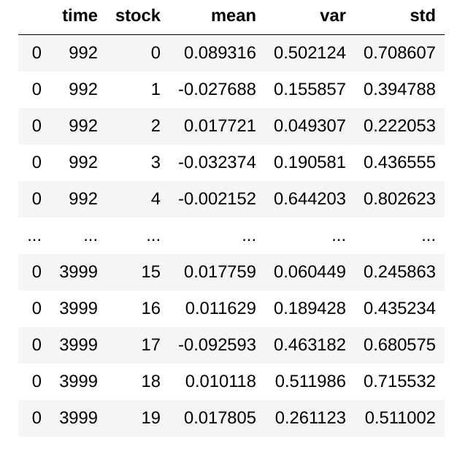
Data tables
Transactions list
Volumes are very small, should increase once I use a steeper sigmoid function or increase portfolio total volumes
Stock Characterstics
Characteristics of each stock at each time point taken based on the window of points beforehand
Portfolio weights
Each portfolio has a table tracking its weights over time

Slide 14
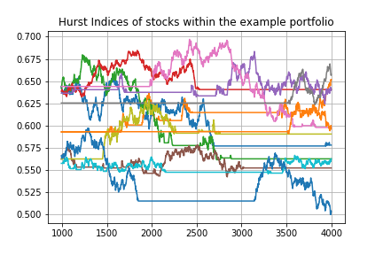
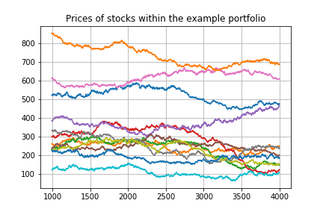
Example Portfolio
Contains 12 stocks

Slide 15
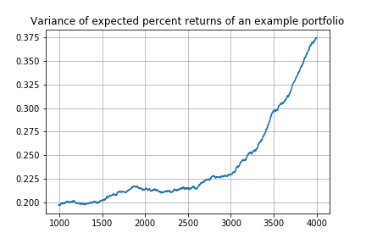
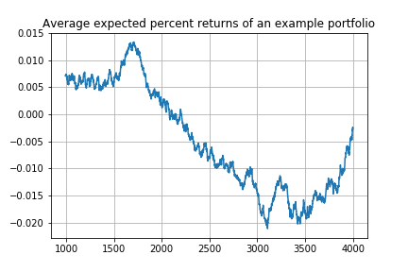
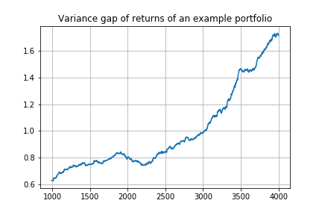
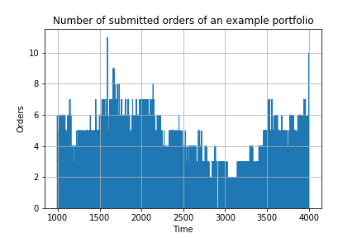
Haven’t accounted for weights in these figures

