Slide 2
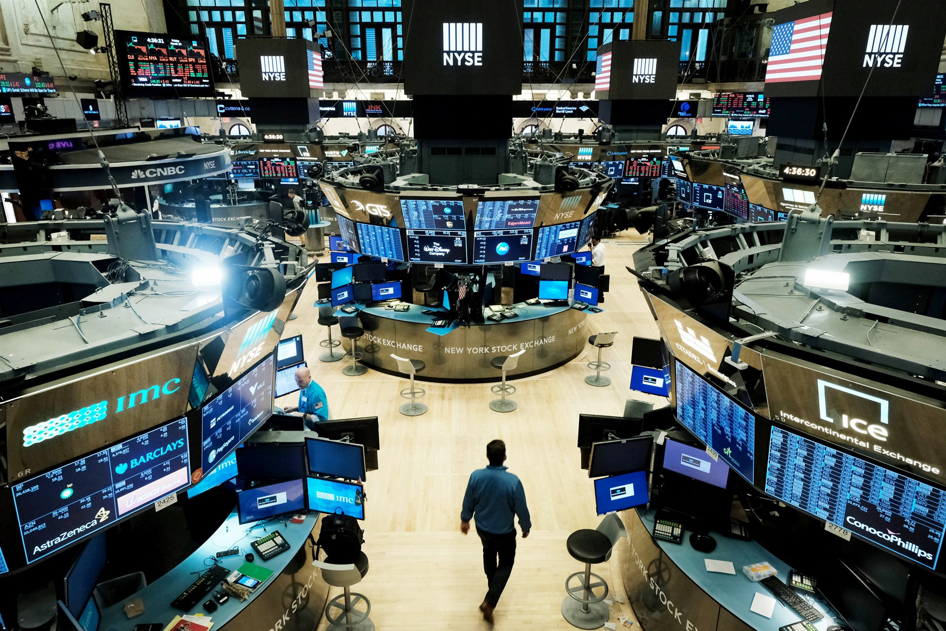
Image from nbcnews.com

Slide 3
Modern Portfolio Theory
Maximize returns while minimizing risk through diversification

Slide 4
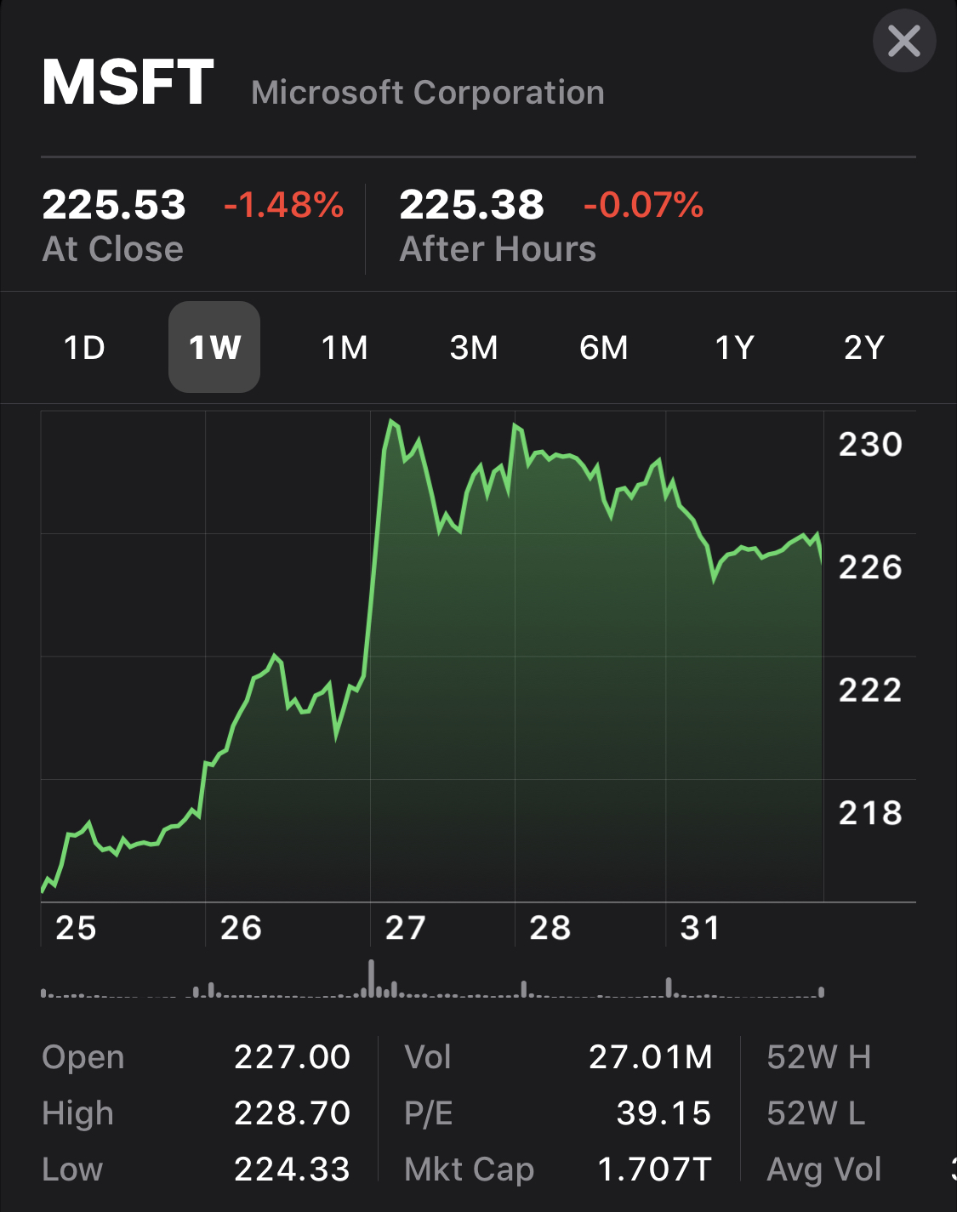
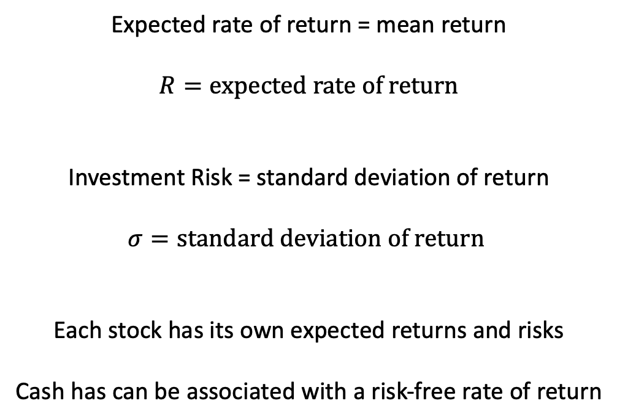
Mean-Variance Analysis
Expected rate of return = mean return
$$R=expected rate of return$$
Investment Risk = standard deviation of return
$$σ=standard deviation of return$$
Each stock has its own expected returns and risks
Cash has can be associated with a risk-free rate of return

Slide 5
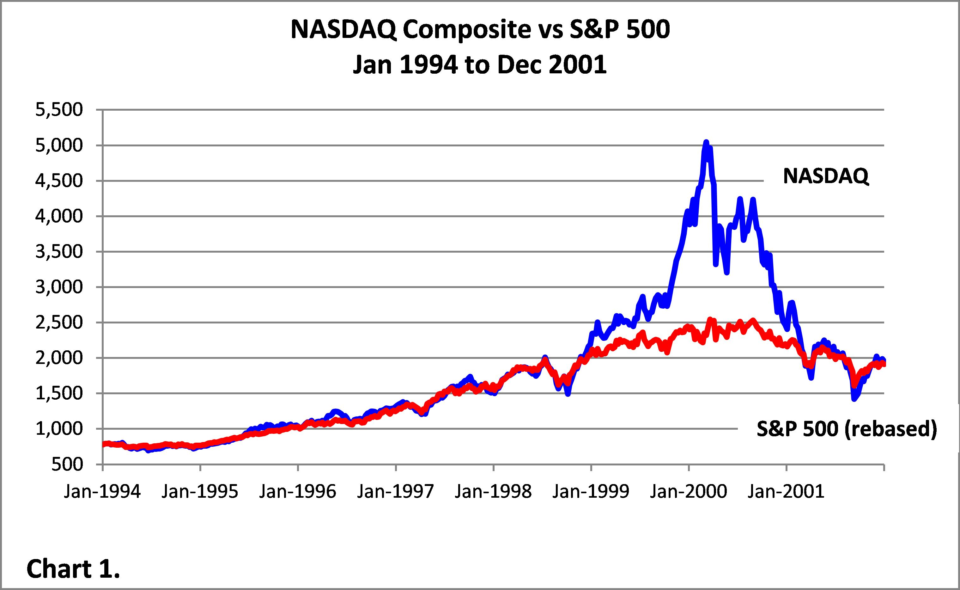
Correlations
Correlated Stocks
https://greenmangotrading.wordpress.com/2014/12/14/case-study-dot-com-bubble/
Investing in uncorrelated stocks reduces portfolio risk

Slide 6





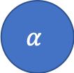


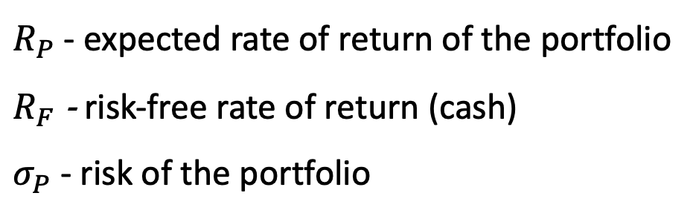



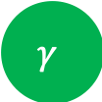


Stocks
$$R_{α} , σ_{α}$$
$$R_{β} , σ_{β}$$
$$R_{γ} , σ_{γ}$$
$$R_{δ} , σ_{δ}$$
$$R_{F} , σ_{F}$$
$$α$$
$$β$$
$$γ$$
$$δ$$
CASH
$$w_{α}$$
$$w_{β}$$
$$w_{γ}$$
$$w_{δ}$$
$$w_{F}$$
Portfolio
$R_{P}$ - expected rate of return of the portfolio
$R_{F}$ - risk-free rate of return (cash)
$σ_{P}$ - risk of the portfolio
Modern Portfolio Theory aims to optimize the weights allocated to each stock to maximize the overall return of the portfolio while minimizing risk.

Slide 7
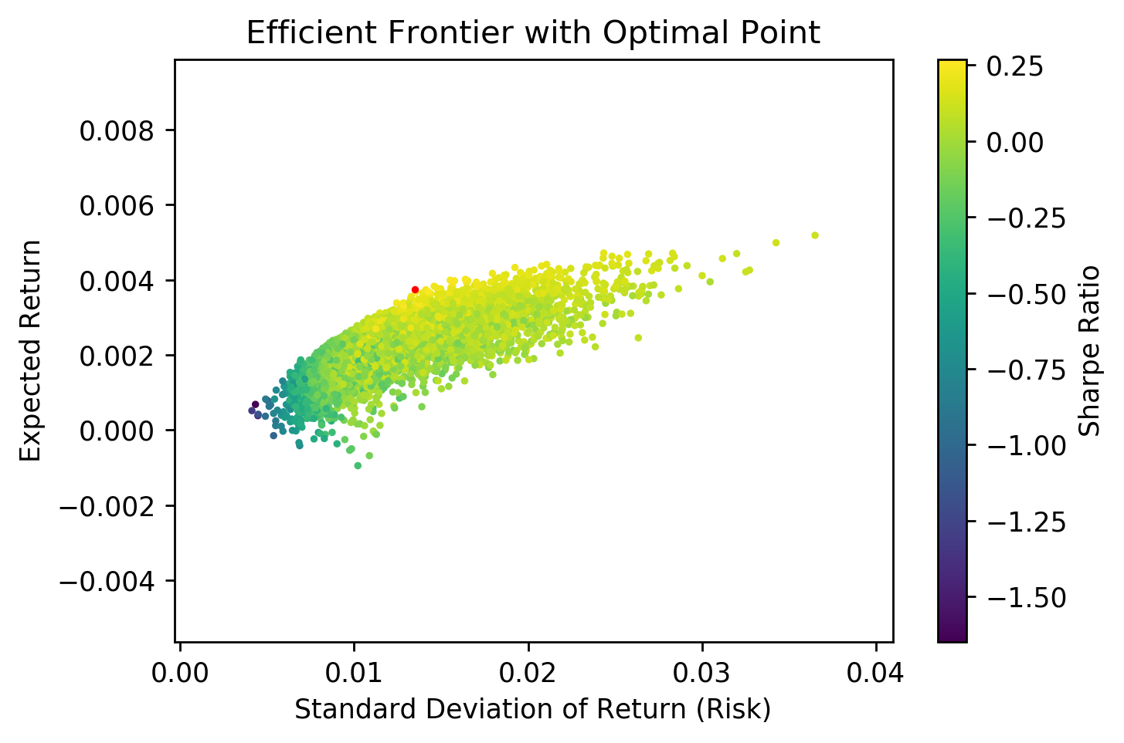
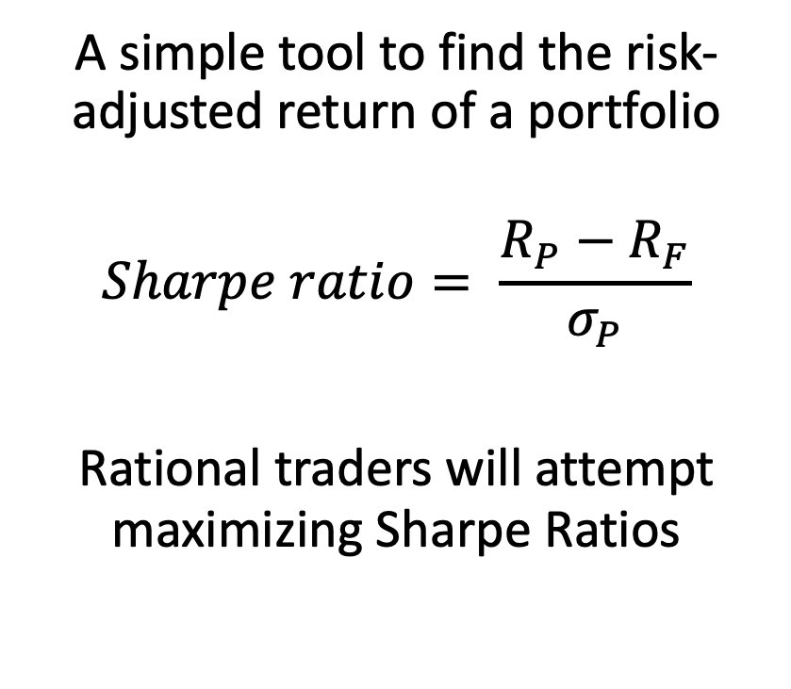
Sharpe Ratio
A simple tool to find the risk-adjusted return of a portfolio
$$Sharpe ratio= \frac{R_{P}−R_{F}}{σ_{P}}$$
Rational traders will attempt maximizing Sharpe Ratios
Efficient Frontier
Simulated portfolio with random allocations of weights generates an efficient frontier of portfolios.
Optimal portfolio found via Sharpe Ratio marked in red.

Slide 8
Simulating Stock Prices

