Slide 1
Rebalancing Cascades on the Stock Market
Braedyn Au
Summer 2020
Supervised by Joern Davidsen and Siew Ann Cheong

Slide 2
Modern Portfolio Theory (MPT)
Maximize returns at a given risk level through mean-variance analysis
Optimal Sharpe Ratio
Reduce risk via diversification
Don’t put all your eggs in one basket
Does not account for other traders following similar strategies
Overlapping portfolios lead to hidden risks

Slide 3
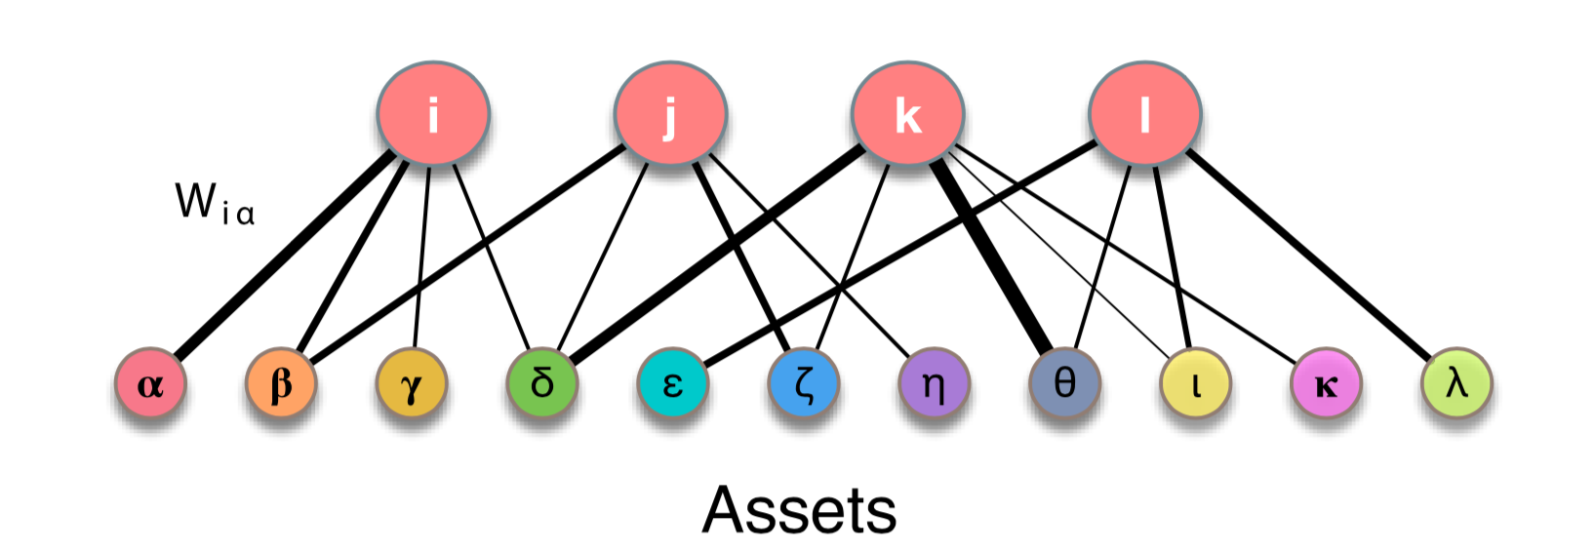
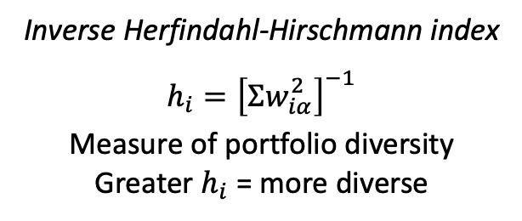
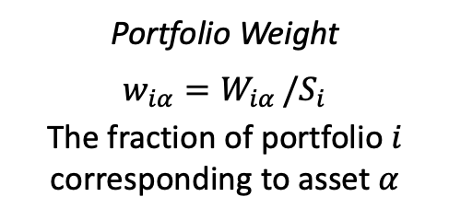
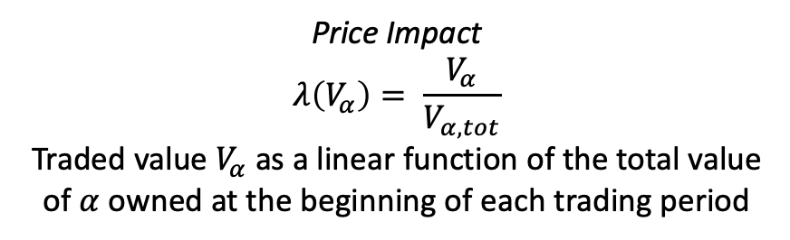
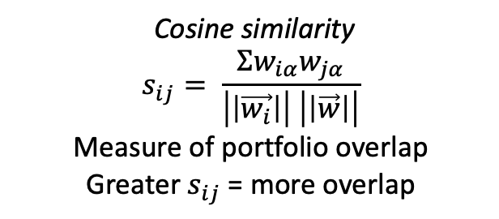
Portfolios
Delpini et al. 2019
Portfolio Weight
$$w_{iα}=W_{iα }/S_{i}$$
The fraction of portfolio $i$ corresponding to asset $α$
Inverse Herfindahl-Hirschmann index
$h_{i}={\left[Σw_{iα}^{2}\right]}^{−1}$
Measure of portfolio diversity
Greater $h_{i}$ = more diverse
Cosine similarity
$$s_{ij}= \frac{Σw_{iα}w_{jα}}{\left|\left|\vec{w_{i}}\right|\right| \left|\left|\vec{w}\right|\right|}$$
Measure of portfolio overlap
Greater $s_{ij}$ = more overlap
Price Impact
$$λ\left(V_{α}\right)= \frac{V_{α}}{V_{α,tot}}$$
Traded value $V_{α}$ as a linear function of the total value of $α$ owned at the beginning of each trading period

Slide 4
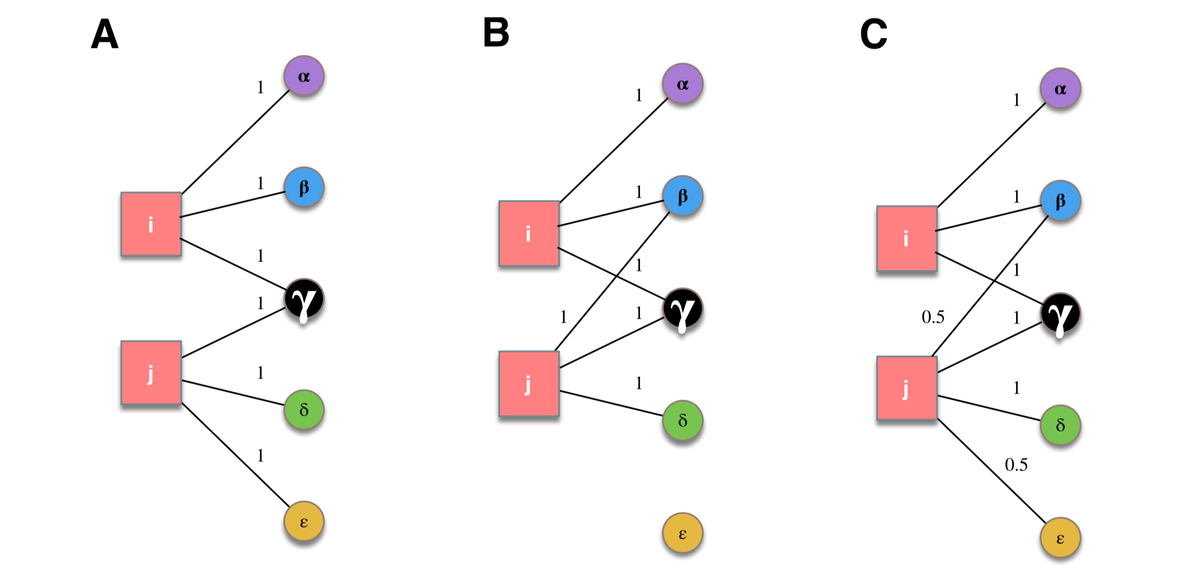
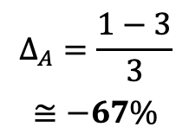





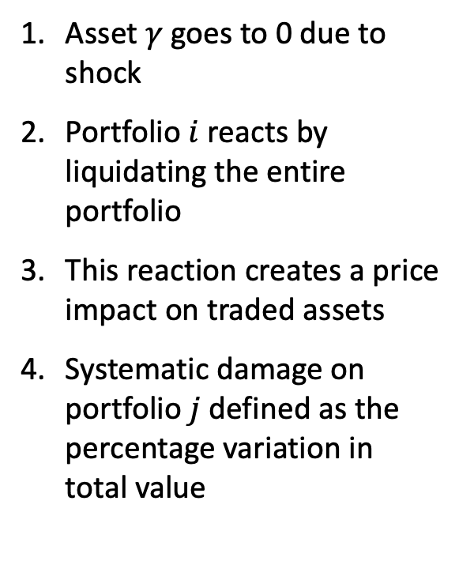
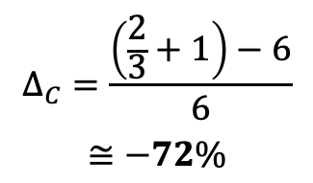
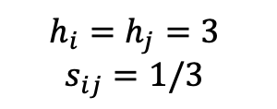
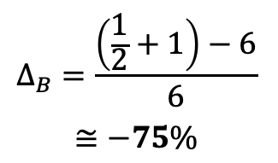
Shock Propagation
Delpini et al. 2019
$$h_{i}=h_{j}=3$$
$$s_{ij}=1/3$$
$$h_{i}=h_{j}=3$$
$$s_{ij}=2/3$$
$$h_{i}=3$$
$$h_{j}≅3.6$$
$$s_{ij}≅0.55$$
Asset $γ$ goes to 0 due to shock
Portfolio $i$ reacts by liquidating the entire portfolio
This reaction creates a price impact on traded assets
Systematic damage on portfolio $j$defined as the percentage variation in total value
$$w_{ij}$$
$$→\frac{1}{2}$$
$$→\frac{1}{3}$$
$$Δ_{B}=\frac{\left(\frac{1}{2}+1\right)−6}{6}$$
$$≅−75\%$$
$$Δ_{C}=\frac{\left(\frac{2}{3}+1\right)−6}{6}$$
$$≅−72\%$$
$$Δ_{A}=\frac{1−3}{3}$$
$$≅−67\%$$
Notes:
Case B exemplifies that for a fixed level of diversification a higher level of similarity between portfolios can lead to a riskier system in the presence of feedback effects;
Case C exemplifies that higher diversification may be obtained to the cost of an increase in portfolio similarity, again making the system riskier.

Slide 5
Portfolios
Delpini et al. 2019
Artificial portfolios formed at various diversity and overlap levels
Stocks follow fractional/geometrical Brownian motion to simulate stock prices
Weights on each stock are rebalanced to optimize Sharpe Ratio
Rebalancing cascades occur when multiple portfolios rebalance together
Compare statistics to real world data

Slide 6
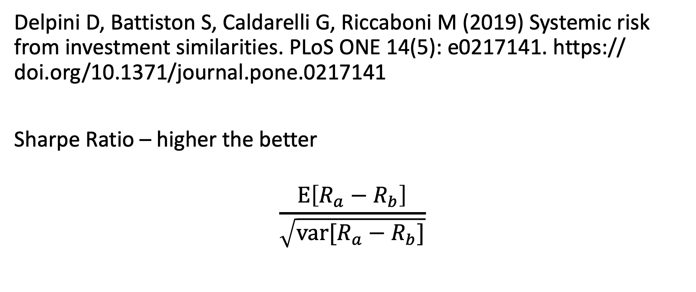
Delpini D, Battiston S, Caldarelli G, Riccaboni M (2019) Systemic risk from investment similarities. PLoS ONE 14(5): e0217141. https:// doi.org/10.1371/journal.pone.0217141
Sharpe Ratio – higher the better
$$\frac{E\left[R_{a}−R_{b}\right]}{\sqrt{var[R_{a}−R_{b}]}}$$

