Slide 1
Aug 21 Update
Braedyn

Slide 2
Topics
Updates to simulation
Weight vs Variance
Cascades

Slide 3
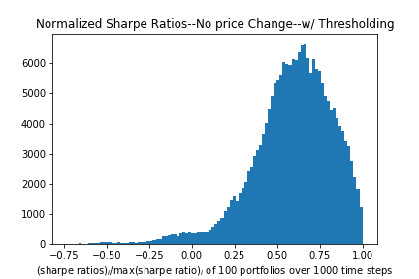
New Thresholding
Many portfolios would get stuck with negative Sharpe ratios and decrease value dramatically with old thresholding technique
New threshold takes 1.05 x the current Sharpe ratio as the threshold in the equation so probability of rebalancing is based on the current Sharpe ratio

Slide 4
Price Change
Divided Hurst Index and stock price changing into two seperate functions which decreased simulation time dramatically
100 stocks, 500 portfolios, 1000 timesteps ~2.5 days simtime

Slide 5
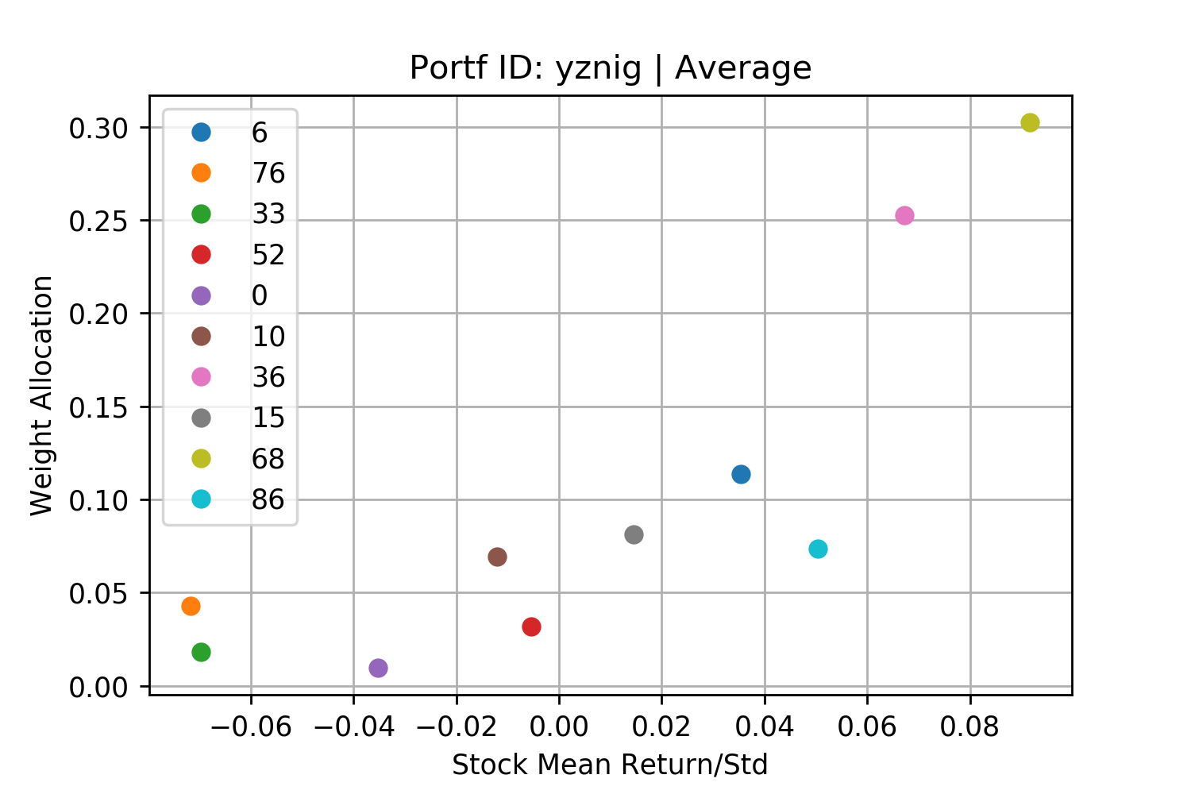
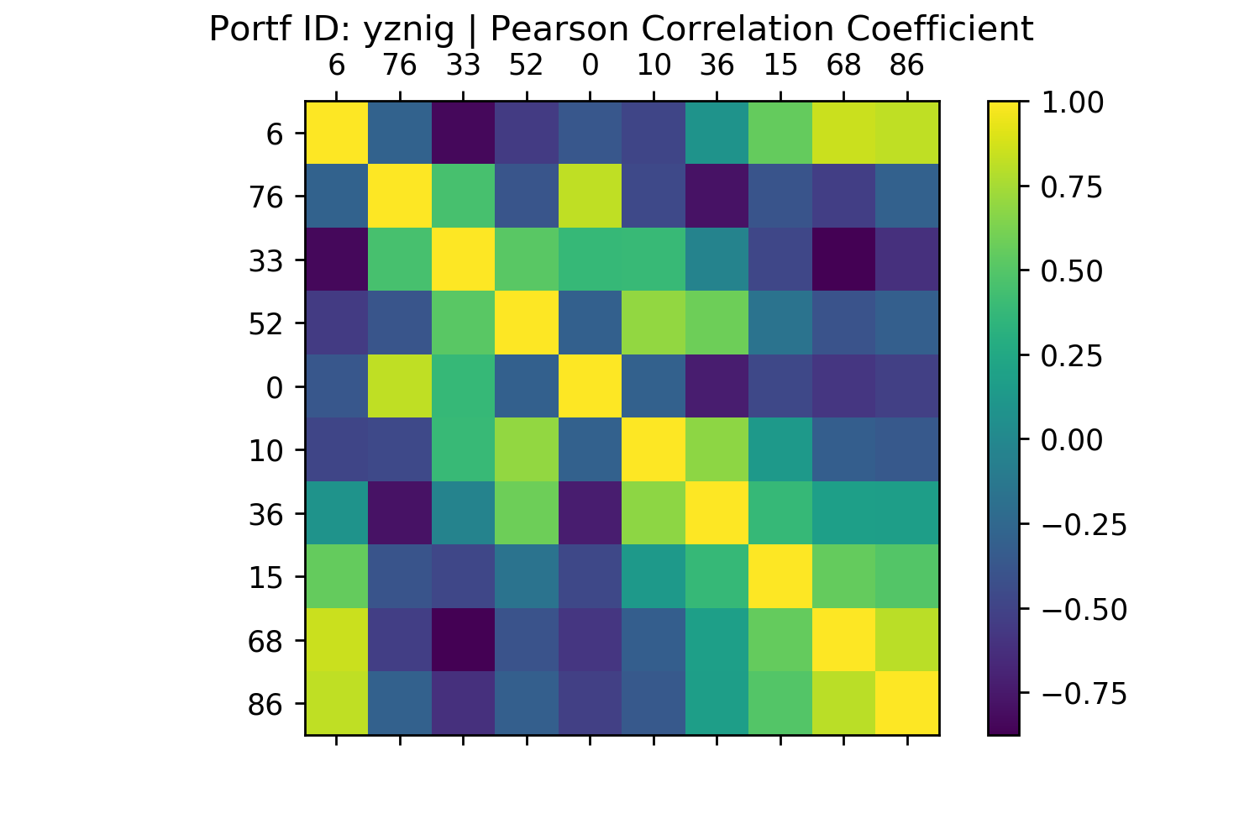
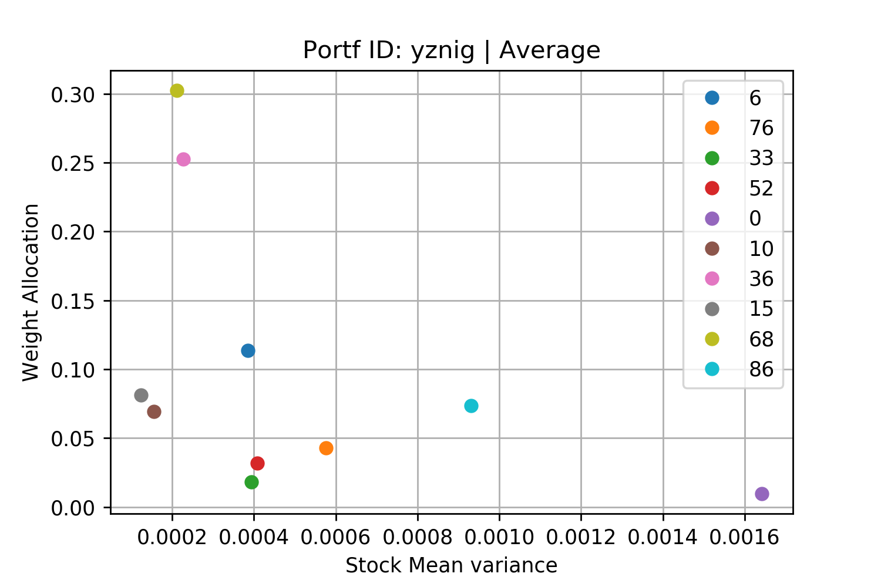
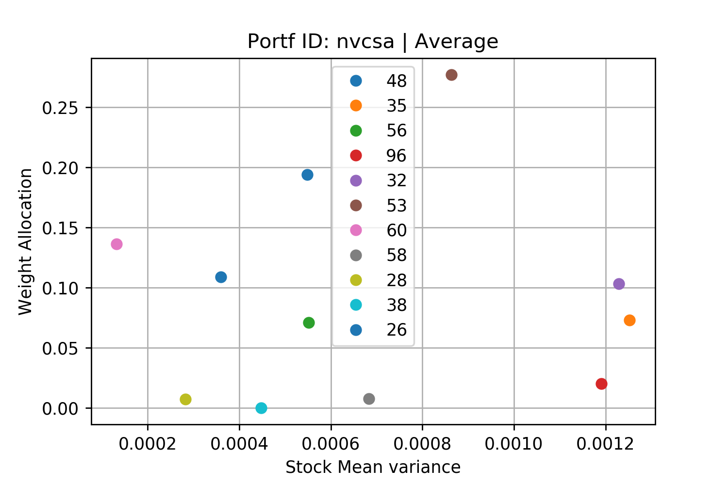
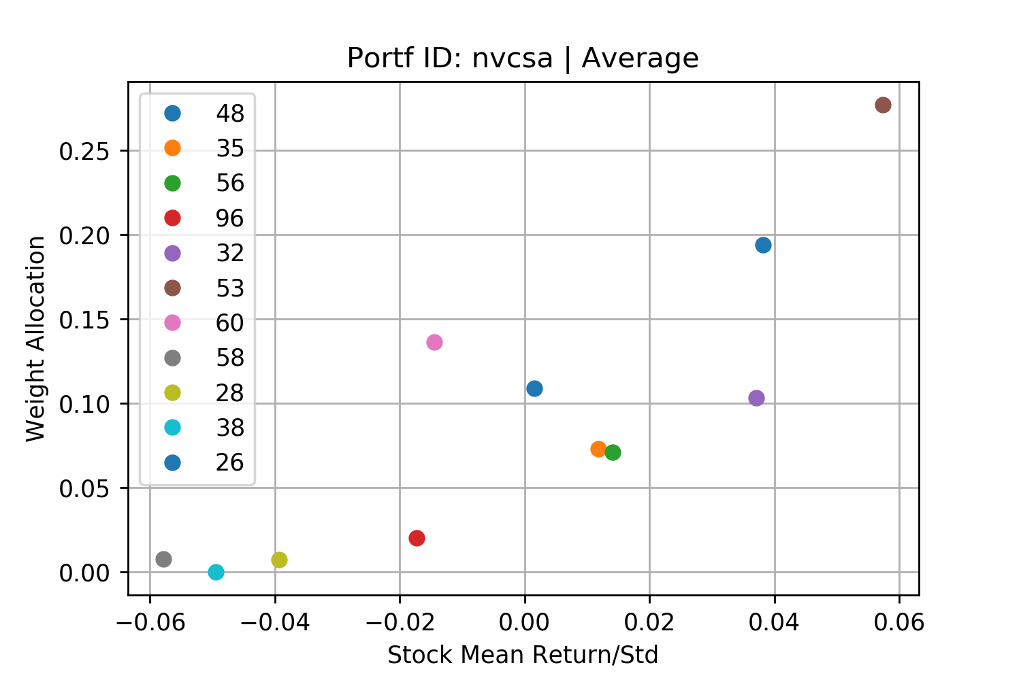
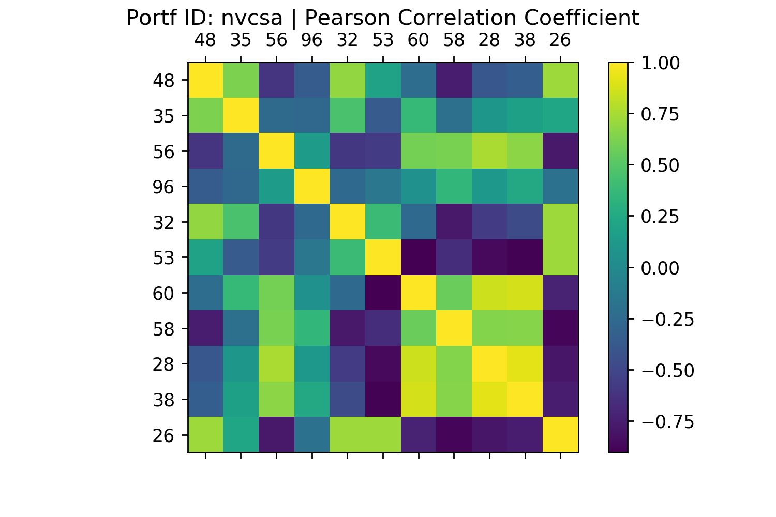
Weight Allocation Plots
Low allocations in low variance stocks are due to low returns
Variance Graphs
Return/Std Graphs
Time
Time
Time
Time

Slide 6
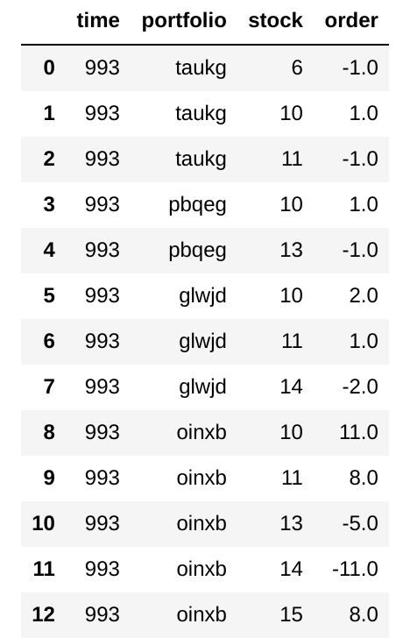
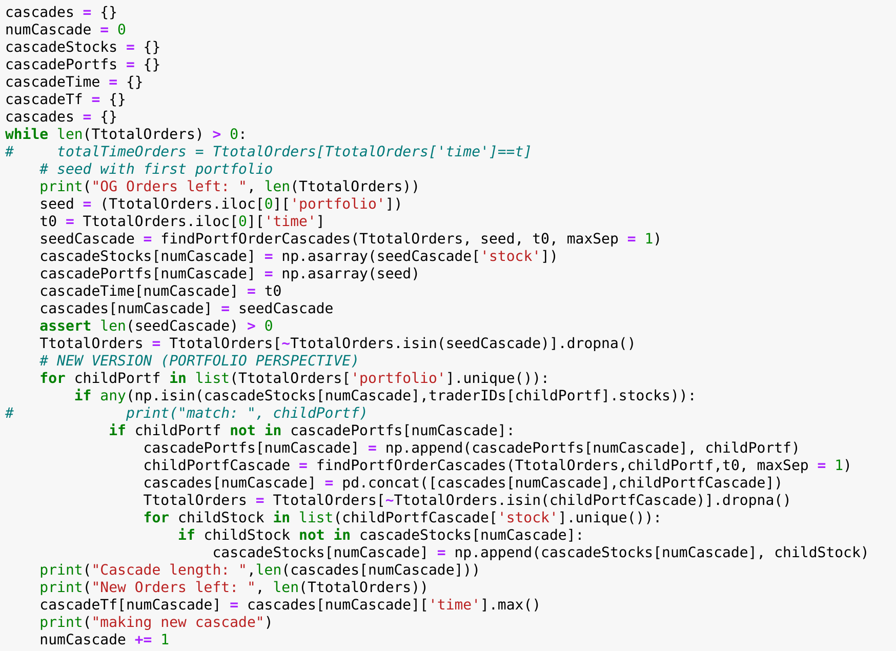
Cascades
1. Take the first row of the orders list as the cascade seed
Identify seedCascade as all portoflio activity that occurs at or after t0 and terminates after maxSep time duration of quiessence
Add all associated stocks in the seedCascade to cascadeStocks dictionary associated with the cascade ID
Add the seed portfolio to CascadePortfs dictionary associated with the cascade ID
Move all rows associated with seedCascade to cascades dictionary
2. Go through each portfolio and see if it holds any stocks traded in this cascade
If match is found, above steps are repeated with this portfolio
3. Identify the cascade end time, and extend number of cascades
1.
2.
3.

Slide 7
Identifying Cascades
Transactions List
CascadeStocks = { 0 : [6, 10, 11] }
CascadePortfs = { 0 : [taukg] }
CascadeTime = { 0 : 993 }
CascadeTf = { 0 : TBD }
Seed Portfolio
CascadeStocks = { 0 : [6, 10, 11, 13] }
CascadePortfs = { 0 : [taukg, pbqeg] }
CascadeStocks = { 0 : [6, 10, 11, 13, 14] }
CascadePortfs = { 0 : [taukg, pbqeg, glwjd] }
CascadeStocks = { 0 : [6, 10, 11, 13, 14, 15] }
CascadePortfs = { 0 : [taukg, pbqeg, oinxb] }
Cascades = { 0 : (table of transactions), 1 : (table of transactions), ...}

Slide 8
Cascades Merging?
Currently, my cascades involve each portfolio undergoing max 1 rebalance cascade (all portfolio activity from first transaction to last determined by maxSep time duration)
How long ago can
Due to the high level of overlap, misidentifying overlap may lead to all cascades merging into 1 neverending cascade, which may or may not be correct
Cascades = { 0 : (table of unique transactions), 1 : (table of unique transactions), ...}

