Slide 1
Data Mining Project 3
Brayden Faulkner &
Christina Hinton

Slide 2
Overview
TF-IDF vectors for each document are loaded from a results file
A small subset of documents are reserved for the testing set
Uses training set to determine the centroids for each class
Based on centroids, classifies the testing set
5 fold cross validation & classification accuracy

Slide 3
Classification
TF-IDF files must be provided
Vectors are stored in allDocs, which contains document name, vector, and class information
File containing the names of documents to be included in the test set is user-given, which allows for varying training/testing set ratios
Members of allDocs that are in the training set are added to groupList
Once every member of groupList has been found, classify the members of the testing set based upon the centroids

Slide 4
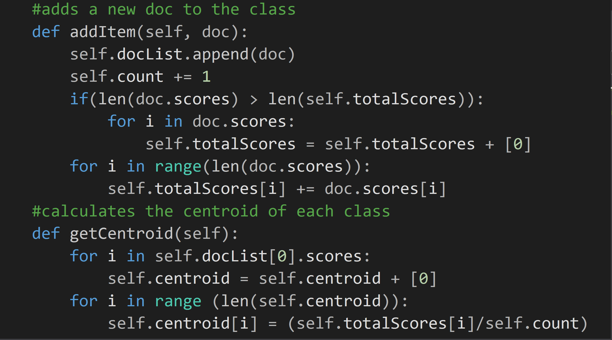
Training
When a member of allDocs is not in the test set, it is added to groupList
Centroid is updated based on the new document’s class and vector information

Slide 5
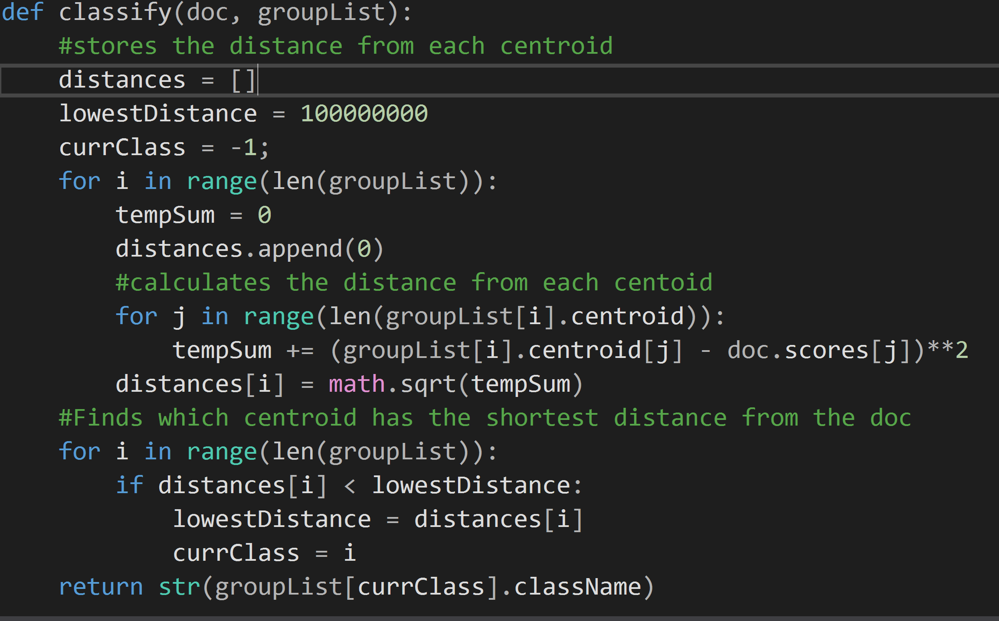
Testing
Each document is sorted into either the testing set or the training set
Once the process is complete, each member of the testing set is classified using the centroids from the training phase

Slide 6
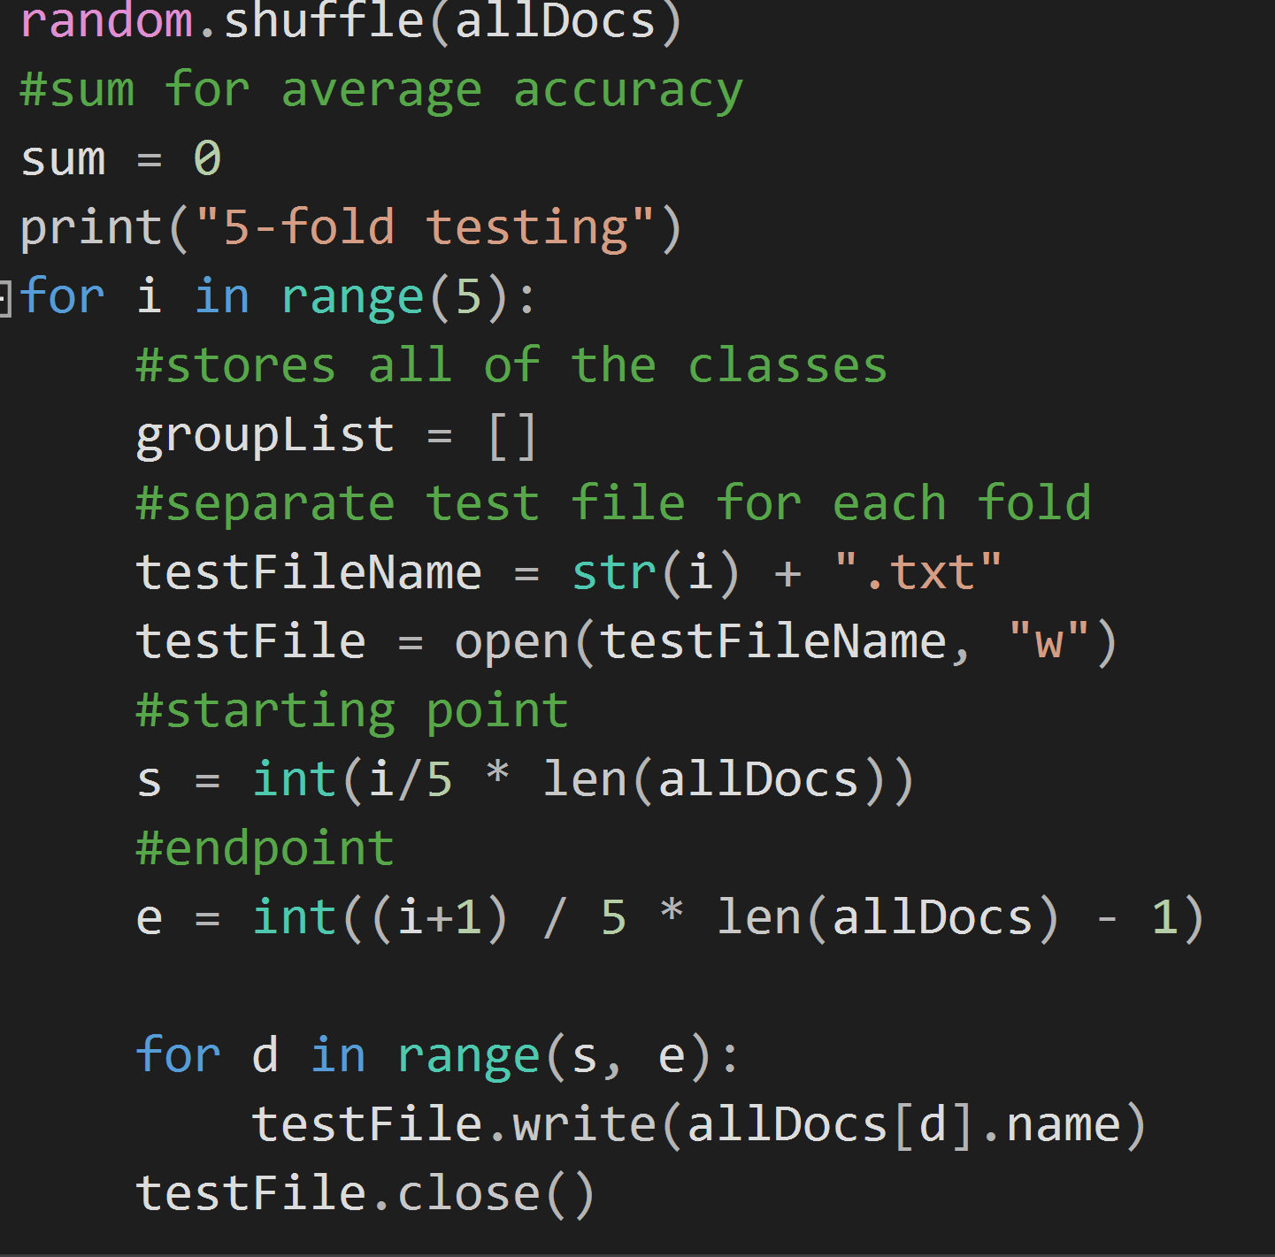
5 Fold cross Validation
allDocs is shuffled to ensure each class will be included in testing phase
For each iteration, choose a new test set that is a fifth of the size of allDocs
The process remains the same as before, except there is no user-given test set

Slide 7
Accuracy
Roughly 50%
Cross fold Validation tends to be more inconsistent across different runs, possibly due to having different sets each run
Using top 1000 and 500 words gives the greatest accuracy
Using bottom 500 words lowers accuracy dramatically

