Slide 1
Course Project 1
Brayden Faulkner and Christina Hinton

Slide 2
Overview
Python
Beautiful Soup
Natural Language Toolkit
Go through over 10,000 HTML documents
remove HTML tags
remove stop words
stem words
sort words by term frequency.

Slide 3
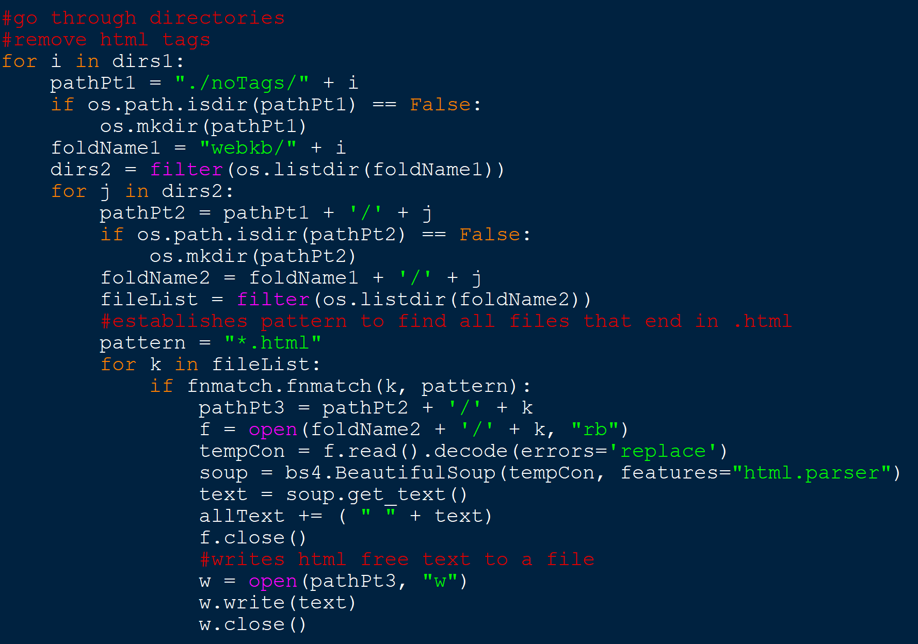
Getting Through the Directory
For each directory, only open HTML files
Remove HTML tags and save remaining text to file

Slide 4
HTML Removal
Beautiful Soup
HTML Parser method to remove HTML tags
get_text() method to save remaining text
Append text file with each new parsed string

Slide 5
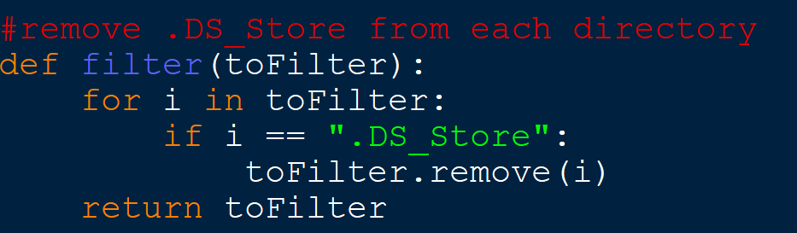

Slide 7
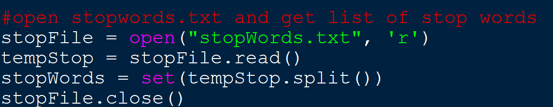
Stop Word Removal
Stop Word List:
https://www.ranks.nl/stopwords

Slide 8
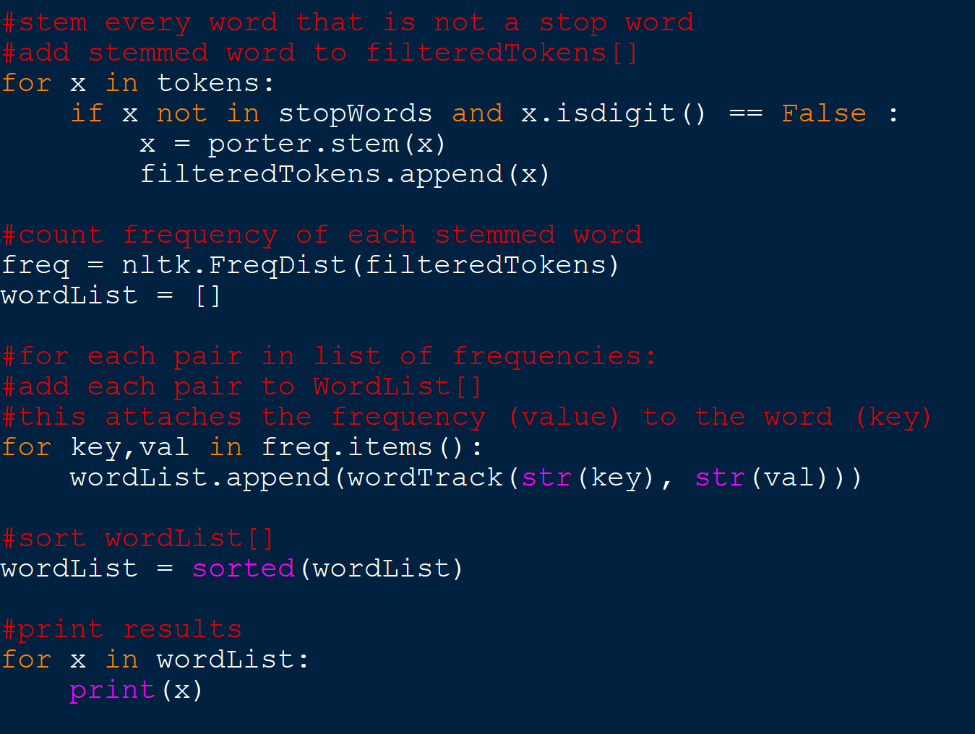
Stemming
Natural Language Tool Kit
Porter Stemmer
If word is not a stop word:
Apply stemming method
Add to word list

Slide 10
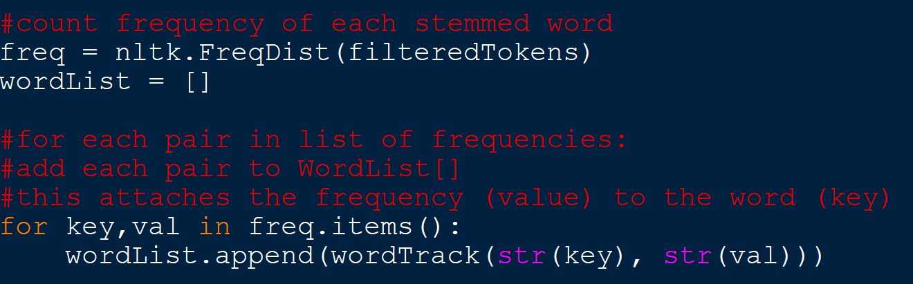
Calculating Results
Construct list of word-value pairs
value corresponds with term frequency
Sort list based on term frequency
Output full list

Slide 11
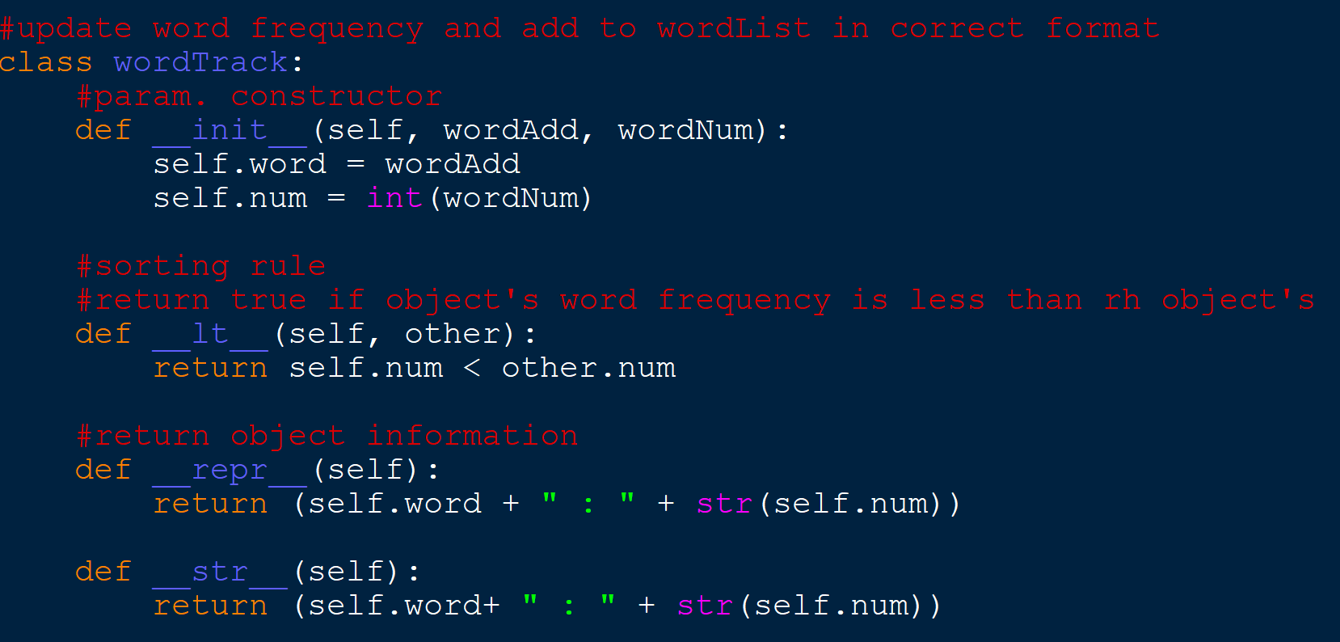

Slide 12
Results
Most Used | Frequency | Least Used | Frequency

