Slide 1
Course Project 1
Brayden Faulkner and Christina Hinton

Slide 2
Overview
Python
Beautiful Soup
Natural Language Toolkit
Go through over 10,000 HTML documents
remove HTML tags
remove stop words
stem words
sort words by term frequency.

Slide 3
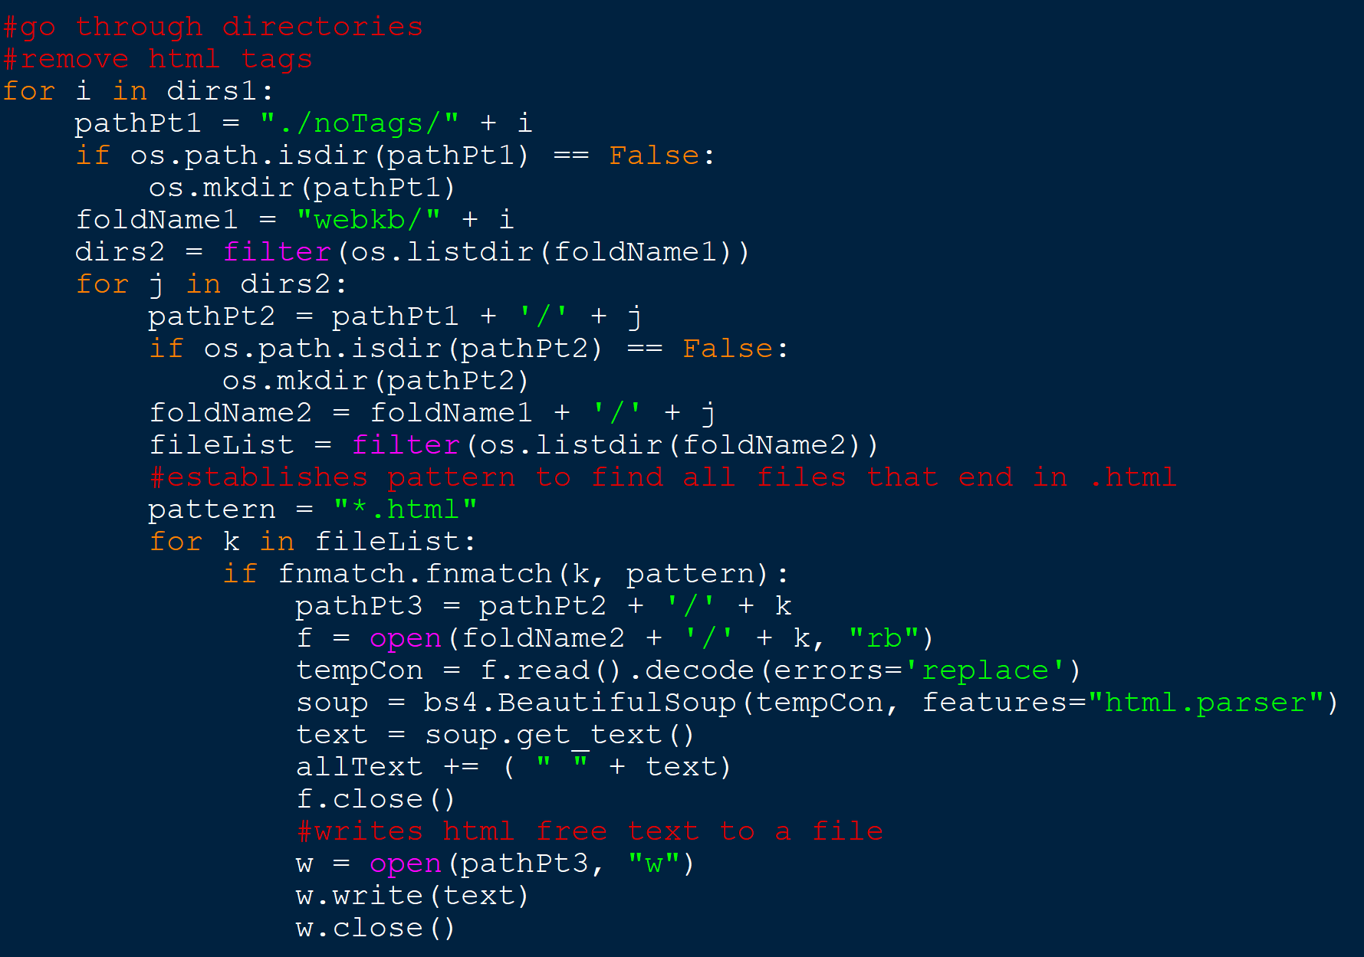
Getting Through the Directory
For each directory, only open HTML files
Remove HTML tags and save remaining text to file

Slide 4
HTML Removal
Beautiful Soup
HTML Parser method to remove HTML tags
get_text() method to save remaining text
Append text file with each new parsed string

Slide 5
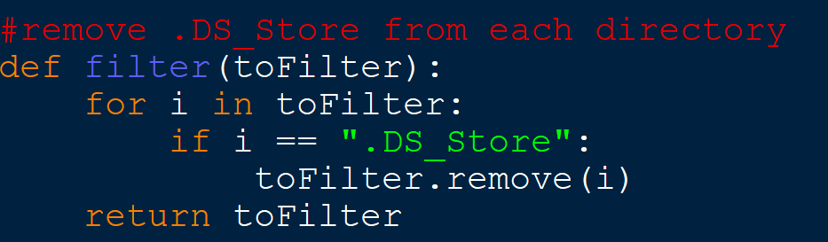

Slide 7
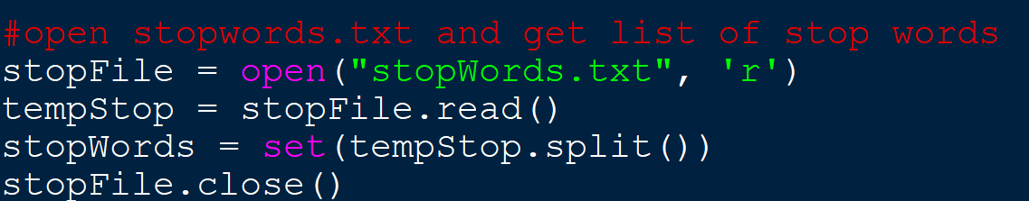
Stop Word Removal
Stop Word List:
https://www.ranks.nl/stopwords

Slide 8
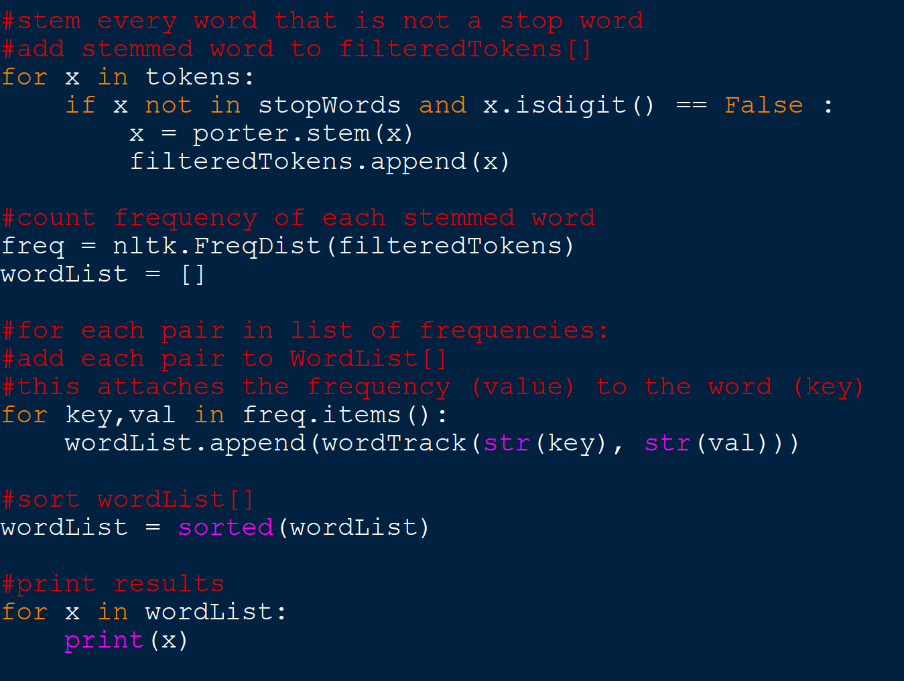
Stemming
Natural Language Tool Kit
Porter Stemmer
If word is not a stop word:
Apply stemming method
Add to word list

Slide 10
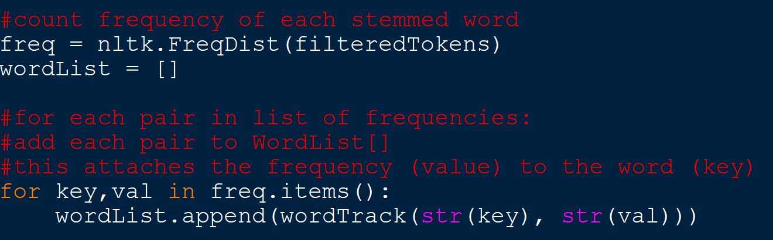
Calculating Results
Construct list of word-value pairs
value corresponds with term frequency
Sort list based on term frequency
Output full list

Slide 11
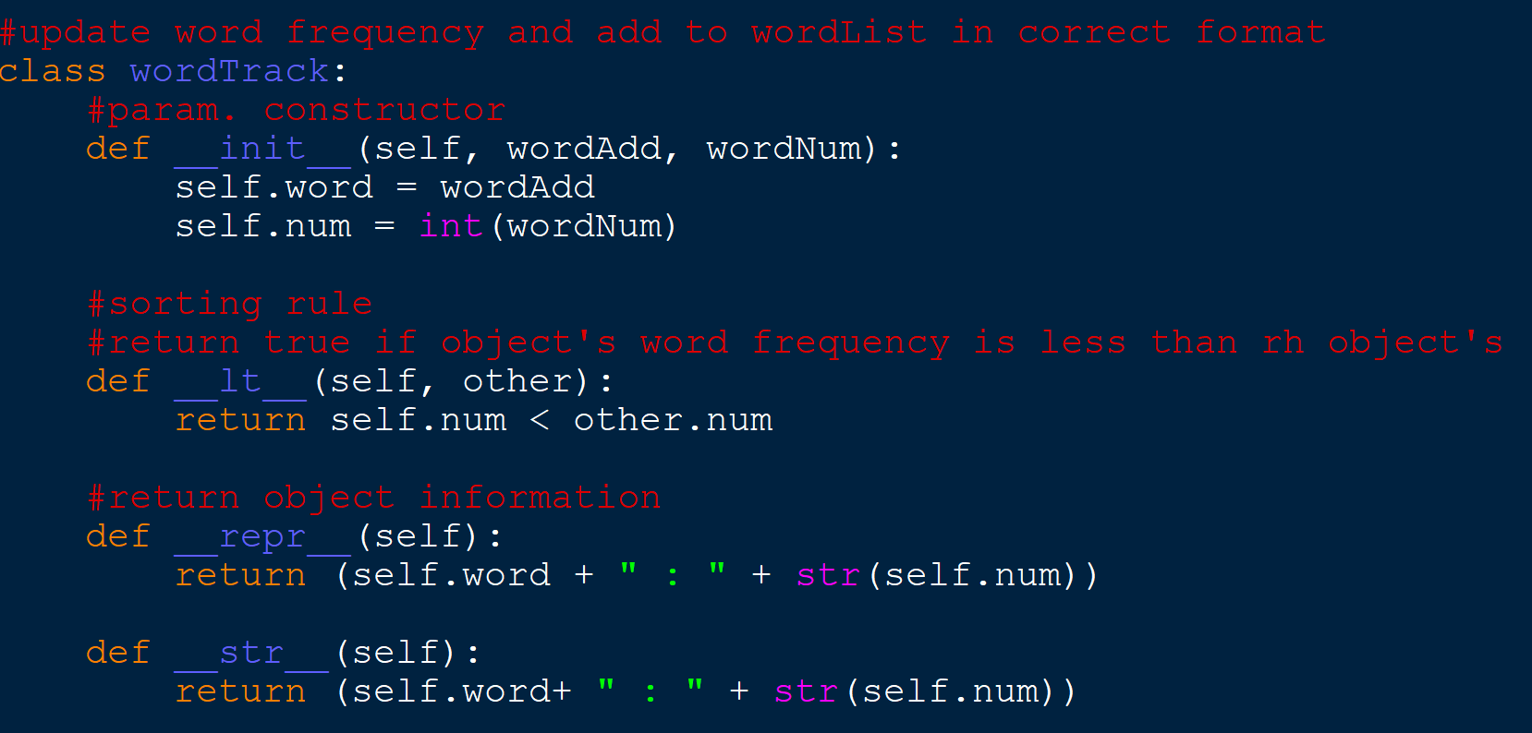

Slide 12
Results
Most Used | Frequency | Most Used | Frequency
comput | 14410 | scienc | 6457
program | 10480 | server | 6417
content | 10208 | text | 6415
system | 9528 | univers | 5707
gmt | 9481 | modifi | 550
cs | 7508 | project | 4896
will | 7292 | length | 4700
type | 6948 | time | 4623
html | 6483 | nov | 4304

