Slide 1
Cybersecurity 101
Notes:
Introduce Ourselves
Introduce Westan Cyber
Thank for opportunity to present
When we assess a network we have to be in mindset of attacker

Slide 2
Ethics Disclosure
Please do not attempt anything you see here today on any system you do not have permission to attempt them on
Please do not perform any illegal activity using anything you see here
Please do not attempt to break into the devices of family and/or friends without permission
There are tons of places to practice these techniques legally, please do so only there

Slide 3
What is Pentesting?
The legal and authorized attempt to exploit, gain access to, or otherwise “hack” a system for the purpose of helping to make that system more secure
Often called Ethical Hacking, White Hat Hacking, or Red Teaming
Different from Vulnerability Assessment, as the vulnerabilities are actually exploited.

Slide 4
The Four Stages of Pentesting
Recon
Scanning
Exploitation
Post Exploitation

Slide 5
Recon
Perhaps the most important and least technical of all steps
Gather as much information as possible about target, email addresses, phone numbers, ip addresses, URLs, and names of employees
Often gather information from social media, search engines, and tools such as Recon-NG, Discover Scripts, and Spiderfoot
Notes:
Facebook stalking joke

Slide 6
Social Engineering
Often the most vulnerable part of any system is the people who use it
Use knowledge gained during the recon phase to deceive others into giving you access to a system
Create fake email, social media, and other accounts that resemble that used by the company and its employees

Slide 7
What is Phishing?
Wikipedia - Phishing is the fraudulent attempt to obtain sensitive information such as usernames, passwords and credit card details by disguising oneself as a trustworthy entity in an electronic communication. Typically carried out by email spoofing or instant messaging, it often directs users to enter personal information at a fake website which matches the look and feel of the legitimate site.
Notes:
Form of social engineering - Deceiving or tricking people
Not as “technical” as traditional hacking
One of the most effective ways to get access to the network. Nearly impossible to defend from institutionally
Up to each individual to always be on guard.
Can be text message, in person meetings, phone calls etc, not just emails.

Slide 8
Why is phishing so prevalent?
It works, and it works extremely well.
The average financial cost of a data breach is $3.86m (IBM)
Phishing accounts for 90% of data breaches
15% of people successfully phished will be targeted at least one more time within the year
BEC scams accounted for over $12 billion in losses (FBI)
Phishing attempts have grown 65% in the last year
Around 1.5m new phishing sites are created each month (Webroot)
76% of businesses reported being a victim of a phishing attack in the last year
30% of phishing messages get opened by targeted users (Verizon)
https://retruster.com/blog/2019-phishing-and-email-fraud-statistics.html
Notes:
Highlights of Slide:
90% of data breaches - because phishing is so easy and effective.
30% of messages opened - if you account for spearfishing and targeted attacks this is most likely much higher.

Slide 9
Phishing
It is much easier than alternative exploitation techniques.
Instant access to networks
Extremely Versatile
Credential Stealing
Malware
Viruses
Data Exfiltration
Spyware
Requires very little “skill”
Payloads can be undetectable by AV

Slide 10
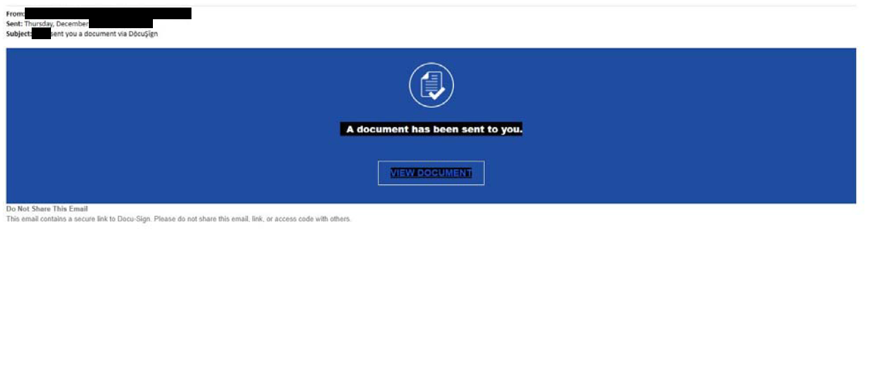
Phishing - Example 1

Slide 11
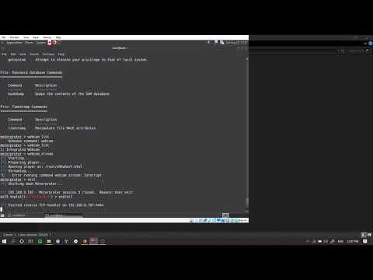
Demo - Webcam Access
Notes:
Received via email attachment, looks suspicious, grammar errors, etc
Much more powerful exploit
Caught by antivirus - Do not ignore
We try to trick users by adding a sense of urgency, excuses, or super tempting content.
Webcam with light on or off, microphone, keystrokes, screen captures, complete control over entire system.

Slide 12
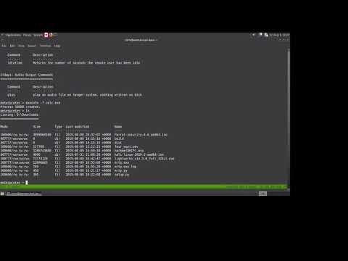
Demo - A Phish In Action
Notes:
Notes:
This is a copy of a local business website, we in no way altered the real site.
We do get a warning that this is an executable file - These should not be blindly ignored
We also get a warning that this is running as admin - Again, should not be ignored.
Both of the above warnings however, are often displayed when downloading and running legitimate software, the computer does not identify this as a virus.
Once the file is executed it runs in the background and is very difficult to find and stop.
This attack could take months of searching for vulnerabilities, can be achieved in minutes with just one successful email.
Now that attackers have a foothold they start to pivot to more valuable targets.
Skip from 2:28 - 2:50
All traffic over port 443 and encrypted, regular web traffic

Slide 13
Port Scanning
A port is a connection that allows data to be exchanged with other devices
Every computer has 65,536 ports
The purpose of port scanning is to determine which ports are “open”
Nmap is the most commonly used network scanning tool
Nmap can conduct a number of different scans, but the one we will be focusing on is the TCP Connect Scan
TCP is often explained as a three-way handshake

Slide 14
Vulnerability Scanning
A vulnerability is a mistake in the design of a system or a piece of software that can be exploited
A vulnerability scanner checks for various pieces of software that are known to be exploitable
There are a variety of dedicated vulnerability scanners available, such as OpenVas and Nessus, but today we will use Nmap’s vuln script

Slide 15
Password Hacking - Methods
Data Dumps
Easiest way to get creds
1TB dump freely available right now
Over 1.4 Billion unique passwords and emails
Social Engineering
Hash Cracking
Data exfiltration
Brute Force
Common passwords - rockyou breach
Custom password lists
Notes:
Westan Cyber stays up to date and has a huge collection of breached passwords. Nearly a terabyte. We can help our clients identify which accounts have been compromised, and which passwords are out there. Additionally, while providing assessments we capture in use passwords and assess their effectiveness by attempting to crack them in the same ways a malicious actor would.
Talk a little about OSINT and building pw lists for dictionary attacks.

Slide 16
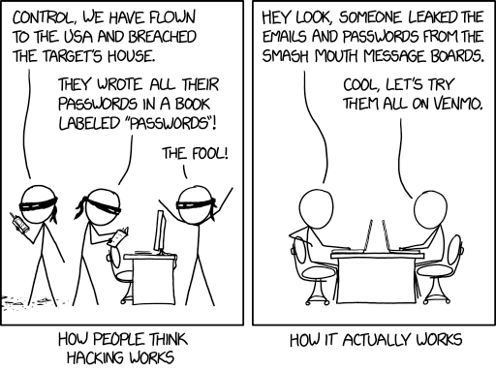
How Password Hacking Works in the Real World
Notes:
Even though the most common form of password theft is not physically stealing a password book, do not write you passwords down on paper, and do not save them to your computer in word docs, spreadsheets, etc.

Slide 17
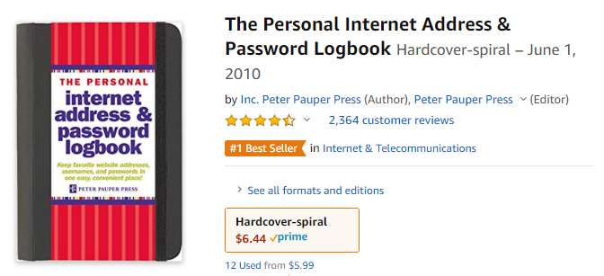
Don’t Do This!
Notes:
If someone steals this, they have stolen your credit cards, your music library, your credit, etc.
If I was robbing your house this is all I would take.
This is a terrible Idea

Slide 18
Password Hashing
Passwords are not stored in plain text on your machine, they are hashed using a hash algorithm
Different from encoding and encryption
It is impossible to reverse engineer a password from its hash
Many different types of hashing algorithms Ex: MD5, NTLM, and SHA

Slide 19
Password Cracking
John the Ripper is a hash cracking tool that generates passwords and their hashes, and then checks for matches in the hash list you provided it
Can also use wordlists, rules, and rainbow tables
On a linux machine hashes are broken up into a “shadow” and a “passwd” file, and have to be unshadowed

Slide 20
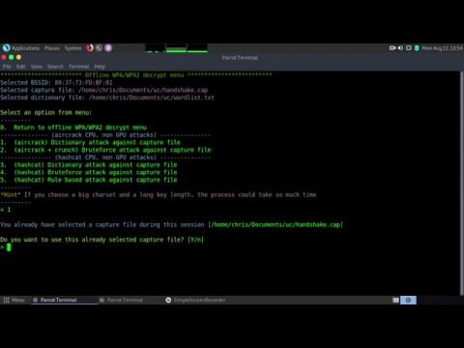
Hash Cracking - With Wordlist
Notes:
When passwords are sent between computers they are encrypted or “Hashed”
We can grab these “hashes” from the network
A good password will take centuries to dehash
This is not a good password
We were able to capture this hash from a network wirelessly from a network that we did not have the password for.
We are going to use a wordlist to see break the hash, as discussed earlier we build custom wordlists, and run common combos like pass1, pass01, p@$$02. We avoid trying every combination.

Slide 21
“Given the choice between security and convenience, people complain about security, but opt for convenience”
Good security is hard
Notes:
Good security is hard. It is a moving target.
It is very difficult to get people to choose to inconvenience themselves. Most everyone will agree they need to be more secure but, when making a choice between convenience and security, most will opt for convenience.

Slide 22
Wifi - Router Spoofing
No need to crack hashes
Pretend to be router
Disconnect Everyone
Offer new login page
Ask user for password
Take whatever they give you
Reconnect everyone back to original network
Works on any network
Notes:
We’ll let you give us the password - CH
If you don’t trust the new login page, skip it, and we’ll grab your hash and crack it per the last slide.

Slide 23

Wifi Spoof - Victims View (Ipad)
Notes:
:15 secs -> disconecct + reconnect
:56 secs -> fake network appears locked network is gone
1:20 secs -> ipad auto connects to fake network and connects to login page
2:06 secs -> reconnects to real network

Slide 24
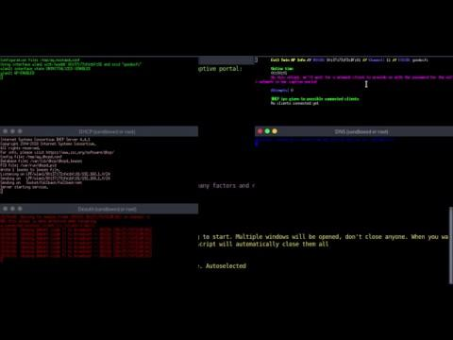
Wifi Spoof From Attackers View

Slide 25
Exploitation(The “fun” part)
Exploitation is the process by which vulnerabilities are used to gain control of a system
Metasploit is the most widely used exploitation tool available
Uses prepackaged code that uses a vulnerability to execute a payload on a remote system
Some of the most common payloads are Meterpreter, Shell, and VNCinject

Slide 26


Questions
Brayden Faulkner UTM Cyber Ambassdor blfaulkner@ut.utm.edu
Chris Humphreys
Westan Cyber Risk Solutions
unicent@protonmail.com
@ChrisCHumphre

