Slide 1
Netflix – An Overperformer?
Brage – Equity Analyst

Slide 2
Agenda
About us:
Equity Research INC
Netflix experts, as this is the only stock we follow
Revenue of 3 000 000 000 USD
Equity Analyst:
Brage
Experienced Netflix viewer
Experience with growth stocks
List of visualizations
TODO

Slide 3
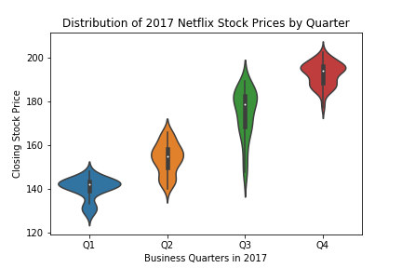
Stock price distribution in 2017
The stock is rising!! OMG! BUY!
Fairly volatile, also within each quarter
The stock has risen from the high 120 to over 200!

Slide 4
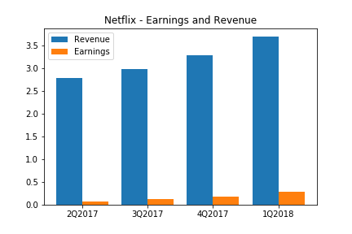
Strong numbers!
Both increasing revenue and earnings
Earnings growing faster
2Q2017: 2,3 % of revenue
1Q2018: 7,8 % of revenue

Slide 5
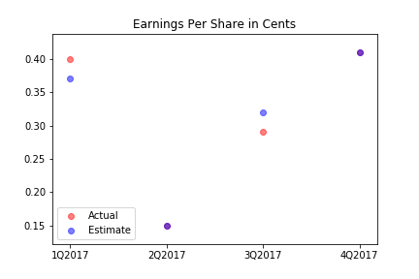
Some inconsistency in achieving guidance
Spot on guidance in 2Q2017 and 4 Q2017
Otherwise – some inconsistency

Slide 6
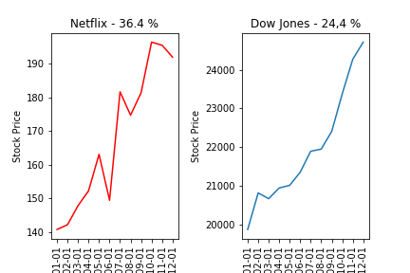
Beating the Dow in Year of year stock growth
Year of year stock performance:
Netflix: 36.4 %
Dow: 24,4 %
But… you had to endure more volatility

