Slide 1
Inventory

Slide 2
Objective
- Create an application based on specific technologies .

Slide 3
Requirement
- A Command Line Interface application

Slide 4
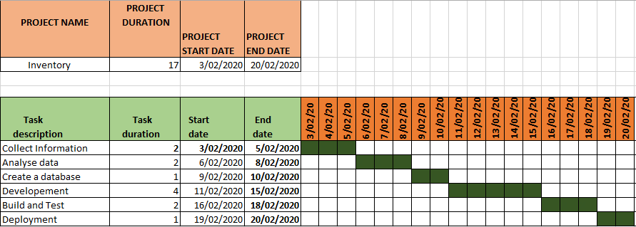
Plan

Slide 5
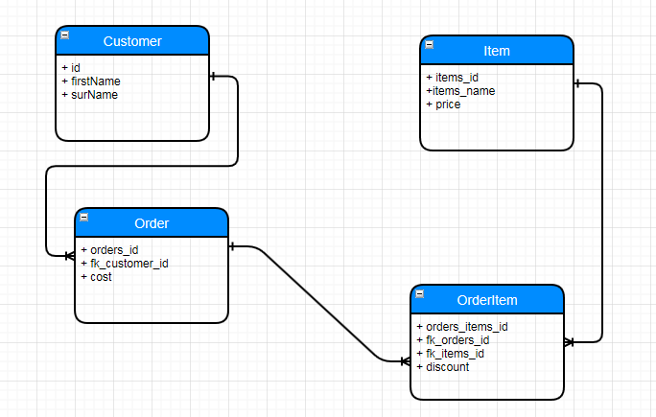
Entity Relation Diagram

Slide 6
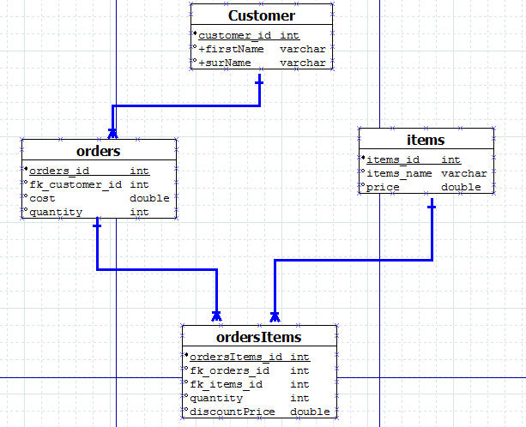
Classe Diagram

Slide 7
Programming
- Developement.
- Testing.
- Build.
- Deployment.

Slide 8
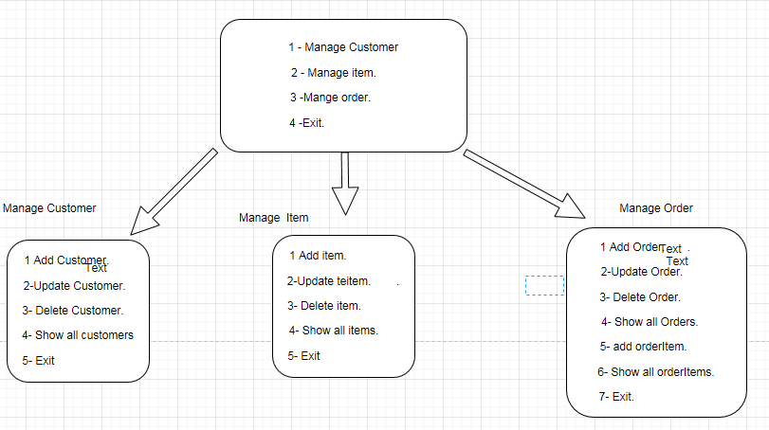
Developement

Slide 9
Test and Deveploy
- Jenkins intgreted with maven,

