Slide 1

Certified Kubernetes Application Developer (CKAD)
Kubernetes 1.28 Edition

Slide 2
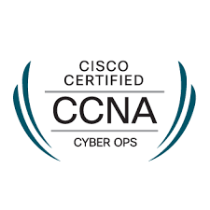
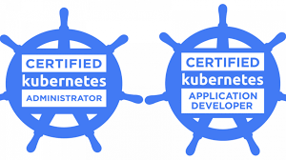

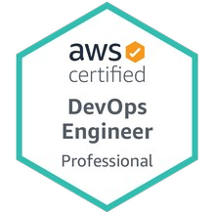



About the trainer
Brahim HAMDI
brahim.hamdi.consult@gmail.com
Consultant / Trainer
DevOps & Cloud Expert

Slide 3
Image and Container Management
Defining, Building, Running, and Distributing Container Images

Slide 4
Container Terminology
Container image creation and distribution
Blueprint of instructions: Spells out what needs to happen when the software is built, e.g. a Dockerfile.
Container Image: Packages an application into a single unit of software including its runtime environment and configuration.
Container Registry: Publishes container images and makes them available for consumption, e.g. on Docker Hub or GCR.

Slide 5
Container Terminology
Container runtime environment and instantiation
Container Runtime Engine: A software component that can run containers on a host operating system, e.g. Docker Engine or containerd.
Container: Instantiates a container image and runs it in an isolated runtime environment. Think of it as a special type of virtual machine.
Container orchestrator: Uses container runtime inside of a Pod to instantiate a container, e.g. Kubernetes.

Slide 6
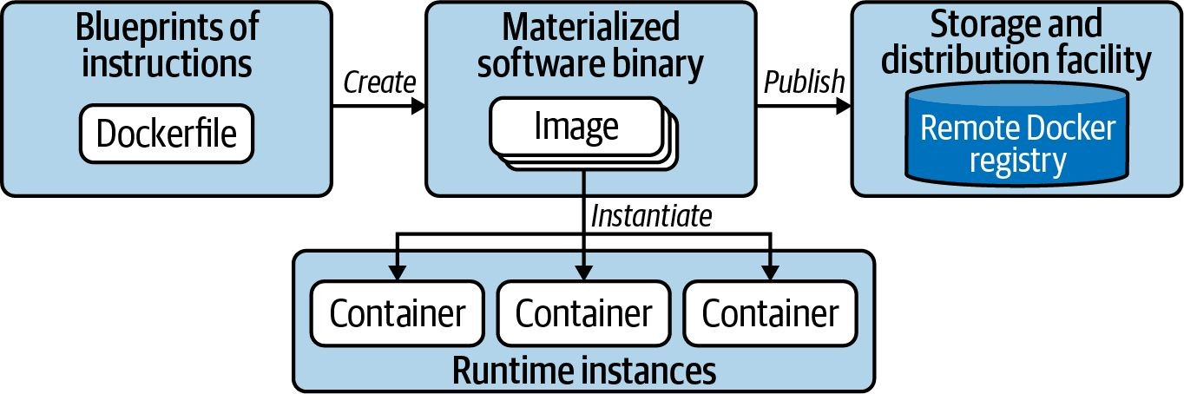
Containerization Process
Building and publishing an image, running image in container

Slide 7
Image Building Instructions
A Dockerfile is a plain-text file with instructions
FROM openjdk:11-jre-slim
WORKDIR /app
COPY target/java-hello-world-0.0.1.jar java-hello-world.jar ENTRYPOINT ["java", "-jar", "/app/java-hello-world.jar"] EXPOSE 8080

Slide 8

Building the Container Image
Provide name and tag of image + context directory
$ docker build -t java-hello-world:1.0.0 . Sending build context to Docker daemon 8.32MB Step 1/5 : FROM openjdk:11-jre-slim
---> 973c18dbf567
Step 2/5 : WORKDIR /app
---> Using cache
---> 31f9c5f2a019
...
Successfully built
Successfully tagged java-hello-world:1.0.0
Context directory
3e9c22451a17
Container Image ID

Slide 9

Listing Container Images
Render all local images including their name + hash
$ docker images
REPOSITORY
java-hello-world
TAG 1.0.0
IMAGE ID 3e9c22451a17
973c18dbf567
CREATED
About a minute ago
20 hours ago
SIZE 213MB
204MB
openjdk
11-jre-slim
Base image is downloaded automatically

Slide 10

Operating the Container
You can interact with container once its running
$ docker run -d -p 8080:8080 java-hello-world:1.0.0
b0ee04accf078ea7c...
$ docker logs b0ee04accf078ea7c...
Hello World!
$ docker exec -it b0ee04accf078ea7c... bash
root@b0ee04accf078ea7c:/# pwd
/
root@b0ee04accf078ea7c:/# exit

Slide 11

Tagging the Container Image
Name + tag need to conform to registry conventions
$ docker tag java-hello-world:1.0.0 bmuschko/java-hello-world:1.0.0
$ docker images
REPOSITORY
java-hello-world openjdk
TAG 1.0.0
11-jre-slim
IMAGE ID ... 3e9c22451a17 ...
973c18dbf567 ...
3e9c22451a17 ...
bmuschko/java-hello-world 1.0.0
Tagged image

Slide 12


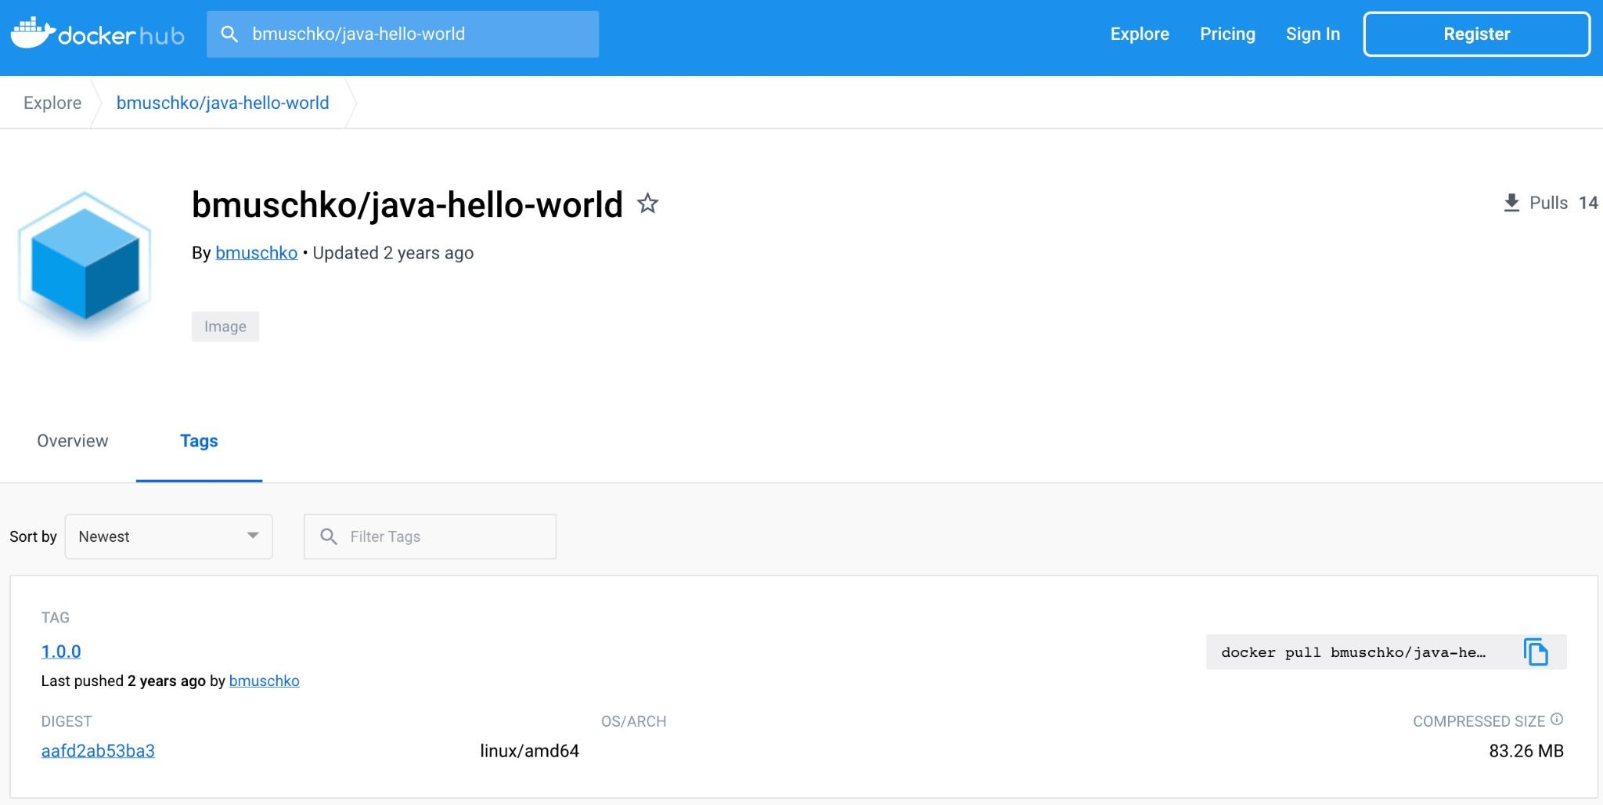
Publishing the Container Image
Authenticate with registry and push a tag
$ docker login --username=bmuschko
$ docker push bmuschko/java-hello-world:1.0.0

Slide 13


Saving a Container Image
Produces a backup TAR archive file with all parent layers
$ docker save -o java-hello-world.tar java-hello-world:1.0.0
$ ls
java-hello-world.tar
openjdk:11-jre-slim
java-hello-world:1.0.0

Slide 14

Loading a Container Image
Restores image from TAR archive file
$ docker load --input java-hello-world.tar
Loaded image: java-hello-world:1.0.0
$ docker images
REPOSITORY
java-hello-world openjdk
TAG 1.0.0
11-jre-slim
IMAGE ID ... 3e9c22451a17 ...
973c18dbf567 ...

Slide 15
Lab 01
Containerize an application

Slide 16
Pod and Namespace Management
Typical Operations and Configuration

Slide 17

Imperative Object Management
Fast but requires detailed knowledge, no track record
$ kubectl create namespace ckad
Creates an object
e.g. a namespace
namespace/ckad created
$ kubectl run nginx --image=nginx -n ckad
pod/nginx created
Creates a Pod object in a namespace
$ kubectl edit pod nginx -n ckad
Modifies the live object e.g. a Pod
pod/nginx edited

Slide 18

Declarative Object Management
Suitable for more elaborate changes, tracks changes
Creates object if it doesn’t exist yet
$ kubectl create -f nginx-deployment.yaml
deployment.apps/nginx-deployment created
Creates object or update if it already exists
$ kubectl apply -f nginx-deployment.yaml
deployment.apps/nginx-deployment configured
$ kubectl delete -f nginx-deployment.yaml
deployment.apps "nginx-deployment" deleted
Deletes object

Slide 19
What is a Pod?
Runs a process or application in container(s)
The smallest, most basic deployable objects in Kubernetes.
It contains one or more containers, such as Docker containers.
Kubernetes enhances the basic functionality of a container with features such as security, storage, and more.

Slide 20

Pod YAML Manifest
Defines containers and their images running in them
apiVersion: v1
kind: Pod
metadata:
name: hazelcast
spec:
containers:
- image: hazelcast/hazelcast
name: hazelcast
ports:
- containerPort: 5701
Container image
Exposed container port(s)

Slide 21

Creating a Pod
Imperative vs. declarative approach
$ kubectl run hazelcast --image=hazelcast/hazelcast --restart=Never↵
--port=5701 --env="DNS_DOMAIN=cluster"↵
--labels="app=hazelcast,env=prod"
pod/hazelcast created
$ kubectl create -f pod.yaml
pod/hazelcast created
Declarative: Point to YAML manifest
Imperative: Spell out configuration with parameters

Slide 22
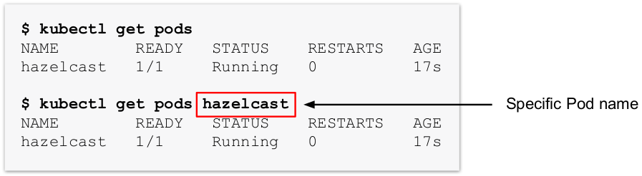
Listing Pods
Get high-level information on all Pods or a specific one

Slide 23
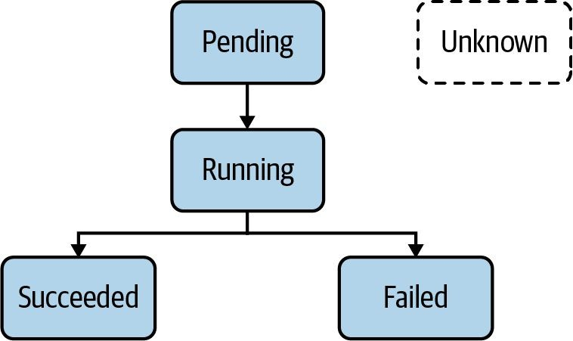
Pod Life Cycle Phases
Indicates operational status of Pod

Slide 24

Rendering Pod Details
Shows Pod configuration, events, and status
$ kubectl describe pods hazelcast
Name: Namespace:
...
Status: IP:
Containers:
...
Events:
...
hazelcast default
Running
10.1.0.41
Virtual IP address assigned to
Pod to communicate with it

Slide 25

Interacting with Container
Rendering logs and shelling into container
$ kubectl logs hazelcast
...
May 25, 2020 3:36:26 PM com.hazelcast.core.LifecycleService
INFO: [10.1.0.46]:5701 [dev] [4.0.1] [10.1.0.46]:5701 is STARTED
$ kubectl exec -it hazelcast -- /bin/sh
# ...

Slide 26

Declaring Environment Variables
Define zero to many key-value pairs
apiVersion: v1
kind: Pod
metadata:
name: spring-boot-app
spec:
containers:
- image: bmuschko/spring-boot-app:1.5.3
name: spring-boot-app
env:
- name: SPRING_PROFILES_ACTIVE
Typical naming conventions for keys are not enforced
value: prod
- name:
VERSION
value: '1.5.3'

Slide 27
Declaring Command and Args
Assign or overwrite container entrypoint and arguments
apiVersion: v1
kind: Pod
metadata:
name: spring-boot-app
spec:
containers:
- image: bmuschko/spring-boot-app:1.5.3
name: spring-boot-app
command: ["/bin/sh"]
args: ["-c", "while true; do date; sleep 10; done"]

Slide 28

Deleting a Pod
Graceful deletion can take up to 30 seconds
$ kubectl delete pod hazelcast
pod "hazelcast" deleted
$ kubectl delete -f pod.yaml
pod "hazelcast" deleted
Imperative approach
Declarative approach

Slide 29
Understanding Namespaces
Prevent naming collisions and a scope for object names
Pod A
Pod B
Pod C
Default namespace
other namespace

Slide 30

Creating and Using a Namespace
Reference namespace with --namespace or -n
$ kubectl create namespace code-red
namespace/code-red created
$ kubectl run nginx --image=nginx --restart=Never -n code-red
pod/nginx created
$ kubectl get pods -n code-red
NAME READY STATUS RESTARTS AGE
nginx 1/1 Running 0 13s

Slide 31
Namespace YAML Manifest
Only defines the name, no additional details
apiVersion: v1 kind: Namespace metadata:
name: code-red

Slide 32

Deleting a Namespace
Cascade-deletes containing objects
$ kubectl delete namespace code-red
namespace "code-red" deleted
$ kubectl get pods -n code-red
No resources found in code-red namespace.

Slide 33
Lab 02
Creating a Pod and inspecting it

Slide 34
Jobs and CronJobs
Differences to Pods, One-Time Operations, Scheduled Operations

Slide 35
Pods vs. Jobs vs. CronJobs
Kubernetes primitives with different use cases
Pod: Continuous operation of an application kept running without interrupts if possible.
Job: Runs functionality until a specified number of completions has been reached, making it a good fit for one-time operations like import/export data processes or I/O-intensive processes with a finite end.
CronJob: Essentially a Job, but it’s run periodically based a schedule.

Slide 36

Creating a Job
"Increment a counter and render its value on the terminal"
$ kubectl create job counter --image=nginx -- /bin/sh -c↵ 'counter=0; while [ $counter -lt 3 ]; do↵
counter=$((counter+1)); echo "$counter"; sleep 3; done;'
job.batch/counter created

Slide 37

Job YAML Manifest
apiVersion: batch/v1
kind: Job
metadata:
name: counter
spec:
Define # of successful completions and whether task should be run in parallel
How many times do we try before Job is marked failed?
Restart Pod upon failure or start a new Pod
completions: 1
parallelism: 1
backoffLimit: 6
template: spec:
restartPolicy: OnFailure
containers:
args:
  /bin/sh
  -c
- ...
image: nginx
name: counter

Slide 38
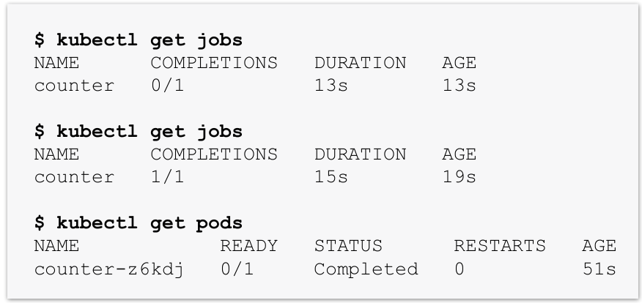
Inspecting a Job
Job is completed when configured # of execution has been reached

Slide 39
Different Types of Jobs
spec.completions: x spec.parallelism: y
Type | Completion criteria
Non-parallel | Complete as soon as its Pod terminates successfully
Parallel with fixed completion count | Complete when specified number of tasks finish successfully
Parallel with a work queue | Once at least one Pod has terminated with success and all Pods are terminated

Slide 40
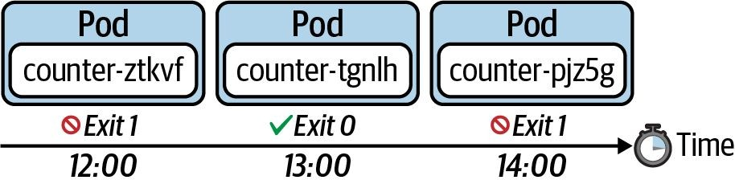
Understanding CronJobs
Similar to Job but task is run on a predefined schedule
spec.schedule: "0 * * * *"

Slide 41

Creating a CronJob
"Render the current date on standard output every hour"
$ kubectl create cronjob current-date --schedule="* * * * *"↵
--image=nginx -- /bin/sh -c 'echo "Current date: $(date)"'
cronjob.batch/current-date created

Slide 42

CronJob YAML Manifest
apiVersion: batch/v1 kind: CronJob metadata:
name: counter
spec:
The crontab expression used to run CronJob periodically
schedule: "*/1 * * * *"
jobTemplate:
spec:
template: spec:
restartPolicy: Never
Run in a new Pod
containers:
args:
  /bin/sh
  -c
- ...
image: nginx
name: counter

Slide 43
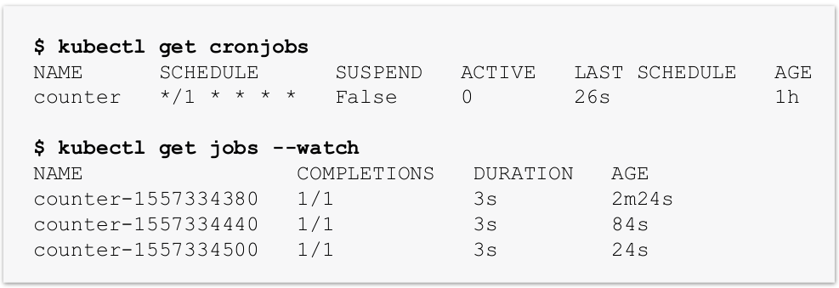
Inspecting CronJobs
Keeps a history of failed and successful Pods

Slide 44
Lab 03
Creating a scheduled container operation

Slide 45
State Persistence
Persistent and Ephemeral Volumes

Slide 46
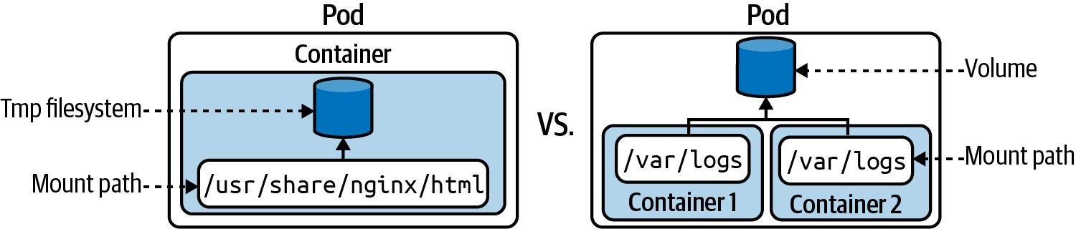
Understanding Volumes
By default, a container manages files in a temporary file system

Slide 47
Types of Volumes
Type | Description
emptyDir | Empty directory in Pod. Only persisted for the lifespan of a Pod.
hostPath | File or directory from the host node’s filesystem into your Pod.
configMap, secret | Provides a way to inject configuration data and secrets into Pods.
nfs | An existing NFS (Network File System) share to be mounted into your Pod. Preserves data after Pod restart.
Cloud provider solutions | Provider-specific implementation for AWS, GCE or Azure.

Slide 48

Defining and Mounting a Volume
Provide type and assign mount path per container
apiVersion: v1
kind: Pod
metadata:
name: my-container
spec:
volumes:
- name: logs-volume
emptyDir: {}
Define Volume name and type
containers:
- image: nginx
name: my-container
volumeMounts:
- mountPath: /var/logs
name: logs-volume
Specify mount path in container

Slide 49
Lab 04
Ephemeral Volume

Slide 50
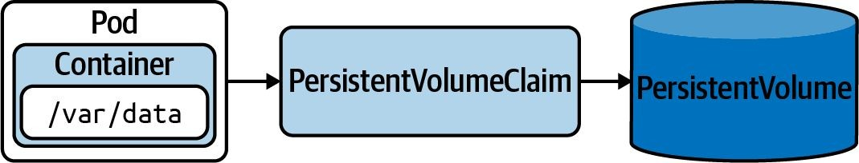
Understanding PersistentVolumes
Persist data that outlives a Pod, node, or cluster restart

Slide 51
Static vs. Dynamic Provisioning
PersistentVolume object is created manually or automatically
Static: Storage device needs to be created first. The PersistentVolume object references the storage device and needs to be created manually.
Dynamic: The PersistentVolumeClaim object references a storage class. The PersistentVolume object is created automatically.
Storage Class: Object that knows how to provision a storage device with specific performance requirements.

Slide 52
Defining a PersistentVolume
Define storage capacity, access mode, and host path
apiVersion: v1
kind: PersistentVolume
metadata:
name: db-pv
spec:
capacity:
storage: 1Gi
accessModes:
- ReadWriteOnce
hostPath:
path: /data/db

Slide 53
Access Mode & Reclaim Policy
Configuration options for PersistentVolume
Access Mode Reclaim Policy
Type | Description
ReadWriteOnce | Read-write access by a single node.
ReadOnlyMany | Read-only access by many nodes.
ReadWriteMany | Read-write access by many nodes.
Type | Description
Retain | Default. When PVC is deleted, PV is “released” and can be reclaimed.
Delete | Deletion removes PV and associated storage.
Recycle | Deprecated. Use dynamic binding instead.

Slide 54

Defining a Claim
Will use a PersistentVolume based on resource request
apiVersion: v1
kind: PersistentVolumeClaim
metadata:
name: db-pvc
spec:
accessModes:
- ReadWriteOnce
resources:
requests:
storage: 256Mi
storageClassName: ""
Assign an empty storage class name to use a statically-created PersistentVolume

Slide 55

Mounting a Claim in a Pod
Use Volume type persistentVolumeClaim
apiVersion: v1
kind: Pod
metadata:
name: app-consuming-pvc
spec:
volumes:
- name: app-storage
persistentVolumeClaim: claimName: db-pvc
Reference the Volume by claim name
containers:
- image: alpine
...
volumeMounts:
- mountPath: "/mnt/data" name: app-storage

Slide 56


Dynamic Provisioning
Creates PersistentVolume object automatically via storage class
apiVersion: v1
kind: PersistentVolumeClaim
metadata:
name: pvc
spec:
accessModes:
- ReadWriteMany
resources:
requests:
storage: 256Mi
apiVersion: storage.k8s.io/v1
kind: StorageClass
metadata:
name: standard
provisioner: kubernetes.io/aws-ebs
storageClassName: standard

Slide 57
Lab 05
Creating a Persistent Volume

Slide 58
Multi-Container Pods
Common Design Patterns

Slide 59
Single vs. Multiple Containers
Used for implementing specific use cases
The general rule of thumb is to deploy one microservice per Pod in a single container which helps with rolling out new versions of a microservice without necessarily interrupting other parts of the system.
Use cases for multiple containers in a single Pod
  Run preconfiguration procedure before the application container should start.
  Helper functionality that runs alongside the application.

Slide 60
Multi-Container Patterns
Understand patterns on a high-level
Init container
Sidecar
Adapter
Ambassador

Slide 61
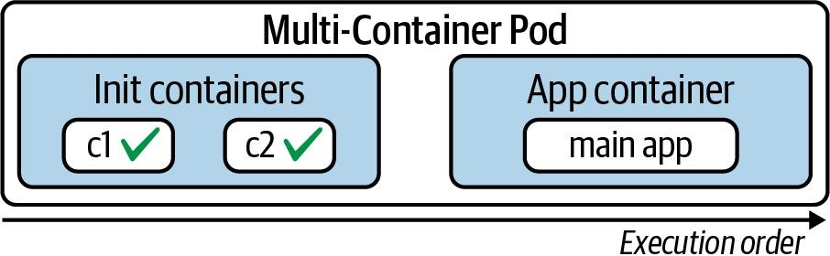
Why Use an Init Container?
Initialization logic before main application containers

Slide 62

Defining an Init Container
Declared adjacent to main application containers
apiVersion: v1
kind: Pod
metadata:
name: multi-container
spec:
containers:
- image: nginx
name: web-server
initContainers:
- image: init:3.2.1
name: app-initializer
Uses the same attributes as main application containers

Slide 63

Creating a Pod with Init Container
Init container execution renders in status column
$ kubectl create -f init.yaml
pod/business-app created
$ kubectl get pod business-app
NAME AGE
business-app
READY STATUS
RESTARTS
0/1 Init:0/1 0
2s
$ kubectl get pod business-app
NAME
business-app
READY
1/1
STATUS
Running
RESTARTS AGE
0 8s

Slide 64
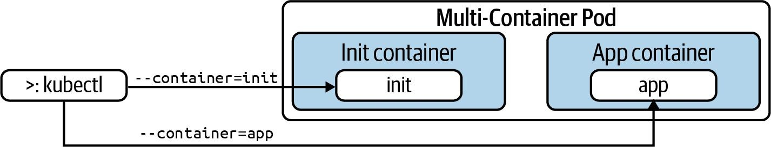
Interacting with an Init Container
Run kubectl with --container or -c CLI option

Slide 65

Shelling in a Container
Defaults to main application container if not explicit
$ kubectl exec -it -c web-server business-app -- /bin/sh
# exit
$ kubectl exec -it business-app -- /bin/sh
Defaulted container "web-server" out of: web-server, ↵
app-initializer (init) # exit

Slide 66
Defining Multiple Containers
Shared container lifecycle and resources
apiVersion: v1
kind: Pod
metadata:
name: multi-container
spec:
containers:
- image: nginx:1.13.0
name: web-server
- image: transformer:1.0.0
name: helper
Defines a second container running alongside the application container

Slide 67
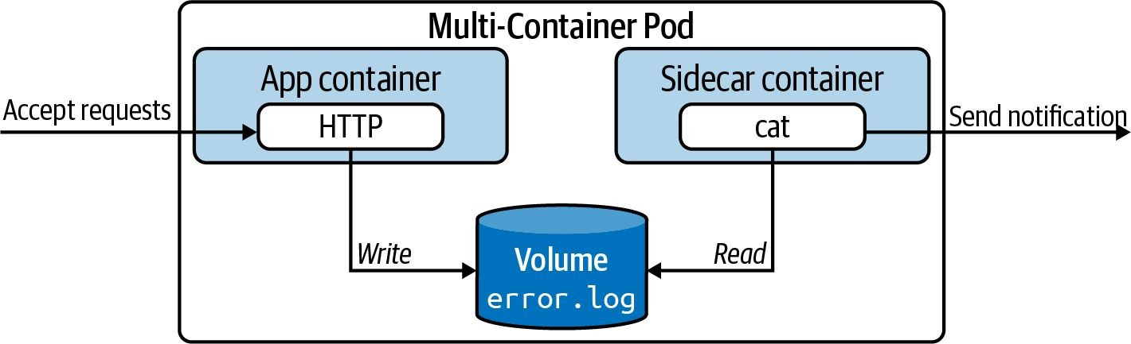
Sidecar Pattern
Not part of the main traffic or API of the primary application

Slide 68
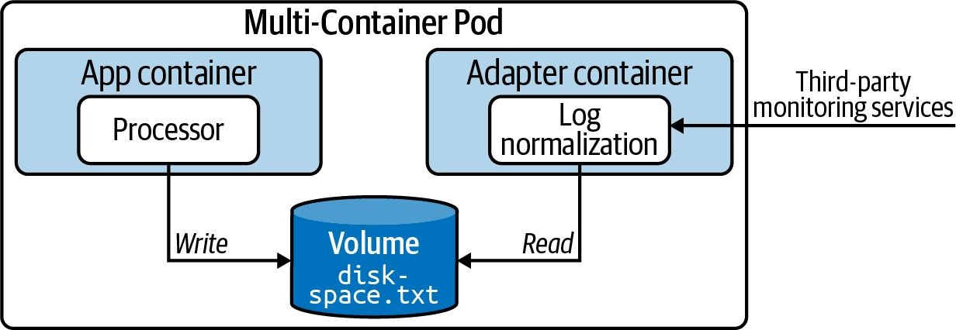
Adapter Pattern
Standardizes and normalizes application output read by external monitoring service

Slide 69
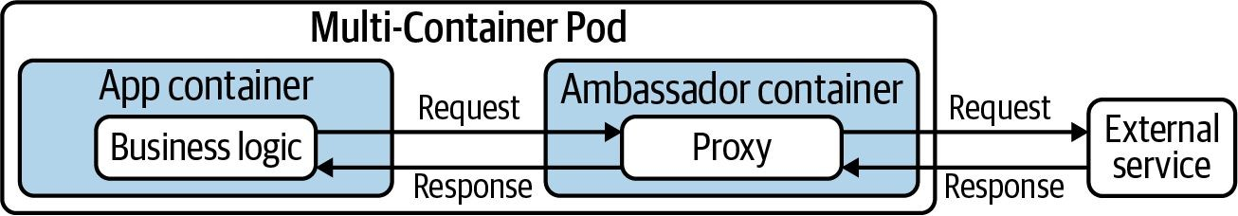
Ambassador Pattern
Hide and/or abstract the complexity of interacting with other parts of the system

Slide 70
Lab 06
Multi-Container Pods

Slide 71
Labels and Annotations
Commonalities and Differences, Use Cases, Usage

Slide 72
What is a Label?
Essential to querying, filtering and sorting Kubernetes objects
Key-value pairs assigned to Kubernetes objects.
Not meant for elaborate, multi-word descriptions of its functionality.
Kubernetes limits the length of a label to a maximum of 63 characters and a range of allowed alphanumeric and separator characters.

Slide 73
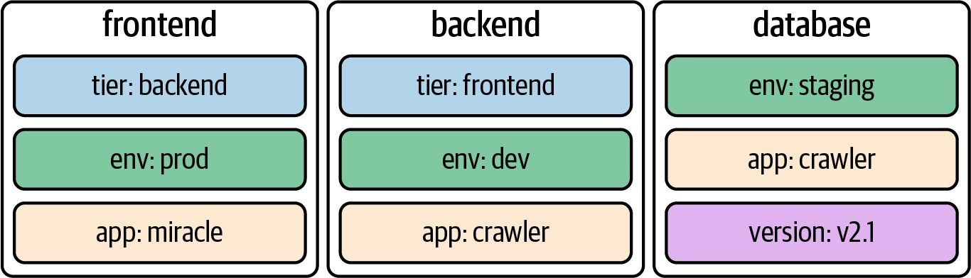
Example Labels
Three different Pods with each three key-value pairs

Slide 74
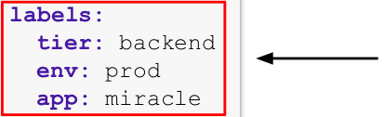
Assigning Labels in YAML
Use the metadata.labels attribute
apiVersion: v1 kind: Pod metadata:
name: pod1
spec:
...
labels:
tier: backend env: prod app: miracle
Declares three label
key-value pairs

Slide 75

Assigning Labels on CLI
Use the kubectl label command
Declares three label key-value pairs
$ kubectl label pod nginx tier=backend env=prod app=miracle
pod/nginx labeled
$ kubectl get pods --show-labels
NAME
pod1
... LABELS
... tier=backend,env=prod,app=miracle
Removes the label with key tier
$ kubectl label pod nginx tier-
pod/nginx labeled
$ kubectl get pods --show-labels
NAME
pod1
... LABELS
... env=prod,app=miracle

Slide 76
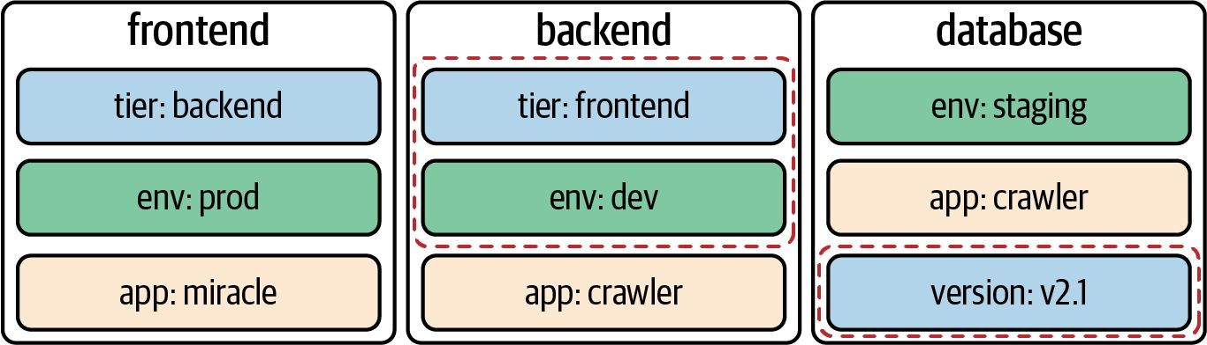
Selecting Labels
Label selector uses a set of criteria to query for objects

Slide 77

Label Selection from the CLI
You can specify equality-based and set-based requirements
Boolean AND expression
$ kubectl get pods -l tier=frontend,env=dev --show-labels
NAME ... LABELS
pod2 ... app=crawler,env=dev,tier=frontend
Key-only expression
$ kubectl get pods -l version --show-labels
NAME ... LABELS
pod3 ... app=crawler,env=staging,version=v2.1
$ kubectl get pods -l 'tier in (frontend,backend),env=dev' --show-labels
NAME ... LABELS
pod2 ... app=crawler,env=dev,tier=frontend
Set-based expression follows Boolean OR

Slide 78

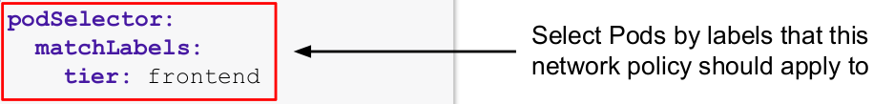
Label Selection in YAML
Certain objects provide label selection via their API
apiVersion: networking.k8s.io/v1
kind: NetworkPolicy
metadata:
name: frontend-network-policy
spec:
...

Slide 79
What is an Annotation?
Descriptive metadata without the ability to be queryable
Key-value pairs for providing descriptive, human-readable metadata.
Cannot be used for querying or selecting objects.
Make sure to put the value of an annotation into single- or double-quotes if it contains special characters or spaces.

Slide 80
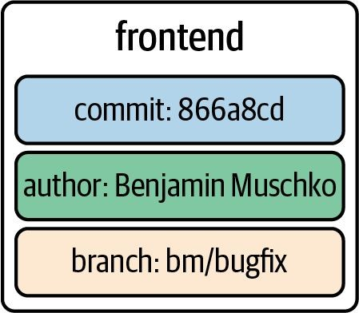
Example Annotations
A Pod with three key-value pairs

Slide 81
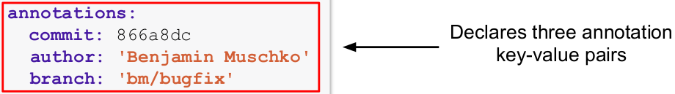
Assigning Annotations in YAML
Use the metadata.annotations attribute
apiVersion: v1 kind: Pod metadata:
name: pod1
spec:
...
annotations:
commit: 866a8dc
author: 'Benjamin Muschko' branch: 'bm/bugfix'

Slide 82

Assigning Annotations on CLI
Use the kubectl annotations command
Declares three annotation
key-value pairs
$ kubectl annotate pod nginx commit='866a8dc' branch='bm/bugfix'
pod/nginx annotated
$ kubectl describe pods my-pod
Annotations:
branch: bm/bugfix commit: 866a8dc
Removes the annotation with key commit
$ kubectl annotate pod nginx commit-
pod/nginx annotated
$ kubectl describe pods my-pod
Annotations: branch: bm/bugfix

Slide 83
Lab 07
Labels and annotations

Slide 84
Application Deployment
Deployments, Manual and Automatic Deployment, Rollout Strategies, Using Helm to Deploy an Application

Slide 85
What is a Deployment?
Scaling and replication features for a set of Pods
Controls a predefined number of Pods with the same configuration, so-called replicas.
The number of replicas can be scaled up or down to fulfill load requirements.
Updates to the replica configuration can be updated easily and is rolled out automatically.

Slide 86
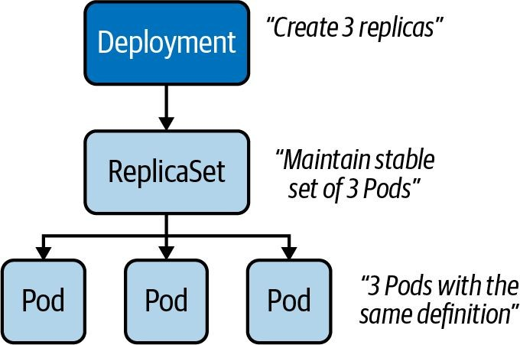
Example Deployment
A Deployment that controls three replicas

Slide 87

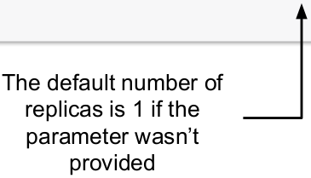
Creating a Deployment
Creates objects for the Deployment, ReplicaSet and Pods
$ kubectl create deployment my-deploy --image=nginx:1.14.2
deployment.apps/my-deploy created
--replicas=3

Slide 88
Deployment Template Attributes
apiVersion: apps/v1
kind: Deployment
metadata:
labels:
app: my-deploy
name: my-deploy
spec:
replicas: 3
selector:
matchLabels:
tier: backend
apiVersion:v1
kind: Pod
metadata:
name: nginx
Template spec attributes are the same as for a Pod spec
template:
metadata:
labels:
tier: backend
spec:
containers:
- image: nginx:1.14.2
name: nginx
spec:
containers:
- image: nginx:1.14.2
name: nginx

Slide 89

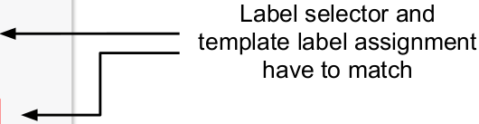
Deployment YAML Manifest
apiVersion: apps/v1
kind: Deployment
metadata:
labels:
app: my-deploy
name: my-deploy
spec:
replicas: 3
selector:
matchLabels:
template:
metadata:
labels:
spec:
containers:
- image: nginx:1.14.2
name: nginx
tier: backend
tier: backend

Slide 90

Listing Deployments
ReplicaSet and Pods can be identified by name prefix
$ kubectl get deployments,pods,replicasets
NAME READY UP-TO-DATE
deployment.apps/my-deploy 1/1 1
AVAILABLE 1
AGE
7m56s
NAME
pod/my-deploy-8448c488b5-mzx5g
READY
1/1
STATUS
Running
RESTARTS 0
AGE
7m56s
NAME
replicaset.apps/my-deploy-8448c488b5
DESIRED 1
CURRENT READY AGE 1 1 7m56s

Slide 91

Rendering Deployment Details
Object details show relationship between parent and child
$ kubectl describe deployment.apps/my-deploy
Replicas:
1 desired | 1 updated | 1 total | 1 available |
0 unavailable
my-deploy-8448c488b5 (1/1 replicas created)
NewReplicaSet:
$ kubectl describe replicaset.apps/my-deploy-8448c488b5
Controlled By: Deployment/my-deploy
$ kubectl describe pod/my-deploy-8448c488b5-mzx5g
Controlled By: ReplicaSet/my-deploy-8448c488b5

Slide 92
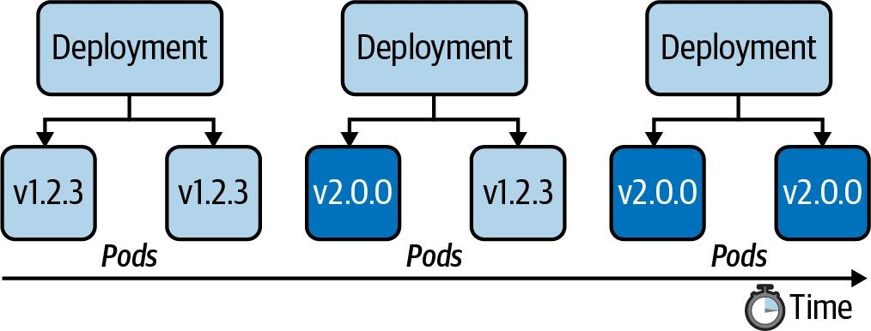
Roll Out and Roll Back Feature
“Look ma, shiny new features. Let’s deploy them to production!”

Slide 93

Rolling Out a New Revision
The rollout history keeps track of changes
$ kubectl rollout history deployment my-deploy
deployment.apps/my-deploy REVISION CHANGE-CAUSE
1 <none>
$ kubectl set image deployment my-deploy nginx=nginx:1.19.2
deployment.apps/my-deploy image updated
$ kubectl rollout history deployment my-deploy
deployment.apps/my-deploy REVISION CHANGE-CAUSE
<none>
<none>
Changes the assigned image for Pod template

Slide 94

Rolling Back to Previous Revision
You can revert to any revision available in the history
$ kubectl rollout undo deployment my-deploy --to-revision=1
deployment.apps/my-deploy rolled back
$ kubectl rollout history deployment my-deploy
deployment.apps/my-deploy REVISION CHANGE-CAUSE
<none>
<none>
Kubernetes deduplicates a revision if it points to the same changes

Slide 95
Common Deployment Strategies
Choosing the right deployment procedure depends on the needs
Recreate: Terminate the old version and release the new one.
Ramped: Release a new version on a rolling update fashion, one after the other.
Blue/green: Release a new version alongside the old version then switch traffic.
Canary: Release a new version to a subset of users, then proceed to a full rollout.

Slide 96
Recreate Deployment Strategy
Terminates all the running instances then recreate them
spec:
replicas: 3
strategy:
type: Recreate
Pros: Good for development environments as everything is renewed at once
Cons: Can cause downtime while applications are starting up

Slide 97

Ramped Deployment Strategy
Secondary ReplicaSet is created with new version of application
spec:
replicas: 3
strategy:
type: RollingUpdate
rollingUpdate:
maxSurge: 2
maxUnavailable: 0
Pros: New version is slowly distributed over time, no downtime
Cons: Breaking API changes can make consumers incompatible

Slide 98
Blue/Green Deployment Strategy
Deployment object with new version is created alongside
apiVersion: apps/v1
kind: Deployment metadata:
labels:
app: my-deploy
version: 1.0.0
name: blue
apiVersion: apps/v1
kind: Deployment metadata:
labels:
app: my-deploy
version: 1.1.0
name: green
Pros: No downtime, traffic can be routed when ready
Cons: Resource duplication, configuration of network routing

Slide 99
Canary Deployment Strategy
Two Deployment objects with different traffic distribution
spec:
replicas: 3
spec:
replicas: 1
Pros: New version released to subset of users, A/B testing of features and performance
Cons: May require a load balancer for fine-grained distribution

Slide 100
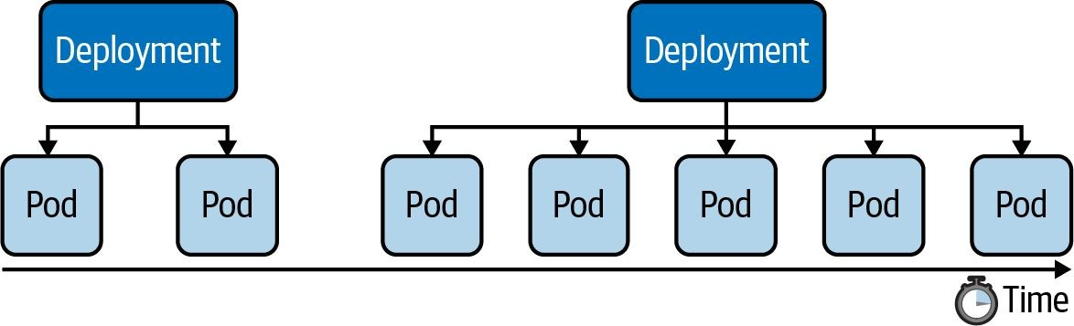
Manually Scaling a Deployment
“Load is increasing. We need to scale up the application.”

Slide 101
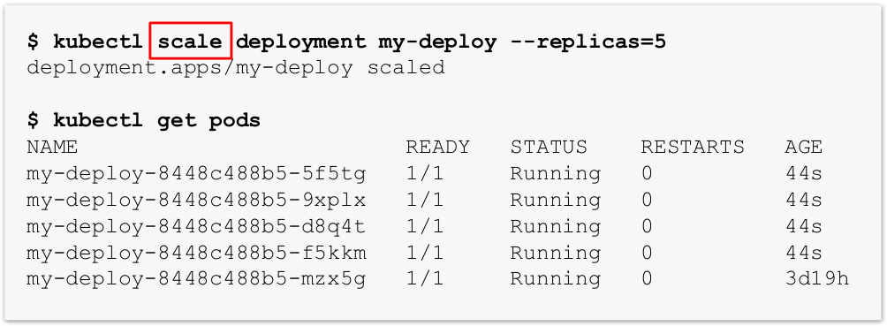
Changing the Number of Replicas
Use scale command or change replicas attribute in live object

Slide 102
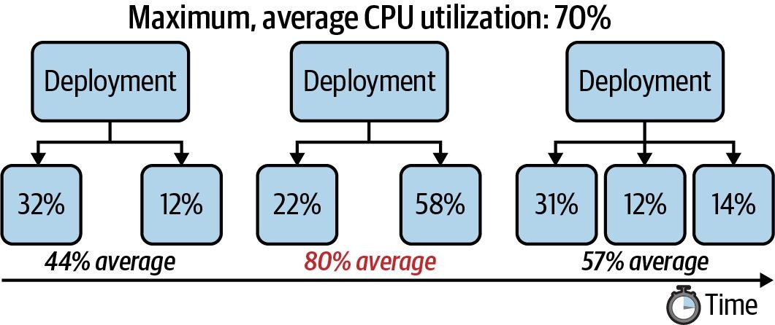
Autoscaling a Deployment
“Don’t make me think. Auto-scale based on CPU utilization.”

Slide 103
Types of Autoscalers
Decisions are made based on metrics
Horizontal Pod Autoscaler (HPA): A standard feature of Kubernetes that scales the number of Pod replicas based on CPU and memory thresholds.
Vertical Pod Autoscaler (VPA): Scales the CPU and memory allocation for existing Pods based on historic metrics. Supported by a cloud provider as an add-on or needs to be installed manually.
Both autoscalers use the metrics server. You need to install the component.

Slide 104
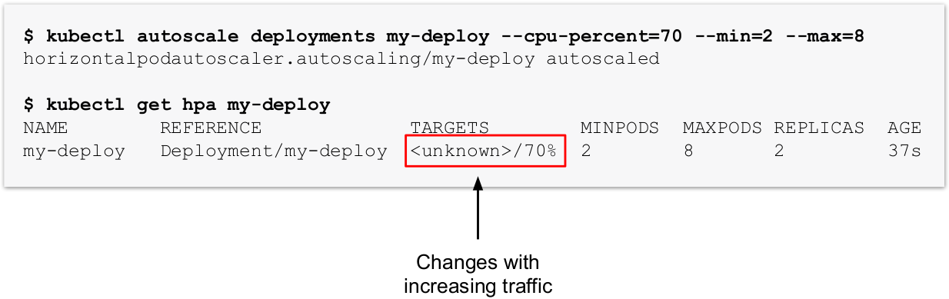
Creating a HPA
The imperative command is a quick way to create the object

Slide 105
Lab 08
Deployment

Slide 106
Deploying an Application with Helm
Use Cases, Commands, Workflow

Slide 107

What is Helm?
Templating engine and package manager for a set of manifests
The artifact produced by the Helm executable is a so-called chart file bundling the manifests that comprise the API resources of an application.
At runtime, it replaces placeholders in YAML template files with actual, end-user defined values.
Chart files can be distributed to a chart repository e.g. central chart repository and consumed from there.

Slide 108

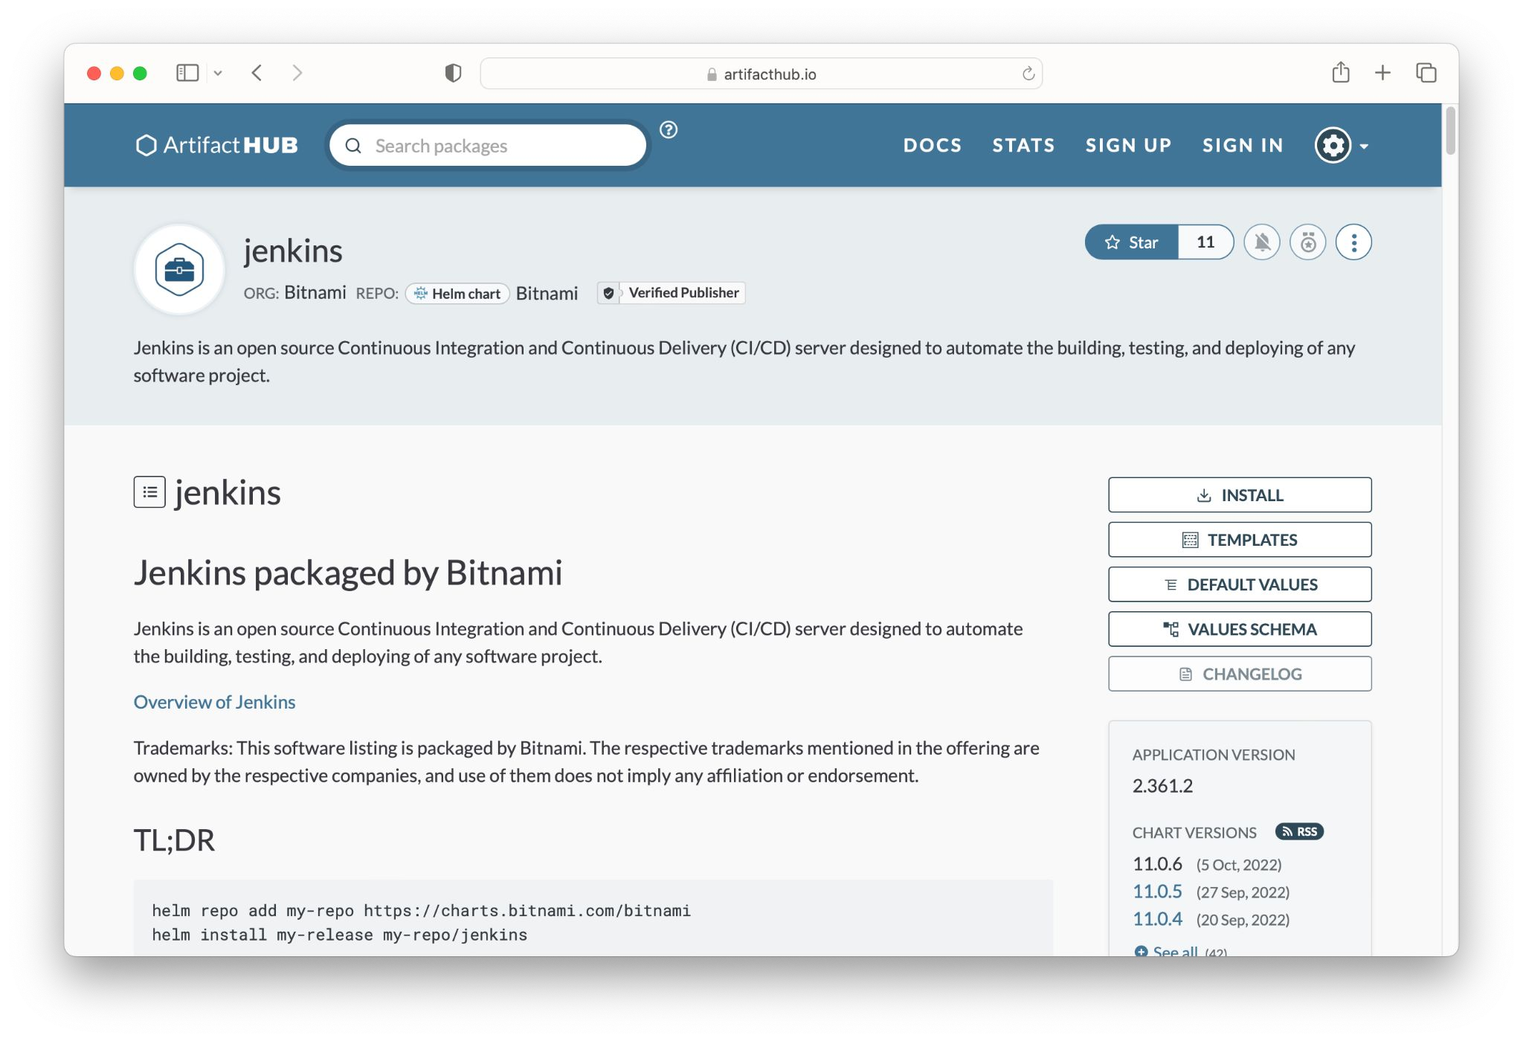
Finding a Chart
Searches the Artifact Hub for a chart with a matching name
$ helm search hub jenkins
URL
https://artifacthub.io/packages/helm/bitnami/jenkins
CHART VERSION APP 11.0.6 2.361.2
...

Slide 109
Installing a Chart
You may have to add an external repository that hosts chart file
$ helm repo add bitnami https://charts.bitnami.com/bitnami
"bitnami" has been added to your repositories
$ helm install jenkins bitnami/jenkins
...
CHART NAME: jenkins CHART VERSION: 11.0.6
APP VERSION: 2.361.2
** Please be patient while the chart is being deployed **

Slide 110

Listing Installed Charts
Information about chart details
$ helm list
NAME NAMESPACE
jenkins default
REVISION ... 1
STATUS
deployed
CHART
jenkins-11.0.6
APP VERSION 2.361.2
$ kubectl get pods
NAME
pod/bitnami-jenkins-764b44cc99-twf6f
...
READY
1/1
STATUS
Running
RESTARTS 0
AGE
7m34s

Slide 111
Uninstalling a Chart
Deletes Kubernetes objects controlled by chart
$ helm uninstall jenkins
release "jenkins" uninstalled
$ kubectl get pods
No resources found in default namespace.

Slide 112
Lab 09
Helm

Slide 113
Probes and Health Checks
Types of Probes, Use Cases, Configuration Options

Slide 114
Understanding Health Probing
Runtime issues can arise, but you check for them
Proper monitoring of applications running in production environments.
Health probing automates the detection and correction of runtime issues.
You can configure a container with health probes to execute a periodic mini-process that checks for certain conditions.

Slide 115
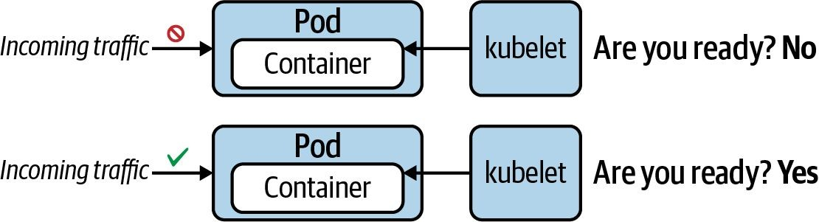
Readiness Probe
“Is application ready to serve requests?”

Slide 116
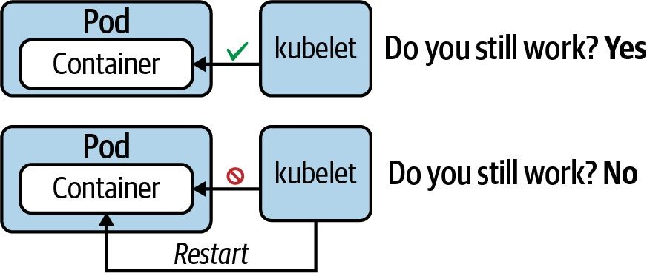
Liveness Probe
“Does the application still function without errors?”

Slide 117
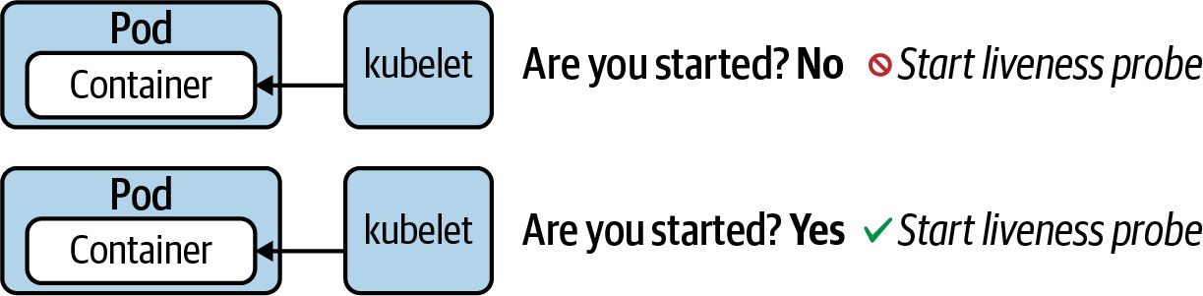
Startup Probe
“Legacy application may need longer to start. Hold off on probing.”

Slide 118
Health Verification Methods
Method | Option | Description
Custom Command | Executes a command inside of the container e.g. a cat _{exec.command} command and checks its exit code. Kubernetes considers an zero exit code to be successful. A non-zero exit code indicates an error.
HTTP GET Request | httpGet | Sends an HTTP GET request to an endpoint exposed by the application. A HTTP response code in the range of 200 and 399 indicates success. Any other response code is regarded as an error.
TCP socket connection | tcpSocket | Tries to open a TCP socket connection to a port. If the connection could be established, the probing attempt was successful. The inability to connect is accounted for as an error.

Slide 119
Health Check Attributes
Attribute | Default Value | Description
initialDelaySeconds | 0 | Delay in seconds until first check is executed.
periodSeconds | 10 | Interval for executing a check (e.g., every 20 seconds).
timeoutSeconds | 1 | Maximum number of seconds until check operation times out.
successThreshold | 1 | Number of successful check attempts until probe is considered successful after a failure.
failureThreshold | 3 | Number of failures for check attempts before probe is marked failed and takes action.

Slide 120
Defining a Readiness Probe
HTTP probes are very helpful for web applications
apiVersion: v1
kind: Pod
metadata:
name: web-app
spec:
containers:
- name: web-app
image: eshop:4.6.3
readinessProbe:
httpGet:
Path: /
port: 8080
initialDelaySeconds: 5
periodSeconds: 2
Successful if HTTP status code is between 200 and 399

Slide 121
Defining a Liveness Probe
An event log can be queried by a custom command
apiVersion: v1
kind: Pod
metadata:
name: web-app
spec:
containers:
- name: web-app
image: eshop:4.6.3
Does the file get updated periodically by the application process?
livenessProbe:
exec:
command:
- test `find /tmp/heartbeat.txt -mmin -1`
initialDelaySeconds: 10
periodSeconds: 5

Slide 122
Defining a Startup Probe
TCP socket connection if exposed by application
apiVersion: v1
kind: Pod
metadata:
name: startup-pod
spec:
containers:
- image: httpd:2.4.46
name: http-server
startupProbe:
tcpSocket:
port: 80
initialDelaySeconds: 3
periodSeconds: 15
Tries to open a TCP socket
connection to a port

Slide 123
Monitoring and Troubleshooting
Metrics Server, Finding and Fixing Issues in Applications

Slide 124
Monitoring Kubernetes
What metrics are of interest?
Number of nodes in the cluster.
Health status of nodes.
Node performance metrics like CPU, memory, disk space, network.
Pod-level performance metrics like CPU, memory consumption.

Slide 125
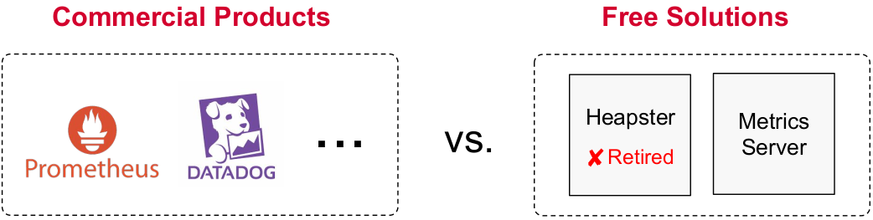
Monitoring Solution
Relevant to the exam: metrics server

Slide 126
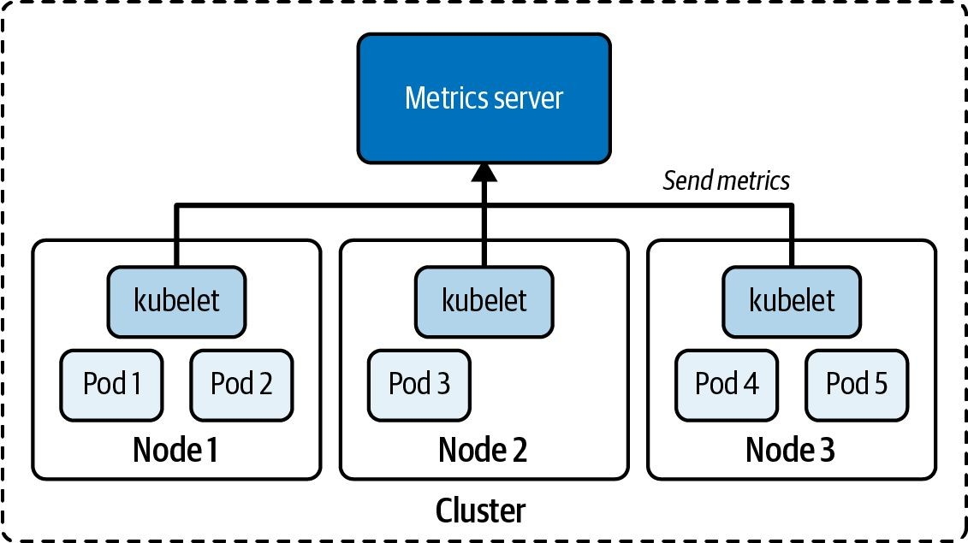
Metrics Server
Cluster-wide metrics aggregator

Slide 127

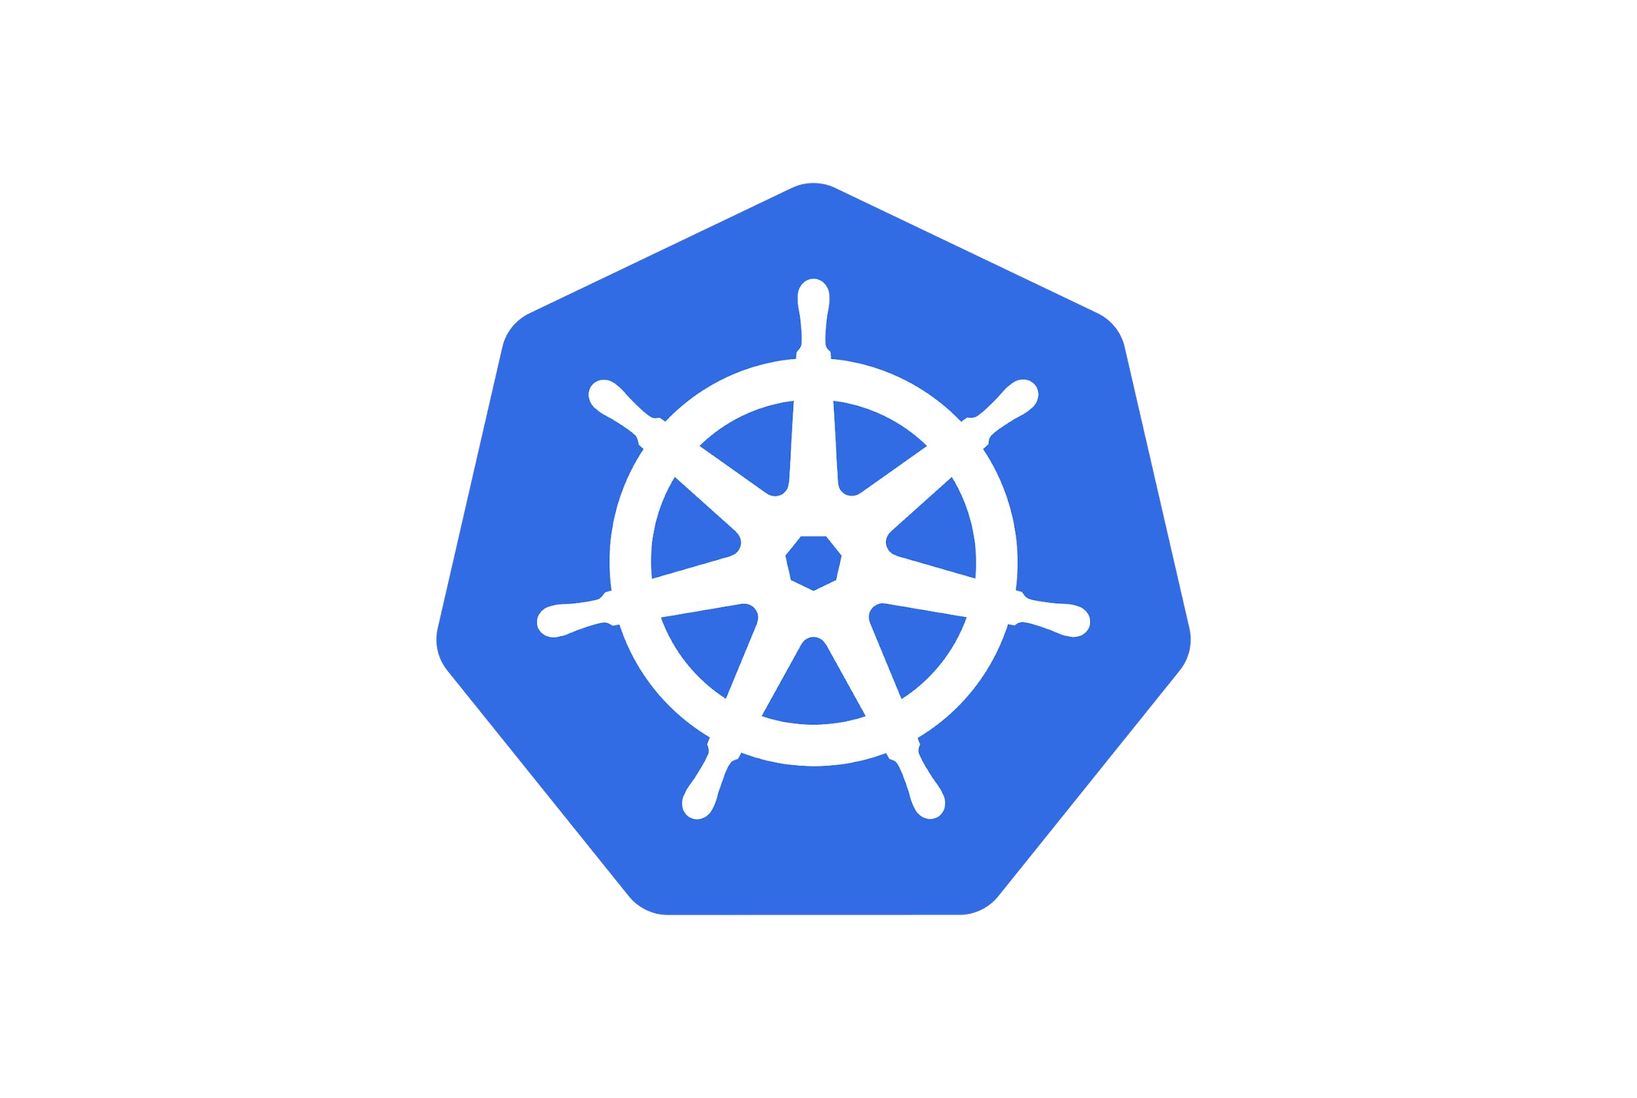
Installing the Metrics Server
Add on-component for Minikube or creating objects
$ minikube addons enable metrics-server
The 'metrics-server' addon is enabled
$ kubectl apply -f
https://github.com/kubernetes-sigs/metrics-server/r eleases/latest/download/components.yaml

Slide 128
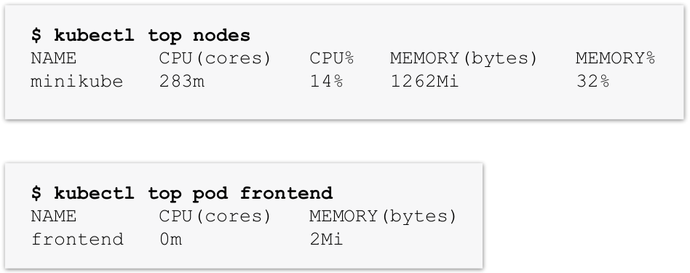
Using the Metrics Server
The kubectl top command can query nodes and Pods

Slide 129
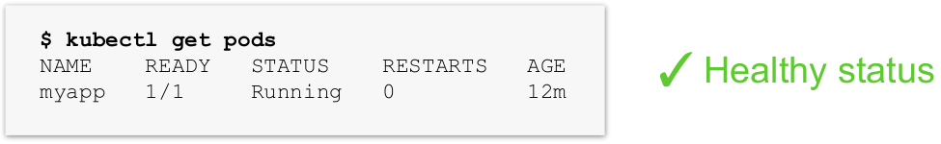
Troubleshooting Pods
Check the status first - is it running?

Slide 130
Common Pod Error Statuses
Status | Root cause | Potential fix
ImagePullBackOff or ErrImagePull | Image could not be pulled from registry. | Check correct image name, check that image name exists in registry, verify network access from node to registry, ensure proper
CrashLoopBackOff | Application or command run in container crashes. | Check command executed in container, ensure that image can properly execute (e.g. by creating a container with Docker)
CreateContainerConfigError | ConfigMap or Secret references by container cannot be found | Check correct name of the configuration object, verify the existence of the configuration object in the namespace

Slide 131
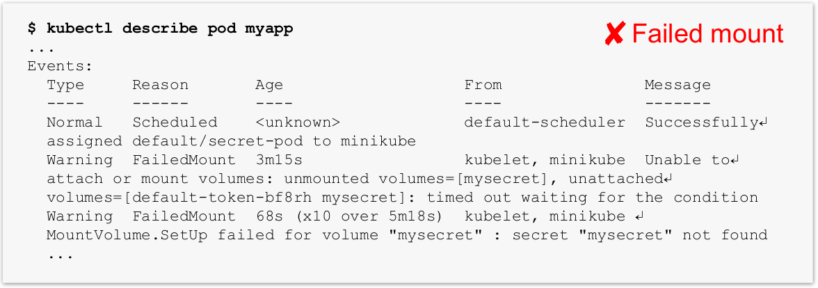
Troubleshooting Pods
Check the event log - does it indicate issues?

Slide 132
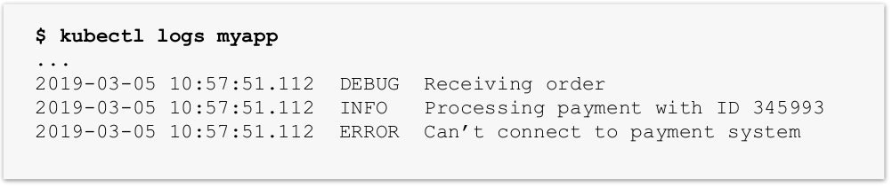
Troubleshooting Pods
Check the container logs - do you see anything suspicious?
✘Connectivity issues
Use the command line option --previous to gets the logs from the previous instantiation of a container after a restart

Slide 133
Lab 10
Troubleshooting Pod

Slide 134
Role-Based Access Control
Defining Roles and RoleBindings for Users and Service Accounts

Slide 135
What is RBAC?
Restricting access control for clients interacting with API server
Defines policies for users, groups, and processes by allowing or disallowing access to manage API resources.
Enabling and configuring RBAC is mandatory for any organization with a strong emphasis on security.
Example: “The human user john is only allowed to list and create Pods, and Deployments but nothing else.”

Slide 136
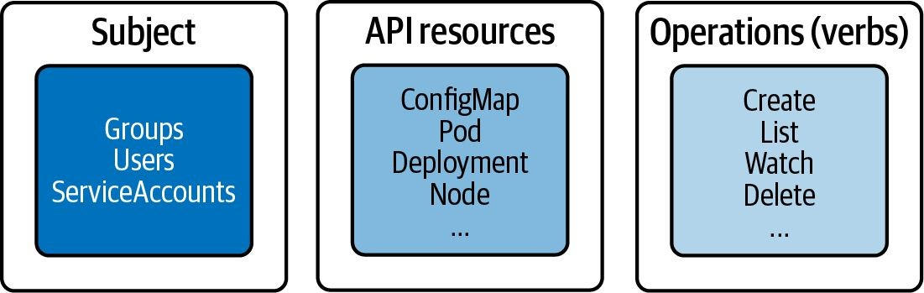
RBAC High-Level Overview
Three key elements for understanding concept

Slide 137
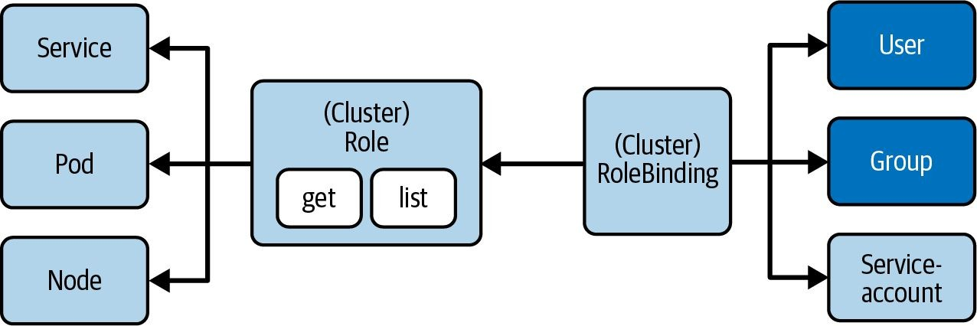
Involved RBAC Primitives
Restrict access to API resources based on user roles

Slide 138

Creating a Role
Defines verbs and resources in comma-separated list
$ kubectl create role read-only --verb=list,get,watch↵
--resource=pods,deployments,services
role.rbac.authorization.k8s.io/read-only created
Resources: Primitives the operations should apply to
Operations: Only allow listing, getting, watching

Slide 139

Role YAML Manifest
Can define a list of rules in an array
apiVersion: rbac.authorization.k8s.io/v1
kind: Role
metadata:
name: pod-reader
rules:
apiGroups: [""]
resources: ["pods", "services"]
verbs: ["list", "get", "watch"]
apiGroups: ["apps"]
resources: ["deployments"]
verbs: ["list", "get", "watch"]
Resources with groups need to spelled out explicitly

Slide 140

Creating a RoleBinding
Map subject to Role
$ kubectl create rolebinding read-only-binding --role=read-only↵
--user=johndoe
rolebinding.rbac.authorization.k8s.io/read-only-binding created
Subject: Binds a user to the Role
Role: Reference the name of the object

Slide 141

RoleBinding YAML Manifest
Roles can be mapped to multiple subjects if needed
apiVersion: rbac.authorization.k8s.io/v1
kind: RoleBinding
metadata:
name: read-only-binding
roleRef:
apiGroup: rbac.authorization.k8s.io
kind: Role
name: read-only
subjects:
- apiGroup: rbac.authorization.k8s.io
kind: User
name: johndoe
Reference to Role
Reference to User

Slide 142
Cluster-wide RBAC
Apply Roles and RoleBindings across multiple namespaces
The configuration elements are effectively the same. The only difference is the value of the kind attribute.
To define a cluster-wide Role, use the imperative subcommand
clusterrole or the kind ClusterRole in the YAML manifest.
To define a cluster-wide RoleBinding, use the imperative subcommand clusterrolebinding or the kind ClusterRoleBinding in the YAML manifest.

Slide 143
What is a Service Account?
Process in a container needs to interact with Kubernetes API
Pods use a Service Account to authenticate with the API server through an authentication token.
If not assigned explicitly, a Pod uses the default Service Account. The default Service Account has the same permissions as an unauthenticated user.
Example: “I have a CI/CD process that should interact with the Kubernetes API using an authentication token.”

Slide 144
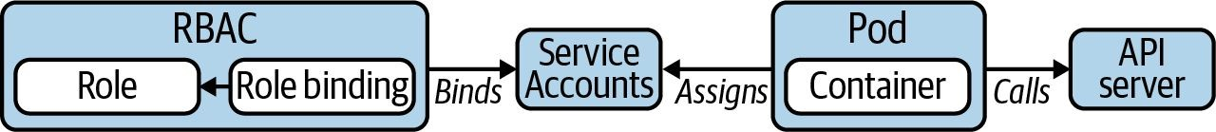
Service Account as Subject
Usage needs to be configured in Pod

Slide 145
ServiceAccount YAML Manifest
Enables authentication token auto-mounting by default
apiVersion: v1
kind: ServiceAccount
metadata:
name: sa-api
namespace: k97
The token file will be available to any Pod that uses the Service Account at
/var/run/secrets/kubernetes.io/serviceaccount/token

Slide 146

Using Service Account in Pod
Enables authentication token auto-mounting by default
apiVersion: v1
kind: Pod
metadata:
name: list-pods
namespace: k97
spec:
serviceAccountName: sa-api
containers:
- name: pods
image: alpine/curl:3.14
List all Pods in the namespace k97 via an API call
Assigned name of Service Account
command: ['sh', '-c', 'while true; do curl -s -k -m 5 -H↵ "Authorization: Bearer $(cat /var/run/secrets/kubernetes.io/↵
serviceaccount/token)" https://kubernetes.default.svc.cluster.↵ local/api/v1/namespaces/k97/pods; sleep 10; done']

Slide 147

RoleBinding YAML Manifest
Default RBAC policies don’t span beyond kube-system
apiVersion: rbac.authorization.k8s.io/v1
kind: RoleBinding
metadata:
name: serviceaccount-pod-rolebinding
namespace: k97
roleRef:
apiGroup: rbac.authorization.k8s.io
kind: ClusterRole
name: list-pods-clusterrole
subjects:
- apiGroup: rbac.authorization.k8s.io
kind: ServiceAccount
name: sa-api
Maps the Service Account as a subject

Slide 148
Lab 11
RBAC Service Account

Slide 149
Resource Requirements and Boundaries
Container Resource Requests and Limits, Resource Quotas for Namespaces

Slide 150
Handling Resources
It’s best practice to make statement about resource consumption
Containers can define a minimum amount of resources needed to run the application, as well as the maximum amount of resources the application is allowed to consume.
Application developers should determine the right-sizing with load tests or at runtime by monitoring the resource consumption.
Enforcement of resources can be constrained on a namespace-level with a ResourceQuota.

Slide 151
Resource Units in Kubernetes
CPU units and memory as fixed-point number or power-of-two equivalents
Kubernetes measures CPU resources in millicores and memory resources in bytes. That’s why you might see resources defined as 600m or 100Mib.
For a deep dive on those resource units, it’s worth cross-referencing the section “Resource units in Kubernetes” in the official documentation.

Slide 152
Container Resource Requests
Definition and runtime effects
Containers can define a minimum amount of resources needed to run the application via spec.containers[].resources.requests.
Resource types include CPU, memory, huge page, ephemeral storage.
If Pod cannot be scheduled on any node due to insufficient resource availability, you may see a PodExceedsFreeCPU or PodExceedsFreeMemory status.

Slide 153
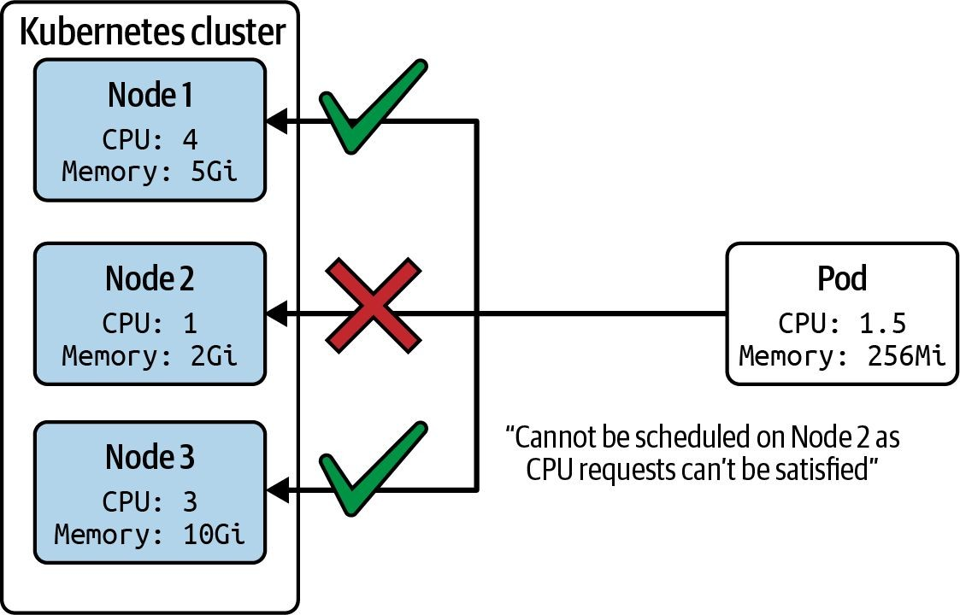
Example Scheduling Scenario
Node’s resource capacity needs to be able to fulfill it

Slide 154
Resource Requests YAML Manifest
Minimum amount of resources defined for a container
apiVersion: v1
kind: Pod
metadata:
name: rate-limiter
spec:
containers:
- name: business-app
image: bmuschko/nodejs-business-app:1.0.0
ports:
- containerPort: 8080
resources:
requests:
memory: "256Mi" cpu: "1"

Slide 155
Container Resource Limits
Definition and runtime effects
Containers can define a maximum amount of resources allowed to consumed by the application via spec.containers[].resources.limits.
Resource types include CPU, memory, huge page, ephemeral storage.
Container runtime decides how to handle situation where application exceeds allocated capacity, e.g. termination of application process.

Slide 156
Resource Limits YAML Manifest
Do not allow more than the allotted resource amounts
apiVersion: v1
kind: Pod
metadata:
name: rate-limiter
spec:
containers:
- name: business-app
image: bmuschko/nodejs-business-app:1.0.0
ports:
- containerPort: 8080
resources:
limits:
memory: "512Mi" cpu: "2"

Slide 157
What is a ResourceQuota?
Defines resource constraints per namespace
Constraints that limit aggregate resource consumption or limit the quantity of objects that can be created.
requests.cpu/memory: Across all pods in a non-terminal state, the sum of CPU/memory requests cannot exceed this value.
limits.cpu/memory: Across all pods in a non-terminal state, the sum of CPU/memory limits cannot exceed this value.

Slide 158
ResourceQuota YAML Manifest
# of objects and limit aggregate resource consumption
apiVersion: v1
kind: ResourceQuota metadata:
name: awesome-quota
namespace: team-awesome
spec:
hard:
pods: 2
requests.cpu: "1" requests.memory: 1024Mi limits.cpu: "4" limits.memory: 4096Mi

Slide 159

No Requests/Limits Definition
Scheduler rejects the creation of the object
$ kubectl create -f nginx-pod.yaml -n team-awesome
Error from server (Forbidden): error when creating "nginx-pod.yaml": pods "nginx" is forbidden: failed quota: awesome-quota: must specify limits.cpu,limits.memory,requests.cpu,requests.memory

Slide 160

Exceeds Requests/Limits
Scheduler rejects the creation of the object
$ kubectl create -f nginx-pod.yaml -n team-awesome
Error from server (Forbidden): error when creating "nginx-pod.yaml"↵: pods "nginx" is forbidden: exceeded quota: awesome-quota, requested↵:
pods=1,requests.cpu=500m,requests.memory=512Mi, used: pods=2,requests.cpu=1↵, requests.memory=1024Mi, limited: pods=2,requests.cpu=1,requests.memory=1024Mi

Slide 161
Lab 12
Resources Requirements

Slide 162
ConfigMaps and Secrets
Creating and Consuming Configuration Data

Slide 163
Defining Configuration Data
Control runtime behavior with centralized information
Stored as key-value pairs in dedicated Kubernetes primitives with a lifecycle decoupled from consuming Pod.
ConfigMap: Plain-text values suited for configuring application e.g. flags, or URLs.
Secret: Base64-encoded values suited for storing sensitive data like passwords, API keys, or SSL certificates. Values are not encrypted!

Slide 164
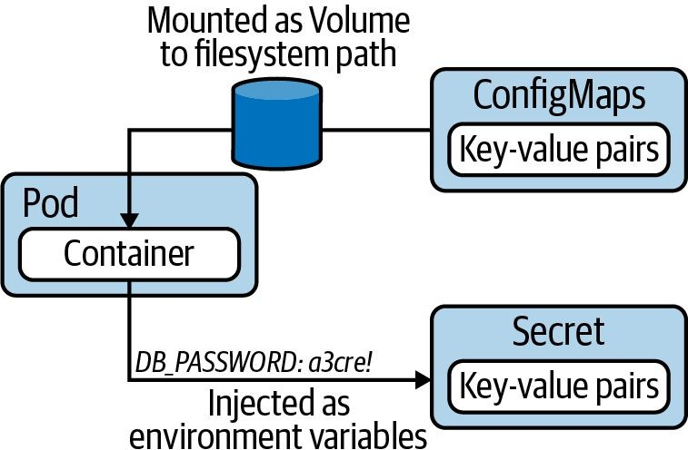
Consuming ConfigMap & Secret
Mounting as a Volume or injecting as env. variables

Slide 165
ConfigMap Data Sources
Imperative command provides options for sourcing data
--from-literal: Literal values, which are key-value pairs as plain text.
--from-env-file: A file that contains key-value pairs and expects them to be environment variables.
--from-file: A file with arbitrary contents.
--from-file: A directory with one or many files.

Slide 166

Creating a ConfigMap
Fast, easy and flexible, can point to different sources
$ kubectl create configmap db-config --from-literal=db=staging
configmap/db-config created
$ kubectl create configmap db-config --from-env-file=config.env
configmap/db-config created
$ kubectl create configmap db-config --from-file=config.txt
configmap/db-config created
$ kubectl create configmap db-config --from-file=app-config
configmap/db-config created

Slide 167
ConfigMap YAML Manifest
Definition of a ConfigMap is fairly short and on point
apiVersion: v1 kind: ConfigMap metadata:
name: db-config
data:
db: staging
username: jdoe

Slide 168

Consuming as Env. Variables
Convenient if ConfigMap reflects the desired syntax
apiVersion: v1
kind: Pod
metadata:
name: backend
spec:
containers:
- image: nginx
name: backend
$ kubectl exec -it nginx -- env
db=staging
username=jdoe
...
envFrom:
- configMapRef: name: db-config

Slide 169


Consuming as a Volume
Use Volume type configMap
apiVersion: v1 kind: Pod metadata:
name: backend
spec:
containers:
- name: backend
$ kubectl exec -it backend -- /bin/sh
# cat /etc/config/db staging
# ls /etc/config
db username
image: nginx
volumeMounts:
- name: config-volume
mountPath: /etc/config
volumes:
- name: config-volume
configMap:
name: db-config

Slide 170
Secret Options
Imperative command: kubectl create secret
Option | Description
generic | Creates a secret from a file, directory, or literal value.
docker-registry | Creates a secret for use with a Docker registry.
tls | Creates a TLS secret.

Slide 171
Secret Data Sources
Imperative generic command provides options for sourcing data
--from-literal: Literal values, which are key-value pairs as plain text.
--from-env-file: A file that contains key-value pairs and expects them to be environment variables.
--from-file: A file with arbitrary contents.
--from-file: A directory with one or many files.

Slide 172
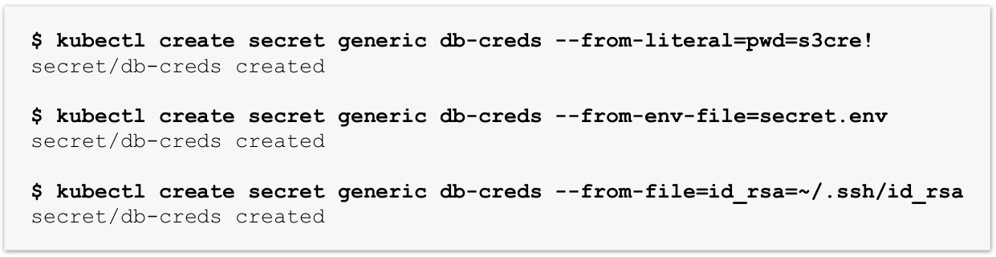
Creating a Secret
Values are base64-encoded automatically

Slide 173

Secret YAML Manifest
Value has to be base64-encoded manually
$ echo -n 's3cre!' | base64
czNjcmUh
apiVersion: v1
kind: Secret metadata:
name: mysecret
type: Opaque
data:
pwd: czNjcmUh

Slide 174


Consuming as Volume
Inside of the container, values are base64-decoded
apiVersion: v1
kind: Pod
metadata:
name: backend
spec:
containers:
- name: backend
image: nginx
volumes:
- name: secret-volume
secret:
secretName: mysecret
$ kubectl exec -it backend -- /bin/sh
# ls /etc/secret pwd
# cat /etc/secret/pwd s3cre!
volumeMounts:
- name: secret-volume
mountPath: /etc/secret

Slide 175
Specialized Secret Types
The table only lists some, more in docs
Type | Description
kubernetes.io/basic-auth | Credentials for basic authentication
kubernetes.io/ssh-auth | Credentials for SSH authentication
kubernetes.io/service-account-token | ServiceAccount token

Slide 176

Plain-Text Secret Values
The stringData attribute allows for plain-text values
apiVersion: v1
kind: Secret
metadata:
name: secret-basic-auth
type: kubernetes.io/basic-auth
username: admin
password: t0p-Secret
stringData:

Slide 177
Lab 13
Config Data

Slide 178
Security Contexts for Pods
Defining Privilege and Access Control

Slide 179
What is a Security Context?
Privilege and access control settings for a Pod or container
Modeled as a set of attributes under the attribute securityContext
within the Pod specification.
Can be applied to all containers in Pod or for individual containers.
Example: “This container needs to run with a non-root user.”

Slide 180

Defining a Security Context
Pod- vs. container-level definition
apiVersion: v1 kind: Pod metadata:
name: secured-pod
spec:
securityContext:
runAsUser: 1000
Defined on the Pod-level
containers:
- image: nginx:1.18.0
name: secured-container
securityContext:
runAsGroup: 3000
Defined on the container-level

Slide 181
Security Context API
Only partial overlap for Pod- and container attributes
API | Description
PodSecurityContext | Defines Pod-level security attributes.
SecurityContext | Defines container-level security attributes.

Slide 182
Lab 14
Security Context

Slide 183
Services
Service Types and Troubleshooting

Slide 184
What is a Service?
Discoverable networking capability for Pods
A Pod’s IP address is not considered stable over time. A Pod restart leases a new IP address.
Building a microservices architecture on Kubernetes requires network interfaces stable over time.
A Service provides discoverable names and load balancing to a set of Pods.

Slide 185
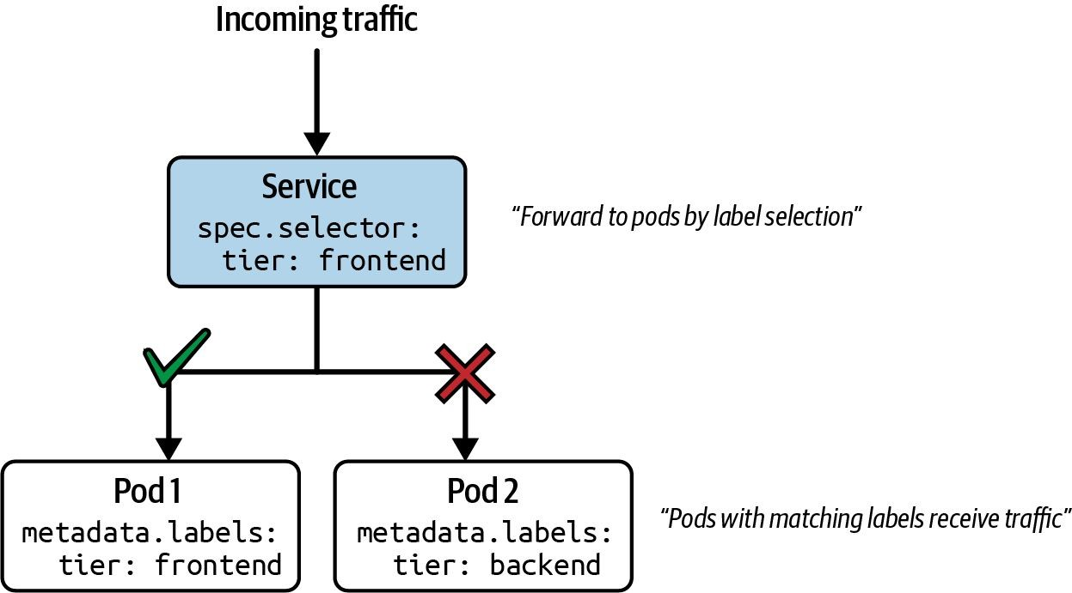
Request Routing
“How does a service decide which Pod to forward the request to?”

Slide 186
Different Types of Services
Type | Behavior
ClusterIP | Exposes the service on a cluster-internal IP. Only reachable from within the cluster.
NodePort | Exposes the service on each node's IP at a static port. Accessible from outside of the cluster.
LoadBalancer | Exposes the service externally using a cloud provider’s load balancer.

Slide 187
Service YAML Manifest
Defines containers and their images running in them
apiVersion: v1 kind: Service metadata:
name: echoserver
spec:
type: ClusterIP
Service type
selector:
app: echoserver
ports:
- port: 80
targetPort: 8080
Label selection for Pods
Mapping of incoming to outgoing port

Slide 188
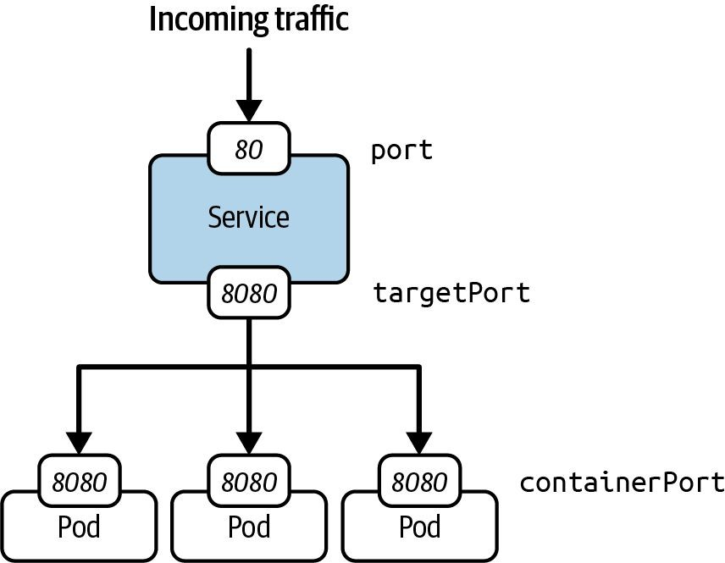
Port Mapping
“How to map the service port to the container port in Pod?”

Slide 189

ClusterIP Service Type
Only reachable from within the cluster, e.g. another Pod

Slide 190

NodePort Service Type
Can be resolved from outside of the Kubernetes cluster

Slide 191

LoadBalancer Service Type
Routes traffic from existing, external load balancer to Service

Slide 192
Lab 15
Services type

Slide 193
Ingress
Purpose, Routing Rules, Access

Slide 194
What is an Ingress?
Route HTTP(S) traffic from the outside of cluster to Service
It’s not a specific Service type, nor should it be confused with the Service type LoadBalancer.
Defines rules for mapping URL context path to Service object.
An Ingress cannot work without an Ingress controller. The Ingress controller evaluates the collection of rules defined by an Ingress that determine traffic routing.

Slide 195

Ingress Traffic Routing
Can involve one or many Services as backend

Slide 196
Creating an Ingress
The rule definition requires intricate knowledge of syntax
$ kubectl create ingress corellian↵
--rule="star-alliance.com/corellian/api=corellian:8080"
ingress.networking.k8s.io/corellian created

Slide 197
Ingress YAML Manifest
The host definition is optional
apiVersion: networking.k8s.io/v1
kind: Ingress
metadata:
name: corellian
spec:
rules:
- host: star-alliance.com
http:
paths:
- backend:
service:
name: corellian
port:
number: 8080 path: /corellian/api pathType: Exact

Slide 198
Ingress Rules
Traffic routing is controlled by rules defined on Ingress resource
Optional host. If no host is defined, then all inbound HTTP traffic is handled.
A list of paths e.g. /testpath.
The backend, a combination of Service name and port.

Slide 199
Path Types
Incoming URLs match based on type
Rule
Request
/foo
✓
Exact
/foo
/bar
✘
/foo, /foo/
✓
Prefix
/foo
/bar
✘

Slide 200

Accessing an Ingress
Use host name and context path
$ wget
star-alliance.com/corellian/api/
--timeout=5 --tries=1
Resolving star-alliance.com (star-alliance.com)... 192.168.64.15
Connecting to star-alliance.com (star-alliance.com)|192.168.64.15|:80... connected.
...

Slide 201
Network Policies
Purpose, Rules, Best Practices

Slide 202
What is a Network Policy?
Firewall rules for Pod-to-Pod communication
Communication between Pods in the same cluster is unrestricted. You can use the Pod’s IP address to communicate with it.
Network policies implement the principle of least privilege. Only allow communicate is needed to fulfill requirement of architecture.
You can disallow and allow network communication with fine-grained rules.

Slide 203

Example Network Policies
“Network Policies control traffic from and to the Pod”

Slide 204
Network Policy Rules
Pod
tier: frontend
Which Pod does the rule apply to? ✔
Pod
Which direction of traffic? Who is allowed?
Ingress
Egress
✘
✓

Slide 205
Deny All Policy YAML Manifest
Start with default deny policy and then allow traffic
apiVersion: networking.k8s.io/v1
kind: NetworkPolicy
metadata:
name: default-deny-all
spec:
podSelector: {}
policyTypes:
Ingress
Egress

Slide 206

Allow Policy YAML Manifest
kubectl doesn’t provide an imperative command
apiVersion: networking.k8s.io/v1
kind: NetworkPolicy
metadata:
name: api-allow
spec:
podSelector:
matchLabels:
app: payment-processor
Selects the labels of Pods the rule should apply to
role: api
ingress:
- from:
- podSelector: matchLabels:
app: coffeeshop
Only defines rules for
incoming traffic

Slide 207


Restricting Access to Ports
...
ingress:
- from:
- podSelector: matchLabels:
tier: backend
ports:
- protocol: TCP
port: 5432
...
By default all ports are open

Slide 208

Additional Learning Resource
Network Policies explained by use case and visualization
https://github.com/ahmetb/kubernetes-network-policy-recipes

Slide 209
Lab 16
Network Policy

