Slide 1

Exoplanet Detection Using Machine Learning
Department of Computer Science and Engineering
Seshadri Rao Gudlavalleru Engineering College, Gudlavalleru
By
P. Krishna Balamohan – 21481A05I1
P. Brahma Reddy – 21481A05F8
M. Yuva Karthik – 22485A0517
M. Durga Sai Sandeep – 21481A05D5
P. Siva Sagar – 21481A05G4
Under the guidance of
Dr. N. Siva Chintaiah, MCA, Ph.D.
Assistant Professor, Department of CSE

Slide 2
Outline
Abstract
Introduction
Objectives
Related Work
Methodology
Implementation
Results

Slide 3
ABSTRACT
The project focuses on enhancing sensor reliability in data-driven systems through deep learning techniques. It introduces a data-driven approach using a diverse dataset to promptly and accurately detect sensor faults. Multiple advanced deep learning methods are evaluated to identify the most efficient sensor fault detection approach. The research has significant implications for various applications relying on sensor measurements. By employing deep learning, the project offers a solution for real-time identification of faulty sensor data, improving system dependability. The work highlights the potential of advanced machine learning in ensuring reliable and precise sensor data, ushering in a new era of trustworthy sensor-enabled environments.

Slide 4

INTRODUCTION
Sensor data accuracy and reliability are crucial in various fields like industrial automation, environmental monitoring, healthcare, and smart infrastructure management.
Challenges such as sensor drift, calibration errors, environmental factors, and physical damage can lead to inaccurate readings, affecting decision-making and system efficiency.
Traditional fault detection methods for sensor data, including threshold setting and statistical analysis, face limitations in handling dynamic real-world data and may result in high rates of false positives and negatives.
In large-scale sensor networks, the volume and velocity of data further complicate fault detection, making conventional methods inefficient and impractical for ensuring data integrity.

Slide 5
OBJECTIVES
Develop a robust sensor fault detection methodology using deep learning techniques.
Create a comprehensive dataset for sensor readings under diverse conditions.
Evaluate and identify the most efficient and precise sensor fault detection method among multiple deep learning architectures and techniques.

Slide 6
RELATED WORK
The existing system addresses vulnerabilities in IoT-based smart sensing systems deployed in challenging environments.
Its objective is to accurately detect IoT sensor behavior in various scenarios, including normal operation, sensor faults, and security attacks.
To achieve this, the system employs an approach based on spatial correlation theory, validated using Moran's I index, and utilizes machine learning models like CART, RF, and SVM for classification. Real-time anomaly detection is enabled through edge computing technology.
The system assumes attackers with significant computational resources and emphasizes the need for robust detection methods.
It comprises three phases: preprocessing, outlier detection, and spatial correlation-based classification, ultimately distinguishing normal behavior from outliers and accurately categorizing detected outliers as sensor failures or security attacks.

Slide 7
METHODOLOGY
Focus on Sensor Reliability: The methodology aims to enhance sensor reliability in data-driven systems.
Utilization of Deep Learning Techniques: Deep learning methods will be employed to detect sensor faults effectively.
Data-Driven Approach: The approach relies on a diverse dataset comprising sensor readings under various conditions.
Efficient Fault Detection: The goal is to promptly and accurately identify sensor faults.
Systematic Evaluation of Techniques: Multiple deep learning architectures and techniques will be explored and assessed.
Identification of Optimal Method: The methodology seeks to identify the most efficient and precise sensor fault detection approach.

Slide 8
METHODOLOGY
Wide Applicability: The outcomes of this research will have significant implications for a broad range of applications reliant on sensor measurements.
Real-Time Fault Identification: The project aims to provide a solution for real-time identification of faulty sensor data, enhancing system dependability.
Integration of Advanced Machine Learning: The work emphasizes the potential of integrating advanced machine learning techniques to ensure the reliability and precision of sensor data.
Advancing Sensor-Enabled Environments: Ultimately, the project contributes to advancing the state-of-the-art in sensor fault detection, heralding a new era of robust and trustworthy sensor-enabled environments.

Slide 9
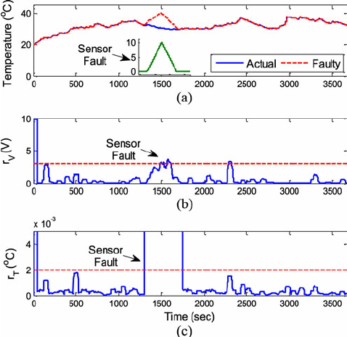
METHODOLOGY
Fig 1: Temperature sensor showing fault results

Slide 10
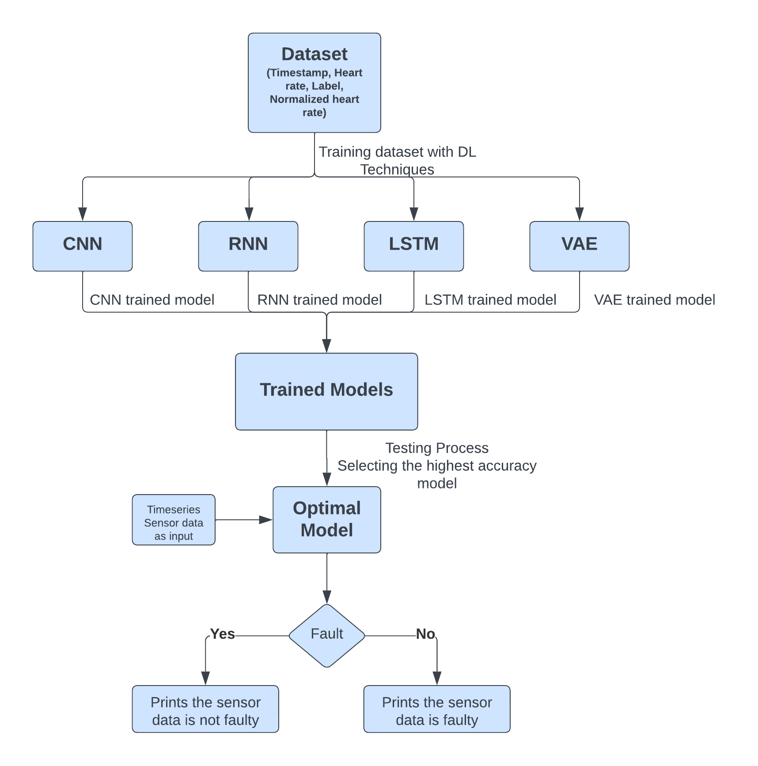
PLAN OF ACTION
Fig 2 : Flow Diagram of Proposed Methodology

Slide 11
IMPLEMENTATION
Utilize 'updated_heart_rate_dataset_formatted.csv': You're being instructed to use a specific CSV file containing pre-processed heart rate data for fault detection.
Focus on 'Normalized_Heart_Rate' and 'Label': The model should use 'Normalized_Heart_Rate' as the input feature and 'Label' as the target for classification. 'Label' has two classes: 0 for normal operation and 1 for a fault.
Split the dataset into 80-20: Before training a model, you usually divide your dataset into a training set and a test set. In this case, 80% of the data should be used for training the model, and the remaining 20% for testing its performance. This is done to evaluate the model on data it hasn't seen during training, ensuring that the model generalizes well to new, unseen data.
Initialize a Sequential model with TensorFlow and Keras: This involves using TensorFlow and its high-level Keras API to define a neural network model. A Sequential model is a linear stack of layers.

Slide 12
IMPLEMENTATION
Add a SimpleRNN layer with 50 units: A SimpleRNN layer is a type of recurrent neural network that is suited for sequence data, like time series. You are instructed to create this layer with 50 neurons (units) and use the 'relu' activation function, which is common for hidden layers.
Follow with a Dense layer with sigmoid activation: After the RNN layer, you need to add a Dense layer, which is a fully connected neural network layer. Since this is a binary classification task, the Dense layer should have one unit with a 'sigmoid' activation function that outputs values between 0 and 1.
Compile the model: The model needs to be compiled with the 'adam' optimizer (a method to change the attributes of the neural network such as weights and learning rate to reduce the losses), 'binary_crossentropy' (a loss function for binary classification), and set 'accuracy' as the metric for evaluation.
Train the model with EarlyStopping: Train the model using the training data. EarlyStopping is a technique to stop training once the model performance stops improving on a hold-out validation dataset.

Slide 13
IMPLEMENTATION
Evaluate the model: After training, assess the model's performance on the test dataset by calculating metrics such as accuracy, precision, recall, and F1-score. These metrics provide different insights into the quality of the model, such as how many predictions are correct (accuracy), how many positive predictions were actually positive (precision), and the proportion of actual positives that were identified correctly (recall).
Hyperparameter tuning: This involves experimenting with different model settings (hyperparameters) such as learning rate, batch size, and number of epochs to improve performance. Grid search or randomized search are systematic ways to do this.
Apply regularization techniques: To improve the model's generalization and prevent overfitting, you may use techniques like dropout (randomly setting a fraction of input units to 0) and batch normalization (normalizing the inputs to a layer for each mini-batch).
Analyze and interpret the results: After training and evaluating the model, you should review the performance metrics and understand what they imply about the model's ability to function in real-world scenarios, such as in heart rate sensor applications.

Slide 14
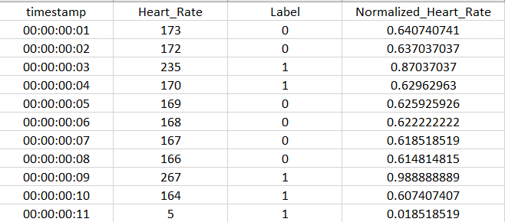
DATASET
The image presents a snapshot of the dataset used in the study, illustrating four critical columns: Timestamps, Heart Rate, Label, and Normalized Heart Rate. The 'Timestamps' column indicates the specific time at which each heart rate reading was recorded. 'Heart Rate' displays the raw heart rate data as captured by the sensors. The 'Label' column categorizes each reading into different classes, such as 'normal' or 'faulty', based on predefined criteria. Lastly, 'Normalized Heart Rate' shows the heart rate data after normalization, a process essential for preparing the data for effective analysis by the neural network models.

Slide 15

Advancing Sensor Data Integrity with Deep Learning-Based Fault Detection
RESULTS
Figure 3: Accuracy values of LSTM and RNN trained models.

Slide 16
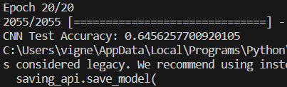
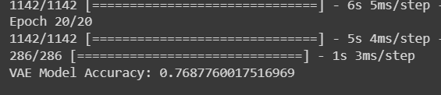
RESULTS
Figure 4: Accuracy values of CNN and VAE trained models.

Slide 17
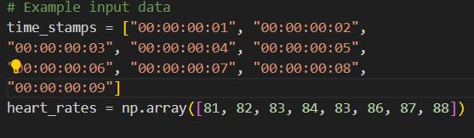
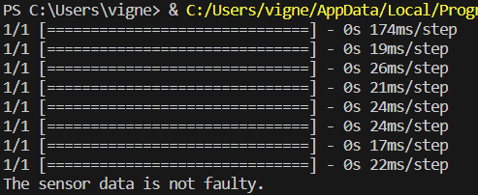
RESULTS
Fig 5: Testing valid inputs and showing the result of those inputs.

Slide 18
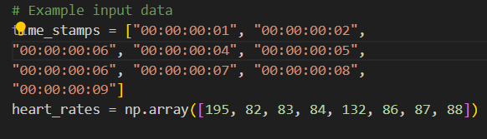
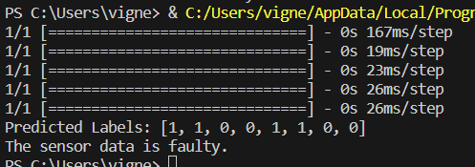
RESULTS
Fig 6: Testing in-valid inputs and showing the result of those inputs.

Slide 19
CONCLUSION
In the contemporary landscape of data-driven systems, sensor reliability is a linchpin for informed decision-making and system integrity.
This project has tackled the pressing issue of sensor dependability by applying innovative deep learning techniques. Our comprehensive approach, encompassing data collection, preprocessing, model selection, and real-time implementation, aims to fortify the trustworthiness of sensor-driven systems.
Through rigorous experimentation and evaluation, we've uncovered the most efficient and precise sensor fault detection method among various deep learning approaches.
The methodology's real-world implementation holds the potential to revolutionize sensor-enabled environments, offering robustness and transformative possibilities across industries.
In conclusion, this work underscores the importance of data-driven solutions in safeguarding sensor measurements' integrity and highlights deep learning's power to address complex real-world challenges, envisioning a future where sensor-enabled systems can be truly dependable and trustworthy.

Slide 20
REFERENCES
1. K. Sood, M. R. Nosouhi, N. Kumar, A. Gaddam, B. Feng and S. Yu, "Accurate Detection of IoT Sensor Behaviors in Legitimate, Faulty and Compromised Scenarios," in IEEE Transactions on Dependable and Secure Computing, vol. 20, no. 1, pp. 288-300, 1 Jan.-Feb. 2023, doi: 10.1109/TDSC.2021.3131991.
2. H. T. T. Jebril, M. Pleschberger and G. A. Susto, "An Autoencoder-Based Approach for Fault Detection in Multi-Stage Manufacturing: A Sputter Deposition and Rapid Thermal Processing Case Study," in IEEE Transactions on Semiconductor Manufacturing, vol. 35, no. 2, pp. 166-173, May 2022, doi: 10.1109/TSM.2022.3146988.
3. E. Cinar, "A Sensor Fusion Method using Deep Transfer Learning for Fault Detection in Equipment Condition Monitoring," 2022 International Conference on INnovations in Intelligent SysTems and Applications (INISTA), Biarritz, France, 2022, pp. 1-6, doi: 10.1109/INISTA55318.2022.9894141.
4. Y. Hu and G. Sethi, "Fault Detection Utilizing Deep Learning for Long-Sequence Time Series Classification," 2022 Annual Reliability and Maintainability Symposium (RAMS), Tucson, AZ, USA, 2022, pp. 1-6, doi: 10.1109/RAMS51457.2022.9893895.
5. M. Chen and Y. Tang, "Deep Learning and Improved K-Means Clustering Algorithm in Electrical Faults," 2022 IEEE 2nd International Conference on Mobile Networks and Wireless Communications (ICMNWC), Tumkur, Karnataka, India, 2022, pp. 1-4, doi: 10.1109/ICMNWC56175.2022.10031636.
6. X. Li and X. Kong, "Aircraft sensor Fault Diagnosis Method Based on Residual Antagonism Transfer Learning," 2021 IEEE International Conference on Artificial Intelligence and Industrial Design (AIID), Guangzhou, China, 2021, pp. 469-472, doi: 10.1109/AIID51893.2021.9456530.

Slide 21


