Slide 1


CSA0810-PYTHON PROGRAMMING
Automated Social Media Sentiment Normalization Tool with CLI, Textual Histogram & SQL Integration
Guided By
Dr.J.Prabaharan
Presented by :
T. Narasimha Reddy(192425190)
K.Bramhaji(192425249)
K.Harshetha(192572009)

Slide 2
ABSTRACT
Automates the analysis of sentiment in social media text.
Normalizes text to improve data quality and consistency.
Classifies content into positive, negative, and neutral sentiments.
Provides command-line execution for simple and efficient operation.
Generates a textual histogram to show sentiment distribution.
Uses SQL integration for storing and managing analyzed data.
Provides a fast, reliable, and user-friendly sentiment analysis solution.

Slide 3
INTRODUCTION
An automated tool designed to analyze and normalize sentiment from social media text.
It processes textual data and identifies positive, negative, and neutral sentiments.
The tool uses command-line execution for simple and efficient user interaction.
Text normalization improves the quality and consistency of social media data.
A textual histogram visually represents sentiment distribution in a simple format.
SQL integration enables efficient storage, retrieval, and management of analyzed data.
The system provides a fast, reliable, and user-friendly solution for sentiment analysis.

Slide 4
PROBLEM STATEMENT
Social media generates a large amount of unstructured textual data every day.
Raw social media text often contains slang, symbols, spelling variations, and unnecessary words.
Manual sentiment analysis is time-consuming and difficult for large datasets.
There is a need to automatically classify text into positive, negative, and neutral sentiments.
Traditional analysis methods may not provide a simple visual representation of sentiment distribution.
Managing and retrieving analyzed sentiment data efficiently requires database integration.
Therefore, an automated tool is needed to normalize, analyze, visualize, and store social media sentiment data efficiently.

Slide 5
LITERATURE REVIEW
S.No | Year | Area / Study | Key Findings | Limitation / Gap
1 | 2024 | Sentiment Analysis | Identifies positive, negative, and neutral opinions. | Depends on text quality.
2 | 2025 | Text Normalization | Removes noise, slang, symbols, and unnecessary words. | Social media language is challenging.
3 | 2022 | Machine Learning | Supports automatic sentiment classification. | Requires suitable training data.
4 | 2023 | Social Media Analysis | Helps understand public opinions and trends. | Large datasets are difficult to process.
5 | 2024 | SQL & Visualization | Stores results and displays sentiment distribution effectively. | Requires proper database management.

Slide 6
OBJECTIVES
To develop an automated system for social media sentiment analysis and text normalization.
To clean and preprocess text by removing noise, symbols, and unnecessary words.
To classify social media content into positive, negative, and neutral sentiments.
To provide a simple command-line interface (CLI) for efficient execution.
To generate textual histograms for easy visualization of sentiment distribution.
To use SQL integration for storing and retrieving sentiment analysis results efficiently.

Slide 7
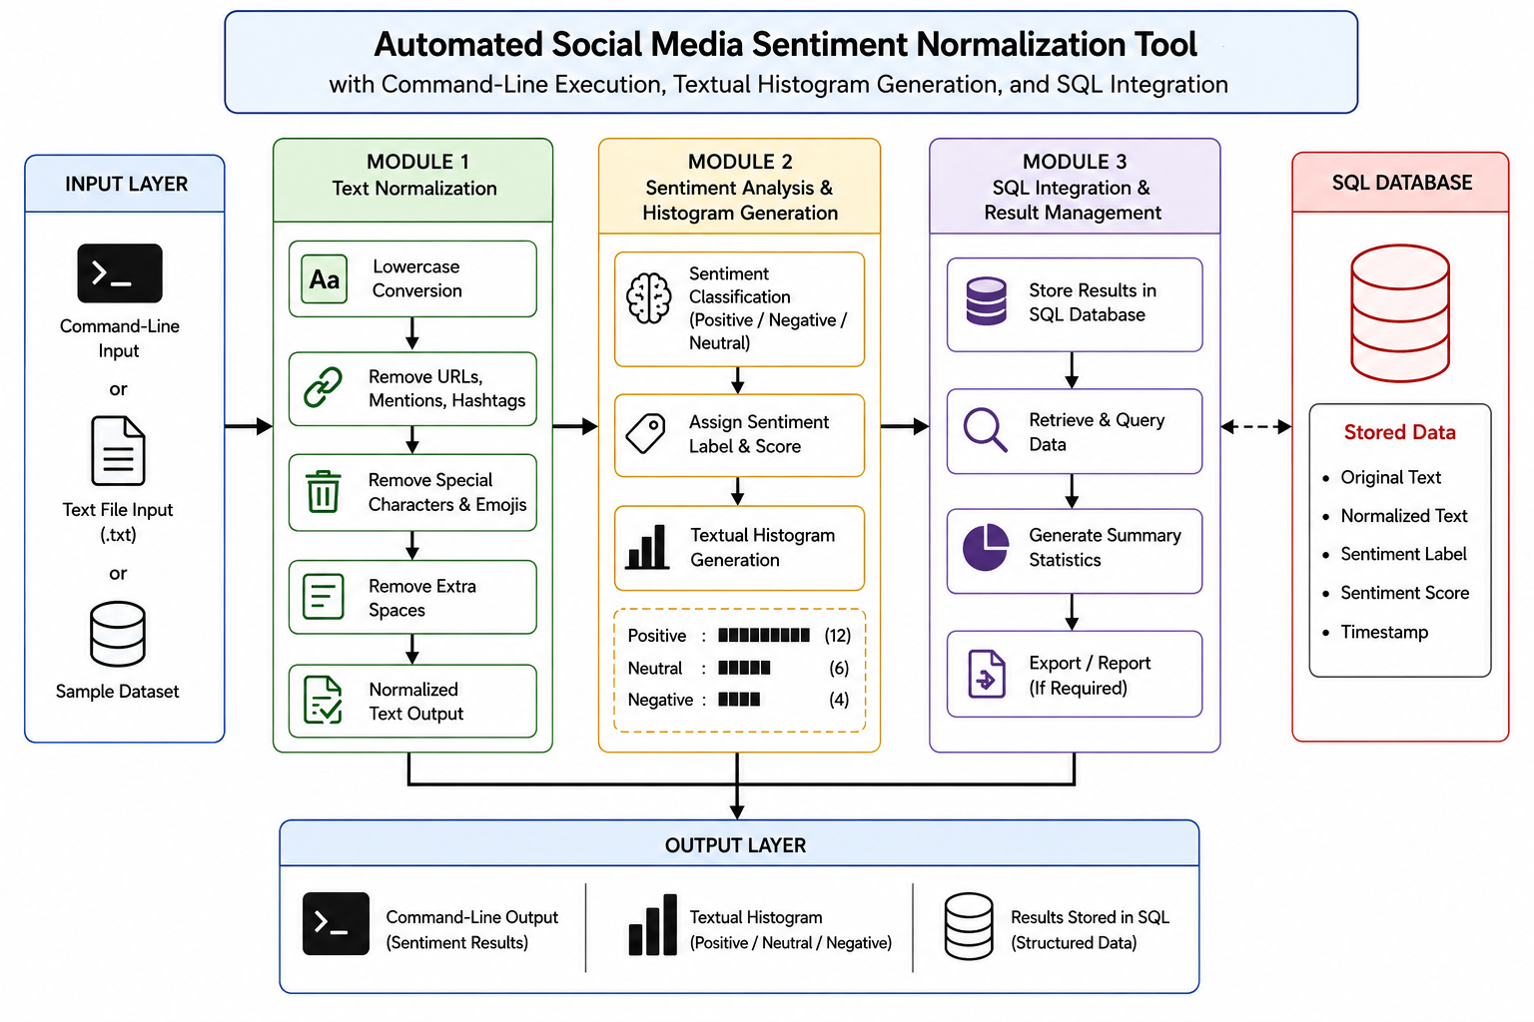
SYSTEM ARCHITECTURE

Slide 8
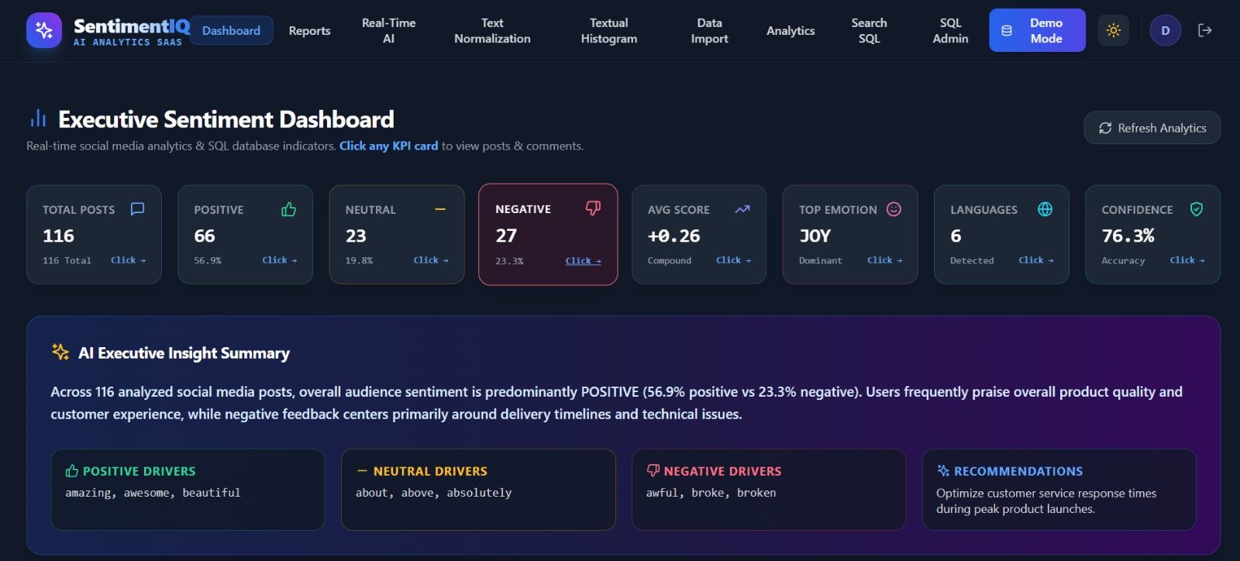
Module 1: Social Media Text Acquisition and Normalization
Collects social media text from command-line input, text files, or sample datasets.
Converts the collected text into lowercase to maintain uniformity during analysis.
Removes URLs, user mentions, hashtags, and other unwanted elements from the text.
Eliminates special characters, emojis, and unnecessary symbols to reduce text noise.
Removes extra spaces and formatting inconsistencies from the collected content.
Generates clean and normalized text that is ready for sentiment classification.

Slide 9
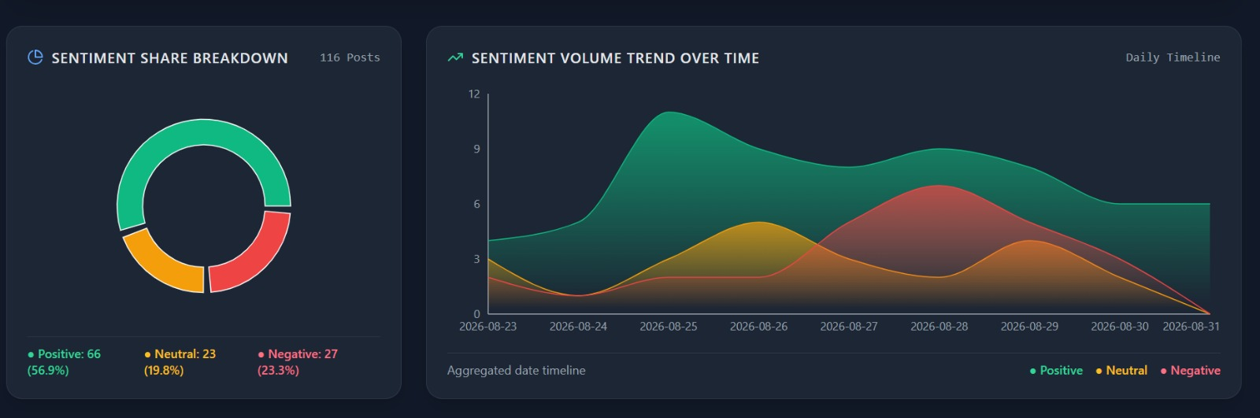
Module 2: Sentiment Analysis and Textual Histogram Generation
Analyzes the normalized text to identify its overall sentiment.
Classifies each text into Positive, Negative, or Neutral categories.
Assigns a sentiment label and score based on the analysis.
Counts the number of texts belonging to each sentiment category.
Generates a textual histogram using symbols to represent sentiment distribution.
Displays the sentiment results clearly for easy interpretation and comparison.

Slide 10
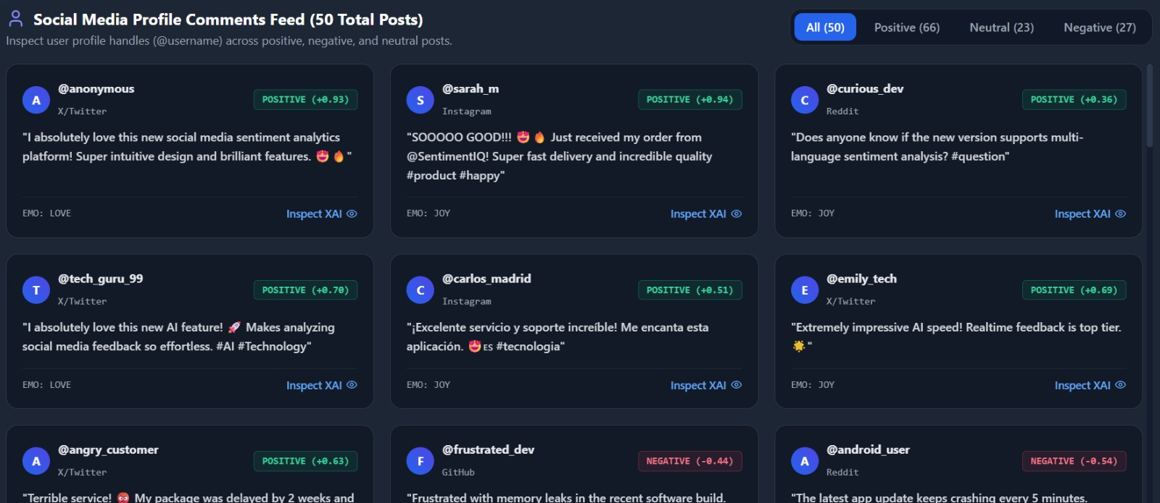
Module 3: SQL Integration and Result Management
Stores the sentiment analysis results in an SQL database for organized data management.
Creates structured tables to maintain text, sentiment labels, and sentiment scores.
Uses SQL queries to insert, retrieve, update, and manage sentiment records.
Enables quick retrieval of stored results for analysis and reporting.
Maintains sentiment data in a structured and reliable format.
Provides efficient result management and database integration for the complete system.
Generates summarized reports from stored sentiment data for easy review and future analysis.

Slide 11
FUTURE SCOPE
Real-Time Analysis – Analyze live social media posts for instant sentiment results.
Advanced AI Models – Use machine learning and deep learning for better accuracy.
Multilingual Support – Extend the system to analyze multiple languages.
Emotion Detection – Detect emotions such as happiness, anger, sadness, and fear.
Interactive Dashboard – Provide graphical dashboards for easy visualization of sentiment trends.
Large-Scale Processing – Support large volumes of social media data efficiently.

Slide 12
REFERENCES
Jurafsky, D., & Martin, J. H. – Speech and Language Processing, Natural Language Processing concepts.
Liu, B. – Sentiment Analysis and Opinion Mining, Morgan & Claypool Publishers.
Bird, S., Klein, E., & Loper, E. – Natural Language Processing with Python, O’Reilly Media.
Pang, B., Lee, L., & Vaithyanathan, S. – Thumbs Up? Sentiment Classification Using Machine Learning Techniques.
Manning, C. D., Raghavan, P., & Schütze, H. – Introduction to Information Retrieval, Cambridge University Press.
Python Documentation – Text processing, command-line programming, and data handling.
SQLite Documentation – SQL database storage, queries, and result management.

Slide 13
CONCLUSION
The proposed system provides an automated approach for analyzing social media sentiment.
Text normalization improves the quality and consistency of the input data.
Sentiment classification identifies positive, negative, and neutral opinions effectively.
The textual histogram provides a simple and clear representation of sentiment distribution.
SQL integration enables organized storage and efficient management of analysis results.
The command-line interface makes the system simple, fast, and user-friendly.
The system can be extended for real-time analysis and larger social media datasets in future applications.

Slide 14


