Slide 1
EduZone
by Brahma Kulkarni
Under the guidance of Arjun Trivedi
A platform to collaborate with fellow students using posts and comments

Slide 2
TechStack
Ruby on Rails
Front-end: HTML, CSS, Bootstrap, HAML
Back-end: Ruby
Database: SQLite

Slide 3
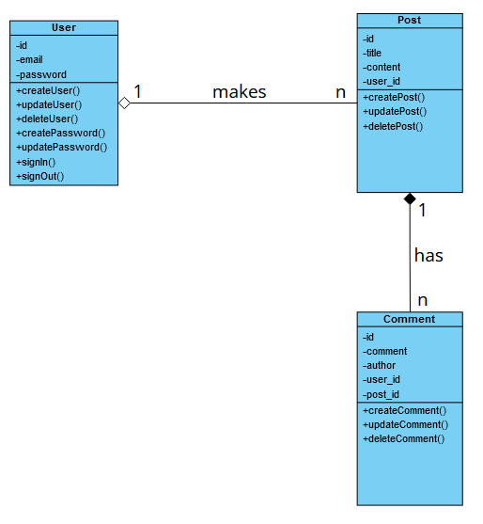
UML Diagram

Slide 4
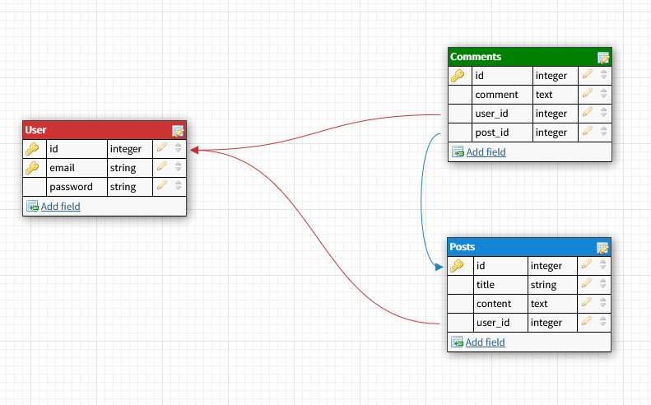
Database Diagram

Slide 5
Thank you!

