Slide 1
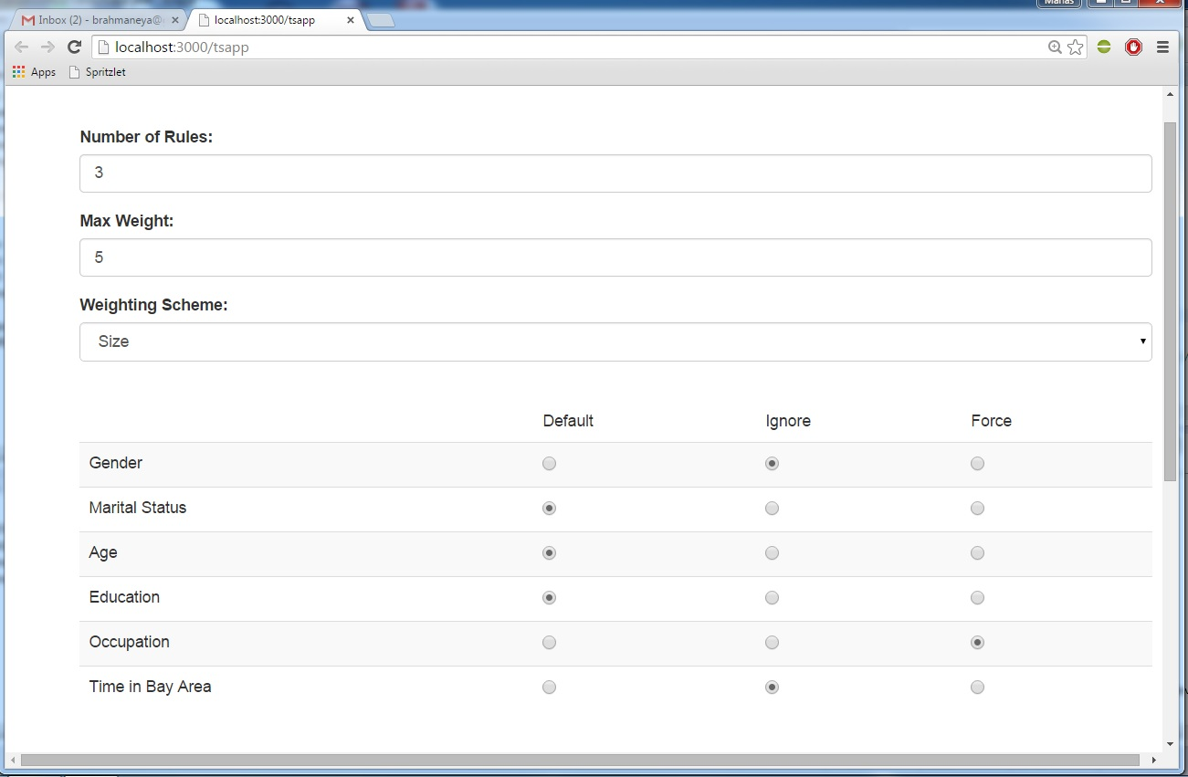
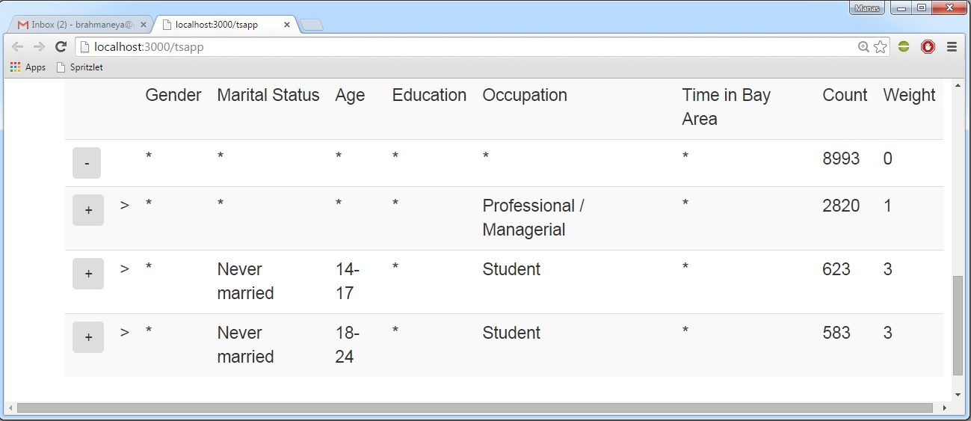
Smart Drill Down: A New Data Exploration Operator
Manas Joglekar, Hector Garcia-Molina, Aditya Parameswaran
Smart Drill-Down : Interactively find the best set of rules to summarize a database table.
Rule : A tuple consisting of actual values and wildcard-characters e.g. (a, *) matches (a,b) but not (c,b).
Sub-rule : Pattern that matches superset of tuples
Best set of rules: Interestingness of a rule is based on :
Weighting function: Inherent interestingness of a rule e.g. Number of non-* values.
Count : Number of tuples matched by rule.
MCount : Number of new tuples covered by rule in a list of rules
Smart Drill Down Maximizes Score: ∑ MCount(r) x Weight(r)
Example Datasets
Marketing Survey, demographic data – 10000 tuples
Political Donations Data – 24000 tuples
User Interface
Number of sub-rules to display on drill-down
Tradeoff response time vs score
Determine what rules are interesting
Always instantiate column in rules
Never instantiate column in rules
Instantiate column only if it maximizes score
Interactive Output
Clicking on a ‘-’ undos the drill down
Clicking on a ‘+’ drills down further on that part of the table

