Slide 1
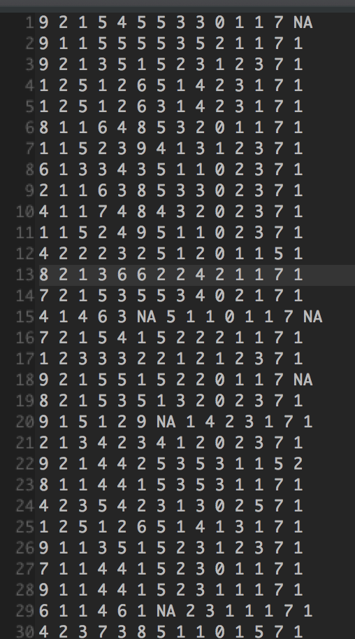
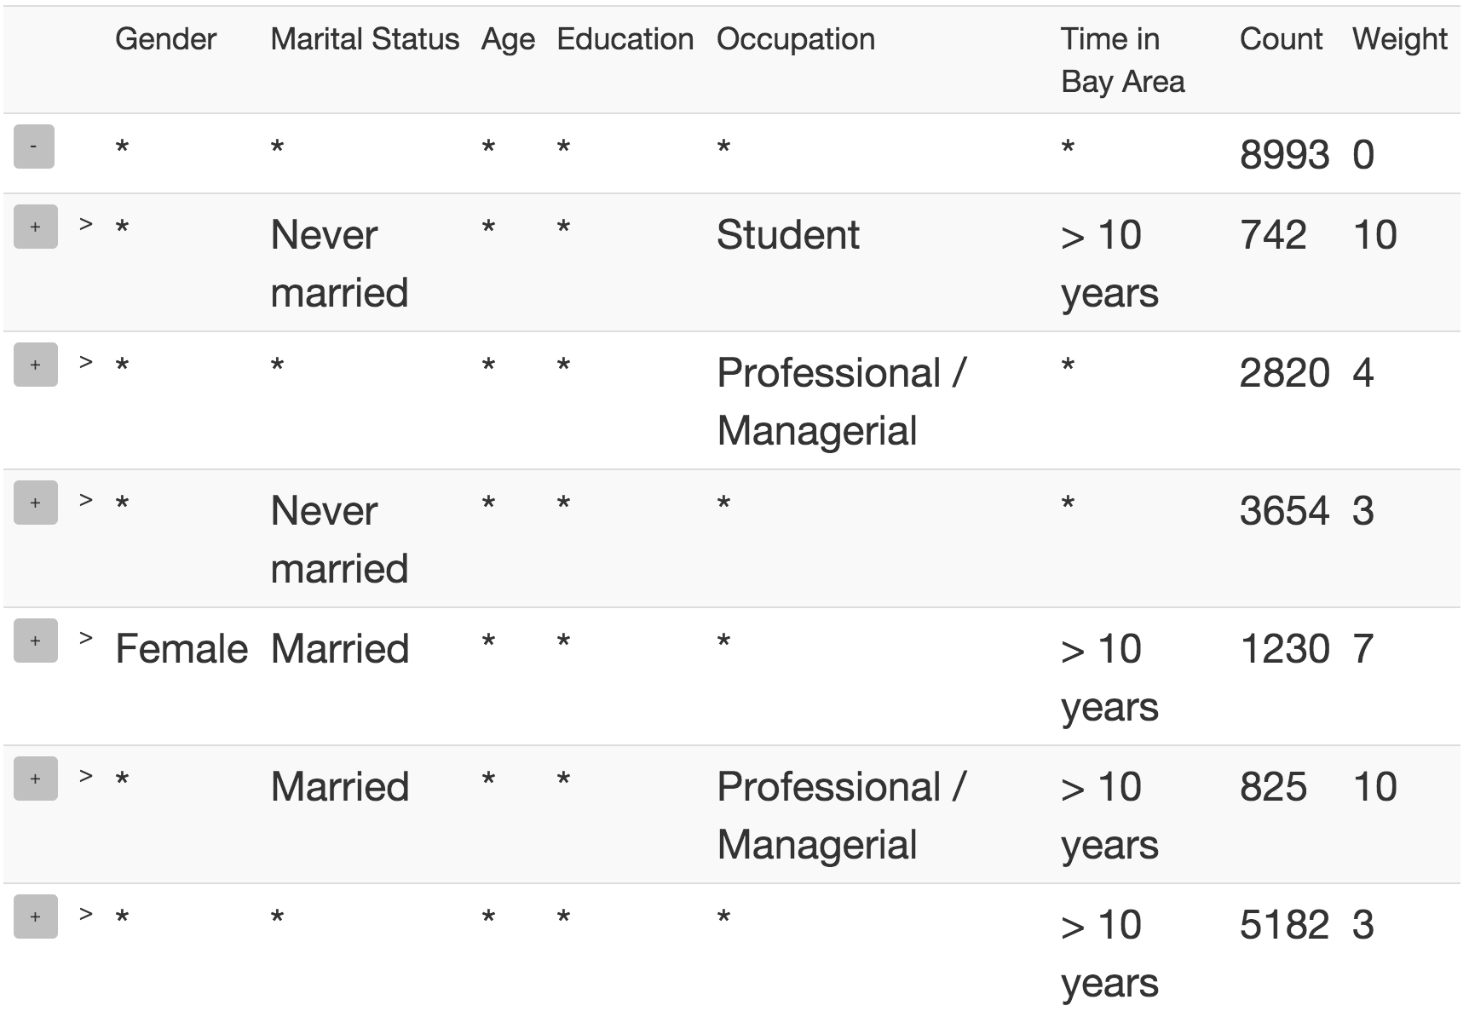
Smart Drill Down: A New Data Exploration Operator
Manas Joglekar, Hector Garcia-Molina, Aditya Parameswaran
manasrj@stanford.edu, hector@cs.stanford.edu, adityagp@illinois.edu
Problem: Enable fast tunable and interactive summarization of structured data.
Summary = Most
Interesting set of Rules
Rule = Tuple with
values and wildcards
Interesting =
High Weight
High Count
High MCount
Raw Data
Interactive Summary
Technical Challenges System Architecture
Rule Finding NP-Hard
Limited Space Budget
Large Datasets
Expensive Disk Reads
Optimal Sampling NP-Hard
Rule Finder
Score submodular for
monotone Weight functions
Greedy Approximation
A priori-like algorithm for
each greedy step
1. Start with empty Set S
2. Greedily add best rule to S using a-priori like algorithm
4. Return S sorted by weight
3. If we have enough rules, return to Step 2, else:
Sample Handler
If not possible, compute optimal new samples to create
User clicks on rule R
Attempt to create R-sample from main memory
Materialize new samples from Hard Disk
Return R-sample to Rule Finder
Notes:
Speech/Story:
Have an actual story: suppose you are sales manager. you have a survey results on your customers, and want to learn more about your target demographic. you have this raw data which is hard to make sense of. Our system gives you this nice summary. And you can tune it and explore further.
Say something about algorithms : submodular – greedy, etc.
Say we have paper on this.
State scoring stuff while showing example on marketing data
Mention and contrast drill-down at start
Clarify that > 10 years is a string, not a range
Have a story (show the big rule for marketing).
Multiple sections: basics, more options, new dataset
Interface: line on dataset in interface. put three parameters in same line.

