Slide 1


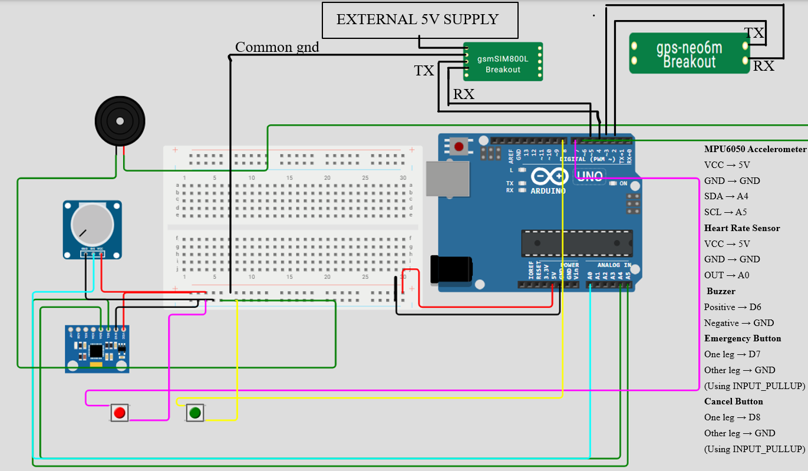
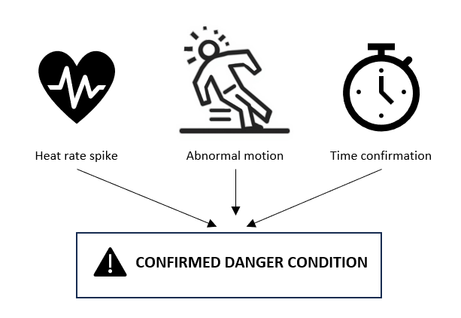
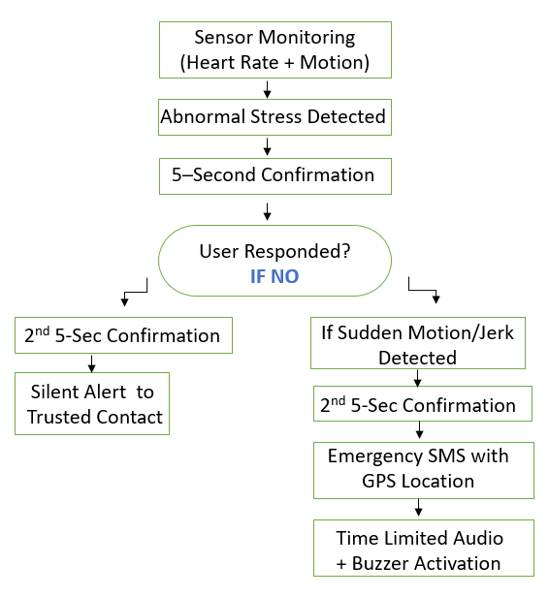
AUTOWN’25
Poster Presentation Title: Physiological Stress–Based Automatic Women Safety Alert System
Student/Team Name : S. Brahmini Chowdary | Bhamitha Rao | B. Nani Manideep Kumar
College Name: KLH BACHUPALLY
Introduction
Problem Statement and Objective of the Work
Results
Women safety is a major social concern, especially in situations where victims are unable to react due to fear, stress, or physical constraints. Women often cannot manually activate safety apps during panic or physical restraint. This work proposes a wearable embedded device that automatically detects abnormal stress and unsafe situations and sends emergency alerts without user interaction. .
Problem statement– Existing women safety systems rely heavily on manual user actions, making them ineffective when the user is unable to respond during critical situations.
Threat conditions correctly detected in simulation using multi-sensor logic
Time confirmation reduced false alert triggering
Alert activation logic verified for real-time implementation
Hardware modules to be implemented in prototype
Objective :
To design a wearable embedded system for automatic women safety alerts .
Integrate To detect abnormal physiological stress and motion patterns
To reduce false alerts using time-based confirmation logic
To send emergency alerts with live location without internet dependency
Conclusions
The proposed system automatically detects abnormal stress and threat situations using heart rate and motion sensing. Multi-sensor validation and time-based confirmation reduce false alerts, while emergency SMS with live GPS ensures timely assistance. Operating offline via GSM, it offers a reliable and practical women safety solution.
AI-based personalized stress threshold learning
Mobile application for monitoring and alert management
Miniaturization into pendants or clips
Replacement of GSM with LTE-M or NB-IoT
Integration with campus or public safety networks.
Cloud-based data logging for incident history and analysis
Integration with smartwatches or fitness bands
Integration with emergency helplines.
Analysis Theory
Fear and panic activate the sympathetic nervous system, causing sudden heart-rate elevation.
Threat situations also produce abnormal motion patterns (jerk, struggle, fall).
A single parameter may create false alerts, so multi-sensor validation is used.
Time-based confirmation ensures the abnormal condition is sustained before triggering alert.
Combined physiological and motion analysis improves reliability of danger detection.
Future Scope
Experimental/ Modeling/ Material Synthesis Set-up
Hardware Components Used:
Arduino UNO (Microcontroller)
Heart Rate Sensor
MPU6050 Accelerometer
GSM Module (SIM800/900)
GPS Module
Push Button (User Response)
Push Button (Emergency Trigger)
Buzzer
Power Supply
Methodology
References
D. Chitkara, N. Sachdeva, and Y. D. Vashisht, "Design of a Women Safety Device," 2017 IEEE International Conference, IEEE, 2017.
N. R. Sogi, P. Chatterjee, U. Nethra, and V. Suma, "A Raspberry Pi Based Smart Ring for Women Safety Using IoT," International Conference on Inventive Research in Computing Applications (ICIRCA), Coimbatore, IEEE, 2018, pp. 451-454.
B. S. Aishwarya, K. M. Bhat, S. Pooja, and B. K. Sindhu, "Automated Alert Generation Ensuring Women Safety Using Heartbeat Detection," 2022 International Conference on Inventive Computation Technologies (ICICT), IEEE, 2022, pp. 565-570, DOI: 10.1109/ICICT54344.2022.9774067.
A. O. Akmandor and N. K. Jha, "Keep the Stress Away with SODA: Stress Detection and Alleviation System," IEEE Transactions on Multi-Scale Computing Systems, vol. 3, IEEE, 2017, pp. 269-282, DOI: 10.1109/TMSCS.2017.2703613.
T. M. R, Aishwarya, C. K. S, D. M. K, and N. H, "IoT Based Smart Security Gadget for Women's Safety," 1st International Conference on Advances in Information Technology (ICAIT), Chikmagalur, IEEE, 2019, pp. 348-352.
Expermental / Modelling Process Parameters
The system continuously monitors heart rate , body movement and using embedded sensors.
Abnormal conditions are identified using threshold-based logic and time-based confirmation.
Upon confirmation, emergency alerts with GPS location and local buzzer activation are triggered.

