Slide 1

Movie Data EDA
-Brahmishree Maitreyee

Slide 2
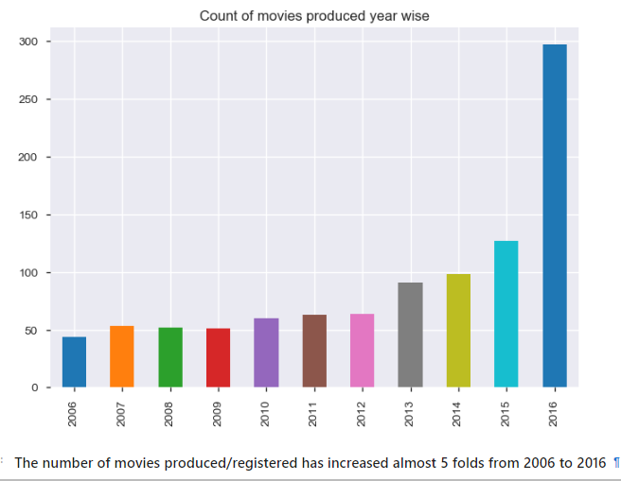
What is the relation between Year and Movies Produced/Registered?
It could be large number of movies were produced but those listed/registered
in Global database like IMDB might be less

Slide 3
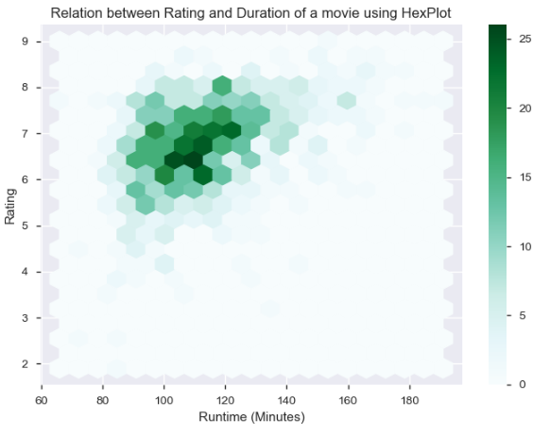
Is there any relationship between duration and rating?
Most average(6-7) rated movies have a duration of 90-130 mins.
The graph doesnot not give much detail insight on duration impacting the rating of a movie.HOWEVER, we can conclude most movie duration ranges between 80-130 minutes.

Slide 4
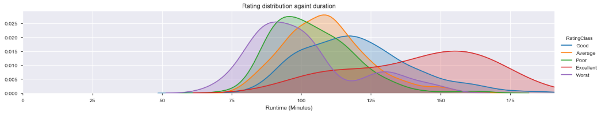

ConTInued…

Slide 5
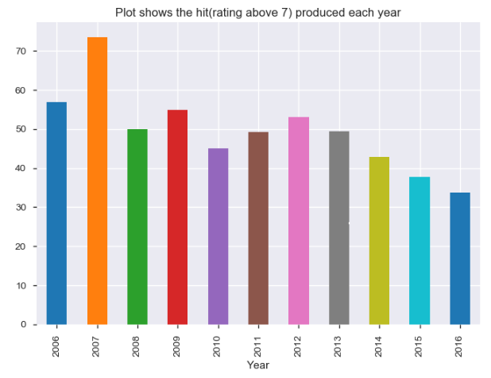
Which Year produced most hit movies Based on audience Rating?
Year 2007 produced most of the hit movies
2) Although 2016 produced a highest quantity of movies, quality wise it scored the lowest.

Slide 6
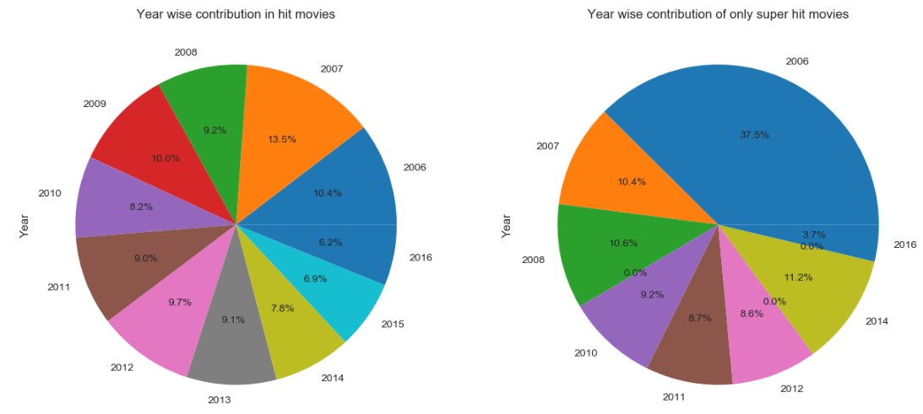
Year Wise Share of HIT & SUPERHIT movies

Slide 7
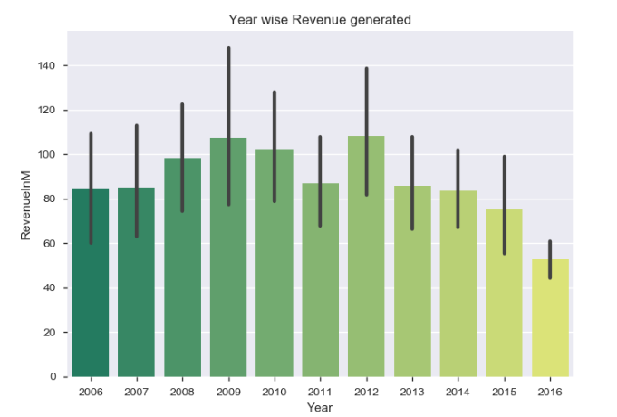
Which Year generated maximum revenue?

Slide 8
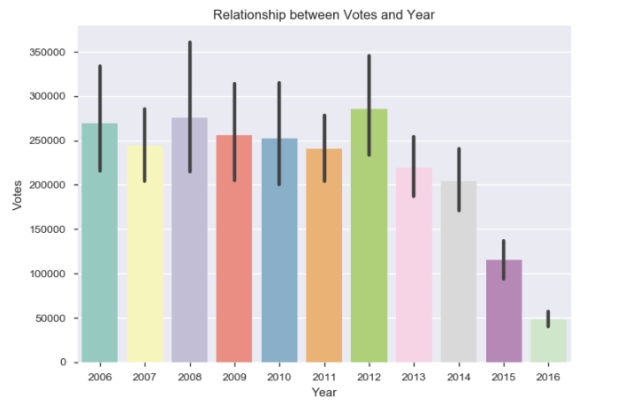
What is the relationship between Votes and Year?
1) From the plot, 2012 has the highest number of votes.
2) After 2012, the number of votes have been declining.
Could it be that the other type of motion pictures (Netflix/Amazon Originals, Youtube webseries/channels etc)
have gained more popularity and are not listed in the dataset.
Therefore, viewers focus is distributed leading to low votes and revenue

Slide 9
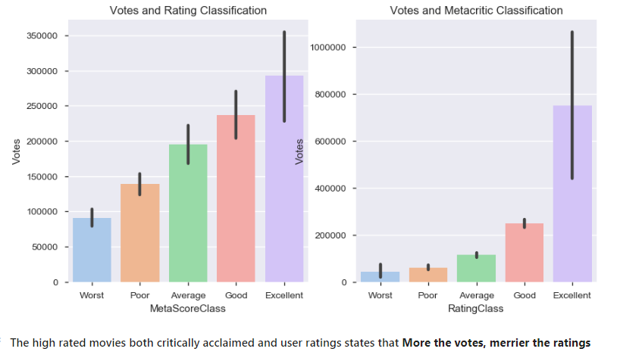
Vote, User Ratings And Reviews

Slide 10
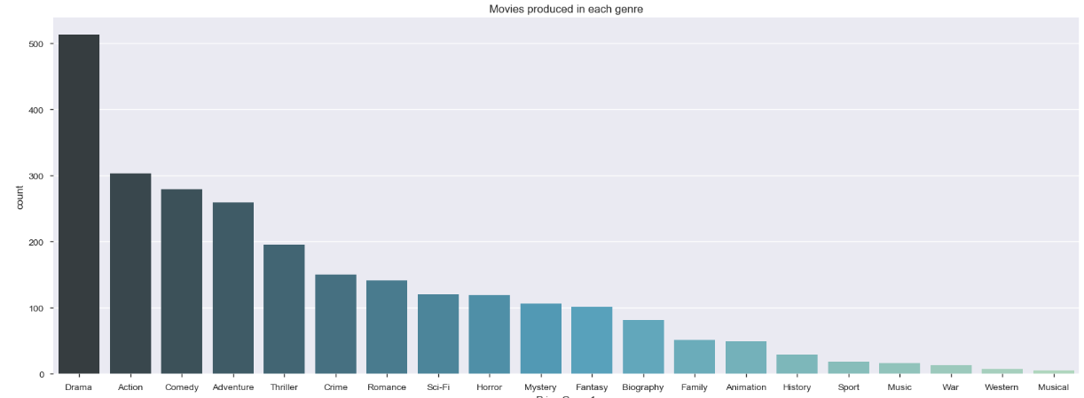
Which genre of movies are the most commonly produced?
1) Drama Genre is the clear winner with total of 513 movies followed by Action with 303 categorized under it 2) Western and Musical genre were least produced.

Slide 11
The dominance of drama as a genre is perhaps not surprising when we consider the following:
Drama is the cheapest genre to produce as movies don’t necessarily require special sets, costumes, locations, props, special/visual effects, etc.
Drama has the broadest definition of all genres – everything that happens anywhere ever is a drama. Conversely, other genres have a higher bar for classification, such as the need for high-octane events for a movie to be classed as Action, scary events to be Horror, funny elements to be a Comedy, etc.

Slide 12
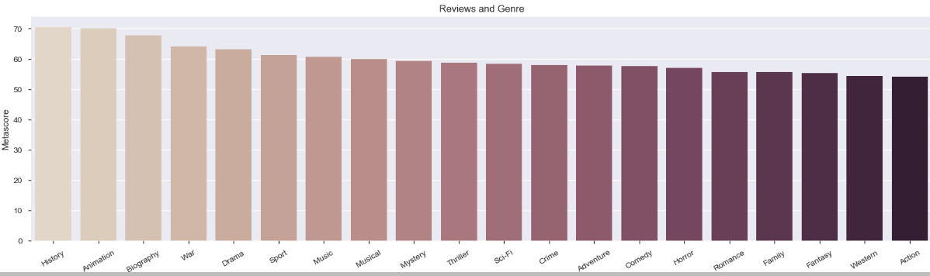
Which genre movies received highest positive reviews?
History, Animation, Biography, War are the with top genres with highest positive reviews.

Slide 13
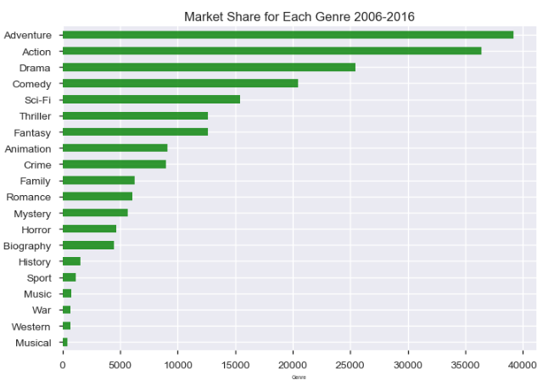
Which genre generated highest revenue?

Slide 14
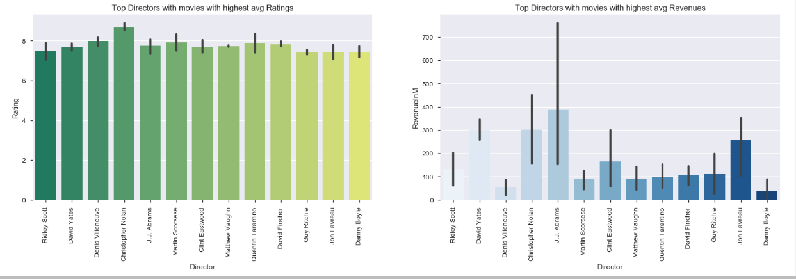
Top directors with Highest ratings and revenues?

Slide 15
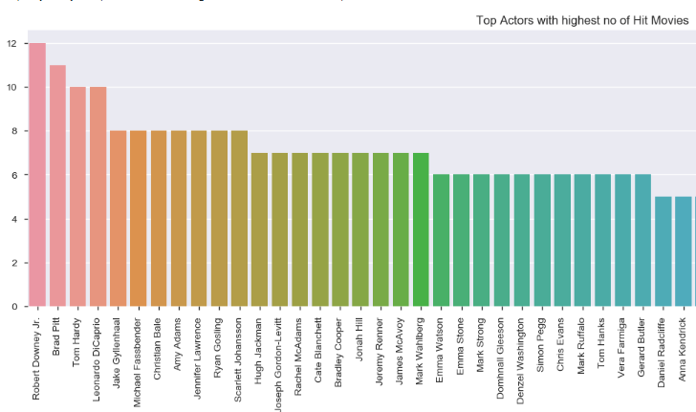
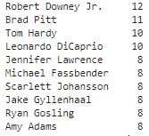
Who are the top performing actors?¶

Slide 16
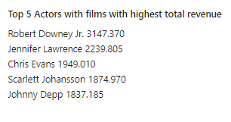
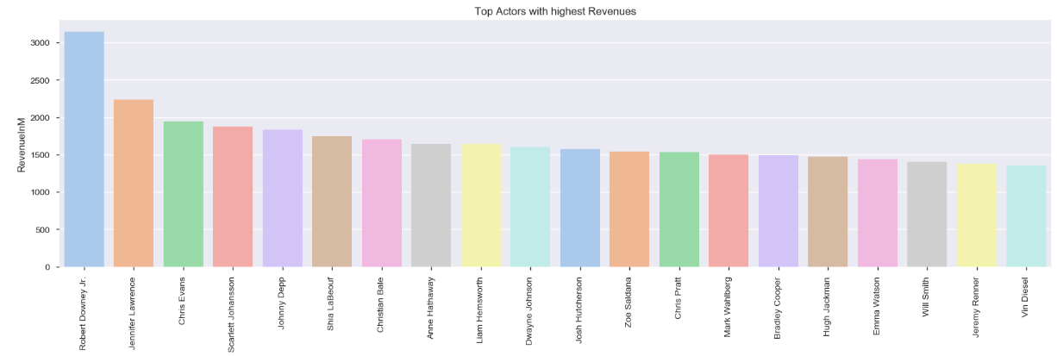
ACTORS with Highest Revenue

Slide 17

Thank You

