Slide 1
AI-Powered Financial System
Domain: FinTech
Team No – 01
Addagiri Srujana Royal (23EG110C02)
Arnav Misra (23EG110C06)
Bandi Brahmma Reddy (23EG110C07)
Barka Akshitha (23EG110C08)
Under the Guidance of
Mrs.M Sridevi
Head Dept. of Data Science

Slide 2
Abstract
Financial institutions process thousands of loan applications every day, making accurate risk assessment essential to reduce loan defaults and financial losses. Traditional loan approval methods rely on manual verification and predefined rules, which are often time-consuming, inconsistent, and prone to human error. To address these challenges, this project presents FinRisk – AI-Powered Financial System, which uses Machine Learning to analyze applicant details such as income, employment status, credit history, loan amount, education, and other financial parameters to predict loan risk. The system provides instant loan predictions, visualizes key financial insights through interactive dashboards, and enables financial institutions to make faster, more accurate, and data-driven lending decisions while improving efficiency and minimizing risk.

Slide 3
Introduction
Banks and financial institutions process thousands of loan applications manually — a process that is slow, inconsistent, and highly prone to human error.
Most individuals lack a unified platform that connects their loan eligibility, spending behavior, investment planning, and credit health together for informed decision-making.
Existing tools address financial needs in isolation — a loan calculator here, a budget tracker there — with no integration between modules.
This project proposes the Financial Risk Analysis System — an AI-powered full-stack web application that integrates loan risk prediction, land collateral assessment, expense tracking, investment planning, credit score simulation, and net worth calculation into one unified platform.
Customers register and log in to access a personalized financial dashboard where all modules are interconnected, providing holistic financial insights based on their actual data.

Slide 4
Objective
The main objective of our project is to simplify financial management.
To provide land collateral assessment with district-wise land valuation and 70% LTV ratio calculation across 22 Indian states.
To develop integrated financial tools including monthly expense tracker, budget planner, investment calculator (SIP/FD), net worth calculator, credit score simulator, loan repayment tracker, and bills manager.

Slide 5
Literature Survey
Research Paper | Contribution | Research Gap
Credit Risk Scoring using ML (2021) | Proposed Random Forest and XGBoost for credit risk prediction with tabular data | Focused only on credit score — no loan amount, employment, or expense analysis
Financial Risk in Banking (2022) | Used logistic regression and decision trees for loan default prediction | No web-based real-time prediction system or interactive user interface
Personal Finance Management Systems (2023) | Built expense trackers and budget planners for individuals | No integration with loan risk or ML-based predictions
AI in FinTech Applications (2024) | Reviewed AI tools in banking for fraud detection and credit scoring | No land collateral or Indian-context district-wise valuation
Integrated Financial Platforms (2025) | Proposed unified financial dashboards with multiple tools | No AI-powered prediction or personalized user accounts

Slide 6
Existing Work & Limitation
Existing System | Key Features | Limitation vs Our Project
CIBIL / Experian Credit Score | Provides credit score and basic credit report | Shows only a score — no loan prediction, no expense tracking, no investment planning, no user dashboard
Online Loan Calculators | Calculate EMI and loan eligibility based on income | No ML model, no risk classification, no collateral check, no personalized user account
Personal Finance Apps (ET Money, Walnut) | Expense tracking, budget management, investment tracking | No loan risk prediction, no AI assistant, no land collateral or credit score simulation
Bank Loan Portals | Accept loan applications and give manual decisions | Slow manual process, no real-time prediction, no integrated financial health insights for customer

Slide 7
Proposed work & Advantages
Proposed Work :
AI-powered web platform integrating 20+ financial tools into one unified system
Random Forest ML model for loan risk prediction with 96.71% accuracy
Secure user authentication with personalized dashboard per customer
Land collateral assessment with district-wise rates for 22 Indian states and 15 districts each
Monthly expense tracker whose disposable income feeds into loan risk for accurate prediction
Integrated budget planner with real-time income, expense, and savings analysis
AI Money Assistant powered by Groq API (LLaMA 3.1 model)
Interactive financial dashboard providing personalized insights, reports, and spending trends
Advantages :
Replaces slow manual loan evaluation with instant AI prediction
Integrates all financial tools — no need for multiple separate apps
Personalized data per user — expenses, goals, loans, bills all saved
Real-time spending alerts and overspending warnings
Helps users improve credit score with actionable personalized tips
District-wise land valuation supports collateral-based loan assessment

Slide 8
Software & Hardware Requirements
Frontend : React 18 + Vite, Recharts, Axios
Backend : FastAPI + Uvicorn (Python)
Database : SQLite (persistent storage)
ML Model : scikit-learn (RandomForest), Pandas, NumPy, Joblib
AI Assistant : Groq API — LLaMA 3.1 8B Instant
Authentication : SHA-256 Hashing + Token Sessions
Environment : python-dotenv (API key management)
Version Control : Git + GitHub
Backend Deploy : Render (Free Tier)
Frontend Deploy : Vercel (Free Tier)

Slide 9
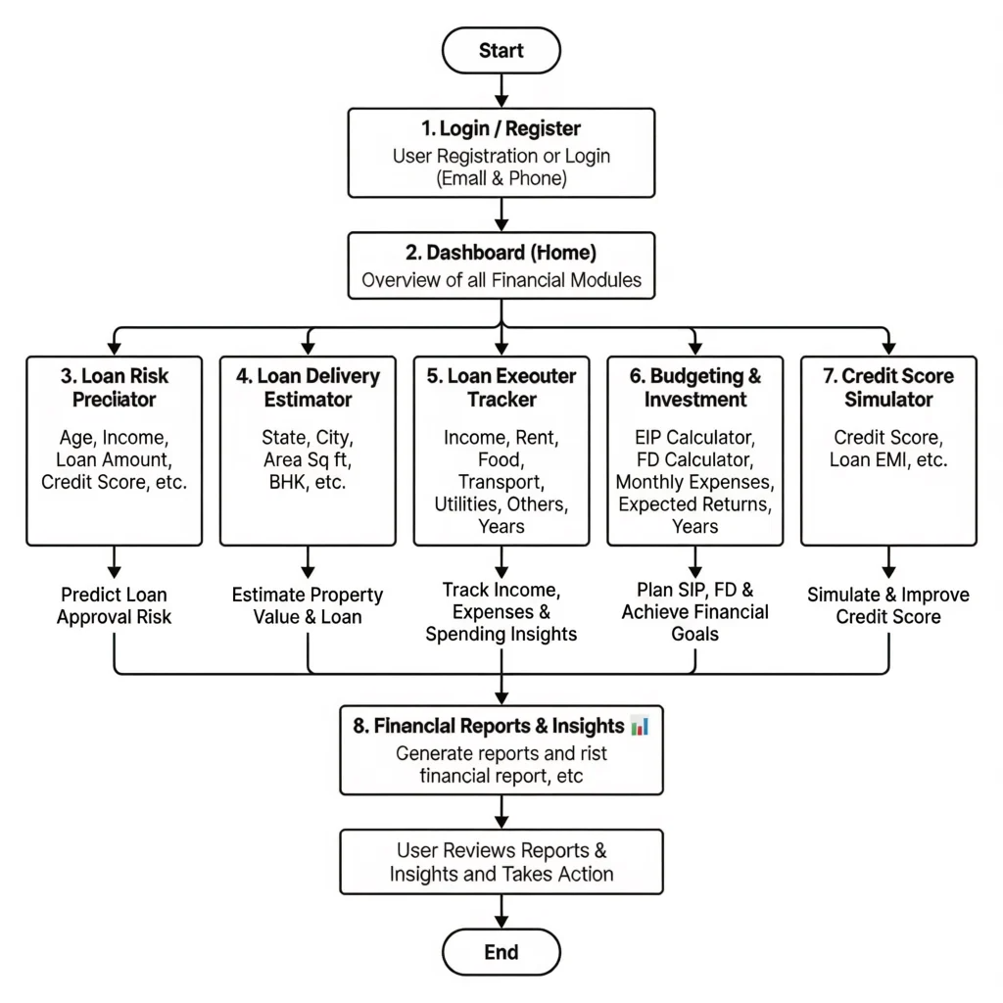
System Architecture

Slide 10
Thank you

