Slide 1
4-Bit CMOS Arithmetic Logic Unit (ALU)
Braidyn Sheffield

Slide 2
Objective
Design and simulate a 4-bit CMOS ALU that performs addition and subtraction using full adder and multiplexer logic.

Slide 3
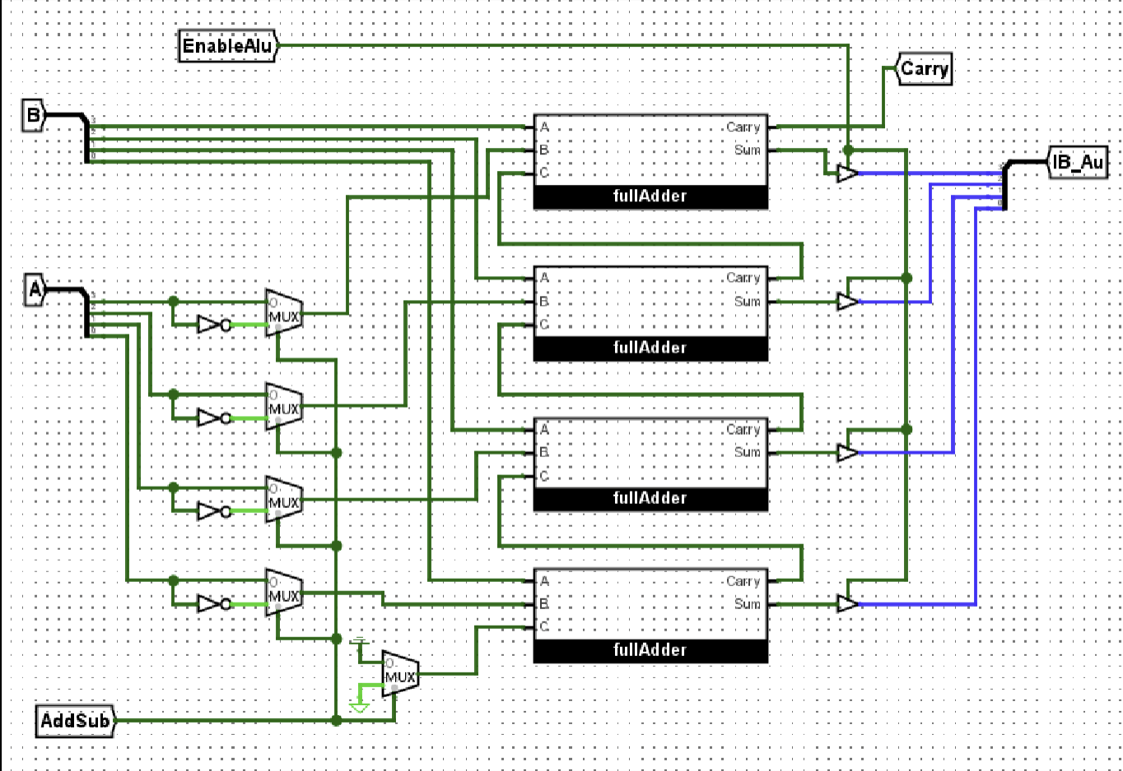
Where I started
The Logisim model defined the logical behavior of the ALU.
It performed A + B or A – B based on the AddSub control.
Output bits: [IB_Au3:0] and Carry.
Served as the blueprint for transistor-level schematic design.

Slide 4
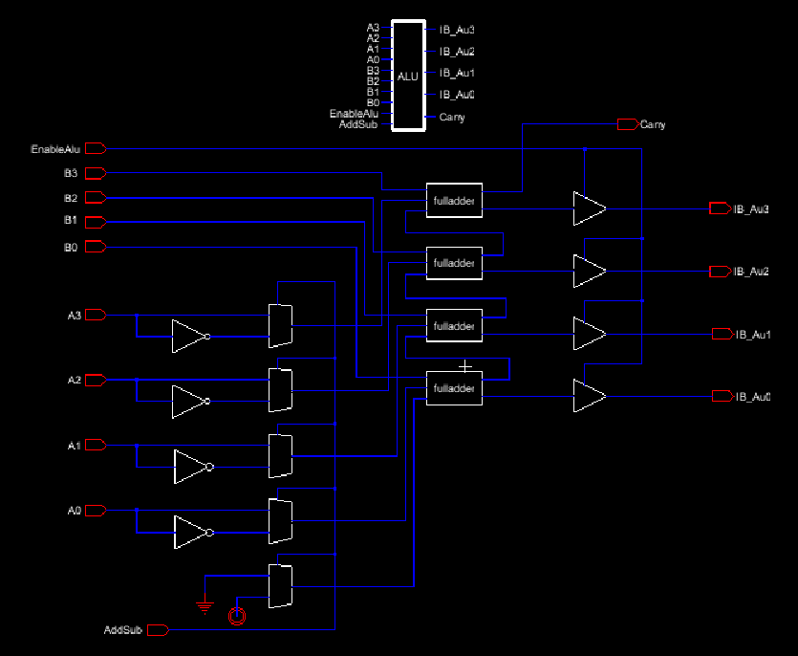
Building the Schematic

Slide 5
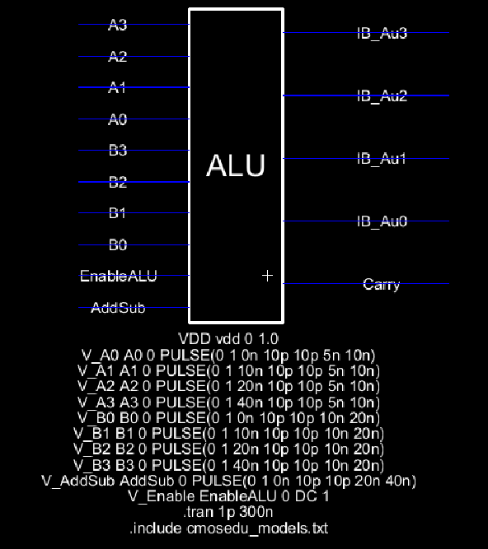
Simulating the Circuit

Slide 6
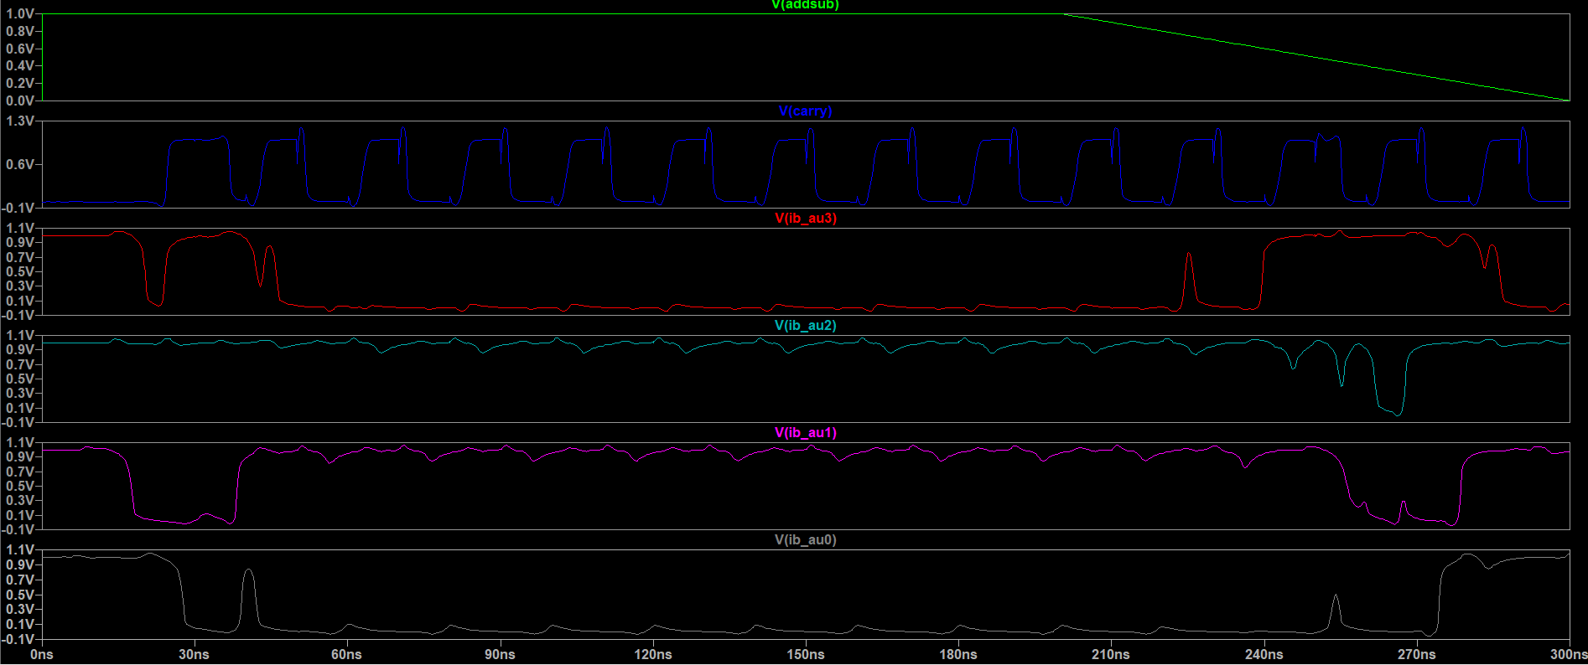
Simulating the Circuit

Slide 7
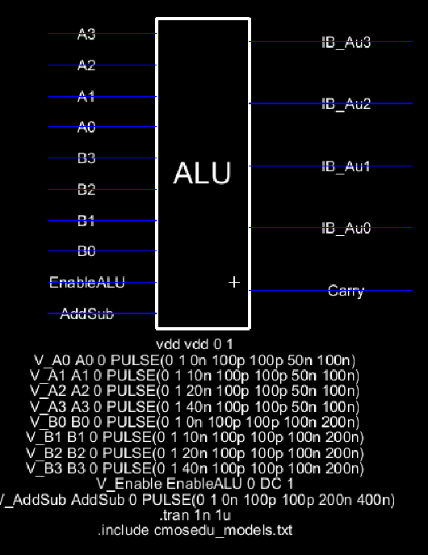
Simulating the Circuit

Slide 8
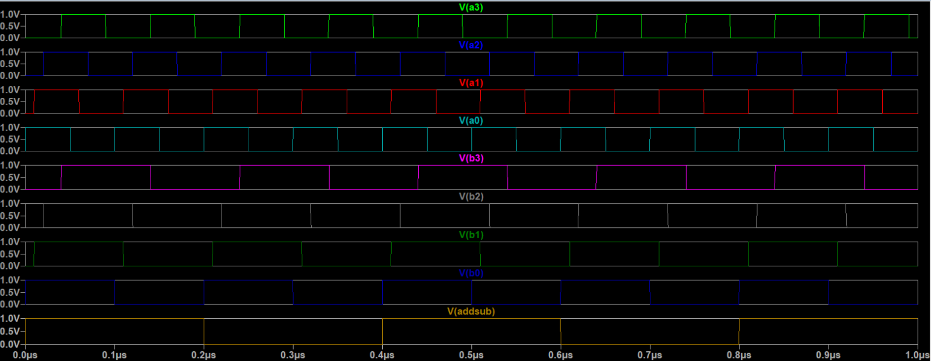
Simulating the Circuit

Slide 9
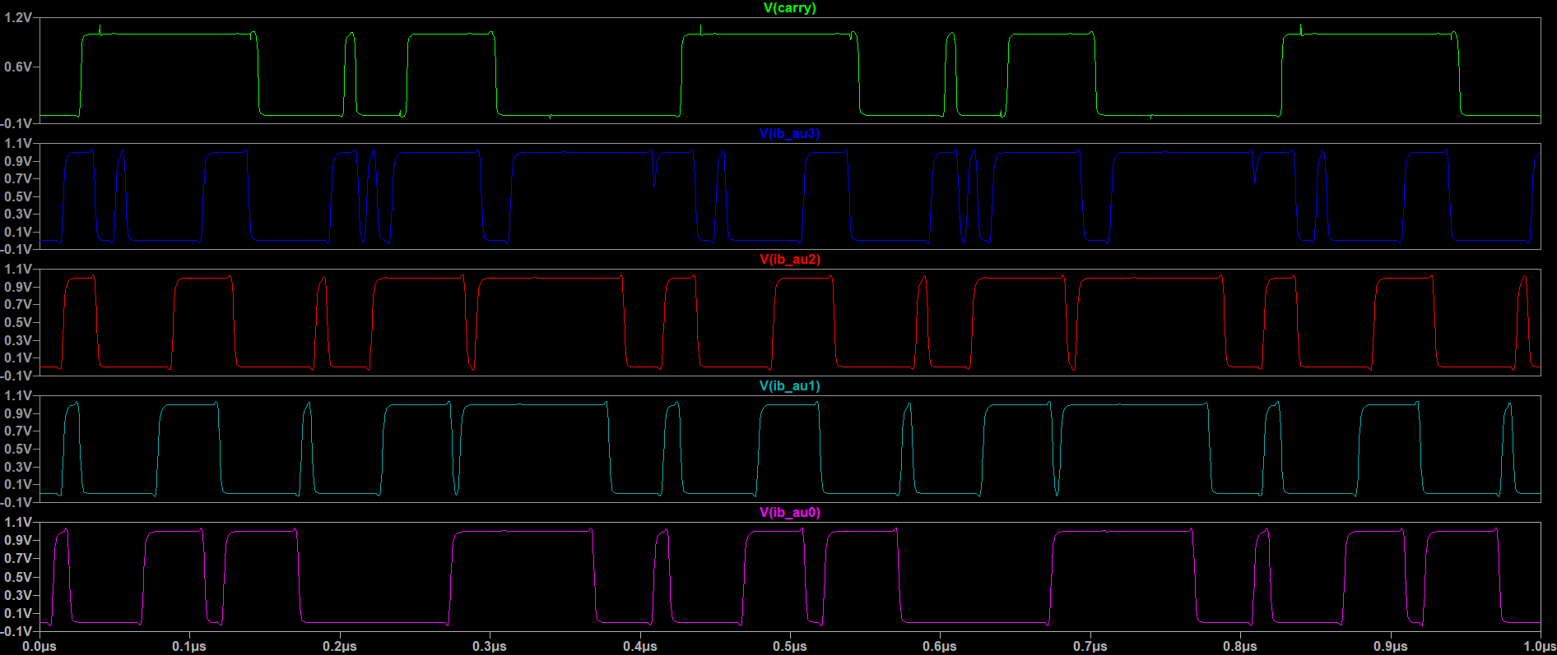
Simulating the Circuit

Slide 10
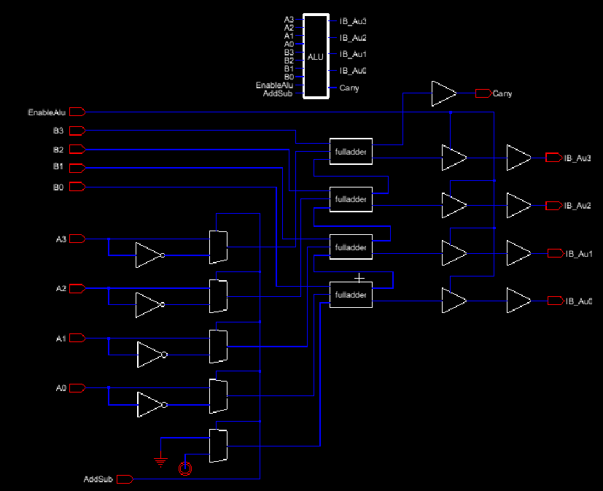
Adjusting the Schematic

Slide 11
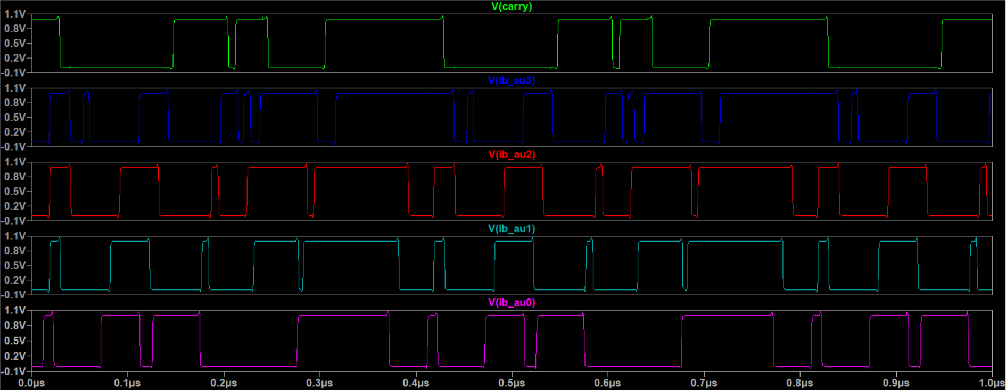
Simulating the Circuit

Slide 12
Building the Layout

Slide 13
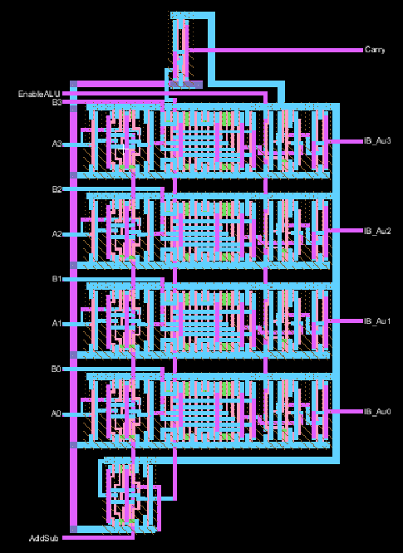
Building the Layout

Slide 14
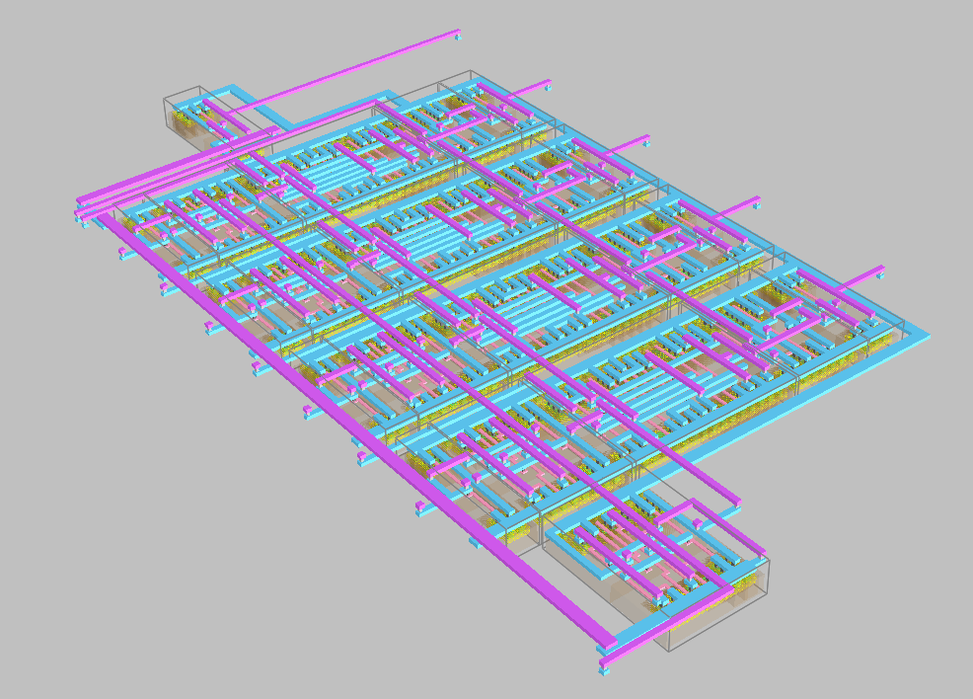
3D View of Layout

Slide 15
Thank you

