Slide 1
Micro Processor Final Project
By: Braidyn Sheffield

Slide 2
Project Process
Assess Old Design
Create BOM for Old Design
Research Components
Power Consumption and Weight Analysis
Create Schematic
Design PCB

Slide 3
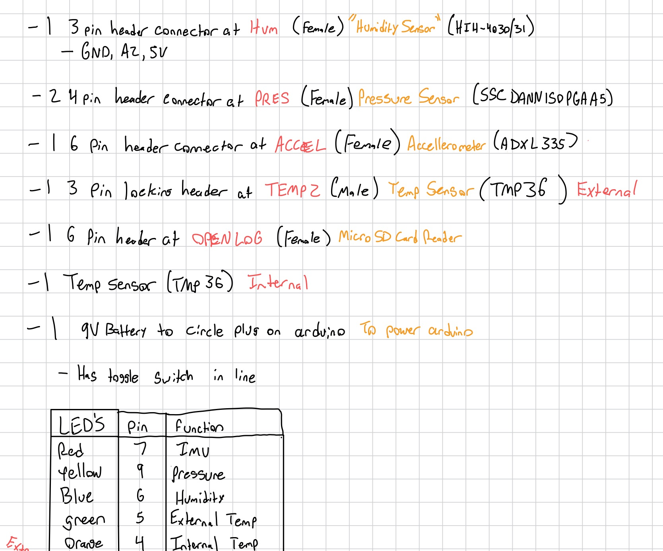
Assess Old Design
Began by going through all of the slides and making a list of all the components that were used, as well as the function of each component and how it was being used in the circuit.
Located a few points in the design that I wanted to move away from
The LED’s and External temperature sensor being connected by jumper wires
The weight from the Arduino Uno with the shield
The power being supplied to the system by a barrel connector
Every sensor being read as a analog input

Slide 4
Project Process
Assess Old Design
Create BOM for Old Design
Research Components
Power Consumption and Weight Analysis
Create Schematic
Design PCB

Slide 5
Create BOM for Old Design
Part | Part Number | Cost
PCB Board | N/A | $5
Arduino Uno | ABX00080 | $19.99
LED | 151051RS11000 | $0.9
330Ω Resistor | CF14JT330R | $0.60
Humidity Sensor | SEN-09569 | $20.50
Pressure Sensor | SSCDANN150PGAA5 | $34.83
Accelerometer | SEN-09269 | $16.95
Temperature Sensor | TMP36GT9Z | $3.30
Micro-SD Card Reader | DEV-13955 | $17.50
9V Battery | 6LF22XWA/B | $2.32
Snap Connector To Barrel | 1528-1117-ND | $2.95
Toggle Switch | RA1113112R | $0.71
2-Pin Male Header | 61300211121 | $0.24
3-Pin Male Header | 61300311121 | $0.12
3-Pin Female Header | 61300311821 | $0.32
4-Pin Female Header | 61300411821 | $0.40
6-Pin Female Header | 61300611821 | $0.78
8-Pin DIP Socket | 1-2199298-2 | $0.22
8-Pin Female Header | 61300811821 | $0.76
Total cost of the old design was around $109.05
I found each of the components on DigiKey with the part number, price, and datasheet
This also gave me an idea of what components were either very expensive, discontinued, or allowed me to find a possible better alternative to the component.

Slide 6
Project Process
Assess Old Design
Create BOM for Old Design
Research Components
Power Consumption and Weight Analysis
Create Schematic
Design PCB

Slide 7
Research Components
Name | Part Number | Cost
PCB Board | N/A | $ 4.21
Arduino Nano | 1050-1001-ND | $ 24.90
LED | 151051RS11000 | $ 0.90
330 Ohm Resistor | CF14JT330R | $ 0.60
Pressure and Altitude Sensor | BMP388 | $ 9.95
Humidity and Temperature Sensor | AHT20 | $ 3.60
Adafruit MicroSD Breakout | 1528-1462-ND | $ 7.50
IMU | MPU6050 | $ 12.95
External Temperature Sensor | TMP 36 | $ 1.65
9V Battery | 6LF22XWA/B | $ 2.32
Snap Connector to JST | PRT-00091 | $ 1.62
Toggle Switch | RA1113112R | $ 0.85
Molex Connector Male | 900-0022232021-ND | $ 0.16
JST Connector to Wire 2 Pin | 1528-2617-ND | $ 1.50
JST Connector Female 2 Pin | 455-B2B-XH-A-ND | $ 0.24
JST Connector to Wire 3 Pin | 1528-2826-ND | $ 1.25
JST Connector Male 3 Pin | 455-2248-ND | $ 0.13
Decided to go with an Arduino Nano
Lighter and more compact
Found that some of the sensors can be combined into one sensor
Had to replace the humidity sensor because it was discontinued
Moved external power onto the board
Used JST connectors and Molex connectors for the external LED’s and temperature sensor
I wanted a more secure and accident prone design
Found a lot of components that were the same functionality but a lot cheaper
Total Cost was $74.33

Slide 8
Project Process
Assess Old Design
Create BOM for Old Design
Research Components
Power Consumption and Weight Analysis
Create Schematic
Design PCB

Slide 9
Power Consumption and Weight Analysis
Power Consumption and Weight of Old Design
Power Consumption: 886.7 mW
Weight: 109.9 g
Power Consumption and Weight of New Design
Power Consumption: 459.5 mW
Weight: 80.7 g
The new design has less power consumption as well as is lighter

Slide 10
Project Process
Assess Old Design
Create BOM for Old Design
Research Components
Power Consumption and Weight Analysis
Designing New Design
Design PCB

Slide 11
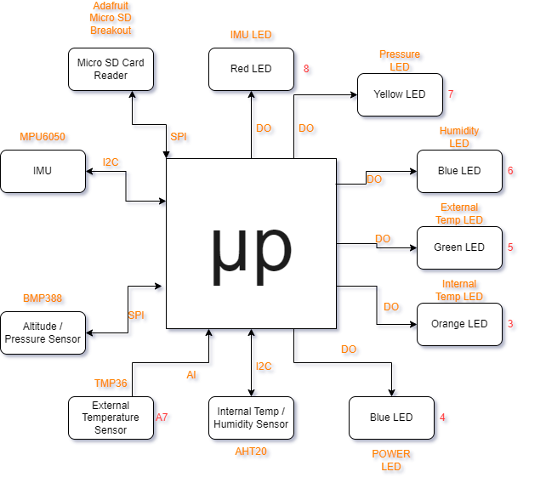
Create Block Diagram
Using the functionality of the old design, I was able to create the block diagram of the new design.

Slide 12
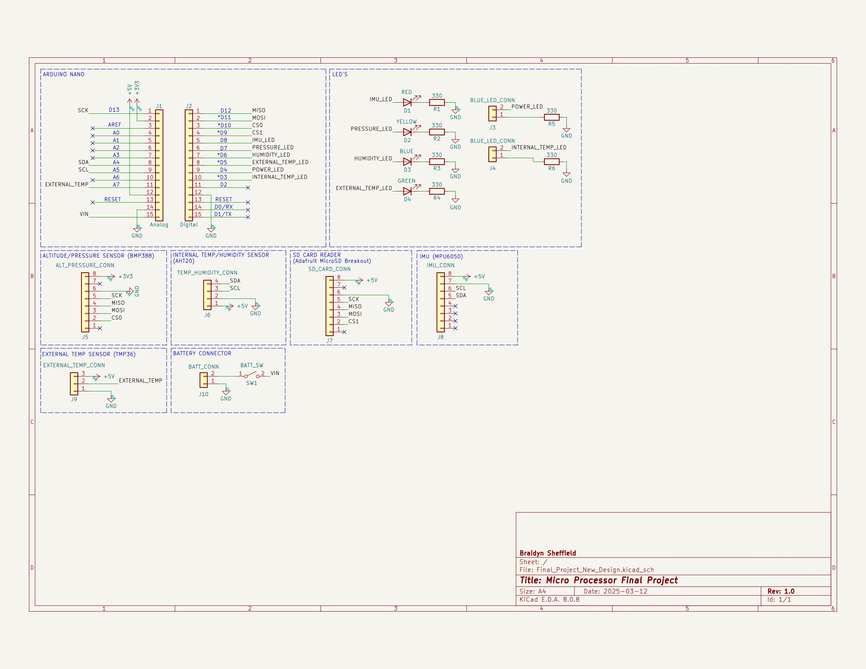
Create Schematic
From the BOM that was created, the schematic was created.

Slide 13
Project Process
Assess Old Design
Create BOM for Old Design
Research Components
Power Consumption and Weight Analysis
Create Schematic
Design PCB

Slide 14
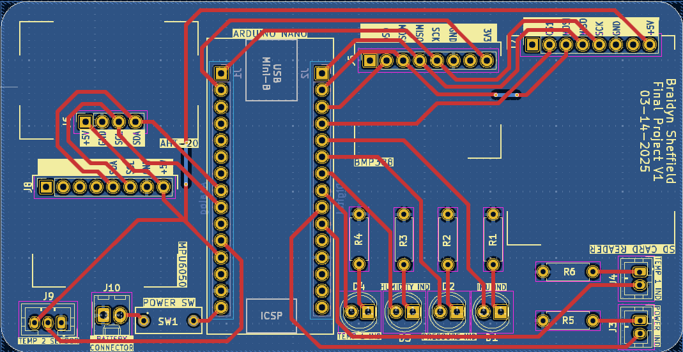

Slide 15
