Slide 1
Carbon Wire Loops for the BrainCap MR 24th November 2020
Dr. Tracy Warbrick
Application Specialist EEG-fMRI

Slide 2
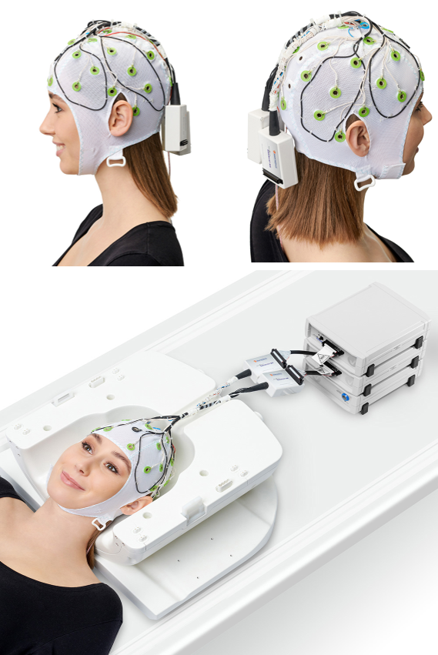
Carbon Wire Loops for the BrainCap MR
4 bipolar loops permanently attached to cap fabric
Positions: frontal-left, frontal-right, parietal-left, and parietal-right
The CWLs can be included on any standard BrainCap MR
They can be used in MRI scanners up to 3 T and are subject to our usual safety guidelines for 3 T.

Slide 3
BrainAmp ExG
CWLs are bipolar so a BrainAmp ExG amplifier will be needed to record these signals.
BrainAmp ExG MR 8 has 8 bipolar channels and does not have any auxiliary channels.
BrainAmp ExG MR 16 (+ ExG AUX Box) has 8 bipolar channels and 8 auxiliary channels.
If you already have a BrainAmp ExG MR you can of course use it for CWL measurements.
If you would like to measure other signals at the same time, e.g. EMG or GSR, you will need a second BrainAmp ExG MR:
one for the CWL measurements (positioned at the head end of the scanner)
one for the peripheral physiology measurements (positioned at the foot end of the scanner).”
Notes:
Talk about use cases for 8 and 16:
When is the BrainAmp ExG MR 8 channel appropriate?
When the BrainAmp ExG is to be used only for CWL measurements
The customer does not intend to use it for measuring other types of signal
When should the customer consider BrainAmp ExG MR 16 rather than ExG MR 8 for CWL measurements?
When the BrainAmp ExG MR might be used for multiple studies with different requirements.
For example, one study measures EEG and CWLs, while another study measures EEG, GSR, and Respiration, or maybe only ExG is required.
In this case the BrainAmp ExG 16 would be the best choice, it is the more flexible option.
Note that the connector box for the CWLs must never be left open during simultaneous EEG-fMRI. It must be connected to the BrainAmp ExG MR or can be terminated by using a termination socket (available upon request) if the EEG cap is used without CWLs being recorded.

Slide 4
What do CWLs do?
They record a reference signal for motion related artifacts that can be used to remove the motion related artifact from the EEG data using a regression approach
How?
Motion-induced signals can be measured by a loop moving inside a magnetic field
Small movements of the head inside the magnetic field will be picked up by the EEG channels and the CWLS
The CWL signal is recorded independently of the EEG data and can be used as a reference signal for motion related artifact
Notes:
Demonstrate the effect with a magnet

Slide 5
When are CWLs useful?
When the application/study population is prone to head movements during scanning. For example:
Special populations, such as epilepsy patients or those with movement disorders such as Parkinson’s
Experimental paradigms that are likely to cause movements e.g. startle reflex, motor tasks
For cardioballistic (CB) artifact correction for those who
aim to further improve CB artifact correction.
are interested in the spectral content of the data where residual CB artifact might contaminate the signal of interest.

Slide 6
Collaborators
Our CWL solution was developed as part of an ongoing collaboration with The Florey Institute of Neuroscience and Mental Health, Melbourne, Australia.
User experience articles coming soon:
Carbon Wire Loops in EEG-fMRI studies of interictal epileptic activity
Nicolas von Ellenrieder, Andreas Koupparis, Natalja Zazubovits, and Jean Gotman (Montreal Neurological Institute, McGill University)
First Steps to Using Carbon-Wire Loops to Correct for Artifacts in simultaneous EEG-FMRI measurements
Dr Lars Hausfeld (Department of Cognitive Neuroscience, Maastricht University)
Notes:
Mention signing up for the press release email to get news first.

Slide 7
Data handling
EEGLAB Plugin for Carbon-Wire Loop based artefact correction of simultaneous EEG-fMRI data
Johan van der Meer
Queensland Institute of Medical Research
Notes:
Hand over to Johan

