Slide 1
Brain network dynamics are hierarchically organized in time
Diego Vidaurre, Stephen M. Smith, and Mark W. Woolrich
www.pnas.org/cgi/doi/10.1073/pnas.1705120114

Slide 2
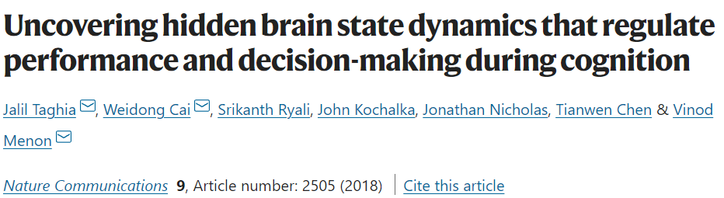
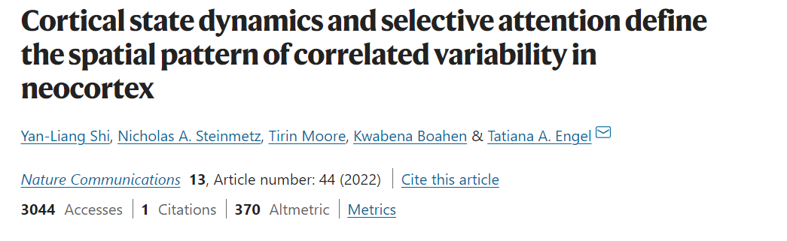
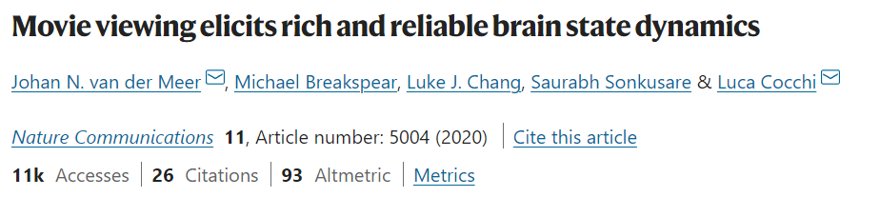
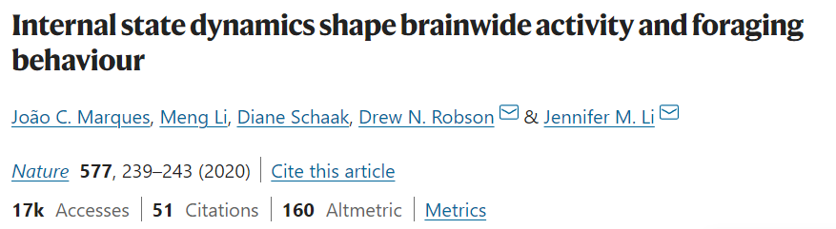
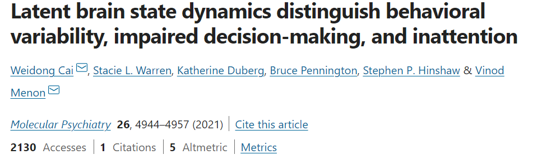

Slide 3
What is Hidden Markov Model(HMM)
HMM assumes that the time series data can be described using a hidden sequence of a finite number of states {s1,s2 … st}.
HMM assumes we can only observe the state s_i with noisy measurements x_i.

Slide 4
HMM sketches
Markov property: the probability of the state at time t (S_t)is wholly determined by the state at time t−1 (S_t-1).
The dependency of the whole state sequence {s1,...,st} can be described by a chain structure called a Markov Chain
Markovian system is a linear dynamical system
HMM is a Bayesian model
HMM is a stochastic model

Slide 5
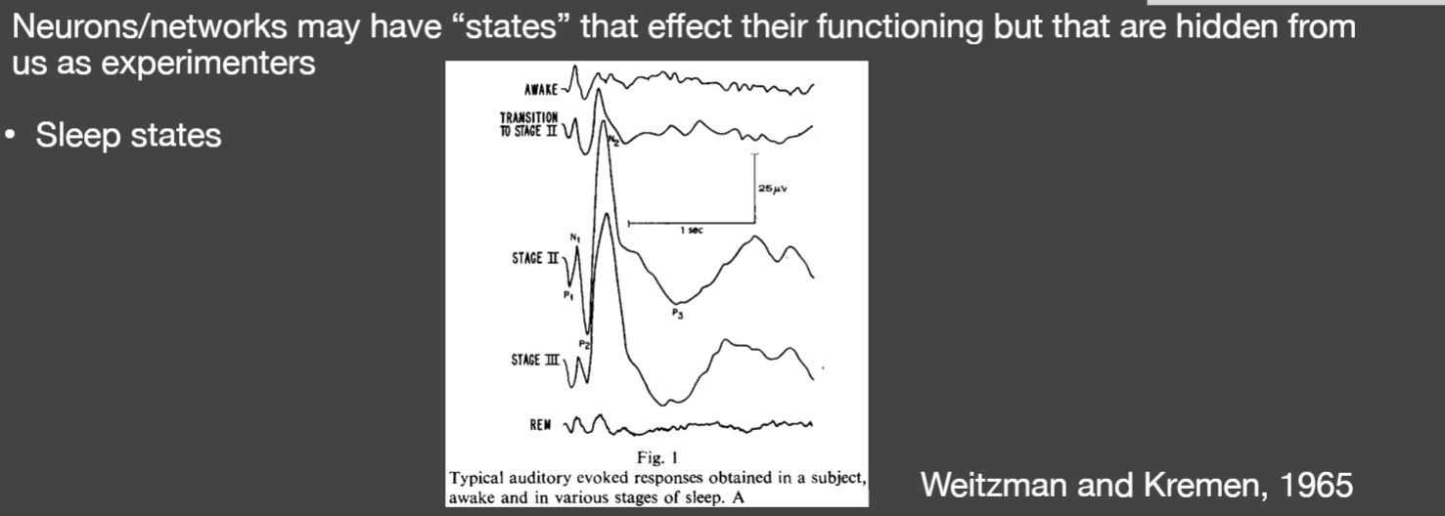
HMM in Neurosience

Slide 6
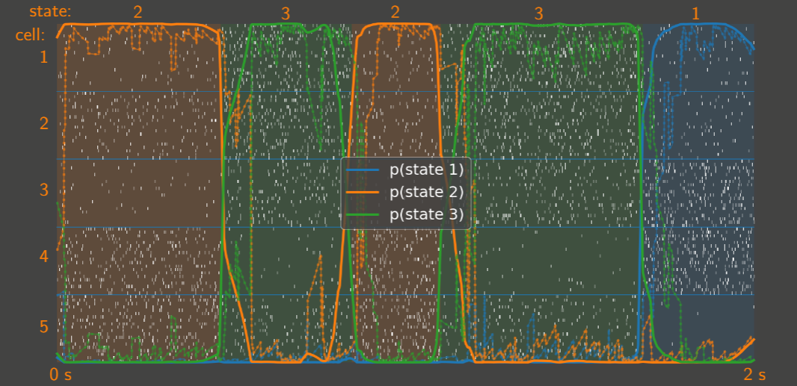
An Example of HMM

Slide 7
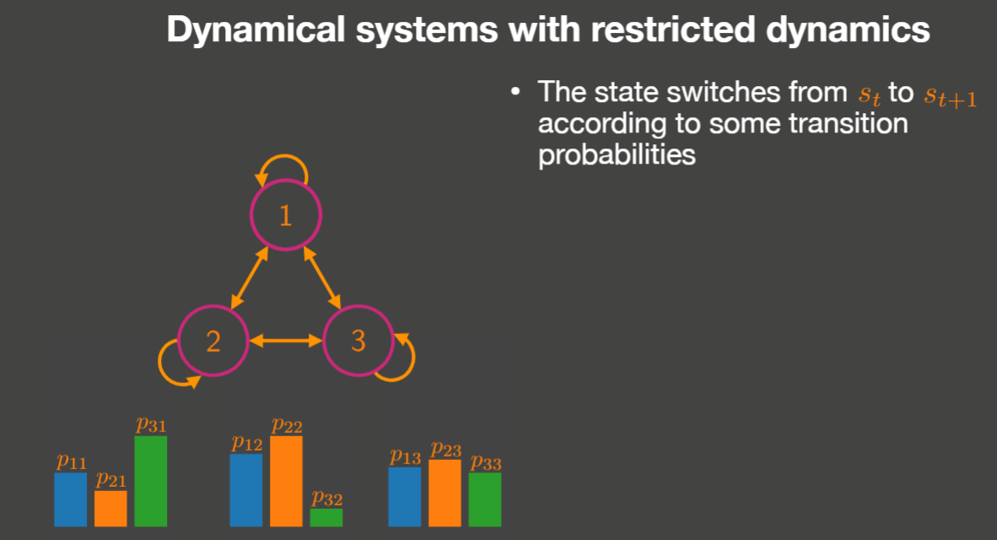

Slide 8
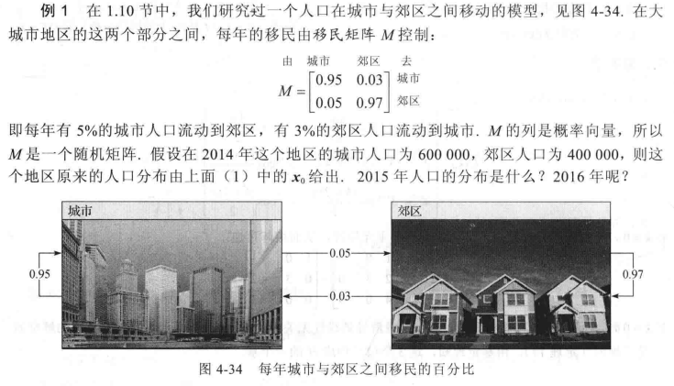
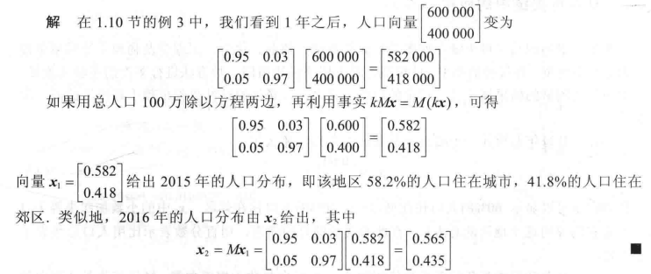
How Markov chain works
这里可以将“城市”，“郊区”理解为人口所处的两个不同State

Slide 9
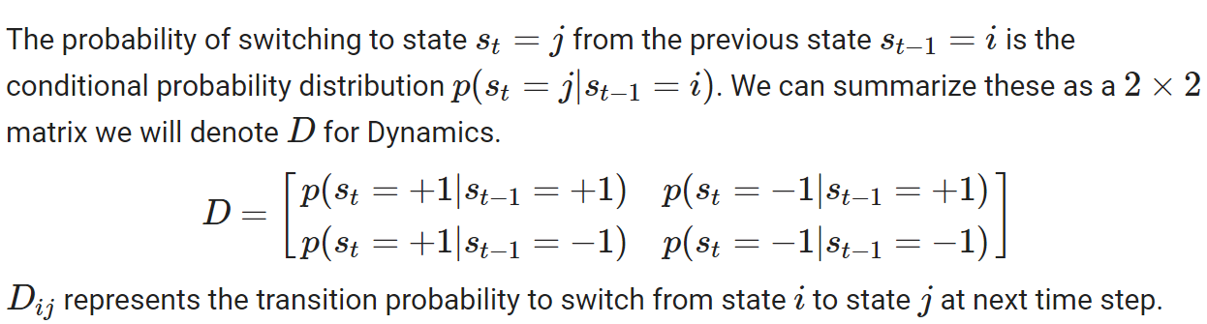
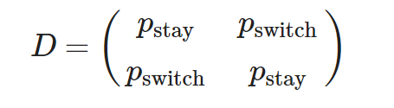
How Markov chain works
Assume we have two different states for our MRI data, sleep and awake represented by +1 and -1.

Slide 10
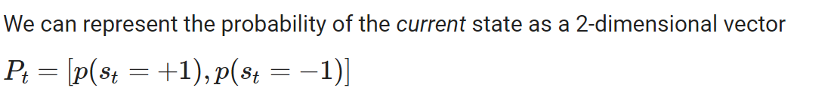

How Markov chain works
This is the case when we can directly observe the state, but we can only observe the brain using our BOLD signal in fMRI study.

Slide 11
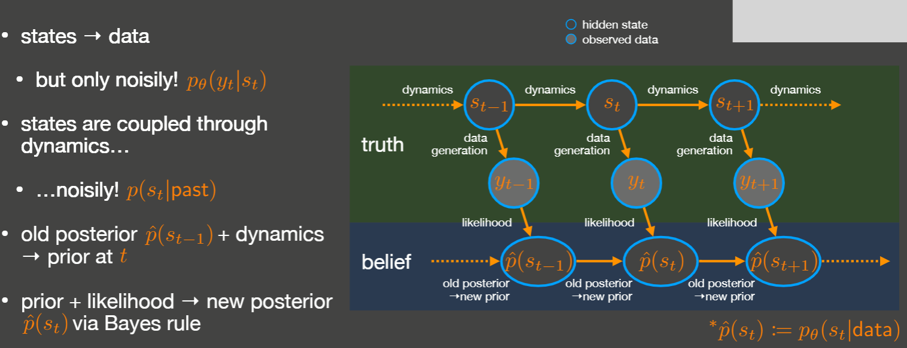
How Hidden Markov Model works

Slide 12

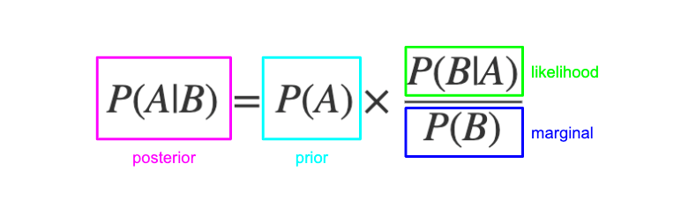

How Hidden Markov Model works
Infer the brain states from our data using Bayes Rule
m_t: measurement at time t;
s_t: hidden state at time t
Probability Density Function of today’s Hidden state
Our “Belief” of the state

Slide 13
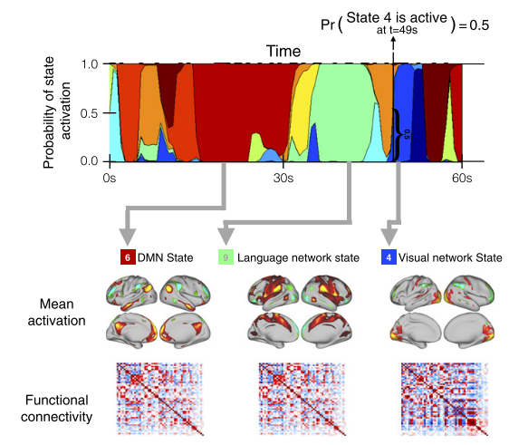
HMM in MRI data
Our measurement m_t : BOLD signal time series in specific brain regions
Hidden state s_t: represented by mean activation and functional connectivity.
We are assuming that the brain are switching between different activity state

Slide 14
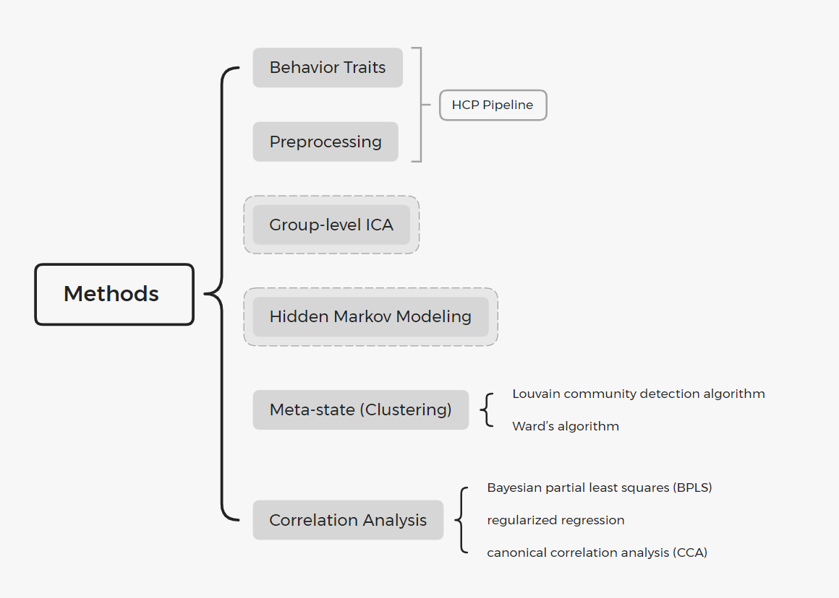
Methods

Slide 15
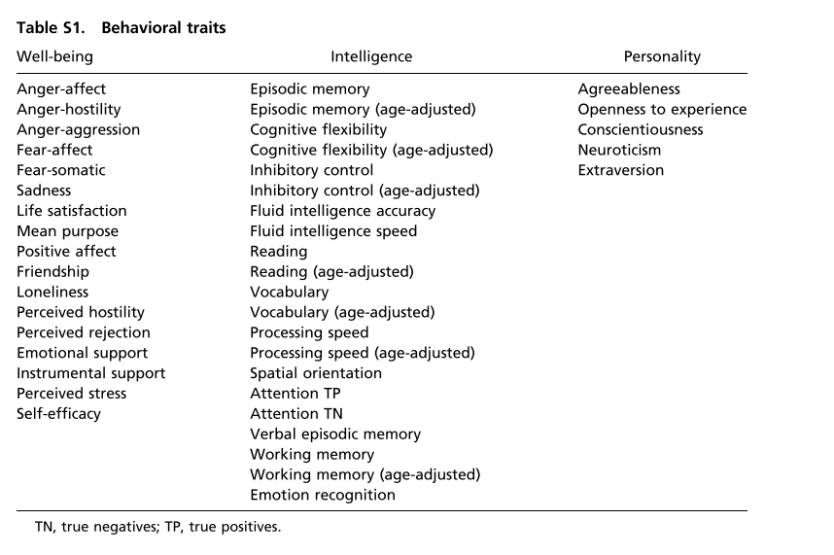
Behavior Traits
Our motivation for choosing these, and excluding, for example, health-related, sociological, and demographical variables is to focus on the pure cognitive aspects of the individuals, which can be reasonably well described using these three categories.

Slide 16
MRI data
Ν = 820 subjects from the HCP
all healthy adults (aged 22–35 y, 453 females)
3-T Siemens connectome-Skyra
For each subject, four 15-min runs of fMRI time series data with a temporal resolution of 0.73 s and a spatial resolution of 2-mm isotropic were available.

Slide 17
Preprocessing
The preprocessing pipeline followed the technique of Smith et al.
Spatial preprocessing was applied using the procedure described by Glasser et al.
Subject-level ICA followed by FMRIB’s ICA-based X-noisefier (FIX), which removed more than 99% of the artifactual ICA components in the dataset,

Slide 18
Group-Level ICA
Use ALL filtered single-subject and ALL session fMRI data as input
Set the IC components to 50
Normalize the 50D timeseries data for each scan.

Slide 19
HMM
Number of states K =12 ( No particular reason)
Stochastic Learning ( similar to Mini-batch)
Multivariate Autoregressive order = 0
assume the input is multivariate Gaussian
The current state only depends on the last state ( typical Markov model)
这个选择并不一定合理，作者只是说这样选择的结果比较好。作者在分析MEG/EEG数据时推荐使用更高阶的MAR，也就是不仅仅考虑上一个时间点的情况。
个人认为与MRI时间分辨率太低有关系，本研究每个scan 有1000个timepoint，与EEG/MEG数据完全不在一个数量级，因此神经活动的自相关在fMRI上很难体现出来

Slide 20
HMM Output
Gamma: The state dynamic time series( in the format of PDD)
Fractional Occupancy: the percentage of time occupied by each state.
FO correlation matrix: correlate FO of each state ), Ward algorithm
Transition Matrix: contains all the probability from one state to another state
A directed, weighted Graph
Calculate Meta-state using Lovian community discovery algorithm

Slide 21
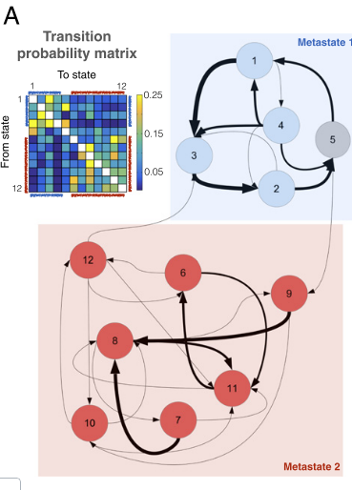
Transition Probability Matrix(TPM)
Dynamic Switching Between Brain Networks Is Not Random.
brain tends to cycle between brain networks within a metastate, with less frequent transitions between them

Slide 22
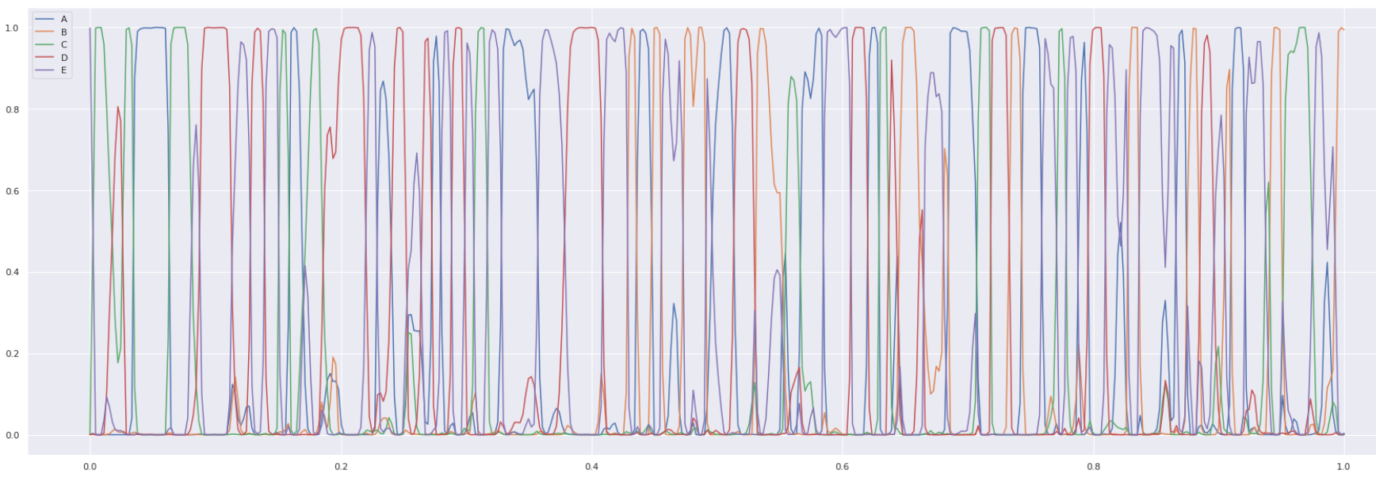
The Gamma

Slide 23
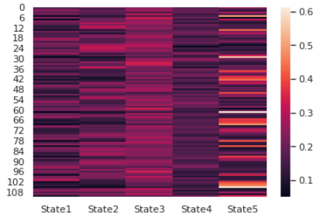
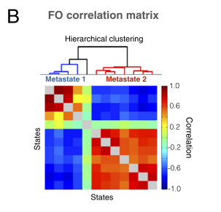
Time Spent Visiting Distinct Brain Networks Is Not Random
Meta-states correspond to sets of states whose FOs are strongly correlated across subjects
conversely, the between meta-states FO correlations are negative.
FO Matrix and FO correlation Matrix

Slide 24
Other Research Quesetions
What is the biological meaning of the meta-state?
Are HMM features relate to the behaviour traits?
Are HMM features heritable?
Are HMM features reproducible? How reliable is the model?
What if we consider the autocorrelation in HMM

Slide 25
Advantages & Disadvantages
Advantage | Disadvantages
Generative model instead of a descriptive model | Hard to select the number K
Versatile | Computationally expensive
 | Requires large sample size to reproduce the result shown in this paper

Slide 26
Thank you!

