Slide 1
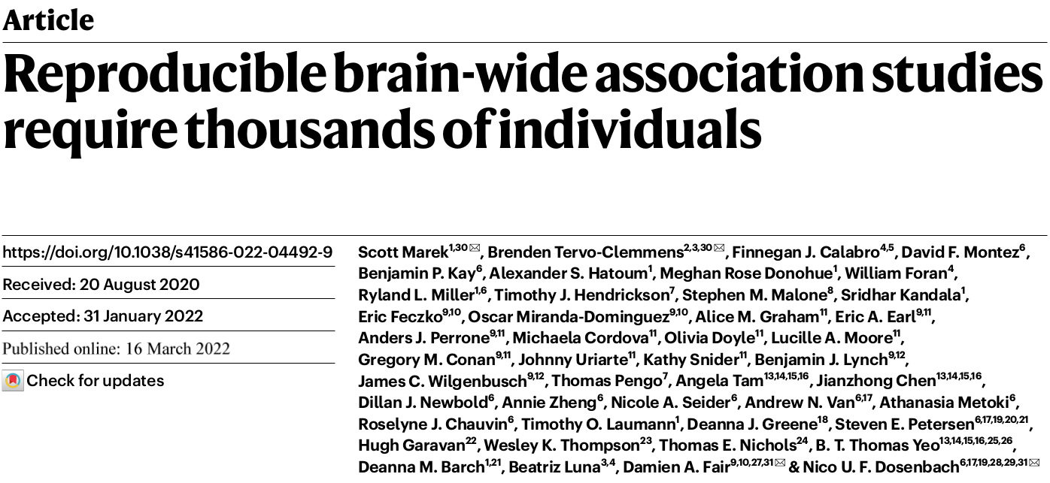

Slide 2
1. Outline
Brain-wide association studies (BWAS): associations between brain structure or function and complex cognitive or mental health phenotypes
ABCD/HCP/UKB
Cortical thickness (vertex/ROI/network), resting-state functional connectivity (RSFC, edge/network/component)
Cognitive ability (NIH Toolbox total score) and psychopathology (child behaviour checklist (CBCL) total score). 41 measures in total.
Pearson correlation (univariate), SVR (support vector regression), CCA (conanical correlation analysis)
The effect size observed using the full sample (all subjects, 3928)
The impact of sample size on observed effect size, statistical errors and reproducibility (replicability) using bootstrapped samples (25-3928)

Slide 3
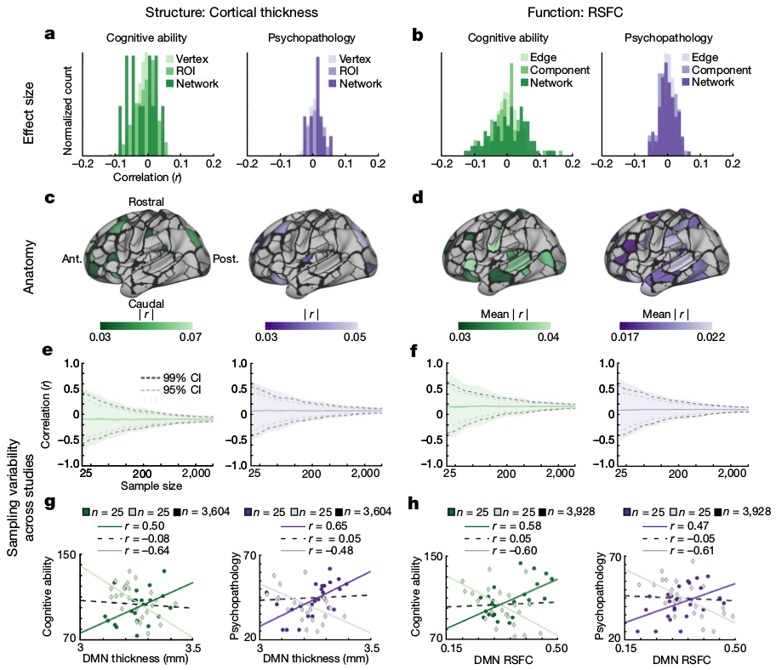
2. Observed effect size of BWAS using the full and bootstrapped samples

Slide 4
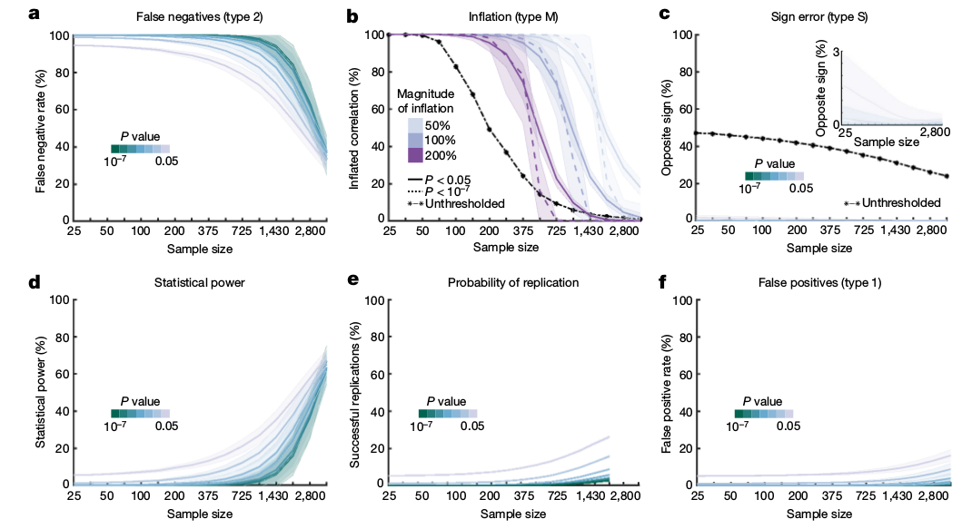
3. The impact of sample size on observed effect size, statistical errors and reproducibility

Slide 5
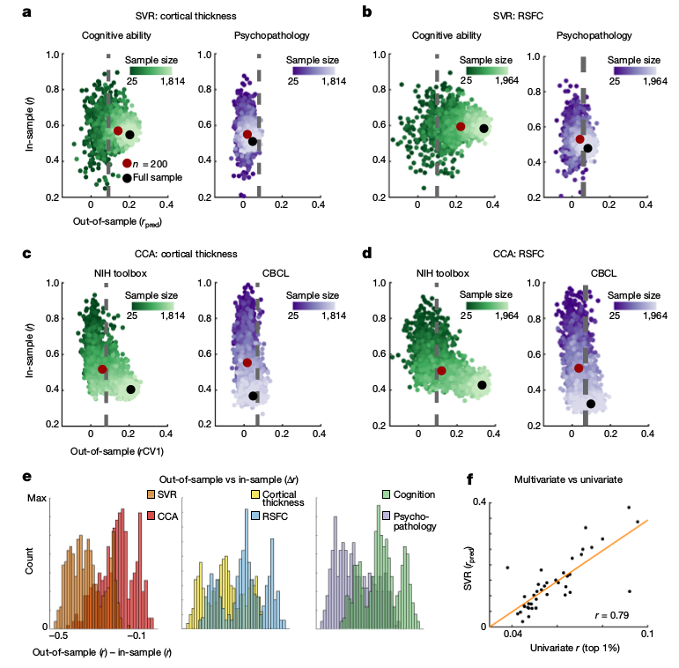
4. The impact of sample size on observed effect size (reproducibility) using multivariate approaches

Slide 6
5. MRI acquisition and processing
ABCD dataset from a total of n = 3928 youth across the discovery (n = 1964) and replication (n = 1964) sets. Matched across 9 variables: site location, age, sex, ethnicity, grade, highest level of parental education, handedness, combined family income, and prior exposure to anaesthesia. At least 600 frames (8 min) of low-motion (filtered-FD < 0.08) for RSFC data.
Twenty minutes (4*5 min runs) of eyes-open resting-state blood oxygenation level dependent (BOLD) data were acquired. All resting-state scans fMRI scans used a gradient-echo echo planar imaging (EPI) sequence (repetition time = 800 ms, echo time = 30 ms, flip angle = 90°, voxel size = 2.4 mm³ , 60 slices).
MRI data processing was completed with the freely available ABCD-BIDS pipeline, which is a modification of the original HCP pipeline.

Slide 7
MRI data-processing pipeline comprises six stages: (1) PreFreesurfer normalizes anatomical data. This normalization entails brain extraction, denoising, and then bias field correction on anatomical T1 and/or T2 weighted data. (2) FreeSurfer constructs cortical surfaces from the normalized anatomical data. Surfaces are refined using the T2 weighted anatomical data. (3) PostFreesurfer converts prior outputs into an HCP-compatible format (that is, CIFTIs) and transforms the volumes to a standard volume template space using ANTs nonlinear registration, and the surfaces to the standard surface space via spherical registration. (4) The Vol (volume) stage corrects for functional distortions via reverse-phase encoding spin-echo images. All resting-state runs underwent intensity normalization to a whole-brain-mode value of 1,000, within run correction for head movement, and functional data registration to the standard template. (5) The Surf (surface) stage projects the normalized functional data onto the template surfaces. (6) We have added an fMRI and fcMRI preprocessing stage, DCANBOLDproc.

Slide 8
The BOLD fMRI volumetric data were sampled to each participant’s original mid-thickness left and right-hemisphere surfaces constrained by the grey-matter ribbon. Once sampled to the surface, time courses were deformed and resampled from the individual’s original surface to the 32 k fs_LR surface in a single step. These surfaces were then combined with volumetric subcortical and cerebellar data into the CIFTI format using Connectome Workbench, creating full brain time courses excluding non-grey matter tissue. Finally, the resting-state time courses were smoothed with a 2 mm full-width-half-maximum kernel applied to geodesic distances on surface data and euclidean distances on volumetric data.

Slide 9
Additional BOLD preprocessing steps were executed to reduce spurious variance unlikely to reflect neuronal activity. First, a respiratory filter was used to improve framewise displacement estimates calculated in the Vol stage. Second, temporal masks were created to flag motion-contaminated frames using the improved framewise displace-ment estimates. Frames with a filtered-FD > 0.3 mm were flagged as motion-contaminated for nuisance regression only. After computing the temporal masks for high motion frame censoring, the data were processed with the following steps: (1) demeaning and detrending,(2) interpolation across censored frames using least squares spectral estimation of the values at censored frames so that continuous data can be (3) denoised via a GLM with whole brain, ventricular, and white matter signal regressors, as well as their derivatives. Denoised data were then passed through (4) a band-pass filter (0.008 Hz < f < 0.1 Hz) without re-introducing nuisance signals or contaminating frames near high-motion frames.

Slide 10
ABCD RSFC data consists of 4*5 min runs. For each participant, all available RSFC data were concatenated and high motion frames (filtered-FD > 0.08) were censored. The timeseries of BOLD activity for each ROI was correlated to that of every other ROI (333 cortical ROIs from Gordon et al.; 61 subcortical ROIs from Seitzman et al.), forming a 394*394 correlation matrix, which was subsequently Fisher z-transformed.
For network level analyses, correlations were averaged across previously defined canonical functional networks.
Inter-individual difference connectome-wide spatial components, which are not bound by network boundaries, were computed by performing PCA on a matrix composed of all ROI * ROI pairs (edges) from each participant. To extract components (100) representing inter-individual differences, we vectorized each participant’s RSFC matrix, concatenated the vectorized matrices and then performed PCA.

Slide 11
6. Covariates and bootstrap resampling
We examined the influence of sociodemographic covariates standardly used in ABCD analyses (race, gender, parental marital status, parental income, Hispanic versus non-Hispanic ethnicity, family and data collection site) on BWAS effect sizes noting that they generally decrease effect sizes.
We randomly selected participants with replacement from the full sample (n = 3928) at logarithmically spaced sample sizes (16 intervals: n = 25, 33, 50, 70, 100, 135, 200, 265, 375, 525, 725, 1000, 1430, 2000, 2800 and 3928). At each sample size, we randomly sampled participants 1,000 times. For multivariate approaches, 100 bootstrap samples were computed across the logarithmically spaced sample sizes (16 intervals: n = 25, 33, 45, 60, 80, 100, 145, 200, 256, 350, 460, 615, 825, 1100, 1475 and 1964).

Slide 12
7. Statistical errors and reproducibility
False negative and false positive rates were derived through resampling for all edge-wise brain-wide associations. For each sample size, we randomly sampled with replacement n individuals (1000 subsamples) and computed the brain–behavioral phenotype correlation and associated P value. A correlation was deemed significant if it passed a threshold (P value range: <0.05 to <10⁻⁷) in the full sample. At each sample size, if a correlation in the full sample was not significant, we determined the percentage of studies that resulted in a false positive significant correlation across a broad range of P values. Conversely, if a correlation in the full sample was significant, we determined the percentage of studies that resulted in a false negative non-significant correlation across a broad range of P values. Statistical power was calculated as (1 - false negative rate).
For each significant correlation in the full sample, we extracted all of the significant correlations observed across 1000 subsamples at each sample size. Of these significant correlations in subsamples at each sample size, we determined the percentage that were inflated, relative to the full sample effect size, across varying magnitudes (50%, 100% and 200%).

Slide 13
Each brain-wide association was extracted from the full sample as a reference. Across the 1000 subsamples at each sample size, we determined the percentage of correlations that had the opposite correlation sign as the correlation sign in the full sample.
Replication is commonly defined as detecting a significant association (for example, P < 0.05) that was deemed significant (P < 0.05) in a previous sample. For each behavioural phenotype, sample size and bootstrapped subsample, we first determined the brain–behavioural phenotype associations that were significant in the discovery (in-sample) dataset. Next, we extracted the same brain features from the replication (out-of-sample) dataset and quantified the percentage of associations that were also significant in the replication dataset.

Slide 14
8. Multivariate association analysis
For multivariate out-of-sample replication, we used SVR and CCA. SVR with a linear kernel was performed. Hyperparameter tuning was examined in (1) split halves of the full discovery sample and (2) tenfold cross-validation within the full discovery sample. Hyperparameter tuning did not appreciably change out-of-sample prediction estimates to the replication sample.
PCA dimensionality reduction was done (with a threshold of 50% variance explained in the discovery set, for each sample size) prior to SVR, given that this procedure balanced out-of-sample prediction and model complexity for nearly all model types. Replication set data were not used to estimate principal components, but rather replication set data were projected into component space via independently estimated loading matrices for each subsample of the discovery set to prevent bias.
An alternative strategy of univariate feature ranking was also examined, where SVR models were trained on the 5000, 10000 or 15000 vertices (cortical thickness) or edges (RSFC) with the highest bivariate correlation to the variable of interest in the training dataset, but this approach resulted in lower out-of-sample prediction.

Slide 15
Out-of-sample association strength is reported as the correlation between predicted and observed phenotypic scores (using models trained on the discovery set). Significance thresholds for out-of-sample replication were estimated via permutation testing (1000 iterations) with models trained on the full discovery set and tested on the full replication set.
CCA was performed for joint associations of the NIH Toolbox and CBCL with individual differences in either RSFC or cortical thickness. Equivalent bootstrapping and subsampling of the in-sample discovery set were tested and applied to the out-of-sample replication set, as in the SVR analyses.
As with SVR, PCA dimensionality reduction was done (threshold of 20% variance explained in the in-sample discovery set, for each sample size) prior to CCA given that this maximized out-of-sample correlation. The first canonical vector (CV1) weights were extracted and applied to the full out-of-sample brain and behavior data. This resulted in the out-of-sample correlation between multivariate brain and behavior data. Significance thresholds for out-of-sample replication were estimated via permutation testing (1000 iterations) with models trained on the full ABCD discovery set and tested on the full replication set.

Slide 16
8. Task fMRI analysis
Data from three in-scanner fMRI tasks (n-back, stop signal, monetary incentive delay) were concatenated to the 4*5 min resting-state runs (rest + task) to determine whether additional data affected the effect size estimates. After data were concatenated across the 4 conditions (rest + 3 task states), correlation matrices were generated and correlated with psychological phenotypes as detailed above, under univariate brain–behavioural phenotype correlations. Task events were not regressed. Data processing steps for task data were the same as RSFC, including the removal of frames with a filtered-FD > 0.08 mm.
We estimated the effect sizes between task activations (86 total contrasts) and behavioural phenotypes (39 total) across three levels of analysis: vertices, ROIs and networks (n = 844). In these same individuals, we estimated the effect sizes between RSFC and the same phenotypes across three levels of analysis: edges, principal components, and networks. This analysis was conducted in HCP dataset.

