Slide 1
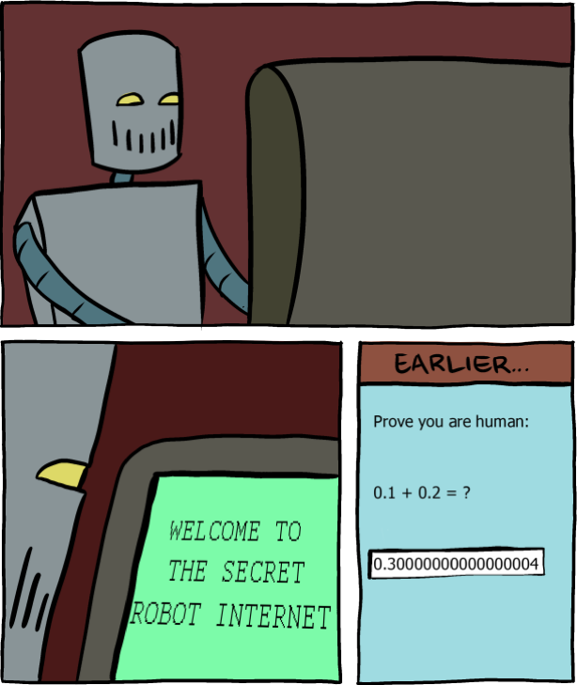
CS107, Lecture 10 Floating Point
Reading: B&O 2.4

Slide 2
CS107 Topic 5: How can a computer represent real numbers in addition to integer numbers?

Slide 3
Learning Goals
Understand the design and compromises of the floating point representation, including:
Fixed point vs. floating point
How a floating point number is represented in binary
Issues with floating point imprecision
Other potential pitfalls using floating point numbers in programs

Slide 4
Plan For Today
Recap: Generics with Function Pointers
Representing real numbers
Fixed Point
Break: Announcements
Floating Point
Floating Point Arithmetic

Slide 5
Plan For Today
Recap: Generics with Function Pointers
Representing real numbers
Fixed Point
Break: Announcements
Floating Point
Floating Point Arithmetic

Slide 6
Function Pointers
In C, there is a variable type for functions!
We can pass functions as parameters, store functions in variables, etc.
Why is this useful?

Slide 7
Generics Limitations
Sometimes, there is functionality that cannot be made generic.
void bubble_sort(void *arr, int n, int elem_size_bytes) {
while (true) {
bool swapped = false;
for (int i = 1; i < n; i++) {
void *prev_elem = (char *)arr + (i-1)*elem_size_bytes;
void *curr_elem = (char *)arr + i*elem_size_bytes;
if (curr_elem should come before prev_elem) {
swapped = true;
swap(prev_elem, curr_elem, elem_size_bytes);
}
}
if (!swapped) {
return;
}
}
}

Slide 8
Generics Limitations
Sometimes, there is functionality that cannot be made generic. The caller can pass in a function to perform that functionality for the data they are providing.
void bubble_sort(void *arr, int n, int elem_size_bytes,
bool (*cmp_fn)(const void *, const void *)) {
while (true) {
bool swapped = false;
for (int i = 1; i < n; i++) {
void *prev_elem = (char *)arr + (i-1)*elem_size_bytes;
void *curr_elem = (char *)arr + i*elem_size_bytes;
if (cmp_fn(prev_elem, curr_elem) > 0)) {
swapped = true;
swap(prev_elem, curr_elem, elem_size_bytes);
}
}
if (!swapped) {
return;
}
}
}

Slide 9
Generic C Standard Library Functions
qsort – I can sort an array of any type! To do that, I need you to provide me a function that can compare two elements of the kind you are asking me to sort.
bsearch – I can use binary search to search for a key in an array of any type! To do that, I need you to provide me a function that can compare two elements of the kind you are asking me to search.
lfind – I can use linear search to search for a key in an array of any type! To do that, I need you to provide me a function that can compare two elements of the kind you are asking me to search.
lsearch - I can use linear search to search for a key in an array of any type! I will also add the key for you if I can’t find it. In order to do that, I need you to provide me a function that can compare two elements of the kind you are asking me to search.

Slide 10
Generic C Standard Library Functions
scandir – I can create a directory listing with any order and contents! To do that, I need you to provide me a function that tells me whether or not you want me to include a given directory entry in the listing. I also need you to provide me a function that tells me the correct ordering of two given directory entries.

Slide 11
Function Pointers
Here’s the variable type syntax for a function:
[return type] (*[name])([parameters])

Slide 12
Function Pointers
int do_something(char *str) {
…
}
int main(int argc, char *argv[]) {
…
int (*func_var)(char *) = do_something;
…
func_var("testing");
return 0;
}

Slide 13
Function Pointers
void bubble_sort(void *arr, int n, int elem_size_bytes,
int (*cmp_fn)(const void *, const void *)) {
…
}
int cmp_double(const void *, const void *) {…}
int main(int argc, char *argv[]) {
…
double values[] = {1.2, 3.5, 12.2};
int n = sizeof(values) / sizeof(values[0]);
bubble_sort(values, n, sizeof(*values), cmp_double);
…
}

Slide 14
Comparison Functions
Comparison functions are a common use of function parameters, because many generic functions must know how to compare elements of your type.
Comparison functions always take pointers to the data they care about, since the data could be any size!
When writing a comparison function callback, use the following pattern:
Cast the void *argument(s) and set typed pointers equal to them.
Dereference the typed pointer(s) to access the values.
Perform the necessary operation.
(steps 1 and 2 can often be combined into a single step)

Slide 15
Comparison Functions
It should return:
< 0 if first value should come before second value
> 0 if first value should come after second value
0 if first value and second value are equivalent
This is the same return value format as strcmp!
int (*compare_fn)(const void *a, const void *b)

Slide 16
Function Pointers
int integer_compare(void *ptr1, void *ptr2) {
// cast arguments to int *s and dereference
int num1 = *(int *)ptr1;
int num2 = *(int *)ptr2;
// perform operation
return num1 – num2;
}
…
qsort(mynums, count, sizeof(*mynums), integer_compare);

Slide 17
String Comparison Function
int string_compare(void *ptr1, void *ptr2) {
// cast arguments and dereference
char *str1 = *(char **)ptr1;
char *str2 = *(char **)ptr2;
// perform operation
return strcmp(str1, str2);
}
…
qsort(mystrs, count, sizeof(*mystrs), string_compare);

Slide 18
Generics Wrap-Up
We use void * pointers and memory operations like memcpy and memmove to make data operations generic.
We use function pointers to make logic/functionality operations generic.

Slide 19
memset
memset is a function that sets a specified amount of bytes at one address to a certain value.
void *memset(void *s, int c, size_t n);
It fills n bytes starting at memory location s with the byte c. (It also returns s).
int counts[5];
memset(counts, 0, 3); // zero out first 3 bytes at counts
memset(counts + 3, 0xff, 4) // set 3rd entry’s bytes to 1s

Slide 20
Plan For Today
Recap: Generics with Function Pointers
Representing real numbers
Fixed Point
Break: Announcements
Floating Point
Floating Point Arithmetic

Slide 21
Real Numbers
We previously discussed representing integer numbers using two’s complement.
However, this system does not represent real numbers such as 3/5 or 0.25.
How can we design a representation for real numbers?

Slide 22
Real Numbers
Problem: unlike with the integer number line, where there are a finite number of values between two numbers, there are an infinite number of real number values between two numbers!
Integers between 0 and 2: 1
Real Numbers Between 0 and 2: 0.1, 0.01, 0.001, 0.0001, 0.00001,…
We need a fixed-width representation for real numbers. Therefore, by definition, we will not be able to represent all numbers.

Slide 23
Real Numbers
Problem: every number base has un-representable real numbers.
Base 10: 1/6₁₀ = 0.16666666…..₁₀
Base 2: 1/10₁₀ = 0.000110011001100110011…₂
Therefore, by representing in base 2, we will not be able to represent all numbers, even those we can exactly represent in base 10.

Slide 24
Fixed Point
Idea: Like in base 10, let’s add binary decimal places to our existing number representation.
5 | 9 | 3 | 4 | . | 2 | 1 | 6
10³ | 10² | 10¹ | 10⁰ |  | 10⁻¹ | 10⁻² | 10⁻³
1 | 0 | 1 | 1 | . | 0 | 1 | 1
2³ | 2² | 2¹ | 2⁰ |  | 2⁻¹ | 2⁻² | 2⁻³

Slide 25
Plan For Today
Recap: Generics with Function Pointers
Representing real numbers
Fixed Point
Break: Announcements
Floating Point
Floating Point Arithmetic

Slide 26
Fixed Point
Idea: Like in base 10, let’s add binary decimal places to our existing number representation.
Pros: arithmetic is easy! And we know exactly how much precision we have.
1 | 0 | 1 | 1 | . | 0 | 1 | 1
8s | 4s | 2s | 1s |  | 1/2s | 1/4s | 1/8s

Slide 27
Fixed Point
Problem: we have to fix where the decimal point is in our representation. What should we pick? This also fixes us to 1 place per bit.
. | 0 | 1 | 1 | 0 | 0 | 1 | 1
 | 1/2s | 1/4s | 1/8s | …
1 | 0 | 1 | 1 | 0 | . | 1 | 1
16s | 8s | 4s | 2s | 1s |  | 1/2s | 1/4s

Slide 28
Fixed Point
Problem: we have to fix where the decimal point is in our representation. What should we pick? This also fixes us to 1 place per bit.
. | 0 | 1 | 1 | 0 | 0 | 1 | 1
 | 1/2s | 1/4s | 1/8s | …
1 | 0 | 1 | 1 | 0 | . | 1 | 1
16s | 8s | 4s | 2s | 1s |  | 1/2s | 1/4s

Slide 29
Fixed Point
Problem: we have to fix where the decimal point is in our representation. What should we pick? This also fixes us to 1 place per bit.
To be able to store both these numbers using the same fixed point representation, the bitwidth of the type would need to be at least 207 bits wide!
Base 10
Base 2
5.07E30 =
10.....0.1
100 zeros
9.86E-32 =
0.0.....01
100 zeros

Slide 30
Let’s Get Real
What would be nice to have in a real number representation?
Represent widest range of numbers possible
Flexible “floating” decimal point
Represent scientific notation numbers, e.g. 1.2 x 10⁶
Still be able to compare quickly
Have more predictable over/under-flow behavior

Slide 31
Plan For Today
Recap: Generics with Function Pointers
Representing real numbers
Fixed Point
Break: Announcements
Floating Point
Floating Point Arithmetic

Slide 32
Midterm Exam
The midterm exam is Fri. 5/10 12:30-2:20PM in Nvidia Aud. and 420-041
Last names A-R: Nvidia Auditorium
Last Names S-Z: 420-041
Covers material through lab4/assign4 (no floats or assembly language)
Closed-book, 1 2-sided page of notes permitted, C reference sheet provided
Administered via BlueBook software (on your laptop)
Practice materials and BlueBook download available on course website
If you have academic (e.g. OAE) or athletics accommodations, please let us know by Sunday 5/5 if possible.
If you do not have a workable laptop for the exam, you must let us know by Sunday 5/5. Limited charging outlets will be available for those who need them.

Slide 33
Plan For Today
Recap: Generics with Function Pointers
Representing real numbers
Fixed Point
Break: Announcements
Floating Point
Floating Point Arithmetic

Slide 34
Let’s Get Real
What would be nice to have in a real number representation?
Represent widest range of numbers possible
Flexible “floating” decimal point
Represent scientific notation numbers, e.g. 1.2 x 10⁶
Still be able to compare quickly
Have more predictable over/under-flow behavior

Slide 35
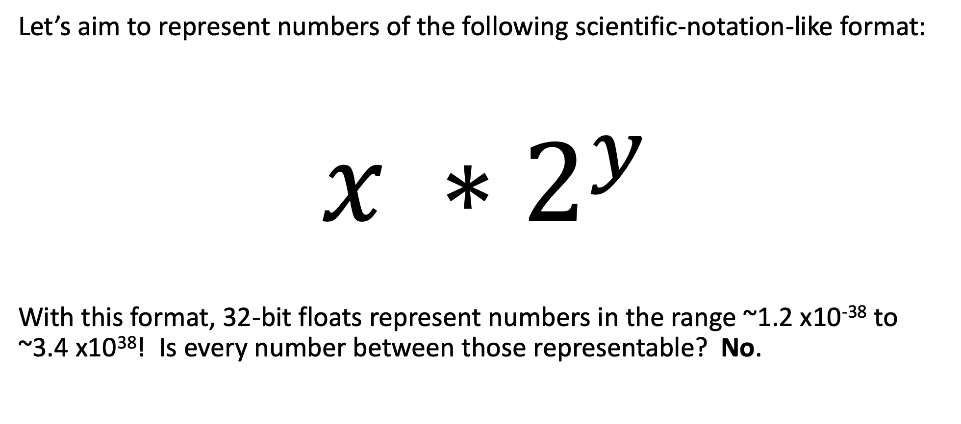
IEEE Floating Point
Let’s aim to represent numbers of the following scientific-notation-like format:
$$x ∗2^{y}$$
With this format, 32-bit floats represent numbers in the range ~1.2 x10⁻³⁸ to ~3.4 x10³⁸! Is every number between those representable? No.

Slide 36
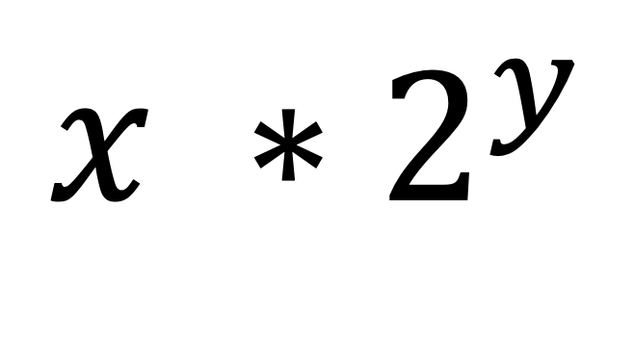
IEEE Single Precision Floating Point
31 | 30 |  | 23 | 22 |  |  |  |  | 0
s | exponent (8 bits) |  |  | fraction (23 bits)
$$x ∗2^{y}$$
Sign bit
(0 = positive)

Slide 37
Exponent
s | exponent (8 bits) | fraction (23 bits)
Exponent (Binary) | Exponent (Base 10)
11111111 | ?
11111110 | ?
11111101 | ?
11111100 | ?
… | ?
00000011 | ?
00000010 | ?
00000001 | ?
00000000 | ?

Slide 38
Exponent
s | exponent (8 bits) | fraction (23 bits)
Exponent (Binary) | Exponent (Base 10)
11111111 | RESERVED
11111110 | ?
11111101 | ?
11111100 | ?
… | ?
00000011 | ?
00000010 | ?
00000001 | ?
00000000 | RESERVED

Slide 39
Exponent
s | exponent (8 bits) | fraction (23 bits)
Exponent (Binary) | Exponent (Base 10)
11111111 | RESERVED
11111110 | 127
11111101 | 126
11111100 | 125
… | …
00000011 | -124
00000010 | -125
00000001 | -126
00000000 | RESERVED

Slide 40
Exponent
s | exponent (8 bits) | fraction (23 bits)
The exponent is not represented in two’s complement.
Instead, exponents are sequentially represented starting from 000…1 (most negative) to 111…10 (most positive). This makes bit-level comparison fast.
Actual value = binary value – 127 (“bias”)
11111110 | 254 – 127 = 127
11111101 | 253 – 127 = 126
… | …
00000010 | 2 – 127 = -125
00000001 | 1 – 127 = -126

Slide 41

Fraction
s | exponent (8 bits) | fraction (23 bits)
$$x ∗2^{y}$$
We could just encode whatever x is in the fraction field. But there’s a trick we can use to make the most out of the bits we have.

Slide 42
An Interesting Observation
In Base 10:
42.4 x 10⁵ = 4.24 x 10⁶
324.5 x 10⁵ = 3.245 x 10⁷
0.624 x 10⁵ = 6.24 x 10⁴
In Base 2:
10.1 x 2⁵ = 1.01 x 2⁶
1011.1 x 2⁵ = 1.0111 x 2⁸
0.110 x 2⁵ = 1.10 x 2⁴
We tend to adjust the exponent until we get down to one place to the left of the decimal point.
Observation: in base 2, this means there is always a 1 to the left of the decimal point!

Slide 43
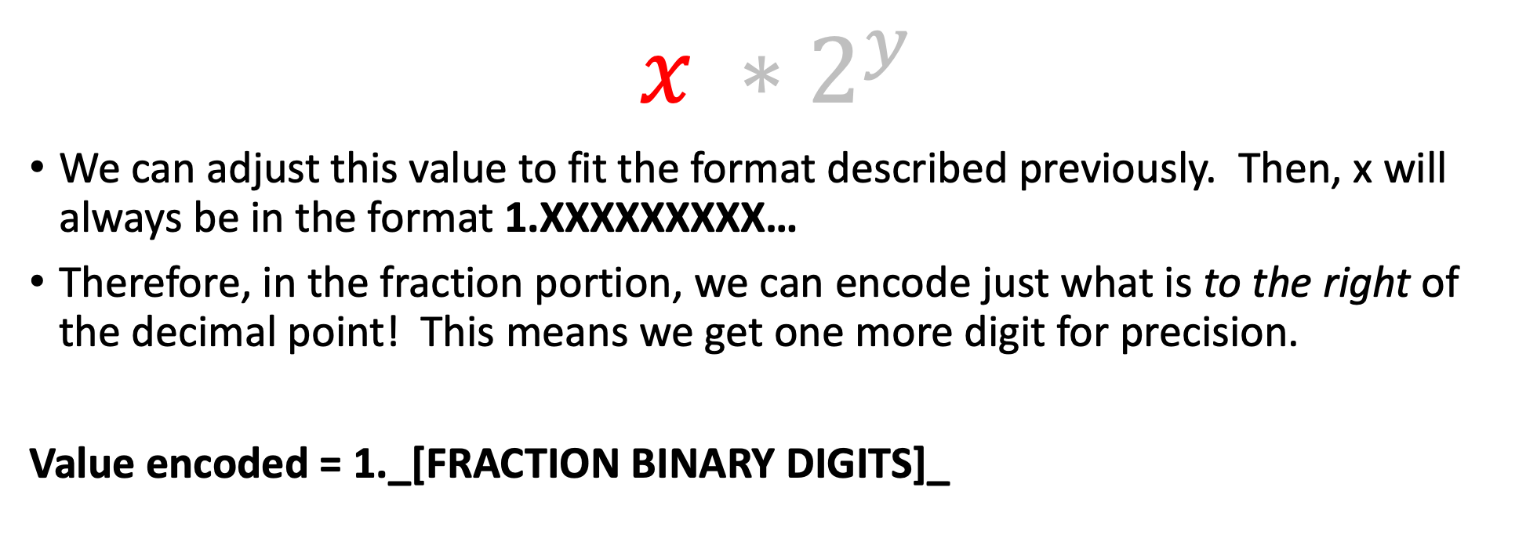
Fraction
s | exponent (8 bits) | fraction (23 bits)
$$x ∗2^{y}$$
We can adjust this value to fit the format described previously. Then, x will always be in the format 1.XXXXXXXXX…
Therefore, in the fraction portion, we can encode just what is to the right of the decimal point! This means we get one more digit for precision.
Value encoded = 1._[FRACTION BINARY DIGITS]_

Slide 44
Practice
Sign | Exponent |  |  |  |  |  | Fraction
0 | 0 | … | 0 | 0 | 0 | 1 | 0 | 1 | 0 | …
Is this number:
Greater than 0?
Less than 0?
Is this number:
Less than -1?
Between -1 and 1?
Greater than 1?
Notes:
1 – A
2 – B
1.25 x 2^-126

Slide 45
Skipping Numbers
We said that it’s not possible to represent all real numbers using a fixed-width representation. What does this look like?
Float Converter
https://www.h-schmidt.net/FloatConverter/IEEE754.html
Floats and Graphics
https://www.shadertoy.com/view/4tVyDK
Notes:
Show smallest increment step – bigger as number is bigger
Then show 0.1 in binary

Slide 46
Let’s Get Real
What would be nice to have in a real number representation?
Represent widest range of numbers possible ✅
Flexible “floating” decimal point ✅
Represent scientific notation numbers, e.g. 1.2 x 10⁶ ❓
Still be able to compare quickly ✅
Have more predictable over/under-flow behavior ❓
Notes:
What about the rest of the values? (0, small numbers, etc.)

Slide 47
Representing Zero
The float representation of zero is all zeros (with any value for the sign bit)
This means there are two representations for zero! ☹
Sign | Exponent | Fraction
any | All zeros | All zeros

Slide 48
Representing Small Numbers
If the exponent is all zeros, we switch into “denormalized” mode.
We now treat the exponent as -126, and the fraction as without the leading 1.
This allows us to represent the smallest numbers as precisely as possible.
Sign | Exponent | Fraction
any | All zeros | Any

Slide 49
Representing Exceptional Values
If the exponent is all ones, and the fraction is all zeros, we have +- infinity.
The sign bit indicates whether it is positive or negative infinity.
Floats have built-in handling of over/underflow!
Infinity + anything = infinity
Negative infinity + negative anything = negative infinity
Etc.
Sign | Exponent | Fraction
any | All ones | All zeros

Slide 50
Representing Exceptional Values
If the exponent is all ones, and the fraction is nonzero, we have Not a Number.
NaN results from computations that produce an invalid mathematical result.
Sqrt(negative)
Infinity / infinity
Infinity + -infinity
Etc.
Sign | Exponent |  |  |  |  |  | Fraction
any | 1 | … | … | … | … | 1 | Any nonzero

Slide 51
Number Ranges
32-bit integer (type int): › -2,147,483,648 to 2147483647 › Every integer in that range can be represented
64-bit integer (type long): › −9,223,372,036,854,775,808 to 9,223,372,036,854,775,807
32-bit floating point (type float):
~1.2 x10⁻³⁸ to ~3.4 x10³⁸
Not all numbers in the range can be represented (not even all integers in the range can be represented!)
Gaps can get quite large! (larger the exponent, larger the gap between successive fraction values)
64-bit floating point (type double):
~2.2 x10⁻³⁰⁸ to ~1.8 x10³⁰⁸

Slide 52
Plan For Today
Recap: Generics with Function Pointers
Representing real numbers
Fixed Point
Break: Announcements
Floating Point
Floating Point Arithmetic

Slide 53
Demo: Float Arithmetic
Notes:
Memory diagram

Slide 54
Floating Point Arithmetic
Is this just overflowing? It turns out it’s more subtle.
float a = 3.14;
float b = 1e20;
printf("(3.14 + 1e20) - 1e20 = %g\n", (a + b) - b); // prints 0
printf("3.14 + (1e20 - 1e20) = %g\n", a + (b - b)); // prints 3.14
Let’s look at the binary representations for 3.14 and 1e20:
31 | 30 |  | 23 | 22 |  |  |  |  | 0
0 | 10000000 |  |  | 10010001111010111000011
3.14:
31 | 30 |  | 23 | 22 |  |  |  |  | 0
0 | 11000001 |  |  | 01011010111100011101100
1e20:

Slide 55
Floating Point Arithmetic
31 | 30 |  | 23 | 22 |  |  |  |  | 0
0 | 10000000 |  |  | 10010001111010111000011
3.14:
31 | 30 |  | 23 | 22 |  |  |  |  | 0
0 | 11000001 |  |  | 01011010111100011101100
1e20:
To add real numbers, we must align their binary points:
3.14
+ 100000000000000000000.00
100000000000000000003.14
What does this number look like in 32-bit IEEE format?

Slide 56
Floating Point Arithmetic
Step 1: convert from base 10 to binary
What is 100000000000000000003.14 in binary? Let’s find out!
http://web.stanford.edu/class/archive/cs/cs107/cs107.1184/float/convert.html
1010110101111000111010111100010110101100011000100000000000000000011.0010001111010111000010100011…

Slide 57
Floating Point Arithmetic
Step 2: find most significant 1 and take the next 23 digits for the fractional component, rounding if needed.
1 01011010111100011101100
1010110101111000111010111100010110101100011000100000000000000000011.0010001111010111000010100011…

Slide 58
Floating Point Arithmetic
Step 3: find how many places we need to shift left to put the number in 1.xxx format. This fills in the exponent component.
66 shifts -> 66 + 127 = 193
1010110101111000111010111100010110101100011000100000000000000000011.0010001111010111000010100011…

Slide 59
Floating Point Arithmetic
Step 4: if the sign is positive, the sign bit is 0. Otherwise, it’s 1.
Sign bit is 0.
1010110101111000111010111100010110101100011000100000000000000000011.0010001111010111000010100011…

Slide 60
Floating Point Arithmetic
The binary representation for 1e20 + 3.14 thus equals the following:
This is the same as the binary representation for 1e20 that we had before!
31 | 30 |  | 23 | 22 |  |  |  |  | 0
0 | 11000001 |  |  | 01011010111100011101100
We didn’t have enough bits to differentiate between 1e20 and 1e20 + 3.14.

Slide 61
Floating Point Arithmetic
Is this just overflowing? It turns out it’s more subtle.
float a = 3.14;
float b = 1e20;
printf("(3.14 + 1e20) - 1e20 = %g\n", (a + b) - b); // prints 0
printf("3.14 + (1e20 - 1e20) = %g\n", a + (b - b)); // prints 3.14
Floating point arithmetic is not associative. The order of operations matters!
The first line loses precision when first adding 3.14 and 1e20, as we have seen.
The second line first evaluates 1e20 – 1e20 = 0, and then adds 3.14

Slide 62
Demo: Float Equality
Notes:
The rounding that happens during the calculation of 0.1 + 0.2 produces a different number than 0.3!

Slide 63
Floating Point Arithmetic
Float arithmetic is an issue with most languages, not just C!
http://geocar.sdf1.org/numbers.html

Slide 64
Let’s Get Real
What would be nice to have in a real number representation?
Represent widest range of numbers possible ✅
Flexible “floating” decimal point ✅
Represent scientific notation numbers, e.g. 1.2 x 10⁶ ✅
Still be able to compare quickly ✅
Have more predictable over/under-flow behavior ✅

Slide 65
Floats Summary
IEEE Floating Point is a carefully-thought-out standard. It’s complicated, but engineered for their goals.
Floats have an extremely wide range, but cannot represent every number in that range.
Some approximation and rounding may occur! This means you definitely don’t want to use floats e.g. for currency.
Associativity does not hold for numbers far apart in the range
Equality comparison operations are often unwise.

Slide 66
Recap
Recap: Generics with Function Pointers
Representing real numbers
Fixed Point
Break: Announcements
Floating Point
Floating Point Arithmetic
Next time: assembly language

