Slide 1
CS107, Lecture 11 Introduction to Assembly
Reading: B&O 3.1-3.4

Slide 2
CS107 Topic 6: How does a computer interpret and execute C programs?

Slide 3
Learning Assembly
Moving data around
Arithmetic and logical operations
Control flow
Function calls
Today
5/13
5/17
5/20

Slide 4
Today’s Learning Goals
Learn what assembly language is and why it is important
Become familiar with the format of human-readable assembly and x86
Learn the mov instruction and how data moves around at the assembly level

Slide 5
Plan For Today
Overview: GCC and Assembly
Demo: Looking at an executable
Registers and The Assembly Level of Abstraction
A Brief History
Our First Assembly
Break: Announcements
The mov instruction

Slide 6
Plan For Today
Overview: GCC and Assembly
Demo: Looking at an executable
Registers and The Assembly Level of Abstraction
A Brief History
Our First Assembly
Break: Announcements
The mov instruction

Slide 7
GCC
GCC is the compiler that converts your human-readable code into machine-readable instructions.
C, and other languages, are high-level abstractions we use to write code efficiently. But computers don’t really understand things like data structures, variable types, etc. Compilers are the translator!
Pure machine code is 1s and 0s – everything is bits, even your programs! But we can read it in a human-readable form called assembly. (Engineers used to write code in assembly before C).
There may be multiple assembly instructions needed to encode a single C instruction.
We’re going to go behind the curtain to see what the assembly code for our programs looks like.

Slide 8
Demo: Looking at an Executable (objdump -d)

Slide 9
Plan For Today
Overview: GCC and Assembly
Demo: Looking at an executable
Registers and The Assembly Level of Abstraction
A Brief History
Our First Assembly
Break: Announcements
The mov instruction

Slide 10
Assembly Abstraction
C abstracts away the low level details of machine code. It lets us work using variables, variable types, and other higher level abstractions.
C and other languages let us write code that works on most machines.
Assembly code is just bytes! No variable types, no type checking, etc.
Assembly/machine code is processor-specific.
What is the level of abstraction for assembly code?
Notes:
C code works on computer and phone, but needs to be recompiled!

Slide 11
Registers
%rax

Slide 12
Registers
%rax
%rsi
%r8
%r12
%rbx
%rdi
%r9
%r13
%rcx
%rbp
%r10
%r14
%rdx
%rsp
%r11
%r15

Slide 13
Registers
A register is a 64-bit space inside the processor.
There are 16 registers available, each with a unique name.
Registers are like “scratch paper” for the processor. Data being calculated or manipulated is moved to registers first. Operations are performed on registers.
Registers also hold parameters and return values for functions.
Registers are extremely fast memory!
Processor instructions consist mostly of moving data into/out of registers and performing arithmetic on them. This is the level of logic your program must be in to execute!

Slide 14
Machine-Level Code
Assembly instructions manipulate these registers. For example:
One instruction adds two numbers in registers
One instruction transfers data from a register to memory
One instruction transfers data from memory to a register

Slide 15
Computer Architecture

Slide 16
GCC And Assembly
GCC compiles your program – it lays out memory on the stack and heap and generates assembly instructions to access and do calculations on those memory locations.
Here’s what the “assembly-level abstraction” of C code might look like:
C | Assembly Abstraction
int sum = x + y; | Copy x into register 1 Copy y into register 2 Add register 2 to register 1 Write register 1 to memory for sum

Slide 17
Plan For Today
Overview: GCC and Assembly
Demo: Looking at an executable
Registers and The Assembly Level of Abstraction
A Brief History
Our First Assembly
Break: Announcements
The mov instruction

Slide 18
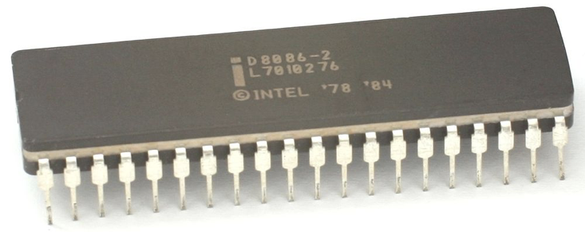
Assembly
We are going to learn the x86-64 instruction set architecture. This instruction set is used by Intel and AMD processors.
There are many other instruction sets: ARM, MIPS, etc.
Intel originally designed their instruction set back in 1978. It has evolved significantly since then, but has aggressively preserved backwards compatibility.
Originally 16 bit processor -> then 32 -> now 64 bit. This dictated the register sizes (and even register names).

Slide 19
Plan For Today
Overview: GCC and Assembly
Demo: Looking at an executable
Registers and The Assembly Level of Abstraction
A Brief History
Our First Assembly
Break: Announcements
The mov instruction

Slide 20
Our First Assembly
int sum_array(int arr[], int nelems) {
int sum = 0;
for (int i = 0; i < nelems; i++) {
sum += arr[i];
}
return sum;
}
What does this look like in assembly?

Slide 21
Our First Assembly
00000000004005b6 <sum_array>:
4005b6: ba 00 00 00 00 mov $0x0,%edx
4005bb: b8 00 00 00 00 mov $0x0,%eax
4005c0: eb 09 jmp 4005cb <sum_array+0x15>
4005c2: 48 63 ca movslq %edx,%rcx
4005c5: 03 04 8f add (%rdi,%rcx,4),%eax
4005c8: 83 c2 01 add $0x1,%edx
4005cb: 39 f2 cmp %esi,%edx
4005cd: 7c f3 jl 4005c2 <sum_array+0xc>
4005cf: f3 c3 repz retq

Slide 22
Our First Assembly
00000000004005b6 <sum_array>:
4005b6: ba 00 00 00 00 mov $0x0,%edx
4005bb: b8 00 00 00 00 mov $0x0,%eax
4005c0: eb 09 jmp 4005cb <sum_array+0x15>
4005c2: 48 63 ca movslq %edx,%rcx
4005c5: 03 04 8f add (%rdi,%rcx,4),%eax
4005c8: 83 c2 01 add $0x1,%edx
4005cb: 39 f2 cmp %esi,%edx
4005cd: 7c f3 jl 4005c2 <sum_array+0xc>
4005cf: f3 c3 repz retq
This is the name of the function (same as C) and the memory address where the code for this function starts.

Slide 23
Our First Assembly
00000000004005b6 <sum_array>:
4005b6: ba 00 00 00 00 mov $0x0,%edx
4005bb: b8 00 00 00 00 mov $0x0,%eax
4005c0: eb 09 jmp 4005cb <sum_array+0x15>
4005c2: 48 63 ca movslq %edx,%rcx
4005c5: 03 04 8f add (%rdi,%rcx,4),%eax
4005c8: 83 c2 01 add $0x1,%edx
4005cb: 39 f2 cmp %esi,%edx
4005cd: 7c f3 jl 4005c2 <sum_array+0xc>
4005cf: f3 c3 repz retq
These are the memory addresses where each of the instructions live. Sequential instructions are sequential in memory.

Slide 24
Our First Assembly
00000000004005b6 <sum_array>:
4005b6: ba 00 00 00 00 mov $0x0,%edx
4005bb: b8 00 00 00 00 mov $0x0,%eax
4005c0: eb 09 jmp 4005cb <sum_array+0x15>
4005c2: 48 63 ca movslq %edx,%rcx
4005c5: 03 04 8f add (%rdi,%rcx,4),%eax
4005c8: 83 c2 01 add $0x1,%edx
4005cb: 39 f2 cmp %esi,%edx
4005cd: 7c f3 jl 4005c2 <sum_array+0xc>
4005cf: f3 c3 repz retq
This is the assembly code: “human-readable” versions of each machine code instruction.

Slide 25
Our First Assembly
00000000004005b6 <sum_array>:
4005b6: ba 00 00 00 00 mov $0x0,%edx
4005bb: b8 00 00 00 00 mov $0x0,%eax
4005c0: eb 09 jmp 4005cb <sum_array+0x15>
4005c2: 48 63 ca movslq %edx,%rcx
4005c5: 03 04 8f add (%rdi,%rcx,4),%eax
4005c8: 83 c2 01 add $0x1,%edx
4005cb: 39 f2 cmp %esi,%edx
4005cd: 7c f3 jl 4005c2 <sum_array+0xc>
4005cf: f3 c3 repz retq
This is the machine code: raw hexadecimal instructions, representing binary as read by the computer. Different instructions may be different byte lengths.

Slide 26
Our First Assembly
00000000004005b6 <sum_array>:
4005b6: ba 00 00 00 00 mov $0x0,%edx
4005bb: b8 00 00 00 00 mov $0x0,%eax
4005c0: eb 09 jmp 4005cb <sum_array+0x15>
4005c2: 48 63 ca movslq %edx,%rcx
4005c5: 03 04 8f add (%rdi,%rcx,4),%eax
4005c8: 83 c2 01 add $0x1,%edx
4005cb: 39 f2 cmp %esi,%edx
4005cd: 7c f3 jl 4005c2 <sum_array+0xc>
4005cf: f3 c3 repz retq

Slide 27
Our First Assembly
00000000004005b6 <sum_array>:
4005b6: ba 00 00 00 00 mov $0x0,%edx
4005bb: b8 00 00 00 00 mov $0x0,%eax
4005c0: eb 09 jmp 4005cb <sum_array+0x15>
4005c2: 48 63 ca movslq %edx,%rcx
4005c5: 03 04 8f add (%rdi,%rcx,4),%eax
4005c8: 83 c2 01 add $0x1,%edx
4005cb: 39 f2 cmp %esi,%edx
4005cd: 7c f3 jl 4005c2 <sum_array+0xc>
4005cf: f3 c3 repz retq
Each instruction has an operation name (“opcode”).

Slide 28
Our First Assembly
00000000004005b6 <sum_array>:
4005b6: ba 00 00 00 00 mov $0x0,%edx
4005bb: b8 00 00 00 00 mov $0x0,%eax
4005c0: eb 09 jmp 4005cb <sum_array+0x15>
4005c2: 48 63 ca movslq %edx,%rcx
4005c5: 03 04 8f add (%rdi,%rcx,4),%eax
4005c8: 83 c2 01 add $0x1,%edx
4005cb: 39 f2 cmp %esi,%edx
4005cd: 7c f3 jl 4005c2 <sum_array+0xc>
4005cf: f3 c3 repz retq
Each instruction can also have arguments (“operands”).

Slide 29
Our First Assembly
00000000004005b6 <sum_array>:
4005b6: ba 00 00 00 00 mov $0x0,%edx
4005bb: b8 00 00 00 00 mov $0x0,%eax
4005c0: eb 09 jmp 4005cb <sum_array+0x15>
4005c2: 48 63 ca movslq %edx,%rcx
4005c5: 03 04 8f add (%rdi,%rcx,4),%eax
4005c8: 83 c2 01 add $0x1,%edx
4005cb: 39 f2 cmp %esi,%edx
4005cd: 7c f3 jl 4005c2 <sum_array+0xc>
4005cf: f3 c3 repz retq
$[number] means a constant value (e.g. 1 here).

Slide 30
Our First Assembly
00000000004005b6 <sum_array>:
4005b6: ba 00 00 00 00 mov $0x0,%edx
4005bb: b8 00 00 00 00 mov $0x0,%eax
4005c0: eb 09 jmp 4005cb <sum_array+0x15>
4005c2: 48 63 ca movslq %edx,%rcx
4005c5: 03 04 8f add (%rdi,%rcx,4),%eax
4005c8: 83 c2 01 add $0x1,%edx
4005cb: 39 f2 cmp %esi,%edx
4005cd: 7c f3 jl 4005c2 <sum_array+0xc>
4005cf: f3 c3 repz retq
%[name] means a register (e.g. edx here).

Slide 31
Announcements
The midterm exam is Fri. 5/10 12:30-2:20PM in Nvidia Aud. and 420-041
Last names A-R: Nvidia Auditorium
Last Names S-Z: 420-041
We have confirmed via email accommodations for all students who have requested midterm accommodations. If you expected accommodations but did not receive an email, please email the course staff immediately.
We’ve added labels on Piazza for posts regarding the different practice exams and practice problems. Please use these when posting for quick organization!
Assignment 4 on time deadline is tonight, assignment 5 goes out then and is due Fri. 5/17. We recommend starting to work on it after the midterm exam.

Slide 32
Plan For Today
Overview: GCC and Assembly
Demo: Looking at an executable
Registers and The Assembly Level of Abstraction
A Brief History
Our First Assembly
Break: Announcements
The mov instruction

Slide 33
mov
The mov instruction copies bytes from one place to another.
mov src,dst
The src and dst can each be one of:
Immediate (constant value, like a number)
Register
Memory Location (at most one of src, dst)

Slide 34
Operand Forms: Immediate
mov $0x104,_____
Copy the value 0x104 into some destination.

Slide 35
Operand Forms: Registers
Copy the value in register %rbx into some destination.
mov %rbx,____
mov ____,%rbx
Copy the value from some source into register %rbx.

Slide 36
Operand Forms: Absolute Addresses
Copy the value at address 0x104 into some destination.
mov 0x104,_____
mov _____,0x104
Copy the value from some source into the memory at address 0x104.

Slide 37
Practice #1: Operand Forms
What are the results of the following move instructions? For this problem, assume the value 5 is stored at address 0x42, and the value 8 is stored in %rbx.
mov $0x42,%rax
mov 0x42,%rax
mov %rbx,0x55

Slide 38
Operand Forms: Indirect
Copy the value at the address stored in register %rbx into some destination.
mov (%rbx),_____
mov _____,(%rbx)
Copy the value from some source into the memory at the address stored in register %rbx.

Slide 39
Operand Forms: Base + Displacement
Copy the value at the address (0x10 plus what is stored in register %rax) into some destination.
mov 0x10(%rax),_________
mov __________,0x10(%rax)
Copy the value from some source into the memory at the address (0x10 plus what is stored in register %rax).

Slide 40
Operand Forms: Indexed
Copy the value at the address which is (the sum of the values in registers %rax and %rdx) into some destination.
mov (%rax,%rdx),__________
mov ___________,(%rax,%rdx)
Copy the value from some source into the memory at the address which is (the sum of the values in registers %rax and %rdx).

Slide 41
Operand Forms: Indexed
Copy the value at the address which is (the sum of 0x10 plus the values in registers %rax and %rdx) into some destination.
mov 0x10(%rax,%rdx),______
mov _______,0x10(%rax,%rdx)
Copy the value from some source into the memory at the address which is (the sum of 0x10 plus the values in registers %rax and %rdx).

Slide 42
Practice #2: Operand Forms
What are the results of the following move instructions (executed separately)? For this problem, assume the value 0x11 is stored at address 0x10C, 0xAB is stored at address 0x104, 0x100 is stored in register %rax and 0x3 is stored in %rdx.
mov $0x42,(%rax)
mov 4(%rax),%rcx
mov 9(%rax,%rdx),%rcx

Slide 43
Operand Forms: Scaled Indexed
Copy the value at the address which is (4 times the value in register %rdx) into some destination.
mov (,%rdx,4),______
mov _______,(,%rdx,4)
The scaling factor (e.g. 4 here) must be hardcoded to be either 1, 2, 4 or 8.
Copy the value from some source into the memory at the address which is (4 times the value in register %rdx).

Slide 44
Operand Forms: Scaled Indexed
Copy the value at the address which is (4 times the value in register %rdx, plus 0x4), into some destination.
mov 0x4(,%rdx,4),______
mov _______,0x4(,%rdx,4)
Copy the value from some source into the memory at the address which is (4 times the value in register %rdx, plus 0x4).

Slide 45
Operand Forms: Scaled Indexed
Copy the value at the address which is (the value in register %rax plus 2 times the value in register %rdx) into some destination.
mov (%rax,%rdx,2),________
mov _________,(%rax,%rdx,2)
Copy the value from some source into the memory at the address which is (the value in register %rax plus 2 times the value in register %rdx).

Slide 46
Operand Forms: Scaled Indexed
Copy the value at the address which is (0x4 plus the value in register %rax plus 2 times the value in register %rdx) into some destination.
mov 0x4(%rax,%rdx,2),_____
mov ______,0x4(%rax,%rdx,2)
Copy the value from some source into the memory at the address which is (0x4 plus the value in register %rax plus 2 times the value in register %rdx).

Slide 47
Most General Operand Form
Imm(r_{b},r_{i},s)
is equivalent to…
Imm + R[r_{b}] + R[r_{i}]*s

Slide 48
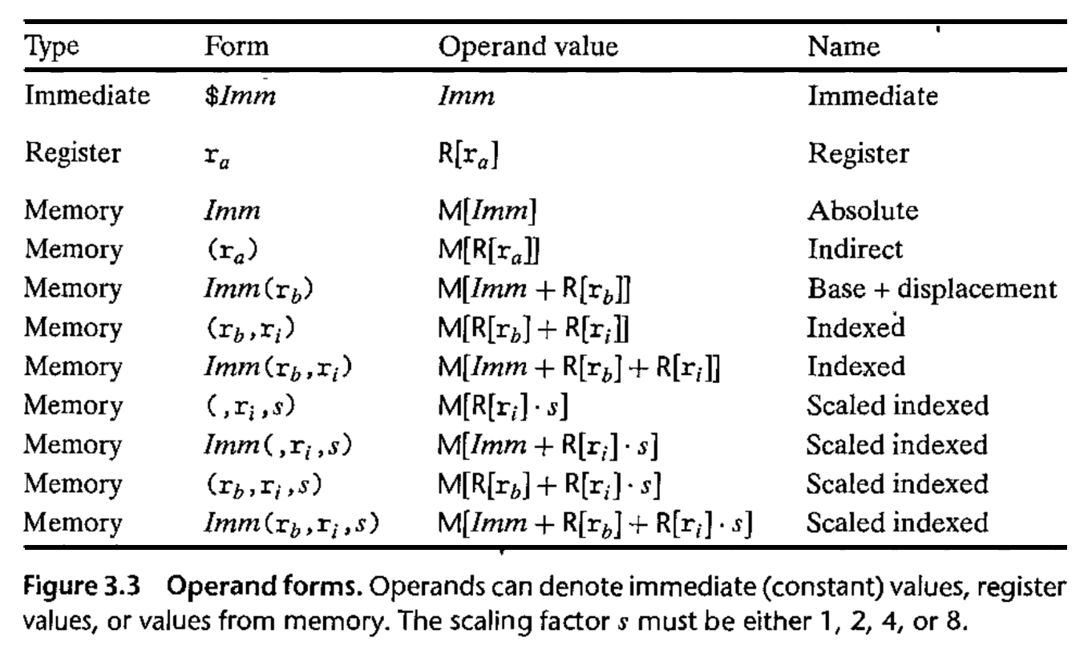
Operand Forms

Slide 49
Practice #3: Operand Forms
What are the results of the following move instructions (executed separately)? For this problem, assume the value 0x1 is stored in register %rcx, the value 0x100 is stored in register %rax, the value 0x3 is stored in register %rdx, and value 0x11 is stored at address 0x10C.
mov $0x42,0xfc(,%rcx,4)
mov (%rax,%rdx,4),%rbx

Slide 50
Recap
Overview: GCC and Assembly
Demo: Looking at an executable
Registers and The Assembly Level of Abstraction
A Brief History
Our First Assembly
Break: Announcements
The mov instruction
Next time: diving deeper into assembly

