Slide 1
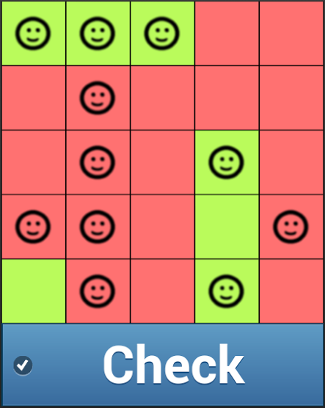

Slide 2

Reverse the GAME of LIFE
Notes:
http://pixabay.com/en/yellow-background-texture-template-370124/
http://pixabay.com/en/gold-trophy-win-winner-first-268640/
Tansparent gemaakt met http://www171.lunapic.com/editor/

