Slide 1
COVID – 19 Machine Learning Hackathon
By:
Name: Rishik C. Mourya
Year: First

Slide 2
Problem Statement #1
Public surfaces are a possible way for the transmission of COVID-19. NIT Warangal administration has decided to minimize the spread of COVID-19 to ensure the safety of its residents. Elevator switches are public surfaces. So the admin wants to implement a deep learning model for elevators on the campus. The goal is to determine the destination floor of a person standing inside the elevator using hand signs
Why this problem?
Since this problem is one of the most practically applicable to the pandemic, so if we can solve this issue it can be implemented immediately at scale, as a both short and long term solution to help out, as its necessary considering the current situation of the pandemic.

Slide 3
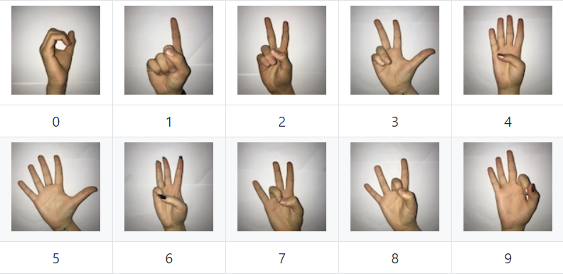
The Dataset
- Image size: 100 x 100 pixels
- Color space: RGB
- Number of classes: 10 (Digits: 0-9)
- Number of participant students: 218
- Number of samples per student: 10

Slide 4
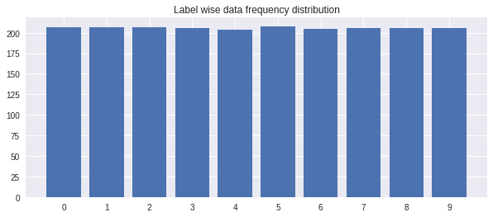
Decoding the dataset
- Data frequency distribution based on classes is very close to the
uniform distribution, so that’s awesome. As we don’t need to worry
about the data bias.
- There is pretty highly similarities between the images belonging to same class.
- There’s almost no variation at all between the background of all those images,
so during production we have to follow the same.

Slide 5
Issues with the dataset
- All the hand signs provided in the datasets, are of right hands only.
- The people who created the dataset are of fare skin color only.
- Almost all the hands are completely naked, i.e. so there’s no watches, or rings
or gloves or any other stuff.
- There is quite limited amount of data per label, that is about 200 only.
- Almost no variation of vertical alignment of the hand positions.
So even if we would be able to get 100% accuracy on the validation data
(cuz we will split the available data to get the validation data which would also
have the same issues), our model will still perform very poorly if deployed to
production.

Slide 6
Solving the data discrepancy
1. Data Preprocessing:
- Converting the images to grayscale: This solves the issue of fare skin color only and
the issue of naked hands. Also doing this does not
affect the model predictions (much), as the labels are
based on the structure of the hand sign only.
- Resizing image to 64 x 64: This reduces the feature dimensions while maintaining label
discrepancy. Which helps to train model faster, and sometimes
even better as the model now will have fewer features to interpret.
- Normalizing the values to from -1 to 1: This improves the loss convergence as all the images
now are normalized, which means there’s much less
variance for all the features.

Slide 7
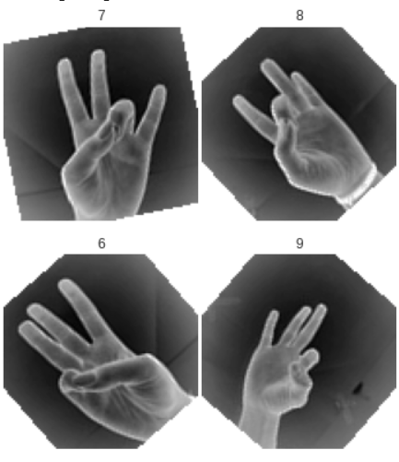
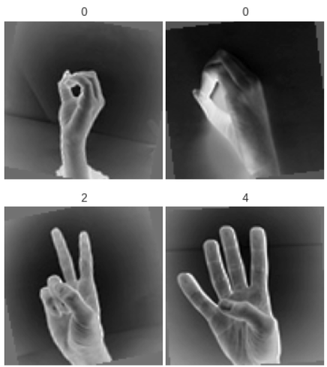
Solving the data discrepancy
2 . Data Augmentation: This solves the issue of limited data
- Random horizontal flip : This solves the issue of right hands only.
- Random rotation : This solves the issue of similar vertical alignment.
Note: - Doing random rotation creates blank spatial region around the image,
(which is okay if we have large dataset), but we found that doing this was not
working well. So to solve this issue, we filled the blank region with 0.85
(chosen by experimentation) times mean of the image.
Without Filling
With Filling

Slide 8
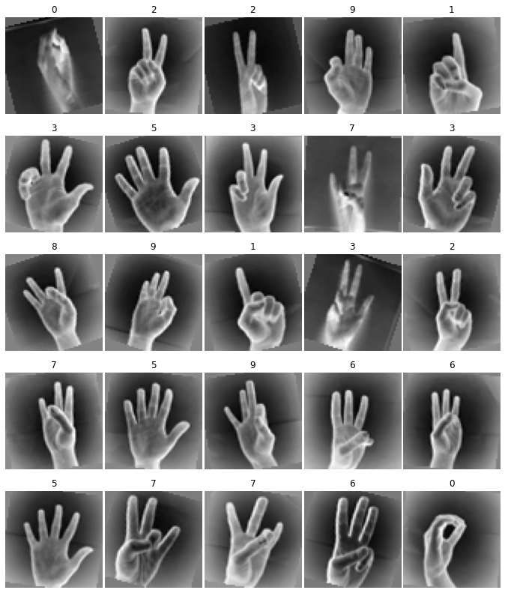
Training and Validation Split
- About 20% of the data is used for validation.
- For each class in validation, there's total 40 images.
- So in total I've used 400 images for validation.
- And the remaining 1,662 images for training.
Training sample after preprocessing and data augmentation. Since our augmentation is random, we now have unlimited supply of data.

Slide 9
Building the Model
- Since this is a novel image classification problem, a CNN architecture is a go to.
Also the dataset is sort of simplified, as there’s not much (relatively) variation for
images for each class. (A reminiscent of MNIST)
- We first experimented with wide CNN’s (with more channels), and observed a
threshold for the validation accuracy (~0.98). Even the models with more than 2 million
parameters were not able to overcome this threshold accuracy.
- So we decided to go with the much deeper model. But the problem with deeper models
is vanishing gradient.
- To prevent this issue a ResNet architecture looks good, as here for each convolutional block
there’s a residual connection, represented by y = f(x, w) + x or y = f(x, {w1}) + w2.x if inputs
and outputs dimensions are note same shape, and this residual connection solves the vanishing
gradient issue.
- But the problem with ResNet is the amount of parameters, since if we deploy this model then
the inference performance would be very bad.
- Thus, we finally decided to choose the DenseNet, which can be very deeper as it solves the vanishing
gradients issue better than the ResNet, very with low parameters counts, therefore solving all our issues.

Slide 10
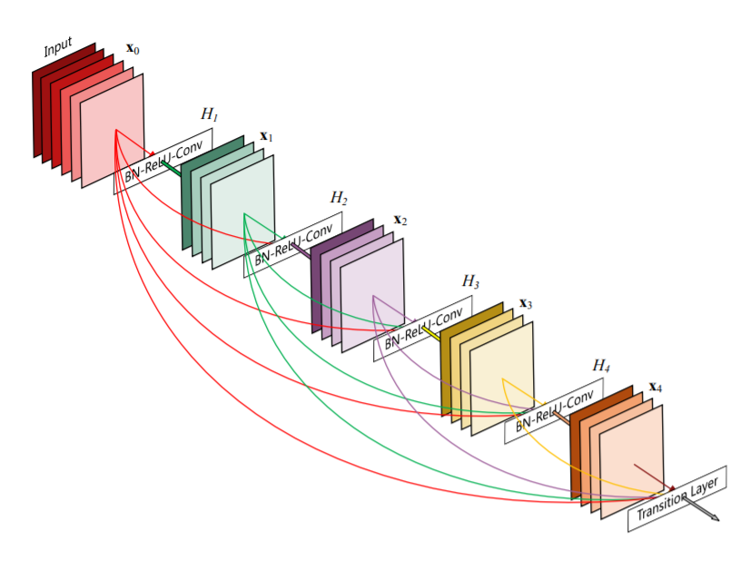
The DenseNet Architecture
Source: https://arxiv.org/pdf/1608.06993.pdf

Slide 11
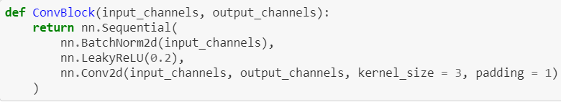
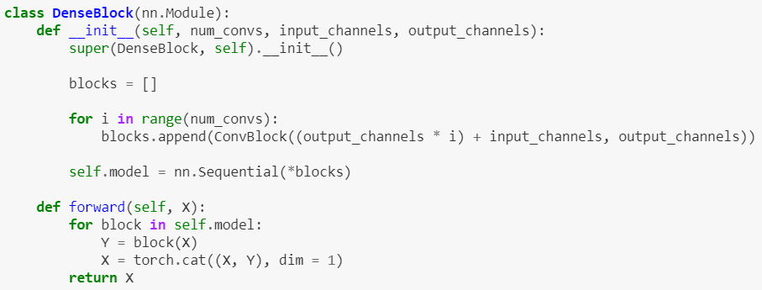
DenseNet Block

Slide 12
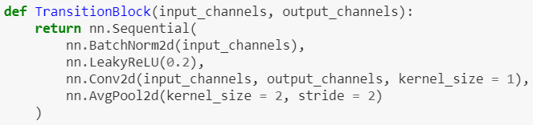
Transition Block
Final Model
- Replaced the ReLU activation with Leaky ReLU with alpha 0.2
- And removed all dropouts. Since we have unlimited supply of data, thanks to the data
augmentation, so the model wouldn’t be overfitting easily (unless we train the model forever).
If we still apply the dropout then we would have to train the model much longer (as the model
is quite large here), cuz at the beginning of the training the dropout gives worse result in terms
of loss convergence. Same goes for l1 or l2 regularization.
- Since we have used batch norm, so this also make sure that we apply random noise to the hidden layers.
- So total we have 19 conv blocks followed by flattening and a single dense layer as outputs.
- And total its 758,226 trainable parameters (including Batch Norm).

Slide 13
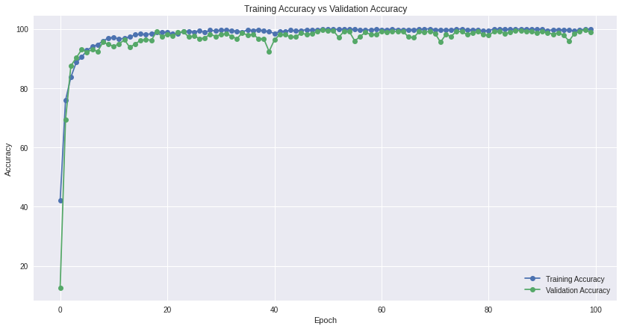
Training Results
- Training Accuracy : 99.819712
- Validation Accuracy : 99.609375
- Validation F1 Score : 0.9989696
- Training vs Validation accuracy comparison:

Slide 14
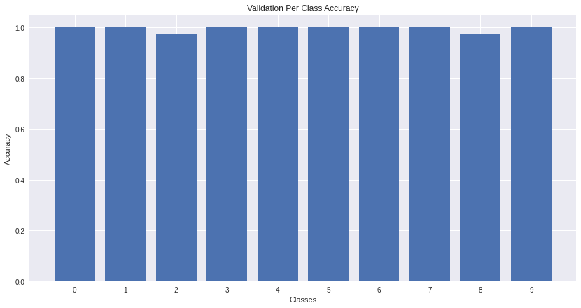
- Class wise validation accuracy frequency distribution:
Which is extremely close to the uniform distribution, as this is same case with the dataset
on which this model is trained on.

Slide 15
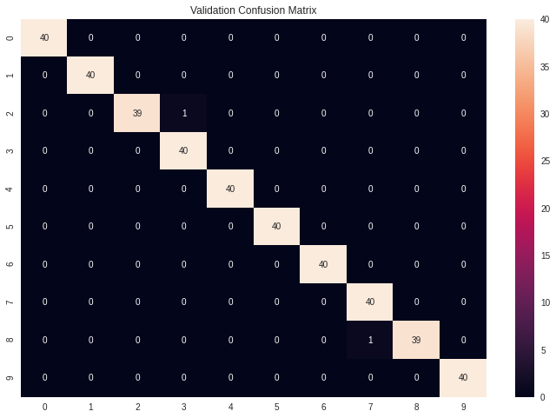
- Confusion matrix for validation:
And as its clearly visible that out of 400 validation images (40 images per class),
only 2 were predicted incorrectly. Yet another indication that the model isn’t overfitted.

Slide 16
Could we have done even better?
Yuppp, 🙃
- By setting the dropout layer with dropout probability < 0.3 as the first input later
to the model, doing this would random noise to the images, creating even more
random image.
- By training the model for longer time, and varying batch size using gradient
accumulation.
- By using a cyclic learning rate decay.

Slide 17
Thank you hosting the hackathon

